Slide 1

SPIED2024
The 1st SmartCare AI Light
Intelligent waking ssystem
Class # :
Team Name : OneAsia Team member : 2
August 5, 2025
Notes:
Good afternoon, professors, i'm glad i have this chance to do this presentation in front of you.Firstly, please allow me to introduce our team memebers.

Slide 2
Team introduction (Team name and Team photos)
Concept & Idea with sketch 2-1 Who will use it for what? 2-2 When and Where your product will be used? 2-3 Why your product is expected?
What are your skills and knowledge
CONTENTS

Slide 3
Team Name & Photo
"This idea came from a real experience.
A friend of mine had a broken leg and used a crutches.
I often went with him to hospitals and helped him cross the street.
But even at crosswalks, we couldn’t cross in time before the light turned red.
It made me think:
Why don’t traffic lights give more time to people who really need it — especially near hospitals?
That moment inspired our idea."

Slide 4
Background & Concept
2-1 Who will use it and for what?
Who:
People with disabilities, like those in wheelchairs or using crutches or canes
Hospital patients with IV stands or limited movement For what:
To cross the street safely without needing to rush
To avoid stress and reduce the chance of accidents
To feel noticed, respected, and supported in public places
2-3 Why your product is expected?
The Problem:
Right now, traffic lights treat everyone the same.
But not everyone walks at the same speed.
Some people move slower and can't finish crossing in time.
For example:
A person in a wheelchair or with a broken leg might still be crossing when the green light ends.
Cars can’t move, even though their light is green.
Drivers lose time, and traffic jams start to build up.
What already exists (in Korea):
A big screen showing car speed and signals
A display warning drivers that someone is crossing
But these are only for information, not real help.
✅ Our Solution: SmartCare AI Light
Detects people who need more time (like people with crutches)
Extends the green light for them until they finish crossing
Only then turns on the green light for cars — with full time
This helps both:
→ Pedestrians feel safe
→ Drivers don’t waste time and traffic flows better
2-2 When and Where your product will be used?
When:
During both daytime and nighttime traffic
Especially during rush hour when lights change quickly
When vulnerable people are detected crossing the street Where:
Near hospitals, rehab centers, or elderly homes
At busy intersections or near schools
At any crosswalk that already has a traffic light

Slide 5
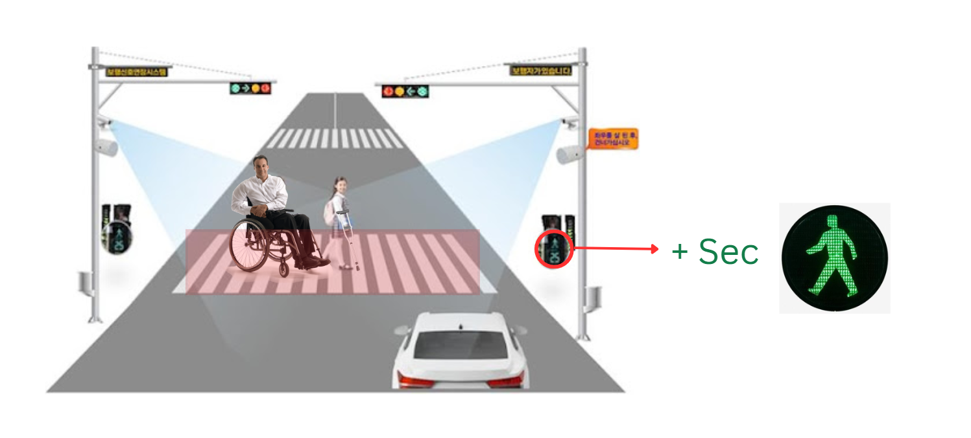
Idea with sketch
YOLO-based Object
Detection Structure
Pose-based Vulnerability
Detection Structure
Camera Input
Camera Input
YOLOv8 Detection
Pose Estimation:
YOLO11-Pose
Detected Classes:
'wheelchair', 'cane', 'crutch'
Extracted Keypoints: 17 joints per person
If YES → vulnerable_pedestrian = True
Rule-based or ML-based Classification: wheelchair? cane?
Green light extended for
pedestrian
If YES → vulnerable_pedestrian = True
After pedestrian crosses →
normal green light for vehicles
Green light extended for
pedestrian
After pedestrian crosses →
normal green light for vehicles

