Slide 1
Fall Detection: Progress Presentation
Abbos Aliboev

Slide 2
Table of contents
01
02
03
04
Motivation
System Overview
Dataset
Pose Completion + CNN + TE
05
06
07
08
Model Architecture
Comparative Table
Develop. Progress
Conclusion

Slide 3




Motivation
Construction sites are dangerous
– Falls are the No-1 cause of death on construction sites
– Many falls go unseen — no one reacts in time
Real-time detection saves lives
– Stop machines, call help immediately
Why vision-based?
– Cameras are cheaper, always on
– Sensors are limited, uncomfortable
– Challenge: occlusion & speed

Slide 4
Problems in Existing Work
1
Sensor-based systems: expensive, non-scalable
2
Old vision models: slow, not real-time
3
Occlusion not handled
4
Pre-fall not predicted

Slide 5

Our Objective
1
Real-time detection
2
Handle occlusion
3
Predict fall before it happens (Pre-fall)
4
Estimate time-to-fall (regression)
5
Edge-compatible (Jetson, etc.)

Slide 6
System Overview Diagram
3
4
Pose Completion
CNN
2
5
YOLOv8
pose
Transformer
6
1
Frame
Classification + Regression

Slide 7
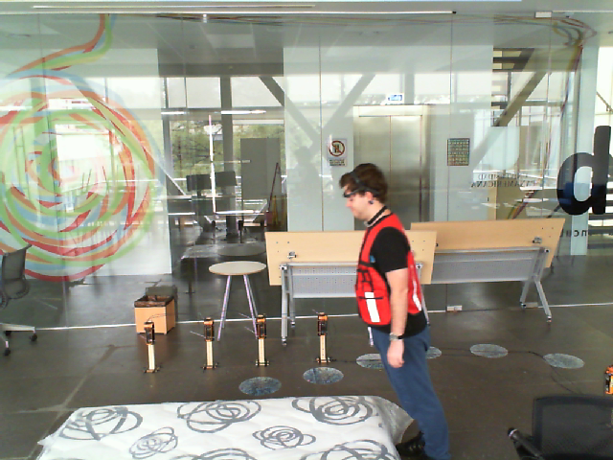
Dataset Use
UP-Fall - only frames
Custom video dataset
Publicly available
17-folders, one per subject:
11-subfolders, one per activity:
Multiple people in a frame (multi-person scenarios)
PPE gear (helmets, vests, etc.)
Various fall types with occlusion
Pre-fall behavior recorded explicitly
1.5BN People
People who get and Engineering degree around the world
553MN People
People who live in underdeveloped country

Slide 8
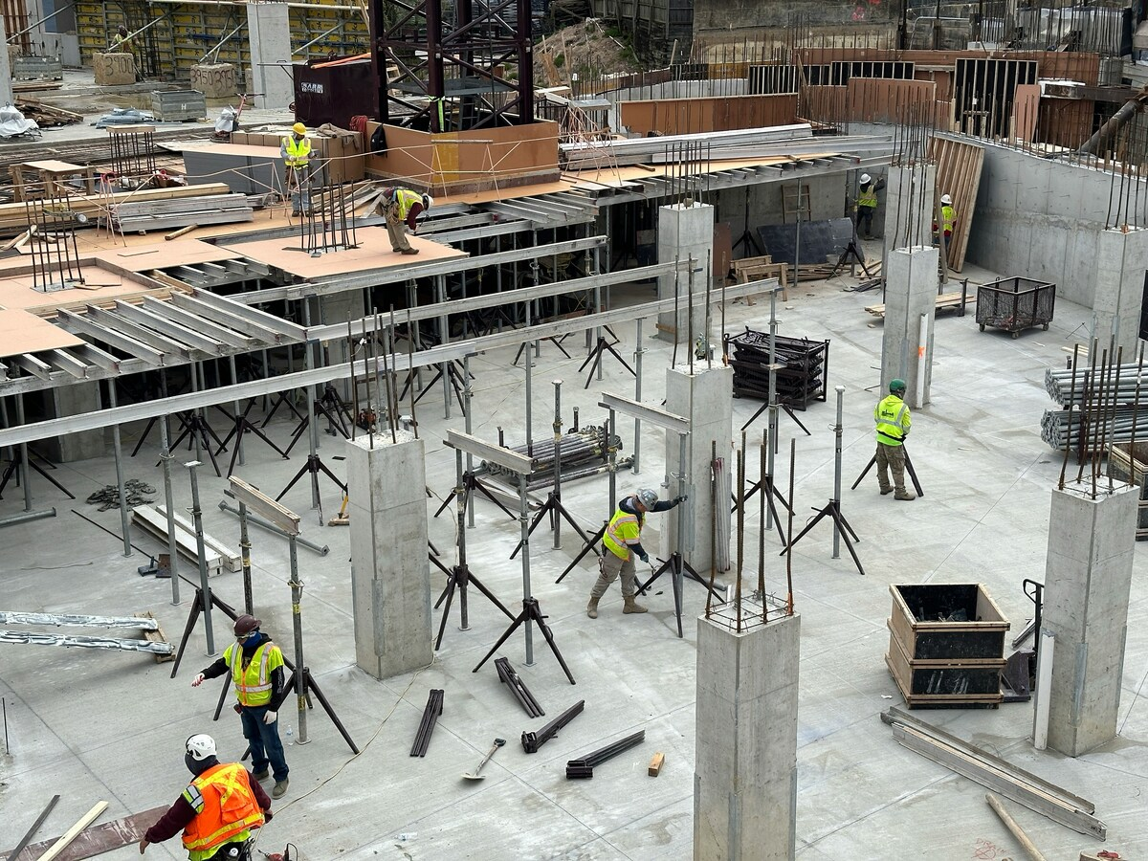
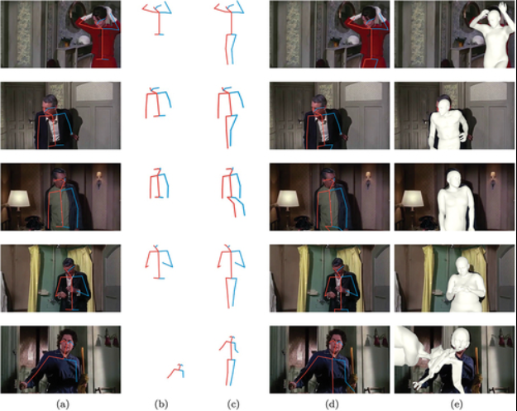
Pose Completion
Problem: Occlusion = missing joints Solution: MLP or AutoEncoder fills missing keypoints Lightweight for real-time

Slide 9
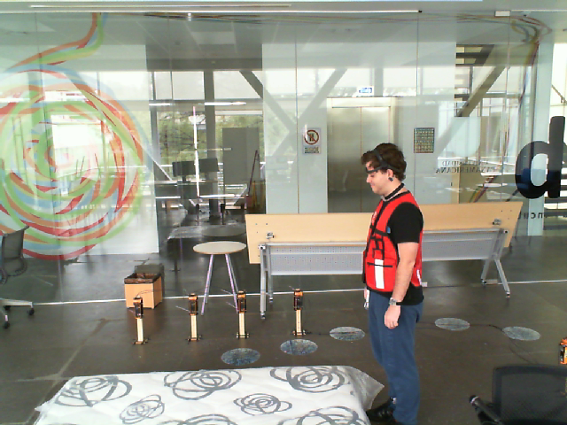
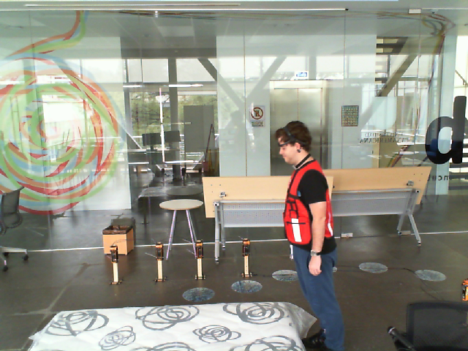
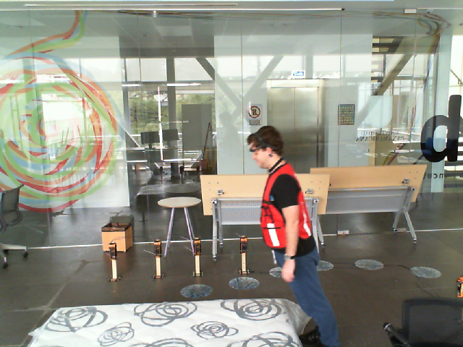
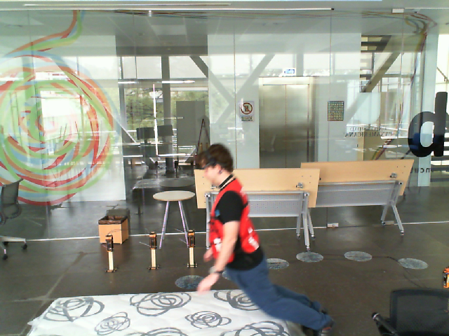
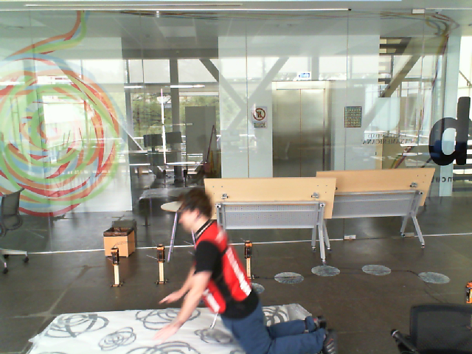
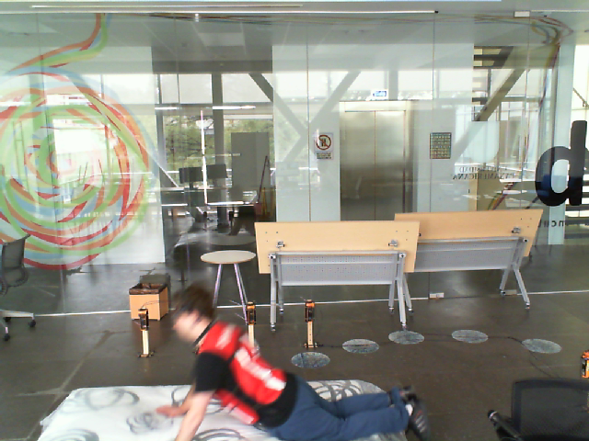
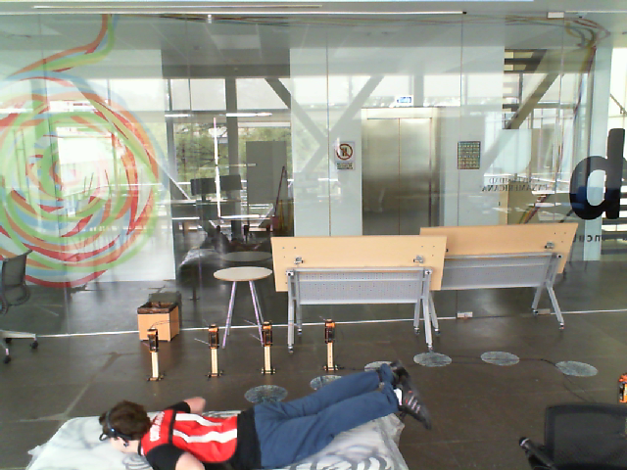
Sequence Modeling (CNN)
Detects short-term motion patterns
Works on a sliding window of pose vectors
Very fast – ideal for real-time systems
Frame 1
Frame 2
Frame 3
Frame 4
Frame 5
Frame 6
Frame 7
Used as a motion window for CNN

Slide 10
Temporal Attention (Transformer Encoder)
Captures important frames in time
Focuses on motion before fall
Efficient attention head
Frame 1
Frame 2
Frame 3
Frame 4
Frame 5
Frame 6
Frame 7

Slide 11
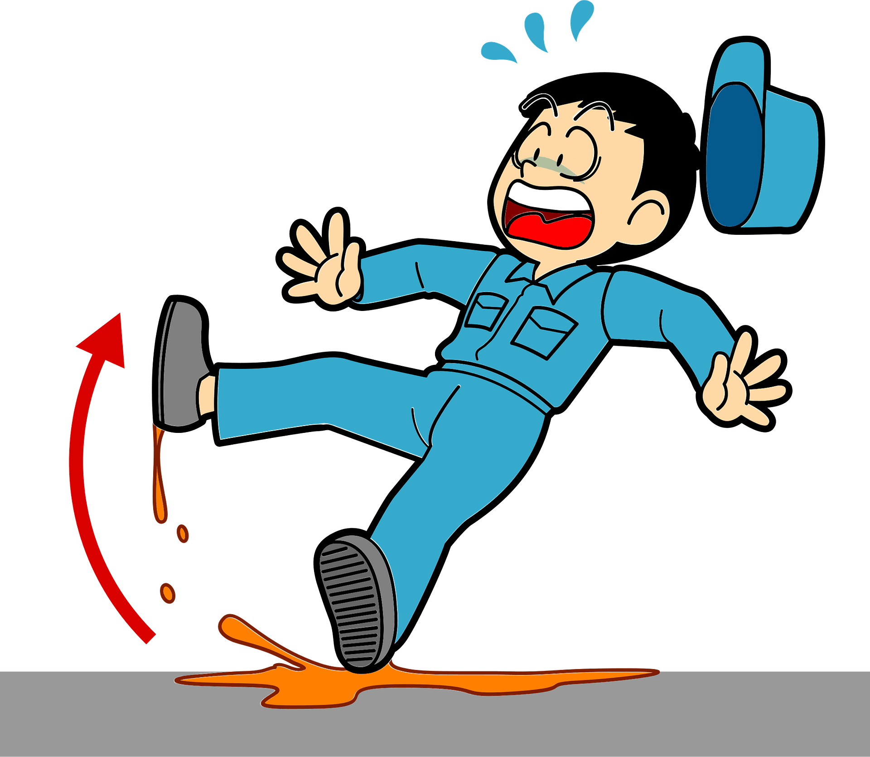
Dual Output Head
Output 1 | Output 2
Classification | Regression
Fall / Pre-fall / No fall | Time-to-fall in seconds (ttf = 1.45)
ttf = 1.45
Fall

Slide 12
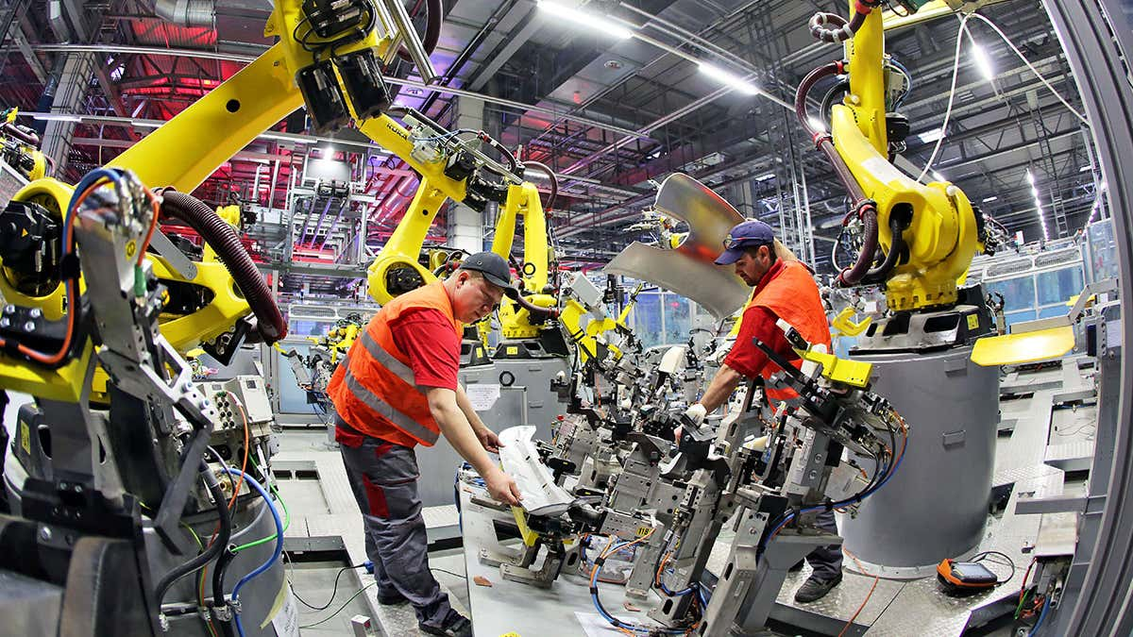
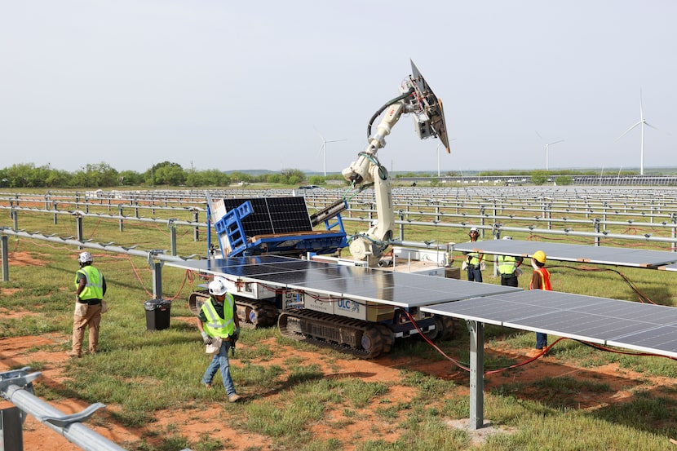
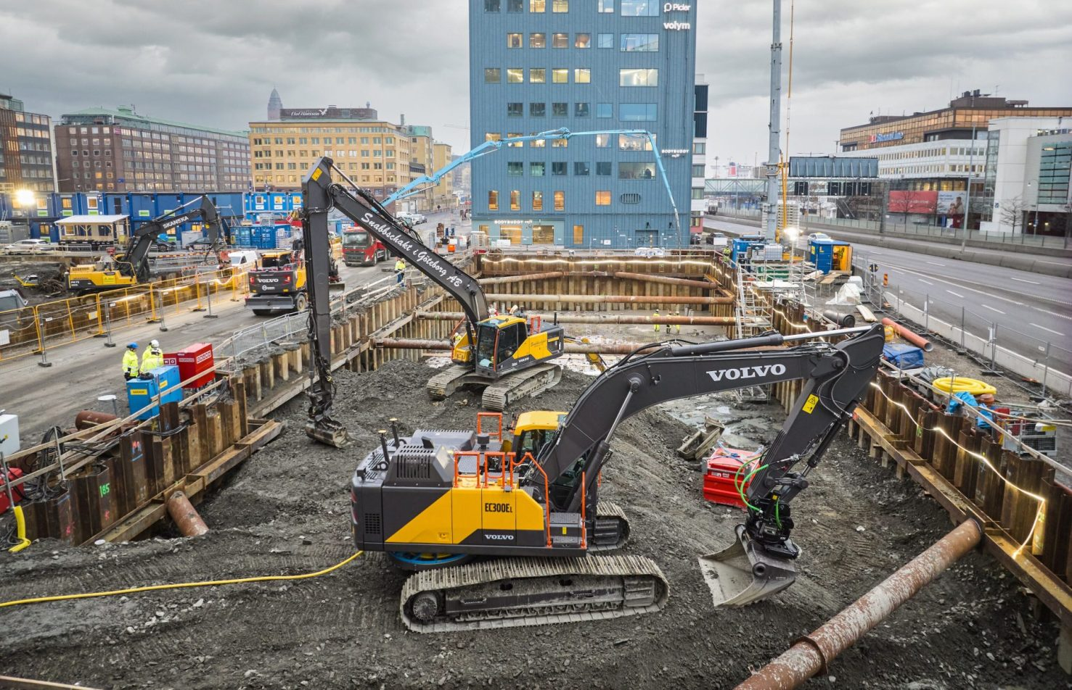
Dual Why Is Regression Important?
Regression predicts "how many seconds until a fall occurs” - *(e.g., “1.7 seconds to fall”)
Enables early warning systems: alarm, drone, emergency response
Helps take action before the actual fall happens
Offers a precise estimate of how close the person is to falling

Slide 13
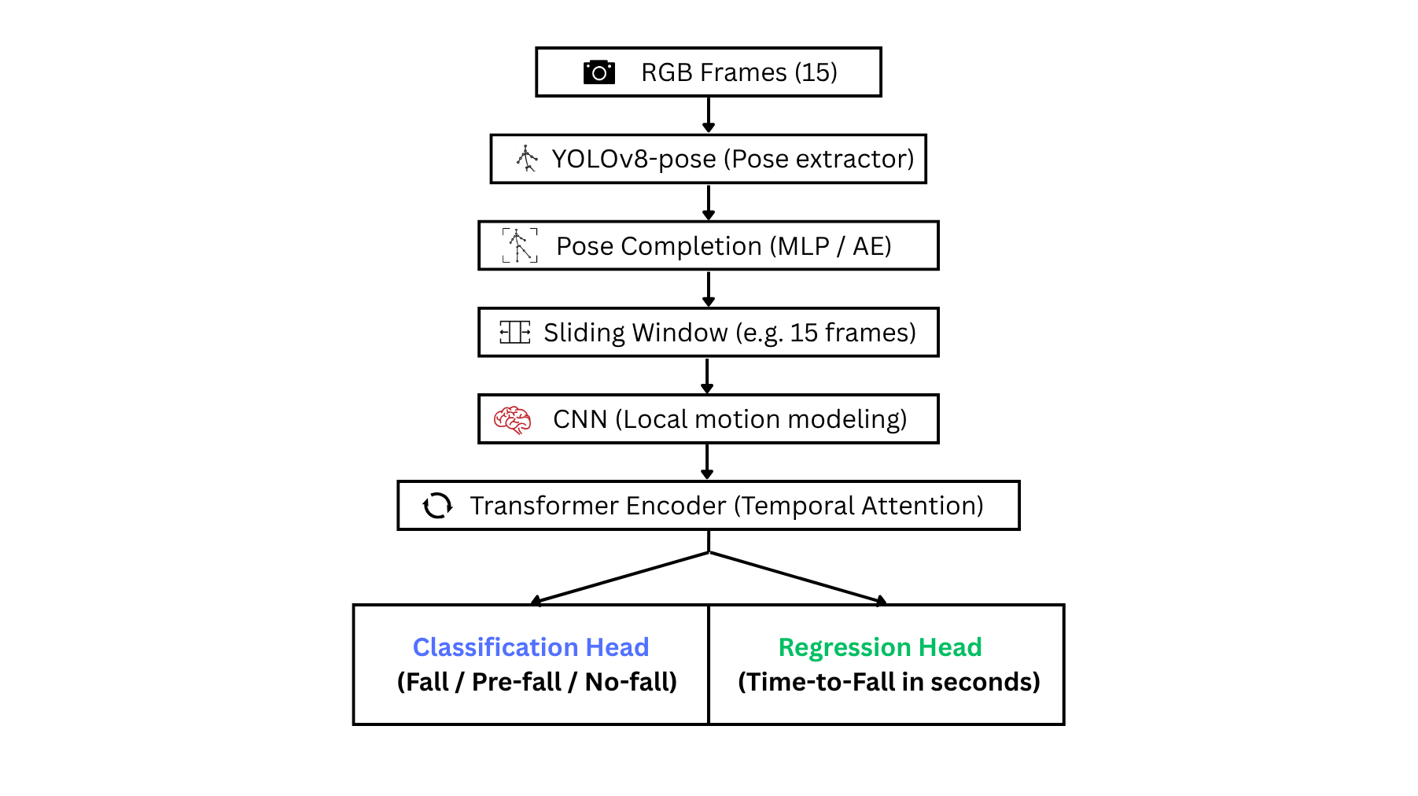
Model Architecture Overview

Slide 14
Comparative Table
Model | Occlusion | Pre-fall | Regression | Attention | Real-time
YOSAP | ❌ | ✅ | ❌ | ❌ | ❌
TCNTE | ❌ | ❌ | ❌ | ✅ | ✅
TST | ❌ | ❌ | ❌ | ✅ | ❌
Ours | ✅ | ✅ | ✅ | ✅ | ✅

Slide 15
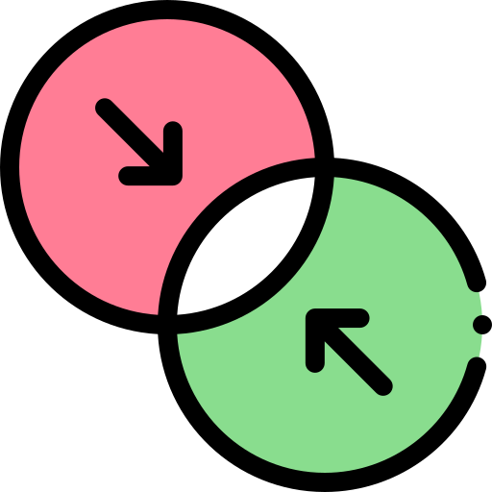



Model Innovation Summary
First
Combine pose completion + attention + TTF regression
Multiple people
Multi-person ready, real-time capable
3 Stage fall detection
Fall prevention, not just detection

Slide 16
Development Progress
Task | Status
Dataset exploration | In progress (analyzing UP-Fall, reviewing options)
Pose extraction (YOLOv8-pose) | Planned
Pose completion | Studying techniques (MLP, AutoEncoder)
Annotation (Pre-fall, TTF) | To be designed
Model structure comparison | CNN, TCN, Transformer analysis ongoing
Training | Not started
Evaluation | Not started

Slide 17
Technical Challenges
Frame-label alignment
Manual annotation time
01
02
03
Keeping FPS high while adding complexity

Slide 18
Conclusion & Final Thoughts
We proposing a real-time vision-based fall detection system tailored for construction site environments
Our model handles:
→ Occlusion via Pose Completion
→ Short-term motion via CNN
→ Temporal patterns via Transformer
→ Fall risk via Classification + Regression
🛠️ Currently under development – focusing on:
→ Annotation, model training, real-time optimization

Slide 19
Thanks!
Do you have any questions?
www.abbosaliboev.site

