Slide 1

Fall Detection: A Review of Recent Research Papers
Abbos Aliboev

Slide 2
TABLE OF CONTENTS
01
02
03
04
05
Introduction
Paper 1
Paper 2
Paper 3
Conclusion

Slide 3
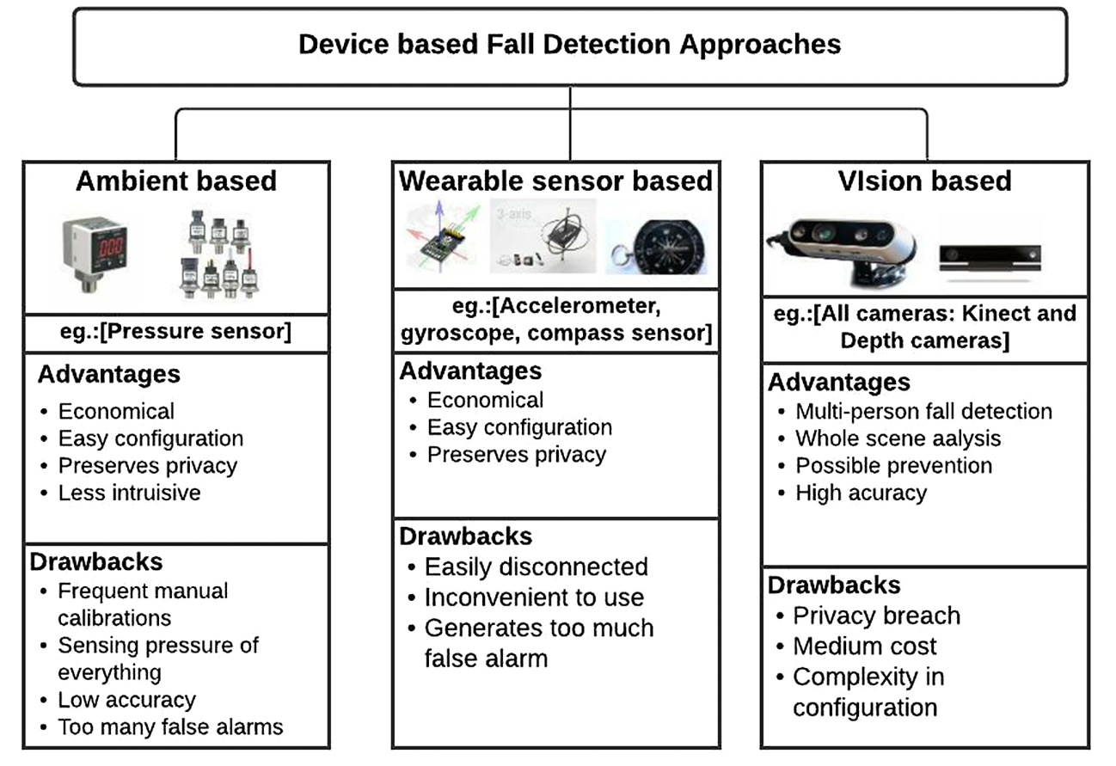
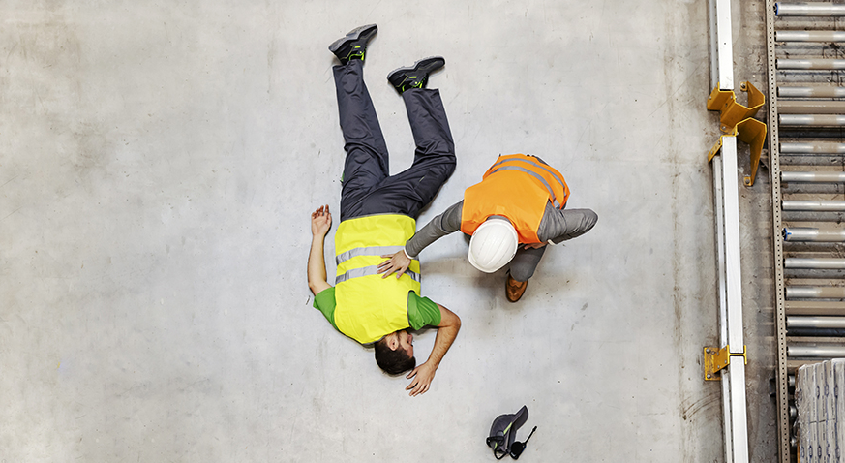
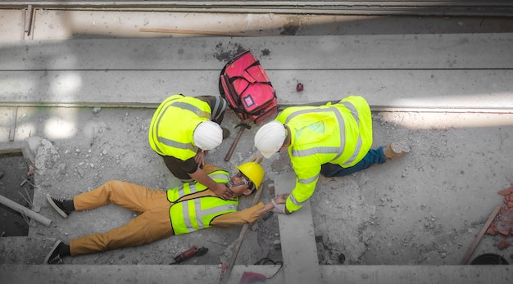
Introduction

Slide 4
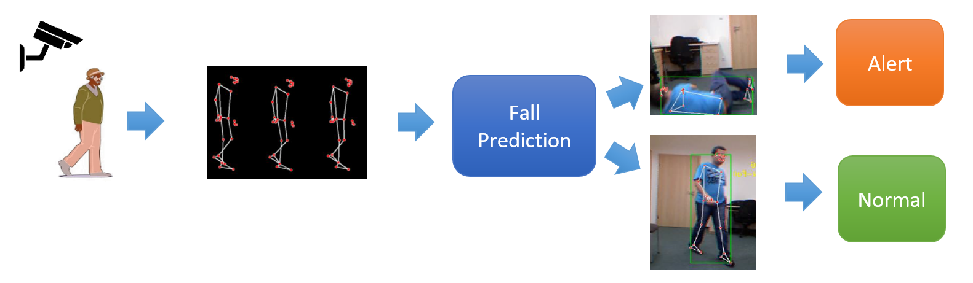
Simple Vision Based Example

Slide 5
01
Paper

Slide 6
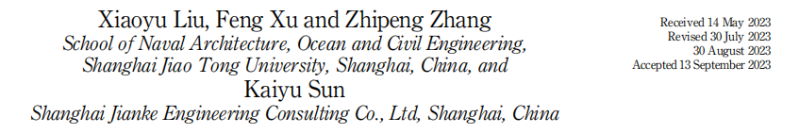

Fall-portent detection for construction sites based on computer vision and machine learning.
Problems:
Main Idea:
Falls are common and dangerous
at construction sites.
Prior works: binary classification
(fall / no-fall), often sensor-based.
3-stage fall detection model
Steady – standing normally
Unsteady – balance lost
Fallen – fall occurred
https://www.emerald.com/insight/content/doi/10.1108/ecam-05-2023-0458/full/html

Slide 7
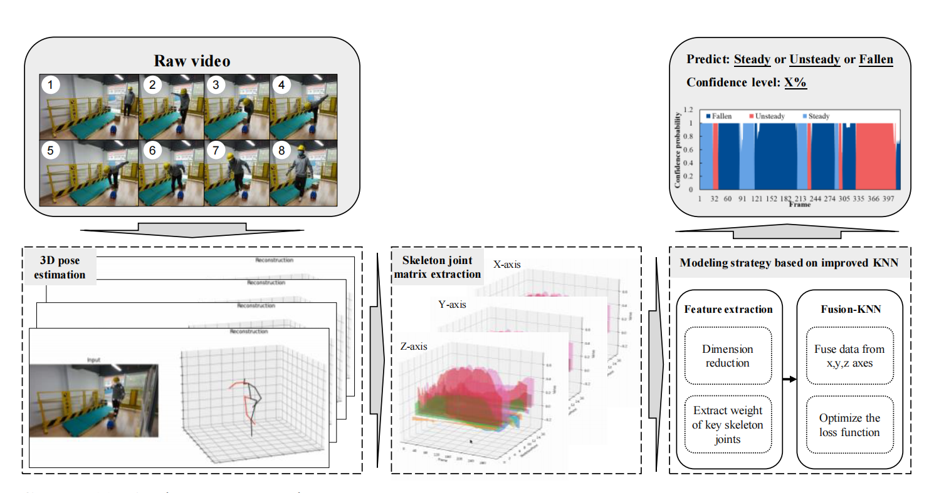
Method Details
Architecture of the methodology
Video → 3D Pose Estimation (VideoPose3D) → Feature Selection (PCA + K-means) → Fusion-KNN → 3-Class Prediction

Slide 8
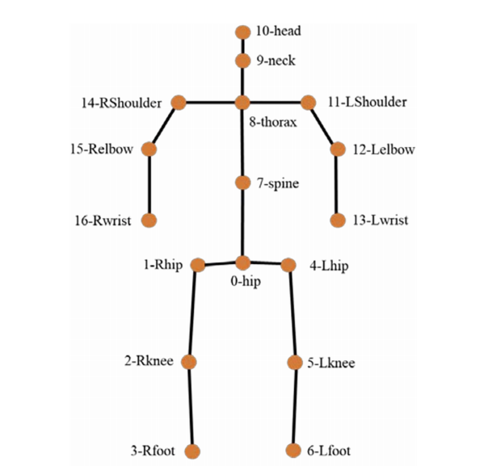
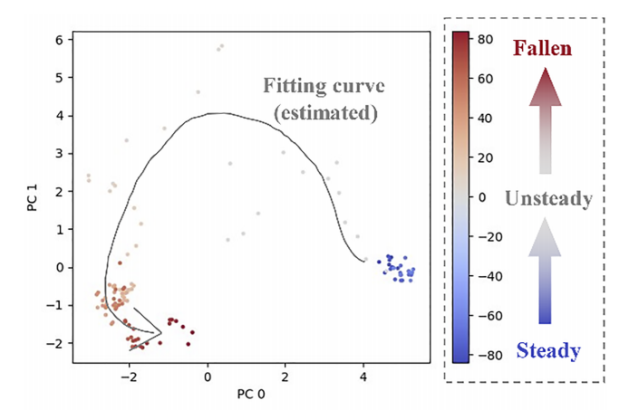
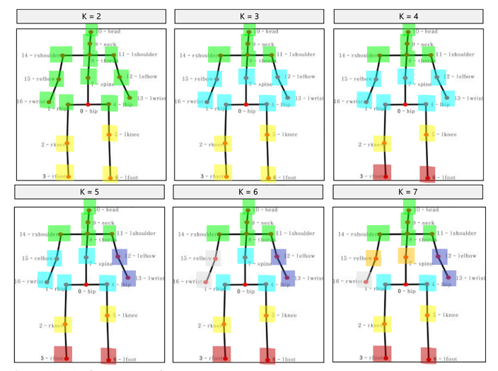
Step-by-Step Pipeline Explanation
VideoPose3D | Converts each video frame into 17 keypoint 3D skeleton data (x, y, z)
PCA - Principal Component Analysis | PCA removes redundant and less relevant keypoints
K means - Clustering | K-means helps identify the most influential joints (e.g., hips, knees)
Fusion KNN - k Nearest Neighbors | Computes weighted distances (x/y/z) → emphasizes z-axis Classifies state as: Steady / Unsteady / Fallen
Post-processing: | Reclassifies short unsteady frames (< 6) as steady → Reduces false alarms, improves stability
Serial numbers of 17 joints
Visualization of banana trip by PCA
Experimantal Results of K-means clustering

Slide 9
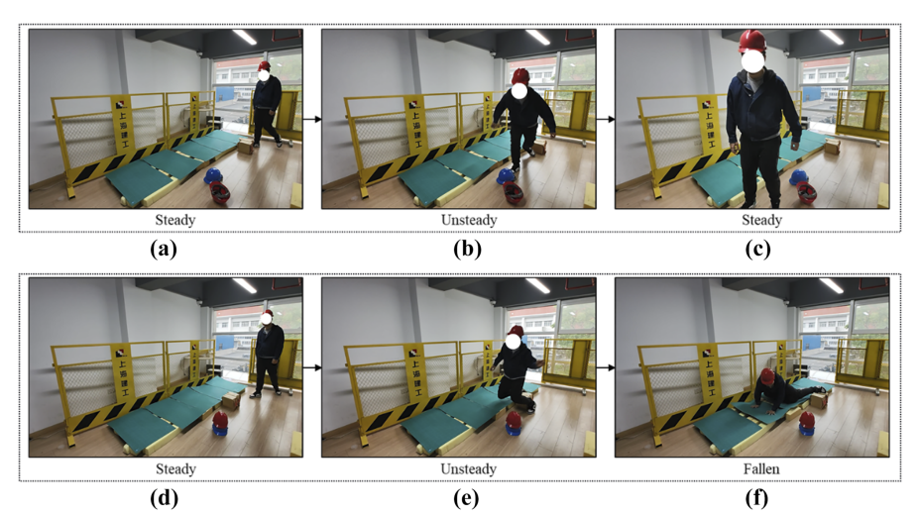
Dataset Details
Samples of workers three states
Class balance:
Steady: 688 frames
Unsteady: 400 frames
Fallen: 600 frames
Total frames: 1688
Data type: 3D skeleton keypoints
Collected from: Simulated fall scenarios

Slide 10
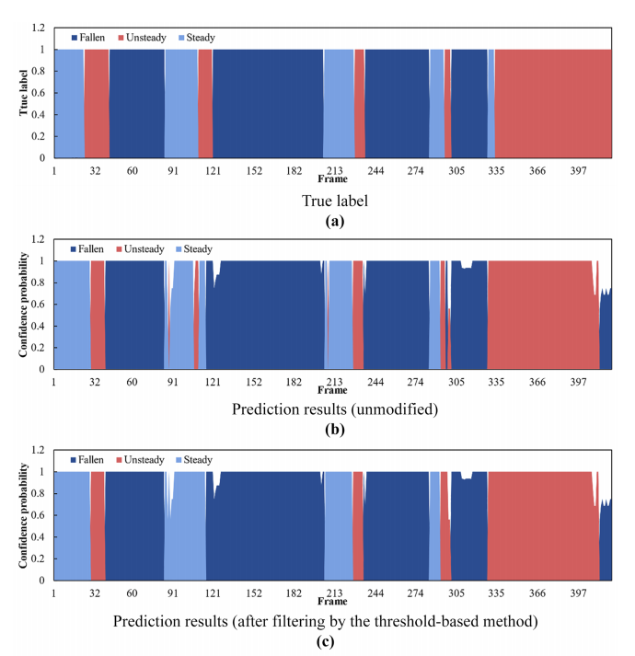
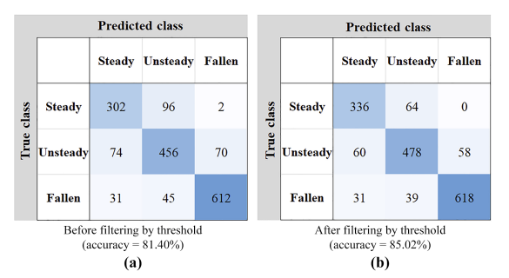
Results

Slide 11
Strengths & Limitations
Strengths | Limitations
3-class detection (Steady, Unsteady, Fallen) | Only 3.125 FPS (not real-time)
No sensors required – only camera input | Small, simulated dataset (1688 frames)
Simple, interpretable Fusion-KNN model | No real-world or multi-person testing
Emphasis on z-axis improves fall recognition | Not tested on real-world construction sites
Post-processing reduces false alarms | No deep learning or end-to-end training

Slide 12
02
Paper

Slide 13

A Real-time skeleton-based fall detection algorithm based on temporal convolutional networks and transformer encoder
Xiaoqun Yu, Chenfeng Wang, Wenyu Wu, Shuping Xiong
a. Department of Mechanical and Industrial Design, School of Mechanical Engineering, Southeast University, Nanjing 211189, PR China
b. Department of Industrial and Systems Engineering, Korea Advanced Institute of Science and Technology (KAIST), Daejeon 34141, Republic of Korea
Received 9 August 2024, Revised 12 January 2025, Accepted 20 January 2025, Available online 20 January 2025, Version of Record 22 January 2025
This work was supported by the Basic Science Research Program of the National Research Foundation of Korea , Samsung Display Co., Ltd, and SEU start-up fund.
Problems:
Main Idea:
Occlusions (partially hidden bodies)
Multiple people in the same frame
Low performance on edge devices
Imbalanced data (fewer fall samples)
Skeleton-based Fall / Non-Fall detection using:
Pose sequences
TCN + Transformer
Real-time edge deployment
https://doi.org/10.1016/j.pmcj.2025.102016

Slide 14
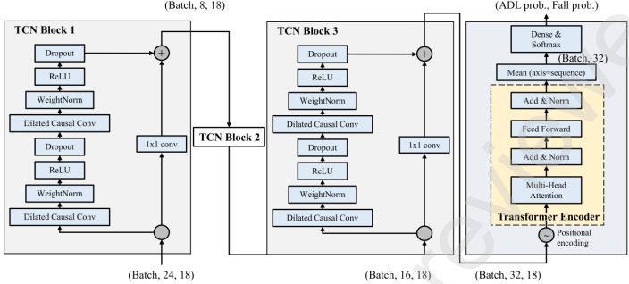
Method Details
The network architecture of TCNTE
Video → YOLOv8-pose → BoT-SORT → Pose Normalization & Windowing → TCN + Transformer Encoder (TCNTE) → Classification

Slide 15
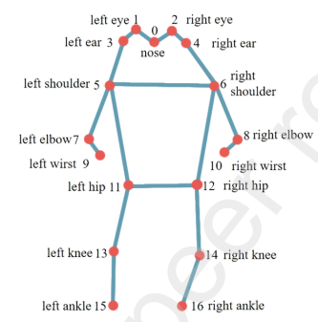
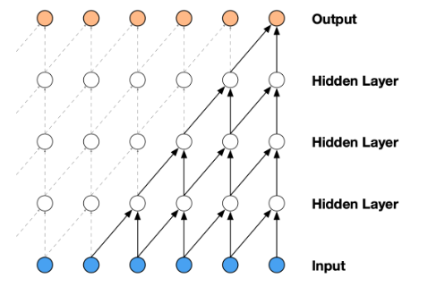
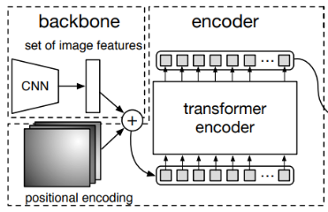
Step-by-Step Pipeline Explanation
YOLOv8-pose | Detects humans and extracts 17 keypoint skeletons from each video frame
BoT-SORT | Tracks each person across frames, assigns consistent ID for each sequence
Pose Normalization | Aligns all skeletons to a standard scale and reference point (e.g., hip-centered, min-max normalization)
Windowing | Groups consecutive frames (e.g., 45) into a motion sequence for temporal analysis
TCN + Transformer Encoder (TCNTE) | Learns both short- and long-term motion patterns to detect falls accurately
17 key points (YOLOv8)
Temporal Convolution Network (TCN)
Transformer Encoder

Slide 16
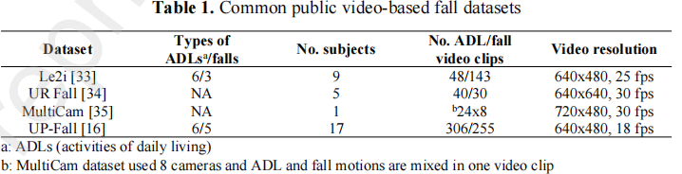
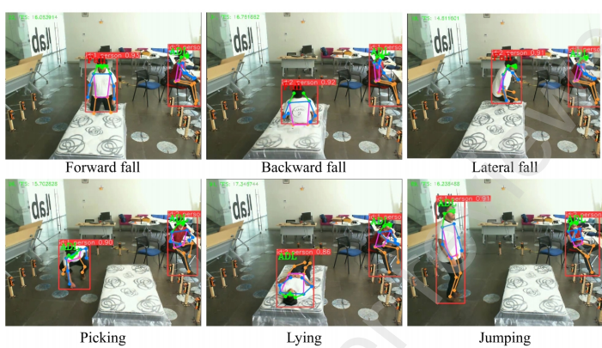
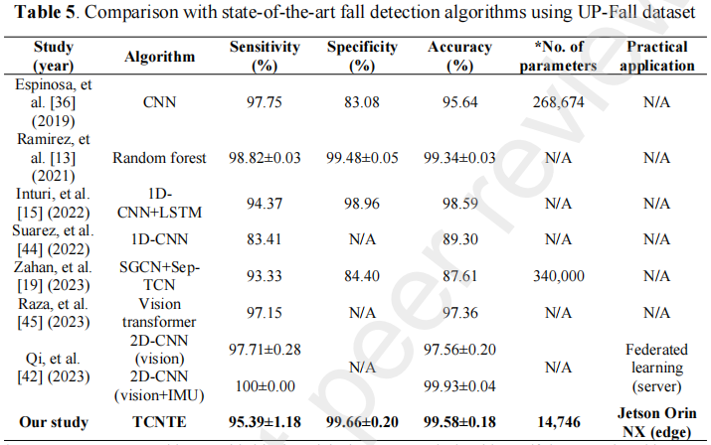
Dataset Details
Classification results on UP-Fall test set using Jetson Orin NX

Slide 17
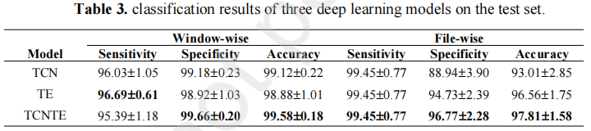
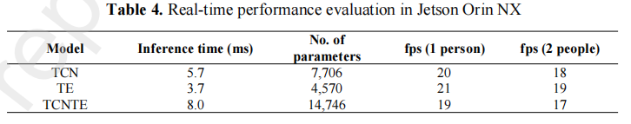
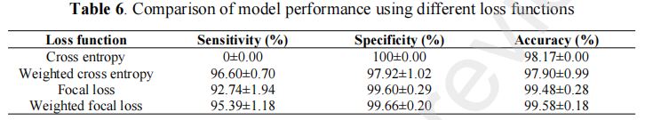
Results

Slide 18
Strengths & Limitations
Strengths | Limitations
High accuracy (99.58%) and robust to noise | Dependent on pose estimation quality (YOLOv8-pose)
Real-time performance (19 FPS on Jetson Orin NX) | Needs consistent lighting and camera placement
Works in multi-person and occlusion-heavy scenes | Transformer adds computational cost compared to LSTM/CNN
No wearable sensors required — camera-only system | Tested only on indoor dataset — may need outdoor generalization
Uses strong architecture: TCN + Transformer

Slide 19
03
Paper

Slide 20
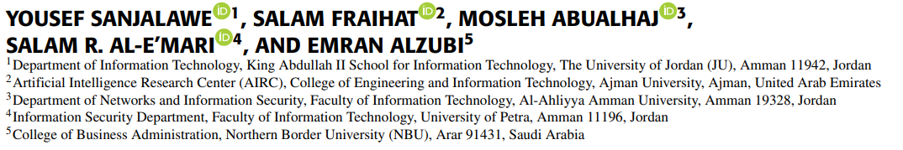


Hybrid Deep Learning for Human Fall Detection: A Synergistic Approach Using YOLOv8 and Time-Space Transformers
Problems:
Main Idea:
Combine YOLOv8 and a Time-Space Transformer (TST)
Old models are slow and can’t run in real-time
Many use sensors or need manual feature design
Transformers are strong, but hard to train and slow
YOLOv8 finds people in each video frame
TST understands how they move over time
Detects Fall vs Non-Fall
https://ieeexplore.ieee.org/abstract/document/10909442

Slide 21
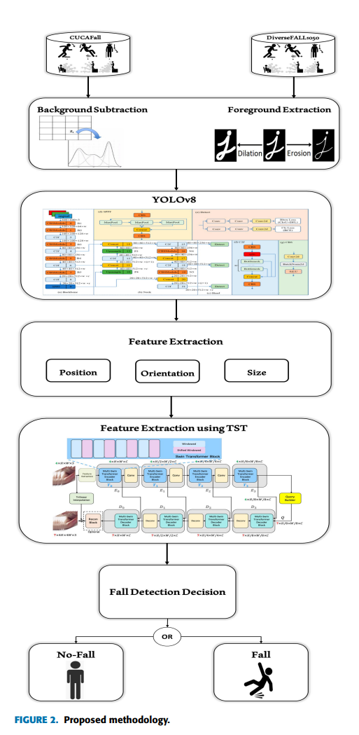
Method Details
Proposed methodology
Video → YOLOv8 → CNN Features → Time-Space Transformer (TST) → Fall / Non-Fall Classification

Slide 22
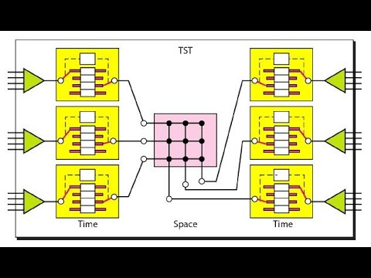
Step-by-Step Pipeline Explanation
YOLOv8 | Detects humans in each frame and extracts bounding box features
CNN Feature Extraction | Converts each frame into a compact feature vector (appearance info)
Pose Normalization | Aligns all skeletons to a standard scale and reference point (e.g., hip-centered, min-max normalization)
Time-Space Transformer (TST) | Learns motion and time-based changes across frames
Time Space Transformer (TST) - Time + Spce

Slide 23
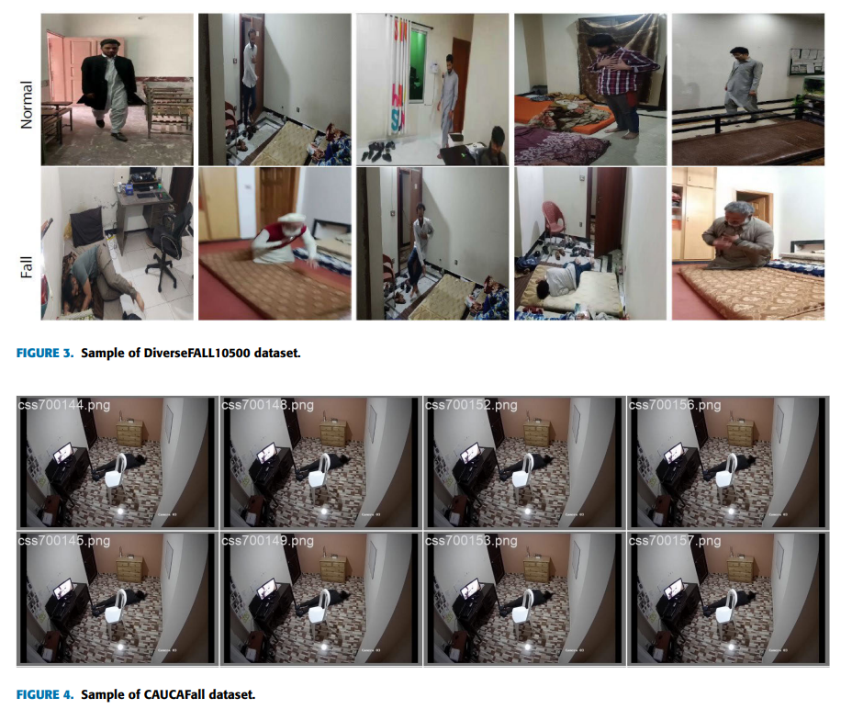
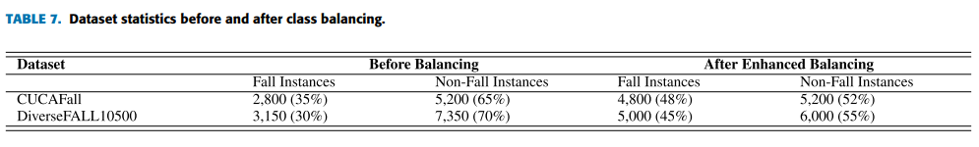
Dataset Details

Slide 24
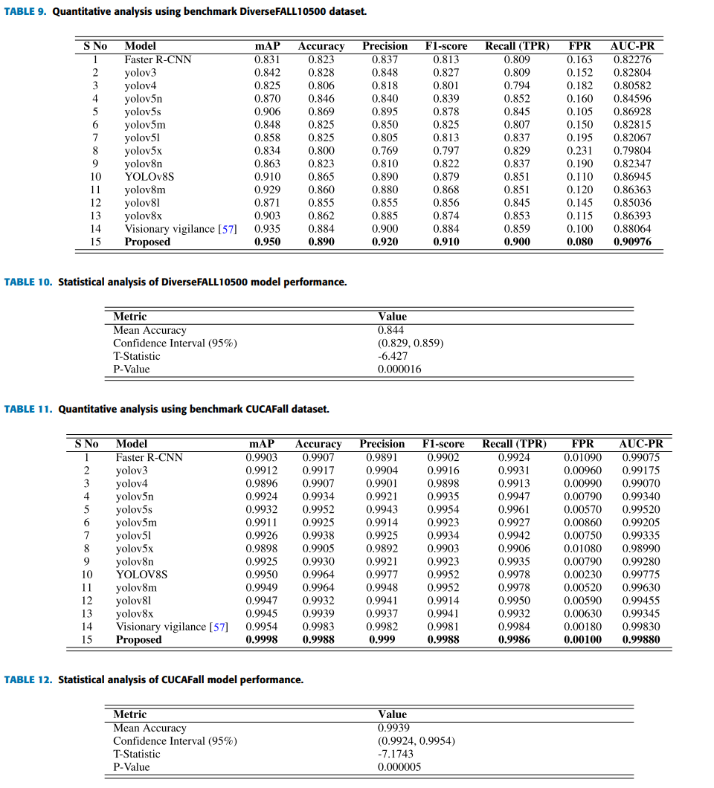
Results

Slide 25
Strengths & Limitations
Strengths | Limitations
Very high accuracy: Accuracy ~99.84%, F1-score ~99.82 | Transformer needs more memory (computationally expensive)
Learns both space (YOLOv8) and time (Transformer) | Depends on good camera input
Works without sensors | Transformer adds computational cost compared to LSTM/CNN
Can detect multiple people | Tested in limited environments
Uses strong architecture: TCN + Transformer

Slide 26
Conclusion
& Insight

Slide 27
Conclusion & Insights
Paper | Main Method | Key Feature
Paper 1 | PCA + K-means + Fusion-KNN | 3D skeleton, 3-stage state classification
Paper 2 | YOLOv8 + BoT-SORT + TCN + Transformer | Real-time fall detection, occlusion handling
Paper 3 | YOLOv8 + Time-Space Transformer | High accuracy using pure visual input
What works well:
High accuracy in controlled environments
Real-time detection using lightweight models
Useful combination of spatial (YOLO) and temporal (Transformer) features
What is missing:
Most papers are tested only indoors
Construction site scenarios with many workers, gear, and occlusion are not fully addressed

Slide 28
THANKS!
Q&A
Abbos Aliboev
GitHub: https://github.com/abbosaliboev/fall-detection-research/

