Slide 1

SIGNALS & SYSTEM
Team 10:
u1610001 – Abbosjon Kudratov
u1610023 – Amalbek Jalilov
u1610247 – Umarjon Rajabov
u1610042 – Azizbek Samatov
Team Project

Slide 2
Implementation Steps:
1. Recording the wav-file and load them.
2. Add padding of 0s
3. Perform Fast Fourier Transformation on the wave file using the core-function fft .
4. Represent imaginary numbers in FFT matrix as real numbers by multiplying the matrix by its complex-conjugate.
5. Look at absolute value of the important part of the data in the new matrix.
6. Standardize the return value by dividing the matrix by it's sum. The higher the number, the higher the correlation between two samples and the more likely the voice match.

Slide 3
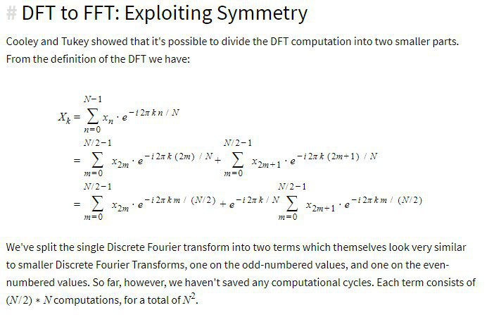

Slide 4
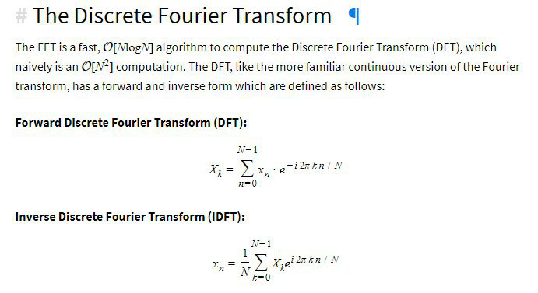


Slide 5
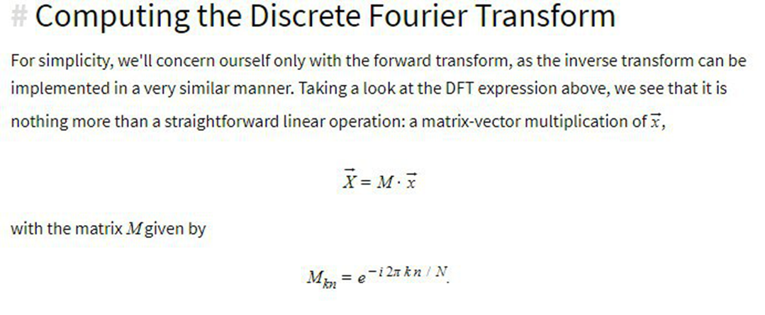

Slide 6
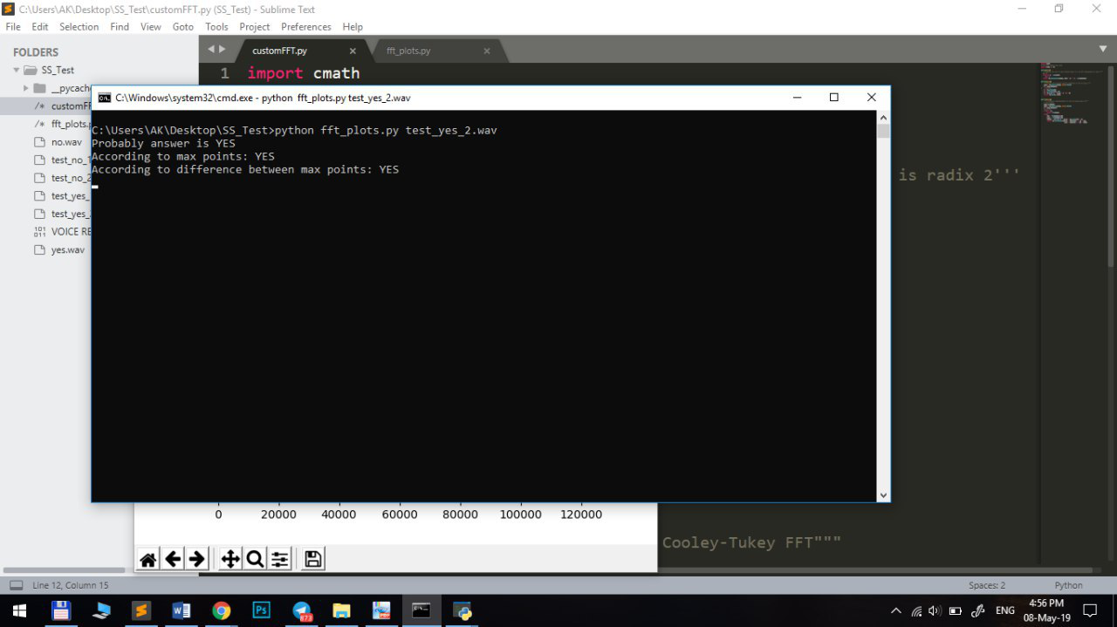
Team’s main goal is to implement simple algorithm based on Fourier Transform to recognize “YES” or “NO” words.

Slide 7
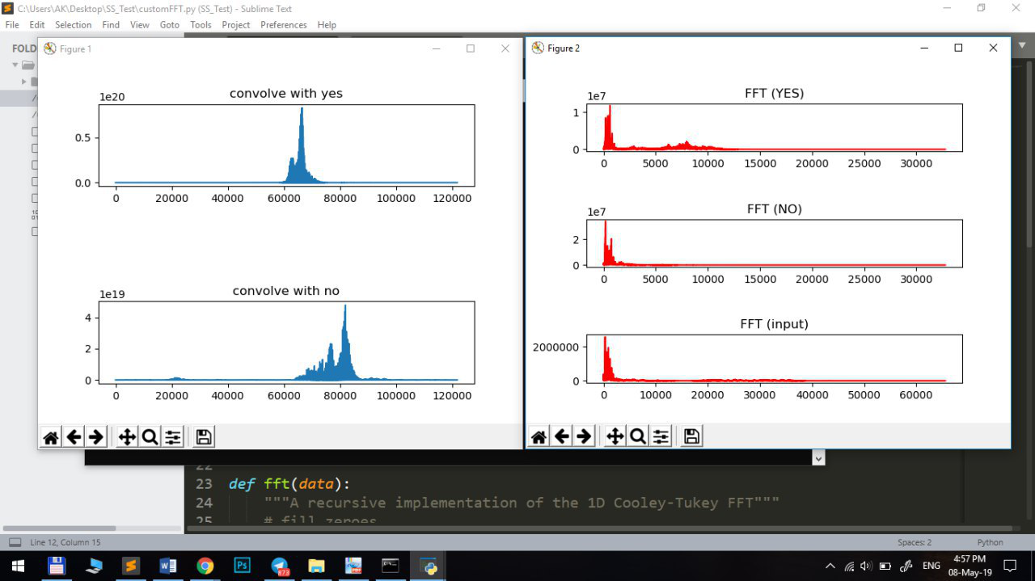

Slide 8
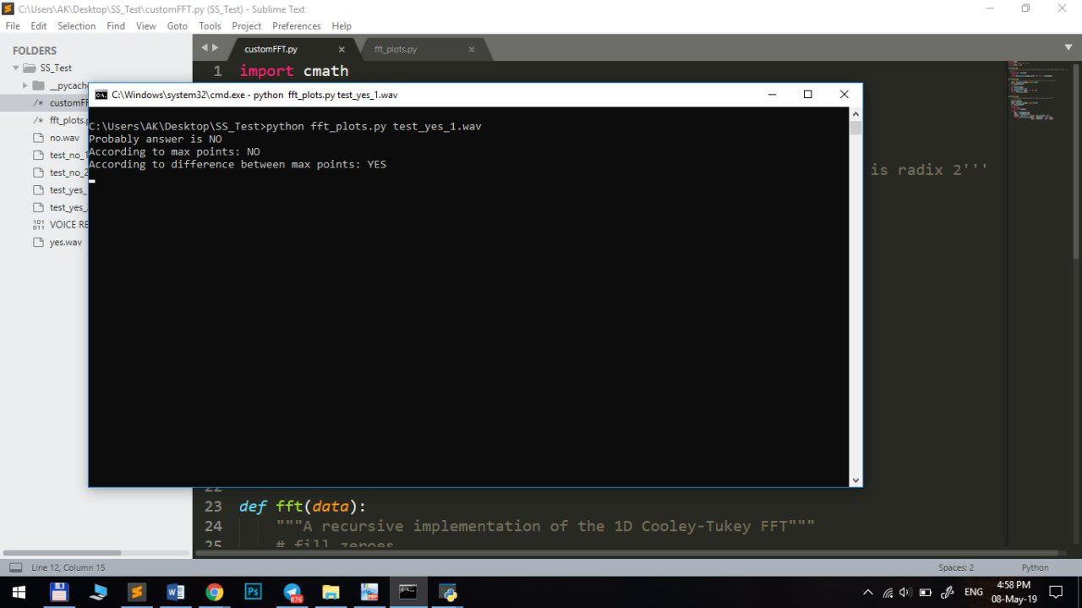

Slide 9
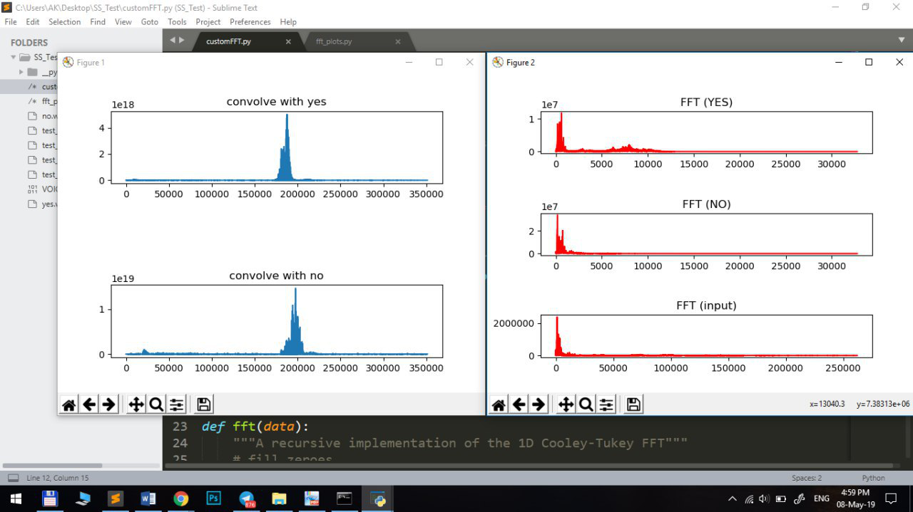

Slide 10
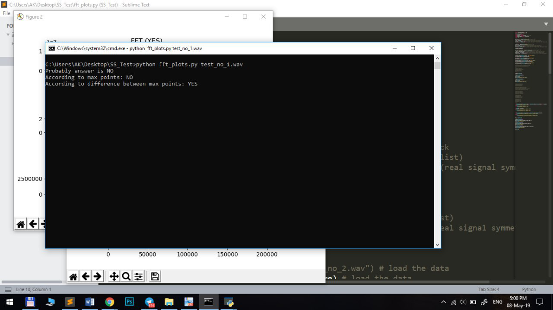

Slide 11
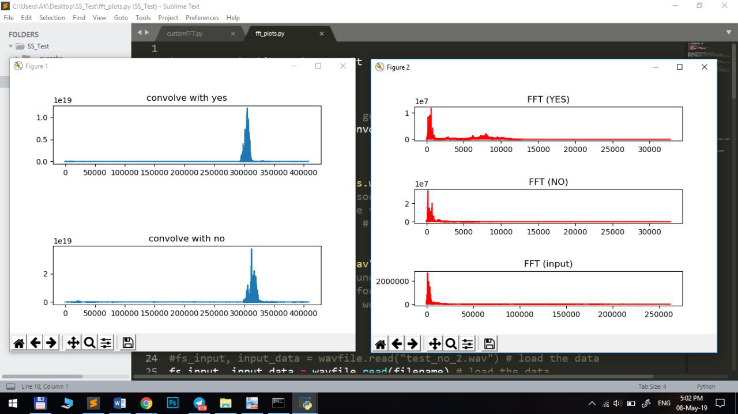

Slide 12
