Slide 1
Fibonacci Heap and Skip List Comparison
Scott Ratchford, Sam Gaines, Abbie Bosko, Audrey Kim, Summer Davis, Kevin Leey

Slide 2

Fibonacci Heap
Collection of trees satisfying the min-heap property
Pointer to minimum element node
Trees have no prescribed shape
Every element could be in a separate tree
Nodes can have >2 children
Called Fibonacci because trees are constructed so that a tree of order n has at least $F_{n+2}$ nodes in it, where $F_{n+2}$ is the ${\text{(}\text{n}\text{+2)}}^{th}$ Fibonacci number
Roots are linked using a circular doubly list
Operations:
Insert
Union
Find min
Extract min
Decrease key
Delete
Notes:
Summer
-Like Binomial Heap, Fib heap
-Maintains a pointer to min value which is always root of tree
-trees can have any shape, unlike binomial heap
-Mainly called Fibonacci because Fibonacci numbers are used in the running time analysis.
-roots are linked using circular doubly linked list
Fibonacci heaps are used to implement the priority queue element in Dikjstra's algorithm, giving the algorithm a very efficient running time.

Slide 3
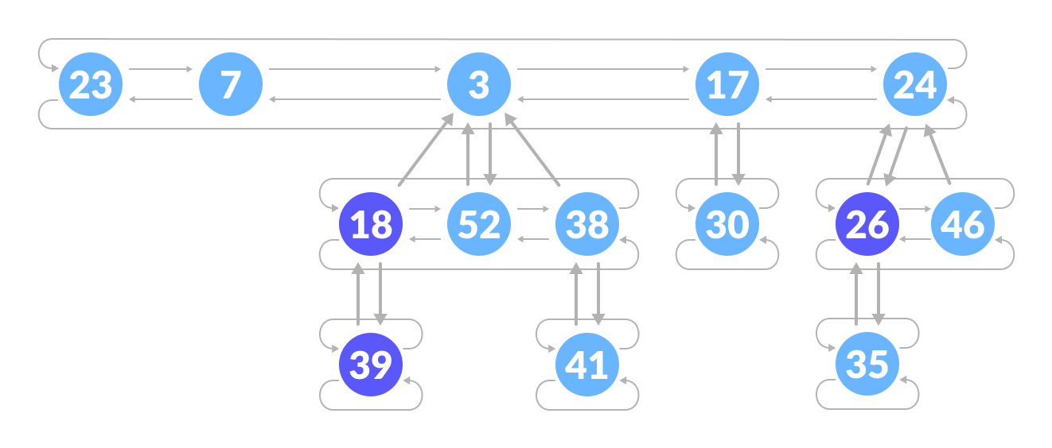


Fibonacci Heap
Unmarked
https://www.programiz.com/dsa/fibonacci-heap
Marked
Notes:
Summer
Here is our first example of a fibonacci heap
-can see all of the roots are connected utilizing circular doubly linked lists
-marking step in the Fibonacci heap allows the data structure to count how many children have been lost so far.
-An unmarked node has lost no children, and a marked node has lost one child.

Slide 4
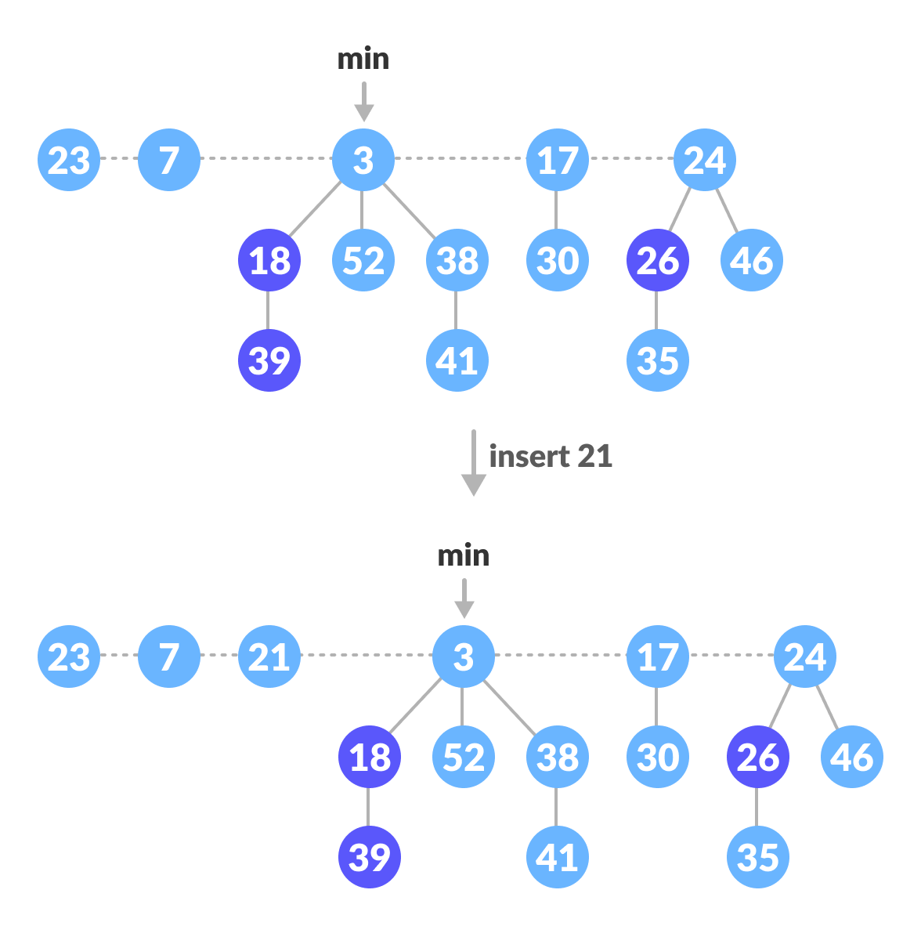
Fibonacci Heap - Insert
If heap is empty, set the new node as a root node and mark it as the minimum
Else, insert node into the root list and update min (if needed)
Insert 21
Notes:
Summer
-just inserted 21

Slide 5
Fibonacci Heap - Insert
5
6
4
8
9
10
Minimum element
Notes:
Summer
-this is a simple example of inserting elements
So 5 starts as the minimum and then we begin inserting values

Slide 6
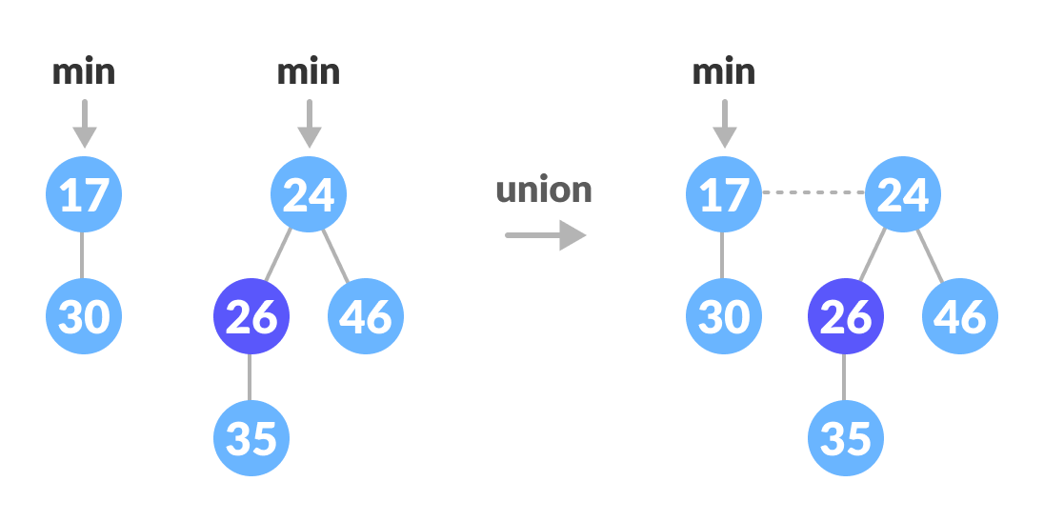
Fibonacci Heap - Union
Concatenate root lists of H1 and H2 and set new minimum node
Results in one new heap
https://www.programiz.com/dsa/fibonacci-heap
Notes:
Audrey

Slide 7
Fibonacci Heap – Extract Min
Delete the minimum node
Set the min-pointer to the next root in the root list
Create an array of size equal to the maximum degree of the trees in the heap before deletion.
Consolidate
Notes:
Audrey

Slide 8
Fibonacci Heap – Consolidate
Map the degree of current root (min-pointer) to the degree in the array.
Map the degree of next root to the degree in array.
If there are more than two mappings for the same degree, then apply union operation to those roots such that the min-heap property is maintained (i.e. the minimum is at the root).
Notes:
Audrey

Slide 9
Fibonacci Heap – Extract Min
5
6
4
8
9
10
Minimum element
Notes:
Audrey

Slide 10
Fibonacci Heap – Consolidate
Next
5
6
8
9
10
Degree 0
Degree | 0 | 1 | 2 | 3
Element
8
Minimum element
Notes:
Audrey

Slide 11
Fibonacci Heap – Consolidate
Next
5
6
8
9
10
Degree 0
Degree | 0 | 1 | 2 | 3
Element
8
Minimum element
Notes:
Audrey

Slide 12
Fibonacci Heap – Consolidate
Next
5
6
8
9
10
Degree 0
Degree | 0 | 1 | 2 | 3
Element
8
Minimum element
Notes:
Audrey

Slide 13
Fibonacci Heap – Consolidate
Next
5
6
8
10
Degree 0
Degree 0
9
Degree | 0 | 1 | 2 | 3
Element
10
8
Minimum element
Notes:
Audrey

Slide 14
Fibonacci Heap – Consolidate
Next
5
6
8
10
9
Degree | 0 | 1 | 2 | 3
Element
10
8
Minimum element
Notes:
Audrey

Slide 15
Fibonacci Heap – Consolidate
Next
5
6
8
10
9
Degree 1
Degree | 0 | 1 | 2 | 3
Element
8
Minimum element
Notes:
Audrey

Slide 16
Fibonacci Heap – Consolidate
Next
5
6
8
10
10
9
Degree 2
Degree | 0 | 1 | 2 | 3
Element
8
5
Minimum element
Notes:
Audrey

Slide 17
Fibonacci Heap – Consolidate
Next
5
6
Degree 0
10
8
9
Degree | 0 | 1 | 2
Element
6
5
Minimum element
Notes:
Audrey

Slide 18
Fibonacci Heap – Decrease Key
Select node to be decreased and decrease value to x . Check if min-heap order violated.
Case 1: Heap order not violated:
Decrease key.
Case 2: Heap order violated and parent node is not marked.
Cut tree rooted at node and meld to root list. Unmark node and mark parent. (Cut)
Case 3: Heap order violated and parent node is marked.
Cut tree rooted at node and meld to root list. Unmark node. Cut parent node, meld to root list, and unmark recursively for all ancestors that lose second child (Cascading Cut)
Adjust min pointer as necessary
Notes:
Abbie

Slide 19
Fibonacci Heap – Decrease Key (Case 1)
Decrease 46 to 29
7
18
38
24
17
23
21
39
41
26
46
30
52
35
88
72
Marked Node
Minimum element

Slide 20
Fibonacci Heap – Decrease Key (Case 1)
Decrease 46 to 29
7
18
38
24
17
23
21
39
41
26
46
30
52
35
88
72
Marked Node
Minimum element

Slide 21
Fibonacci Heap – Decrease Key (Case 1)
Decrease 46 to 29
7
18
38
24
17
23
21
39
41
26
29
30
52
35
88
72
Heap order not violated. Done!
Marked Node
Minimum element

Slide 22
Fibonacci Heap – Decrease Key (Case 2)
Decrease 29 to 15
7
18
38
24
17
23
21
39
41
26
29
30
52
35
88
72
Marked Node
Minimum element

Slide 23
Fibonacci Heap – Decrease Key (Case 2)
Decrease 29 to 15
7
18
38
24
17
23
21
39
41
26
29
30
52
35
88
72
Marked Node
Minimum element

Slide 24
Fibonacci Heap – Decrease Key (Case 2)
Decrease 29 to 15
7
18
38
24
17
23
21
39
41
26
15
30
52
35
88
72
Heap order violated. Cut and meld to root list.
Marked Node
Minimum element

Slide 25
Fibonacci Heap – Decrease Key (Case 2)
Decrease 29 to 15
7
15
18
38
24
17
23
72
21
39
41
26
30
52
35
88
Heap order violated. Cut and meld to root list.
Marked Node
Minimum element

Slide 26
Fibonacci Heap – Decrease Key (Case 2)
Decrease 29 to 15
7
15
18
38
24
17
23
72
21
39
41
26
30
52
35
88
Mark Parent. Done!
Marked Node
Minimum element

Slide 27
Fibonacci Heap – Decrease Key (Case 3)
Decrease 35 to 5
7
15
18
38
24
17
23
72
21
39
41
26
30
52
35
88
Marked Node
Minimum element

Slide 28
Fibonacci Heap – Decrease Key (Case 3)
Decrease 35 to 5
7
15
18
38
24
17
23
72
21
39
41
26
30
52
35
88
Marked Node
Minimum element

Slide 29
Fibonacci Heap – Decrease Key (Case 3)
Decrease 35 to 5
7
15
18
38
24
17
23
72
21
39
41
26
30
52
5
88
Heap order violated. Cut and meld to root list.
Marked Node
Minimum element

Slide 30
Fibonacci Heap – Decrease Key (Case 3)
Decrease 35 to 5
7
5
15
18
38
24
17
23
72
21
39
41
26
30
52
88
Heap order violated. Cut and meld to root list.
Marked Node
Minimum element

Slide 31
Fibonacci Heap – Decrease Key (Case 3)
Decrease 35 to 5
7
5
15
18
38
24
17
23
72
21
39
41
26
30
52
88
Mark Parent
Marked Node
Minimum element

Slide 32
Fibonacci Heap – Decrease Key (Case 3)
Decrease 35 to 5
7
5
15
18
38
24
17
23
72
21
39
41
26
30
52
88
Parent already marked. Cut parent and meld to root list.
Marked Node
Minimum element

Slide 33
Fibonacci Heap – Decrease Key (Case 3)
Decrease 35 to 5
7
26
5
15
18
38
24
17
23
21
39
72
88
41
30
52
Parent already marked. Cut parent and meld to root list.
Marked Node
Minimum element

Slide 34
Fibonacci Heap – Decrease Key (Case 3)
Decrease 35 to 5
7
26
5
15
18
38
24
17
23
21
39
72
88
41
30
52
Unmark
Marked Node
Minimum element

Slide 35
Fibonacci Heap – Decrease Key (Case 3)
Decrease 35 to 5
7
26
5
15
18
38
24
17
23
21
39
72
88
41
30
52
Mark Parent
Marked Node
Minimum element

Slide 36
Fibonacci Heap – Decrease Key (Case 3)
Decrease 35 to 5
7
26
5
15
18
38
24
17
23
21
39
72
88
41
30
52
Parent already marked. Cut parent and meld to root list.
Marked Node
Minimum element

Slide 37
Fibonacci Heap – Decrease Key (Case 3)
Decrease 35 to 5
7
24
26
5
15
18
38
17
23
21
39
72
88
41
30
52
Parent already marked. Cut parent and meld to root list.
Marked Node
Minimum element

Slide 38
Fibonacci Heap – Decrease Key (Case 3)
Decrease 35 to 5
7
24
26
5
15
18
38
17
23
21
39
72
88
41
30
52
Unmark.
Marked Node
Minimum element

Slide 39
Fibonacci Heap – Decrease Key (Case 3)
Decrease 35 to 5
7
24
26
5
15
18
38
17
23
21
39
72
88
41
30
52
Mark Parent.
Marked Node
Minimum element

Slide 40
Fibonacci Heap – Decrease Key (Case 3)
Decrease 35 to 5
7
24
26
5
15
18
38
17
23
21
39
72
88
41
30
52
Parent is root node. Do not mark.
Marked Node
Minimum element

Slide 41
Fibonacci Heap – Decrease Key (Case 3)
Decrease 35 to 5
7
24
26
5
15
18
38
17
23
21
39
72
88
41
30
52
Update Min pointer. Done!
Marked Node
Minimum element

Slide 42
Fibonacci Heap - Delete
Use decrease-key operation to set the value of node to be deleted to -∞
Apply extract-min operation to delete the node and consolidate heap
Notes:
Audrey

Slide 43
Fibonacci Heap – Time Complexity
Procedure | Average Time
Insert | Θ(1)
Find-Min | Θ(1)
Delete-Min | Θ(log n)
Decrease-Key | Θ(1)
Union | Θ(1)

Slide 44
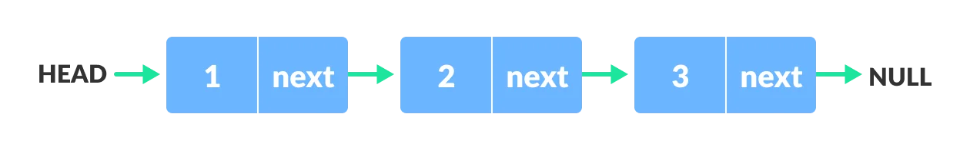
Skip List – Sorted Linked Lists
Find: O(N)
Insert: O(1), after calling find
Delete: O(1), after calling find
What if there was a faster way to go through the list?
https://www.programiz.com/dsa/linked-list
Notes:
Kevin

Slide 45
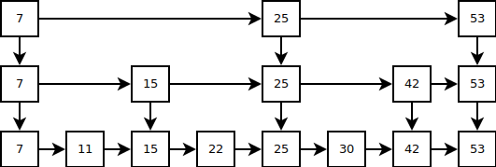
Skip List – Ideal Skip Lists
Create shortcuts for every other node
Create shortcuts for every other shortcut
Find: O(lg n)
Problem: Insert and Delete will break the structure
https://ticki.github.io/blog/skip-lists-done-right/
Notes:
Kevin

Slide 46
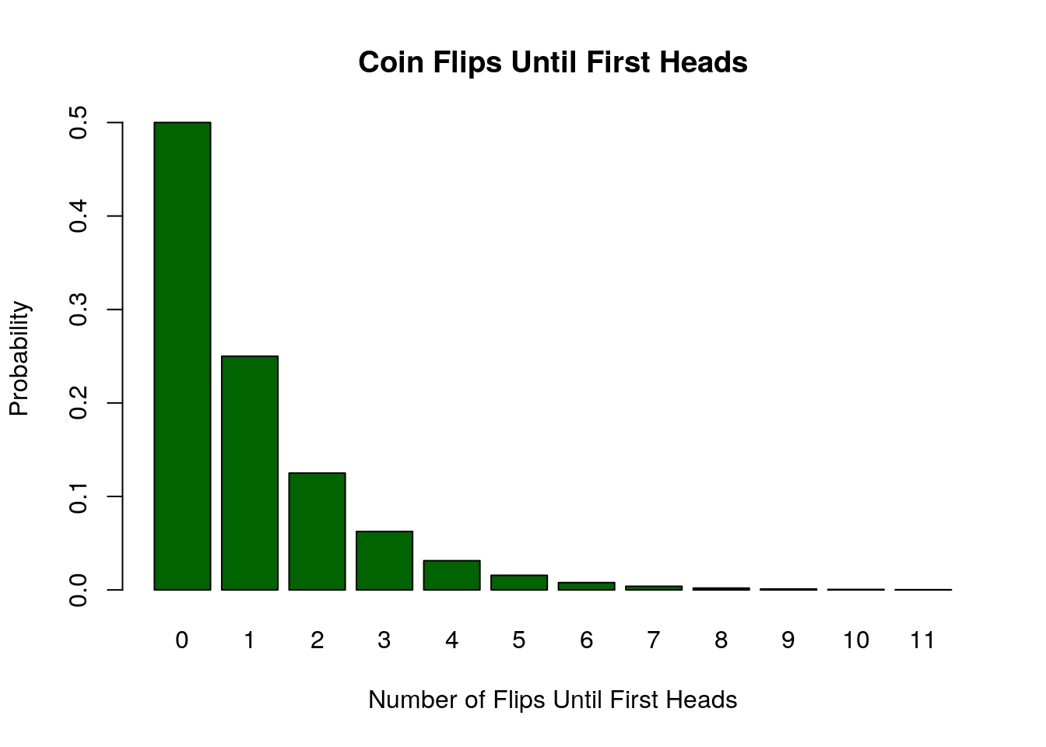
Skip List – Randomness
Solution: use randomness to determine "height" of node
Height: number of shortcuts on a node
Process:
Flip a coin until first heads is flipped
Number of tails = height of node
Height probability distribution:
P(Height = 0) = 1/2
P(Height = 1) = 1/4
P(Height = n) = 1/(2^{n+1})
https://faculty.nps.edu/rbassett/_book/discrete-random-variables.html
Notes:
Kevin

Slide 47
Skip List – Find
Find 5
H
3
6
X
H
3
4
6
X
H
1
3
4
6
X
H
1
2
3
4
5
6
7
X

Slide 48
Skip List – Find
Find 5
H
3
6
X
H
3
4
6
X
H
1
3
4
6
X
H
1
2
3
4
5
6
7
X

Slide 49
Skip List – Find
Find 5
H
3
6
X
H
3
4
6
X
H
1
3
4
6
X
H
1
2
3
4
5
6
7
X

Slide 50
Skip List – Find
Find 5
H
3
6
X
H
3
4
6
X
H
1
3
4
6
X
H
1
2
3
4
5
6
7
X

Slide 51
Skip List – Find
Find 5
H
3
6
X
H
3
4
6
X
H
1
3
4
6
X
H
1
2
3
4
5
6
7
X

Slide 52
Skip List – Find
Find 5
H
3
6
X
H
3
4
6
X
H
1
3
4
6
X
H
1
2
3
4
5
6
7
X

Slide 53
Skip List – Find
Find 5
H
3
6
X
H
3
4
6
X
H
1
3
4
6
X
H
1
2
3
4
5
6
7
X

Slide 54
Skip List – Find
Find 5
H
3
6
X
H
3
4
6
X
H
1
3
4
6
X
H
1
2
3
4
5
6
7
X

Slide 55
Skip List – Find
Find 5
H
3
6
X
H
3
4
6
X
H
1
3
4
6
X
H
1
2
3
4
5
6
7
X

Slide 56
Skip List – Find
Find 5
H
3
6
X
H
3
4
6
X
H
1
3
4
6
X
H
1
2
3
4
5
6
7
X

Slide 57
Skip List – Find
Find 5
H
3
6
X
H
3
4
6
X
H
1
3
4
6
X
H
1
2
3
4
5
6
7
X

Slide 58
Skip List – Find
Find 5
H
3
6
X
H
3
4
6
X
H
1
3
4
6
X
H
1
2
3
4
5
6
7
X

Slide 59
Skip List – Find
Find 5
H
3
6
X
H
3
4
6
X
H
1
3
4
6
X
H
1
2
3
4
5
6
7
X

Slide 60
Skip List – Find
Find 5
H
3
6
X
H
3
4
6
X
H
1
3
4
6
X
H
1
2
3
4
5
6
7
X

Slide 61
Skip List – Find
Find 5
H
3
6
X
H
3
4
6
X
H
1
3
4
6
X
H
1
2
3
4
5
6
7
X

Slide 62
Skip List – Insert
Insert 6
H
3
X
H
1
3
4
X
H
1
2
3
4
5
7
X

Slide 63
Skip List – Insert
Insert 6
H
3
X
H
1
3
4
X
H
1
2
3
4
5
7
X

Slide 64
Skip List – Insert
Insert 6
H
3
X
H
1
3
4
X
H
1
2
3
4
5
7
X

Slide 65
Skip List – Insert
Insert 6
H
3
X
H
1
3
4
X
H
1
2
3
4
5
7
X

Slide 66
Skip List – Insert
Insert 6
H
3
X
H
1
3
4
X
H
1
2
3
4
5
7
X

Slide 67
Skip List – Insert
Insert 6
H
3
X
H
1
3
4
X
H
1
2
3
4
5
7
X

Slide 68
Skip List – Insert
Insert 6
H
3
X
H
1
3
4
X
H
1
2
3
4
5
7
X

Slide 69
Skip List – Insert
Insert 6
H
3
X
H
1
3
4
X
H
1
2
3
4
5
7
X

Slide 70
Skip List – Insert
Insert 6
H
3
X
H
1
3
4
X
H
1
2
3
4
5
7
X

Slide 71
Skip List – Insert
Insert 6
H
3
X
H
1
3
4
X
H
1
2
3
4
5
7
X

Slide 72
Skip List – Insert
Insert 6
H
3
X
H
1
3
4
X
H
1
2
3
4
5
7
X

Slide 73
Skip List – Insert
Insert 6
H
3
X
H
1
3
4
X
H
1
2
3
4
5
7
X

Slide 74
Skip List – Insert
Insert 6
H
3
X
H
1
3
4
X
H
1
2
3
4
5
7
X

Slide 75
Skip List – Insert
Insert 6
H
3
X
H
1
3
4
X
H
1
2
3
4
5
6
7
X

Slide 76
Skip List – Insert
Insert 6
H
3
X
H
1
3
4
X
pickRandomHeight()
H
1
2
3
4
5
6
7
X

Slide 77
Skip List – Insert
Insert 6
H
3
X
H
1
3
4
X
3
H
1
2
3
4
5
6
7
X

Slide 78
Skip List – Insert
Insert 6
6
H
3
6
X
H
1
3
4
6
X
H
1
2
3
4
5
6
7
X

Slide 79
Skip List – Insert
Insert 6
H
6
X
H
3
6
X
H
1
3
4
6
X
H
1
2
3
4
5
6
7
X

Slide 80
Skip List – Insert
Insert 6
H
6
X
H
3
6
X
H
1
3
4
6
X
H
1
2
3
4
5
6
7
X

Slide 81
Skip List – Delete
Delete 4
H
3
6
X
H
3
4
6
X
H
1
3
4
6
X
H
1
2
3
4
5
6
7
X

Slide 82
Skip List – Delete
Delete 4
H
3
6
X
H
3
4
6
X
H
1
3
4
6
X
H
1
2
3
4
5
6
7
X

Slide 83
Skip List – Delete
Delete 4
H
3
6
X
H
3
4
6
X
H
1
3
4
6
X
H
1
2
3
4
5
6
7
X

Slide 84
Skip List – Delete
Delete 4
H
3
6
X
H
3
4
6
X
H
1
3
4
6
X
H
1
2
3
4
5
6
7
X

Slide 85
Skip List – Delete
Delete 4
H
3
6
X
H
3
4
6
X
H
1
3
4
6
X
H
1
2
3
4
5
6
7
X

Slide 86
Skip List – Delete
Delete 4
H
3
6
X
H
3
4
6
X
H
1
3
4
6
X
H
1
2
3
4
5
6
7
X

Slide 87
Skip List – Delete
Delete 4
H
3
6
X
H
3
4
6
X
H
1
3
4
6
X
H
1
2
3
4
5
6
7
X

Slide 88
Skip List – Delete
Delete 4
H
3
6
X
H
3
4
6
X
H
1
3
4
6
X
H
1
2
3
4
5
6
7
X

Slide 89
Skip List – Delete
Delete 4
H
3
6
X
H
3
4
6
X
H
1
3
4
6
X
H
1
2
3
4
5
6
7
X

Slide 90
Skip List – Delete
Delete 4
H
3
6
X
H
3
4
6
X
H
1
3
4
6
X
H
1
2
3
4
5
6
7
X

Slide 91
Skip List – Delete
Delete 4
H
3
6
X
H
3
4
6
X
H
1
3
4
6
X
H
1
2
3
4
5
6
7
X

Slide 92
Skip List – Delete
Delete 4
H
3
6
X
H
3
4
6
X
H
1
3
4
6
X
H
1
2
3
4
5
6
7
X

Slide 93
Skip List – Delete
Delete 4
H
3
6
X
H
3
4
6
X
H
1
3
4
6
X
H
1
2
3
4
5
6
7
X

Slide 94
Skip List – Delete
Delete 4
H
3
6
X
H
3
6
X
H
1
3
6
X
H
1
2
3
5
6
7
X

Slide 95
Skip List – Delete
Delete 4
H
3
6
X
H
3
6
X
H
1
3
6
X
H
1
2
3
5
6
7
X

Slide 96
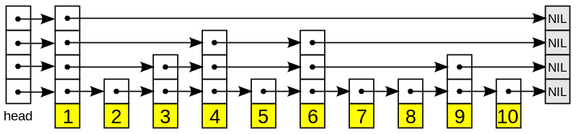
Skip List – Analysis
Find: O(lg N), with high probability
Insert: O(1), after calling find
Delete: O(1), after calling find
https://brilliant.org/wiki/skip-lists/

Slide 97
Application
Fibonacci Heaps: are used to implement the priority queue element in Dijkstra’s algorithm, giving the algorithm a very efficient running time
Skip Lists: commonly used as a prime indexing structure for database technology
Red Black Trees: can be used to efficiently index data in databases, allowing for fast search and retrieval of data.

Slide 98
Demo

Slide 99
Questions?

