Slide 1
EMOTION BASED MUSIC PLAYER
Guided By
Prof. R. D. D. V. Sivaram
Team:
B . Vedasree
A. Abhilash Sai
G. Sneha Sruthi
D. Sri Harsha
P. Madhu Sudan

Slide 2
Contents
Introduction
About Dataset
Problem Statement
Pre-Processing of image and Speech
Results
System Architecture
Methodology
CNN Activation Functions

Slide 3
Problem Statement
The amount of stress in the people is increasing day by day and music is one of the best medicines to remove stress . Though there are a lot of music apps available , lot of time is getting wasted in selecting songs .
In order to avoid this, We are using deep learning techniques to design an application that can identify the current emotion of the user based on his facial image or speech and play the music with respect to his expression

Slide 4
System Flow( Image data)
.
Input Captured
Image
Anger
Preprocessing
Feature
Extraction
Sad
Happy
Classification
Using Cnn
Disgust
Fear
Database Face Image
Preprocessing
Feature
Extraction
Surprise
Neutral

Slide 5
System Flow(Speech Data)
.
Frame blocking Analysis
Pre-Emphasis
Windowing
FFT
Cepstrum
Mel Frequency Wrapping
Feature
CNN
Identified Emotion
Speech Emotion Data Base

Slide 6
Preprocessing of Image
We need to preprocess the input images in order to increase the training and testing accuracies. Methods used are:
Converting to greyscale
Image Cropping
Down sampling
Intensity Normalization

Slide 7


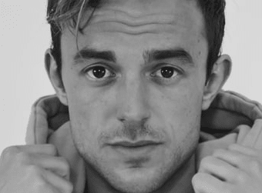
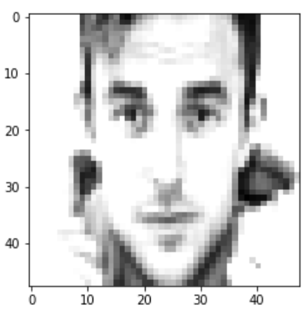

Preprocessing of Image
Normal image to grey scale image
Image Cropping
Intensity Normalization
Down sampling

Slide 8
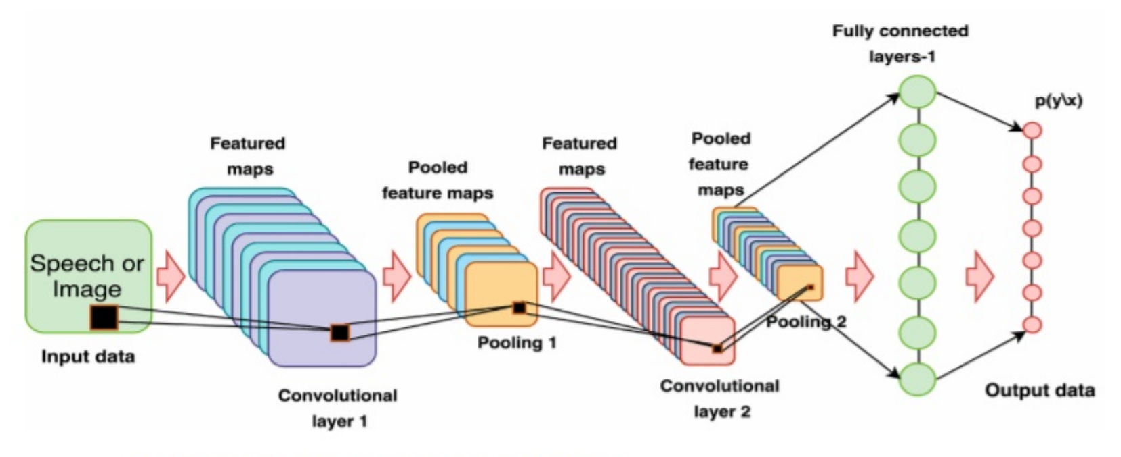
Convolutional Neural Networks

Slide 9
Mel Frequency Cepstrum Coefficient
Mel Frequency Cepstrum Coefficient (MFCC) is a method of feature extraction of voice signals.
Pre emphasis : In the process of speech signal pre-emphasis filter is required after the sampling process. The purpose of this filtering is to obtain a smoother spectral form of speech signal frequency. In other words, this filtering process is done to reduce noise during sound capture
𝑦(𝑛) = 𝑥(𝑛) − 𝑎𝑥(𝑛 − 1)
Here , a is a pre-emphasis filter constant, it is usually 0.9 < a < 1.0
Frame blocking : In this process, the sound signal is segmented into multiple overlapped frames, so there is not a single deletion of signals.

Slide 10
Mel Frequency Cepstrum Coefficient
Windowing: Windowing is a process for analyzing long sound signals by taking a sufficiently representative section
This process removes the aliasing signal due to the discontinuity of the signal Discontinuities occur due to the frame blocking process.
If we define the window as w(n), 0 ≤ n ≤ N - 1, where N is the number of samples in each frame, the result of windowing is a signal:
𝑦1 (𝑛) = 𝑥1 (𝑛)𝑤(𝑛), 0 ≤ 𝑛 ≤ 𝑁 − 1

Slide 11
Mel Frequency Cepstrum Coefficient
y(n) is the result signal of the convolution between the input signal and the window function
x(n) represents the signal to be convolved by the window function.
w(n) usually uses window Hamming which has the form:
𝑤(𝑛) = 0.54 − 0.46. 𝑐𝑜𝑠 ( 2𝜋𝑛 𝑁−1 ) , 0 ≤ 𝑛 ≤ 𝑁 − 1

Slide 12
Mel Frequency Cepstrum Coefficient
Fast Fourier Transform (FFT) : Fourier transform is used to convert a time series of bounded time domain signals into a frequency spectrum.
The frame that has undergone the windowing process is converted into a frequency spectrum i.e converts every frame to N samples from time domain into frequency domain.
𝑋𝑛 = ∑ 𝑥𝑘 𝑁−1 𝑘=0 𝑒 −2𝜋𝑗𝑘𝑛/𝑁
Here n = 0, 1, 2, …, N-1 and j = sqrt-1. X[n] is the n-frequency pattern generated from the Fourier transform, Wk. is the signal of a frame.

Slide 13
Mel Frequency Cepstrum Coefficient
Mel-Frequency wrapping :The perception of the human ear against the sound frequency does not follow the linear scale. The actual frequency scale uses units of Hz.
The scale that works on the human ear is called the frequency Mel scale. The following equation shows the relation of the Mel scale to the frequency in Hz.
𝐹𝑚𝑒𝑙 = { 2595 ∗ [𝑙𝑜𝑔]10 (1 + 𝐹𝐻𝑍 700),
𝐹𝐻𝑍 > 1000 𝐹𝐻𝑍, 𝐹𝐻𝑍 < 1000
Where Fmel is the Mel scale and f is the frequency in Hz

Slide 14
Mel Frequency Cepstrum Coefficient
Cepstrum : Humans listen to voice information based on time domain signals.
At this stage Mel-spectrum will be converted into time domain by using Discrete Cosine Transform (DCT).
The result is called Mel-frequency cepstrum coefficient (MFCC). Here are the equations used in cosine transformations:
𝑐𝑗 = ∑ 𝑋𝑗 𝐾 𝑗=1 𝑐𝑜𝑠 (𝑗(𝑖 − 1)/2 𝜋 𝐾 )

Slide 15
Initial Implementations and output
Implemented code for image pre processing
Designed Front-end of emotion based music player app
Implemented MFCC algorithm for feature extraction of speech dataset
Implemented algorithm for feature comparison of speech data

Slide 16

Thank You

