Slide 1
Jordan Abbott
Peer-to-peer overlay network

Slide 2
Coolest thing about my program
The ease by which two-way TCP sockets can be created, facilitating easy communication between two or more machines, with many practical applications.
Contemporary usage of peer-to-peer networks include Tor, cryptocurrencies, and file sharing, although there are many other interesting potential uses.

Slide 3
How this works (in theory):
First, an node is initially needed by itself to serve as a basis for other nodes to connect
When another node does connect, the new node broadcasts its listen port to the first node. The first node then stores the listen port and the IP address of the new node. The second node already knows the listen port and IP address of the first node, and so stores that data as well.
When further nodes connect to the first or second node, the IP addresses and listen ports of every other connected node are broadcast to the new nodes, so that the new nodes can establish connections to the already-existing nodes.

Slide 4
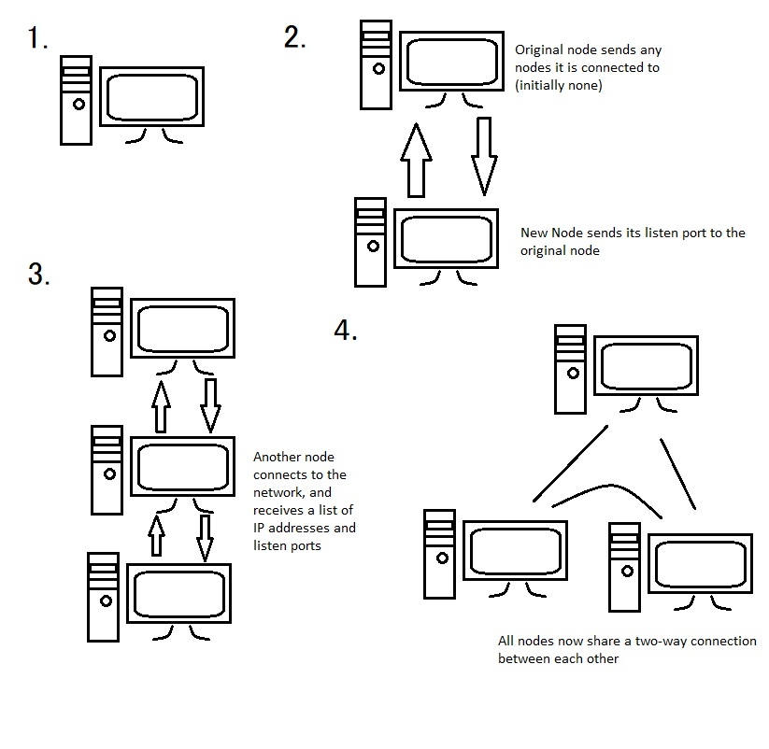

Slide 5
If I could do it all over again, I would…
Probably re-work the structure of the program so that the two parts of the program (one which listens for connections, the other tries to connect to other nodes) are inherited from a single class, so that certain functions can be shared between them, such as a message parsing function.

Slide 6
The thing that I learned the most was…
The different ways in which P2P networks can be arranged, and how that affects their behavior.
A little better understanding of how TCP sockets work at the OS level
More practice in threading, which was required due to the natural asynchronicity of networking, as well as certain functions which block I/O calls (namely receiving packets from the TCP port)

