Slide 1
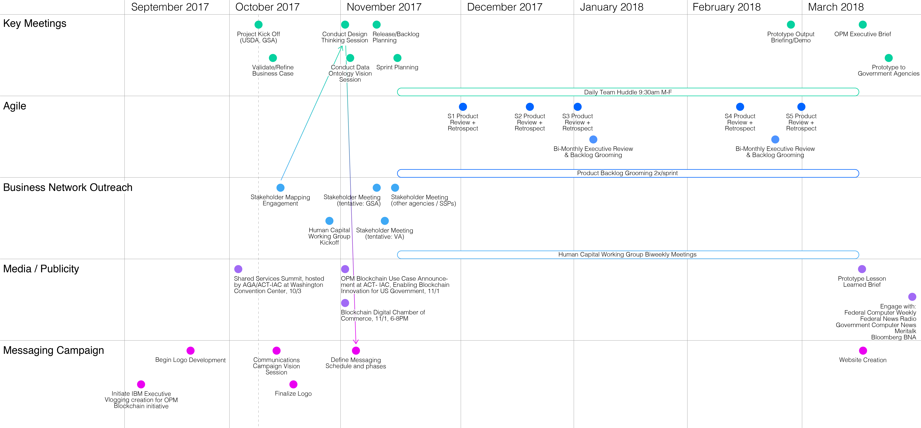
EDR Blockchain Communication Campaign Roadmap
Draft for discussion
October 2017
Notes:
When the draft media vlogs will be launched
Wish well in the beginning
-social media
-the look of government doing something different
-vehicle to talk to communications at OPM (Marcel to engage with POC)
-IBM site for EDR
-blockchain working group?
-Congressional BC pocket
-Digital Chamber of Commerce – March Annual Form (Georgetown)
Government Wide Lessons Learned
Think Conference – present
Data Transparency Group Conferences (Hudson)
Center of Excellence Conference (Lynn)
Booz Allen Internal Project of the Year for IBM (what do we need to do to get the list, Best of IBM – Project of Year, Public Sector) -Raiza
Federal Government Awards ( does the prototype count for that kind of recognition) FCW GTN

Slide 2
EDR Blockchain Communication Campaign Roadmap
Oct 17
Nov 17
Dec 17
Jan 18
Feb 18
Mar 18
Stakeholders
Awareness
Engage with:
Federal Computer Weekly
Federal News Radio
Government Computer News
Meritalk
Bloomberg BNA
IRB
Members
OPM CIO
logo +
style guide
Website
Creation
Social media
Strategy
Social media
Profile creation
CHCOs
Demo Business
Network Members
Ongoing Social Media Engagement
Interest
IRB
Members
OPM CIO
Design Thinking
Workshops
Email
Campaign
Demo Business
Network Members
CHCOs
Consideration
IRB
Members
Demo Business
Network Members
To-be case
study written
Human Capital
Working Group
Kickoff
Case-study
socialization
CHCOs
Ongoing Stakeholder Meetings
Human Capital Working Group Biweekly Meetings
Intent
Demo transcript
created
Informational
video created
IRB
Members
Demo Business
Network Members
Demos
Evaluation
Final presentation
Deck
IRB
Members
Demo one
pager
Demo video
created
Action
IRB
Members
Notes:
When the draft media vlogs will be launched
Wish well in the beginning
-social media
-the look of government doing something different
-vehicle to talk to communications at OPM (Marcel to engage with POC)
-IBM site for EDR
-blockchain working group?
-Congressional BC pocket
-Digital Chamber of Commerce – March Annual Form (Georgetown)
Government Wide Lessons Learned
Think Conference – present
Data Transparency Group Conferences (Hudson)
Center of Excellence Conference (Lynn)
Booz Allen Internal Project of the Year for IBM (what do we need to do to get the list, Best of IBM – Project of Year, Public Sector) -Raiza
Federal Government Awards ( does the prototype count for that kind of recognition) FCW GTN

