Slide 1

dunnhumby Hiring Challenge (React)
Participant Name: Imran Ali

Slide 2
Brief Summary of Project: Build a meme generator which allows users to customize it and place their own text on meme images fetched. The text can be inserted at the top or bottom of the image. The solution should provide the input fields for both and ask users their choice of placement. The images can be fetched automatically and having a database for them is advised.

Slide 3
Technology/Tool Stack Used: Html, Css, JavaScript, Bootstrap 4, Angular 12, Angular CLI. IDE : Visual Studion Code.

Slide 4
Github URL for source code: Files are uploaded : Url for github is https://github.com/abbu1/Meme-generator The folder I uploaded is “src”. Because in angular app this is only the main folder in which we can put all our files and images only we can clone this in our project and pass soe commands to run this i.e ng serve.

Slide 5
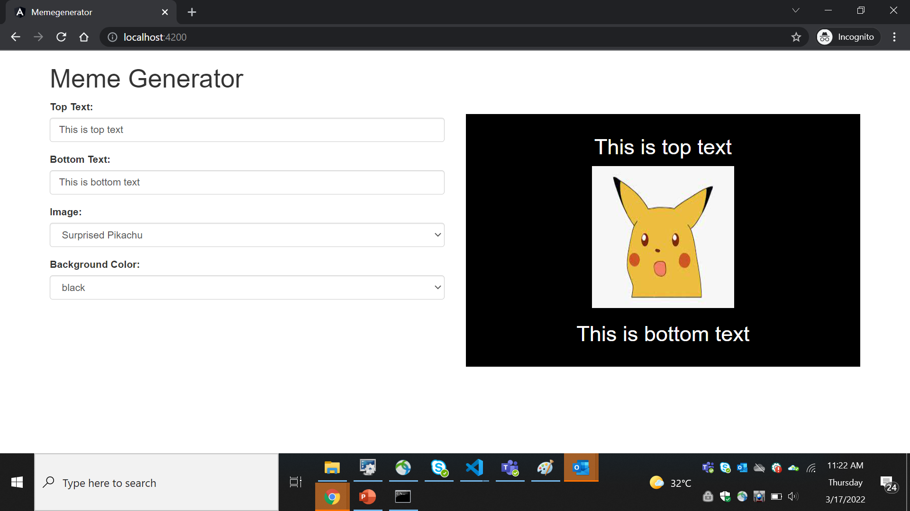
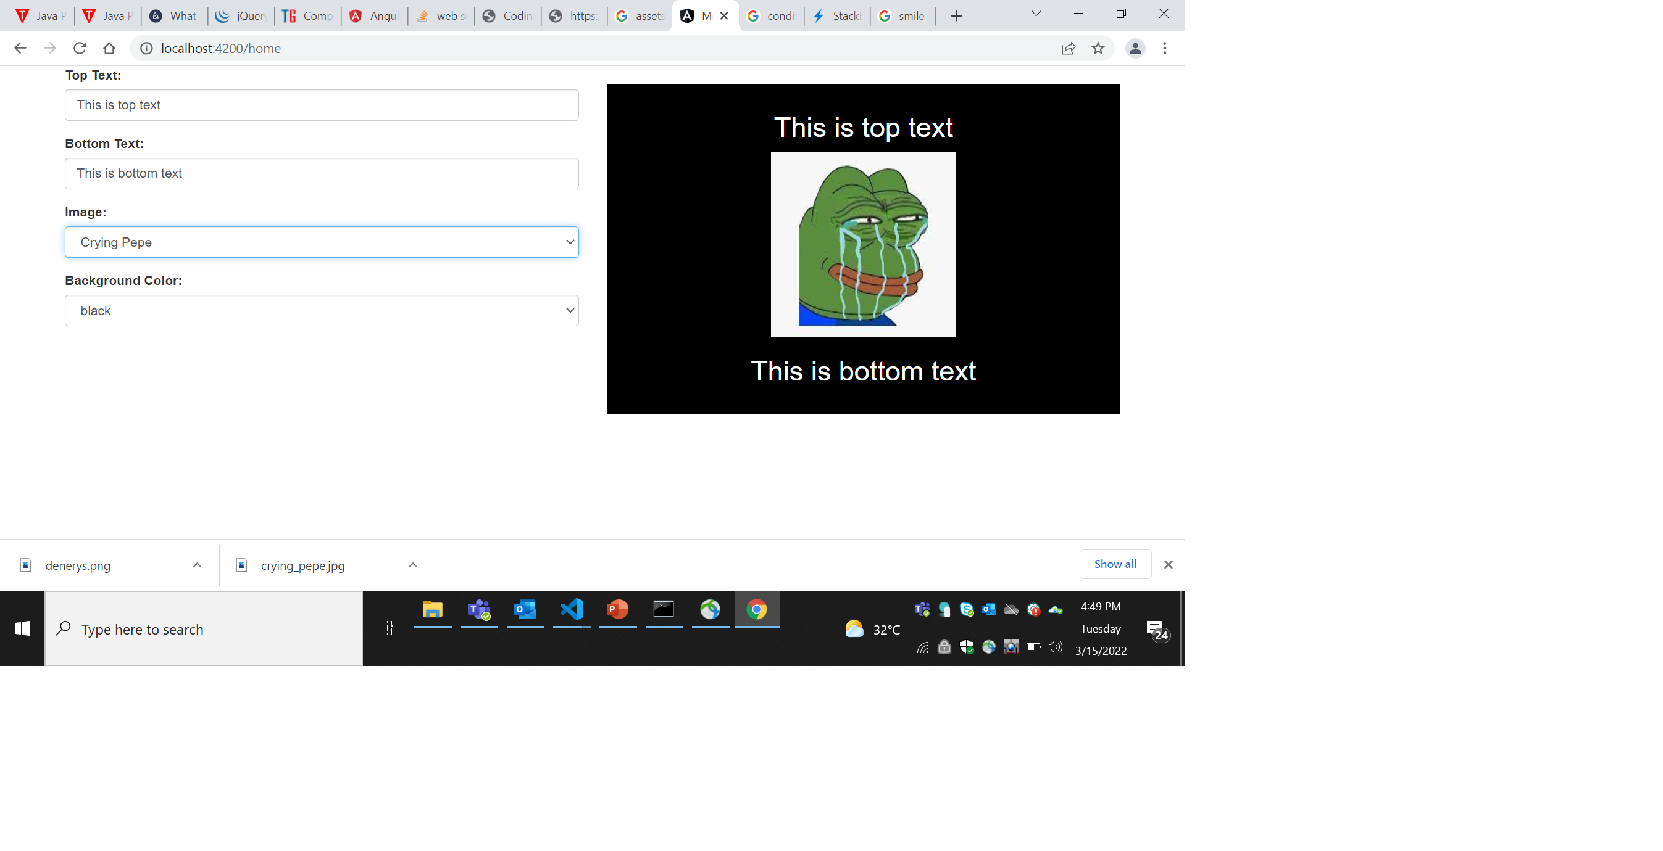
Screenshots/Video Demo of Application:

Slide 6
Any Additional Information:

Slide 7
Thank You

