Slide 1

ONLINE SHOPPING CART SYSTEM
VENKATA PRAVEEN ABBURI – 700689176
vxa91760@ucmo.edu

Slide 2
Tools
XAMPP
ECLIPSE IDE
MySQL Database

Slide 3
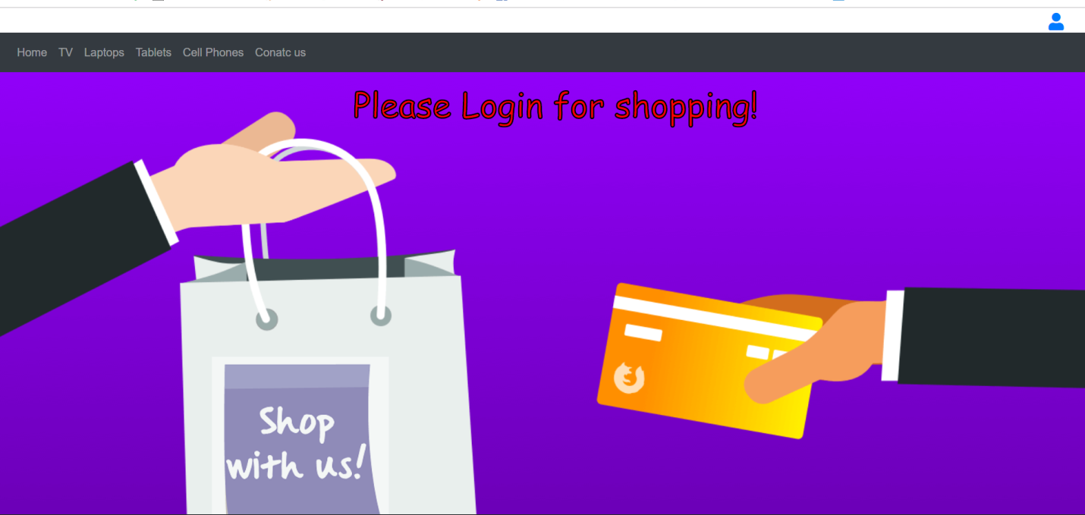
Online Cart System - Home Page

Slide 4
Implementation Process
Bootstrap - Navigation Bar and Dropdowns
For Login - MySQL Database
JavaScript and jquery - Validate user inputs and for redirection.

Slide 5
To buy our products please register
User has to register in order to purchase a product
If not the user has to sign in and be a registered customer
Sessions created once user login

Slide 6
Happy to shop
Implementations of page – PHP
Upon login customer can add available products to cart
Functionality of page – Add/Remove items from cart

Slide 7
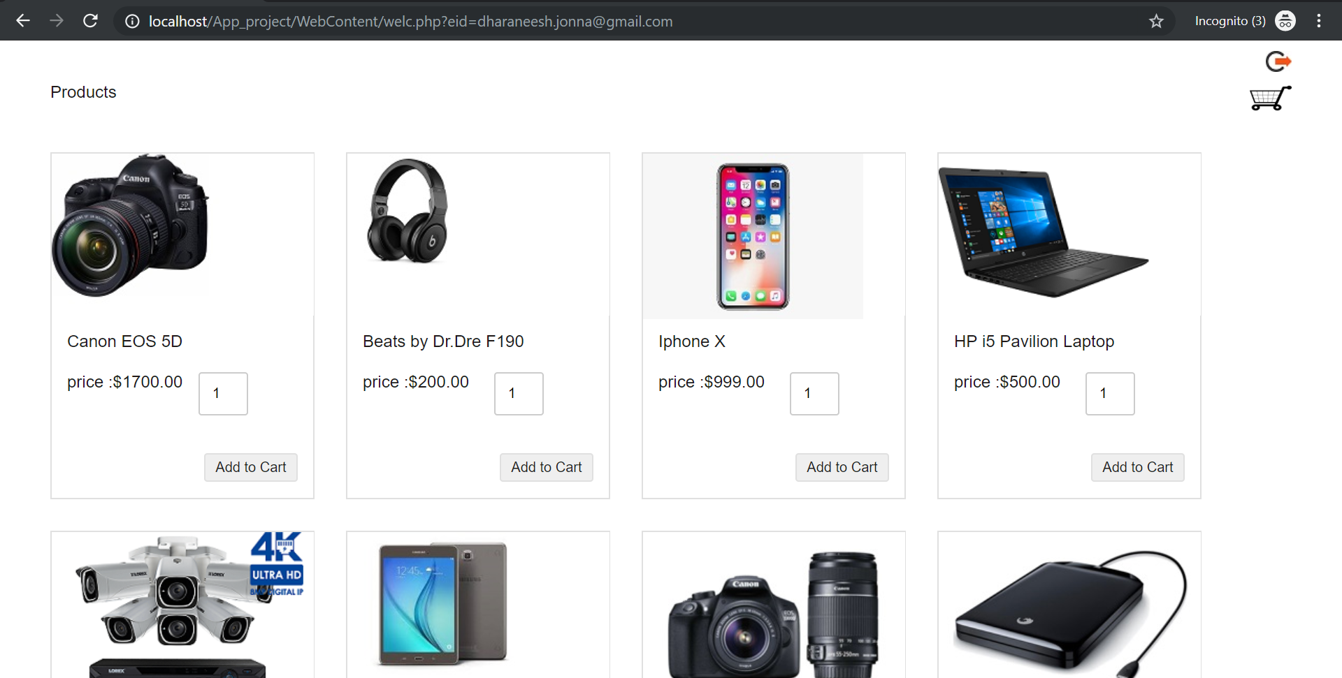
Product Page

Slide 8
Cart Functionalities
User – Delete particular item or all items in cart
Upon adding to cart – User can proceed for payment page

Slide 9
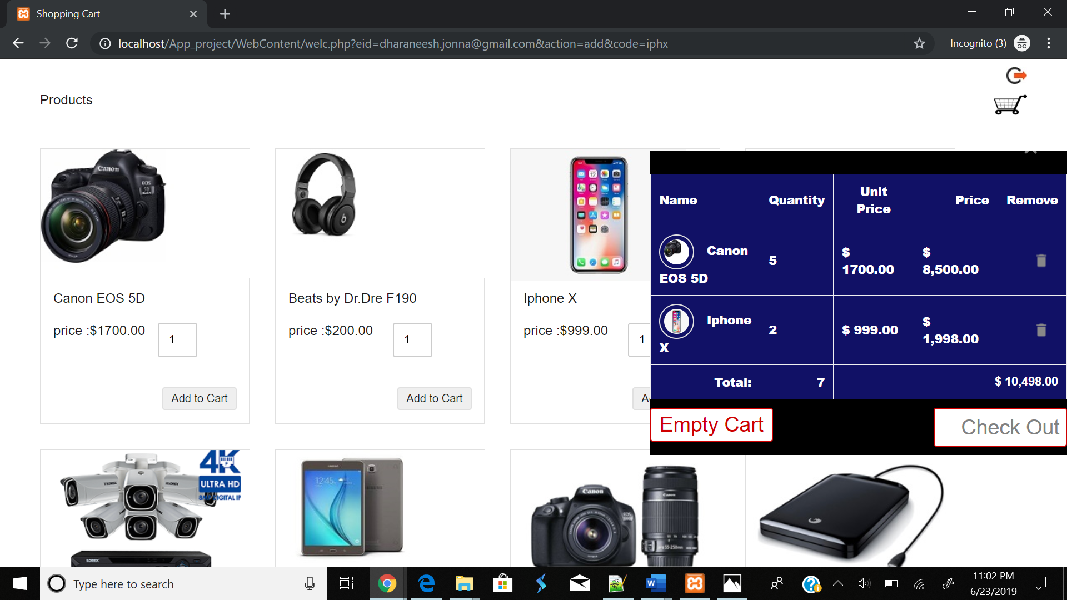
Cart with Products

Slide 10
Review Order Page
Displays selected items
To continue purchase user has to fill the shipping details
User must also fill payment details
Finally hit the pay button
Form Validation Implementation - HTML

Slide 11
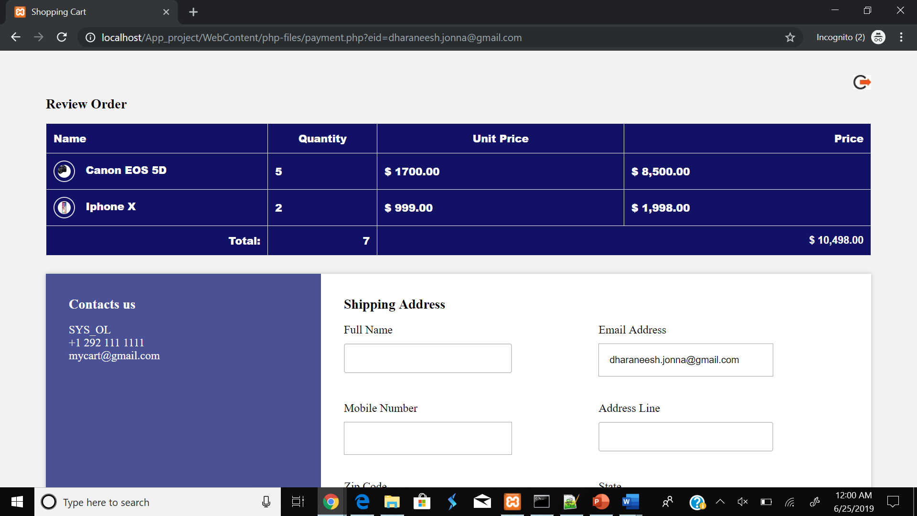
Review Order Page

Slide 12
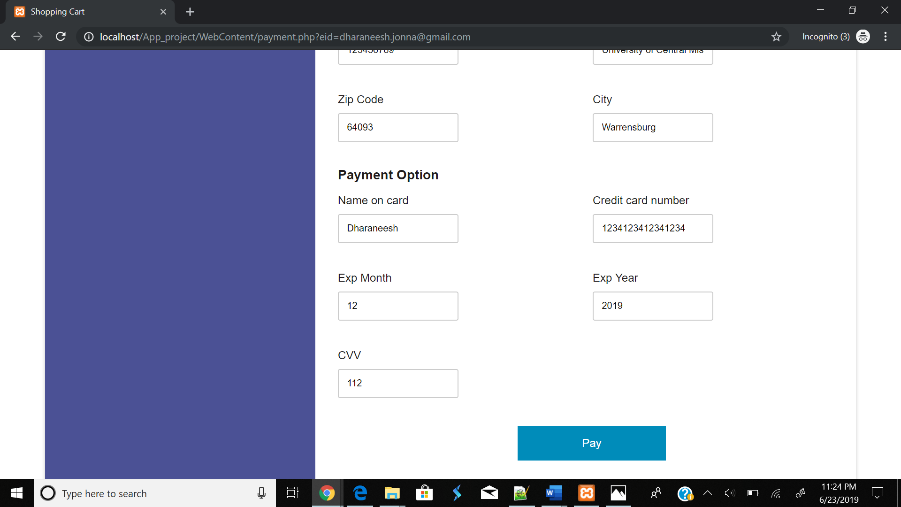
Payment Page

Slide 13
Pay & Email
Once user hit the pay button it will redirect to confirmation page
And user also receive an automated confirmation to registered mail

Slide 14
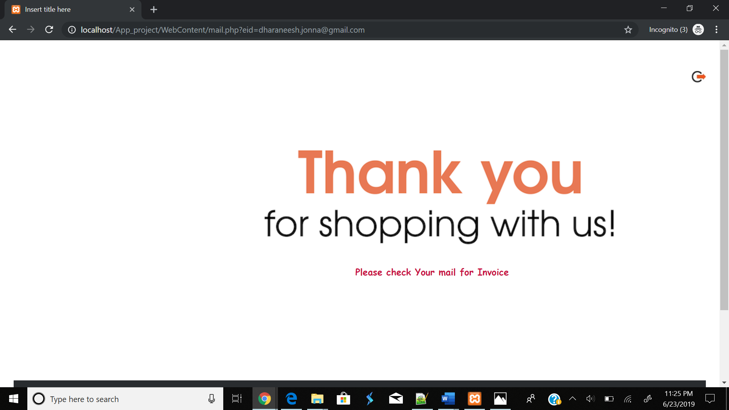
Redirected Page

Slide 15
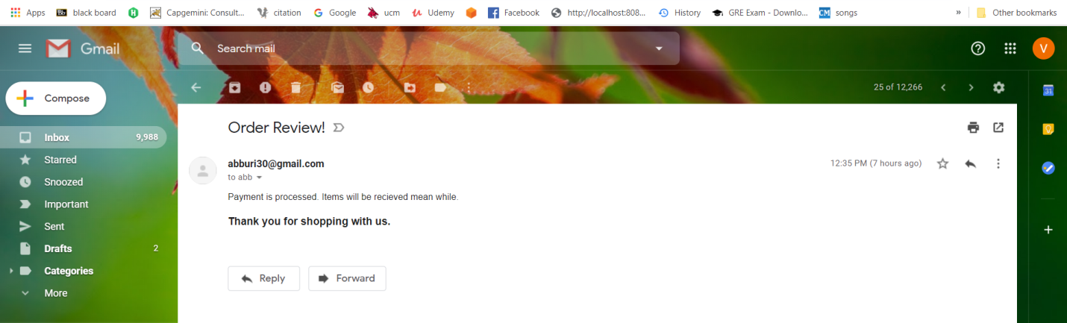
Automated Email Confirmation

Slide 16
Challenges & Learning
Redirection from HTML To PHP
Interface alignment for styles in html
Complexity in footer arrangement.
Gained knowledge on HTML, CSS, PHP & Jquery.
Way to solve the issues in HTML,CSS,PHP.

Slide 17
Thank you for shopping with us
Finally user can sign out

