Slide 1
Secure Data Hiding Using Steganography
CAPSTONE PROJECT
Student Name : Abbushad Shaikh
College Name & Department : B.K. Birla College of Arts, Science and Commerce, Kalyan, Computer Science

Slide 2
OUTLINE
Problem Statement
Technology used
Wow factor
End users
Conclusion
Git-hub Link
Future scope

Slide 3
PROBLEM STATEMENT
In the digital age, secure communication is crucial. Traditional encryption methods often raise suspicion, making them unsuitable for covert communication.
Steganography provides a way to hide encrypted messages within images, ensuring secrecy without attracting attention.
This project aims to develop a secure steganographic system that allows users to embed and retrieve encrypted messages from images using password-based authentication, enhancing confidentiality and security.

Slide 4
TECHNOLOGY USED
OpenCV (cv2) for image processing and Python
NumPy for handling image data
Cryptography (Fernet) for encryption
Tkinter for GUI
Base64, OS, and Subprocess for system operations

Slide 5
WOW FACTORS
Dual-Layer Security: Unlike steghide, which embeds plaintext messages, this project first encrypts the message using Fernet symmetric encryption, ensuring an extra layer of security.
User-Friendly GUI: Existing tools like steghide and OutGuess require command-line operations, while this project offers an intuitive Tkinter-based graphical interface, making it accessible to non-technical users.
Password-Protected Retrieval: Unlike zsteg (which extracts hidden data without authentication), this tool requires a correct password to decrypt and retrieve the hidden message.
Customizable & Expandable: Open-source and modular, this project can be extended with stronger encryption algorithms, different image formats, and AI-driven steganalysis resistance and can be further developed for windows and mac as long as they have python.

Slide 6
END USERS
Cybersecurity Professionals – For secure and covert data transmission.
Journalists & Whistleblowers – To share sensitive information without detection.
Government & Intelligence Agencies – For confidential communication and secure espionage operations.
Corporate Organizations – To protect trade secrets and confidential business data.
Military & Defense Personnel – For secure wartime and classified communication.
Privacy Enthusiasts – Individuals who value personal data security and anonymity.
Activists & Human Rights Defenders – To communicate securely in oppressive regimes.
Researchers & Ethical Hackers – For studying secure data hiding and cryptography techniques.

Slide 7
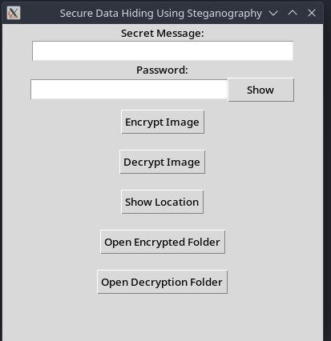
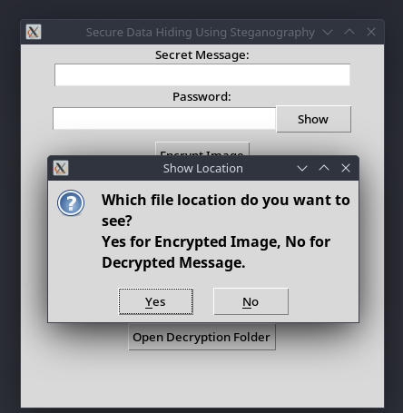
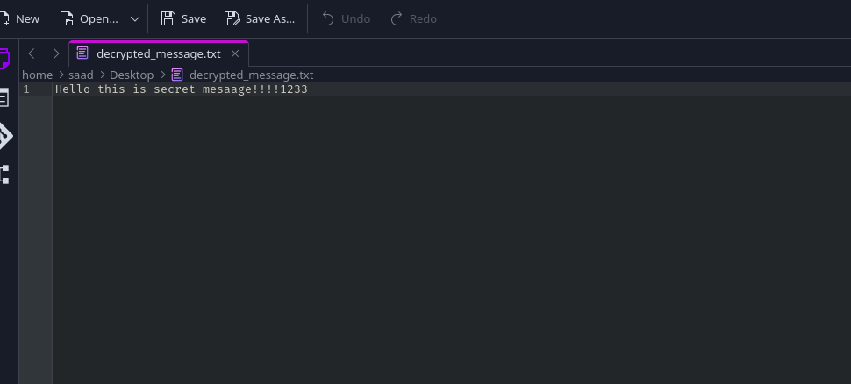
RESULTS
Google Drive Link of this project working in video format with every feature by running it and also note only play in google drive as downloading offline won’t work cuz of video format.
Here is Link: https://drive.google.com/file/d/19c_u6H3qunsNxkWiXmgh7z39o1RclubV/view?usp=drivesdk

Slide 8
CONCLUSION
This project successfully implements secure image-based encryption by integrating steganography and cryptography, ensuring confidential communication. The user-friendly GUI makes it accessible to both technical and non-technical users. With features like the "Show Location" button, users can easily locate encrypted and decrypted files. This tool stands out by offering a seamless, secure, and intuitive approach to data hiding, making it a practical solution for privacy-focused individuals and organizations.

Slide 9
GITHUB LINK
GitHub Link : https://github.com/abbushadshaikh/Secure_Data_Hiding_in_images_using_Steganography
Google Drive Link for video : https://drive.google.com/file/d/19c_u6H3qunsNxkWiXmgh7z39o1RclubV/view?usp=drivesdk

Slide 10
FUTURE SCOPE
Support for additional image formats (JPEG, BMP)
Stronger encryption algorithms (AES-256, RSA)
Mobile and web-based implementations
AI-driven steganalysis resistance improvements

Slide 11
THANK YOU

