Slide 1
CSCI 1070:
Taming Big Data
Dr. Abby Stylianou

Slide 2
Logistics
Are you on the waitlist? Talk to me after class!
Class meetings: Tu/Th, 11AM–12:15PM, Ritter 117
Lecture, discussions, in class coding
Occasional quizzes about readings
Attendance not mandatory, but you’re gonna have a bad time if you don’t show up
Office Hours: Tues, 2:30-3:30PM, Ritter 107

Slide 3
Logistics
Website/schedule/materials: https://cs.slu.edu/~stylianou/1070_sp2020/
Blackboard for turning in assignments and seeing grades
Technologies: Python (w/ data science + scientific libraries), Jupyter Notebooks
Class communications: Piazza! (not email)
Notes:
Demo jupyter notebooks + helloworld

Slide 4
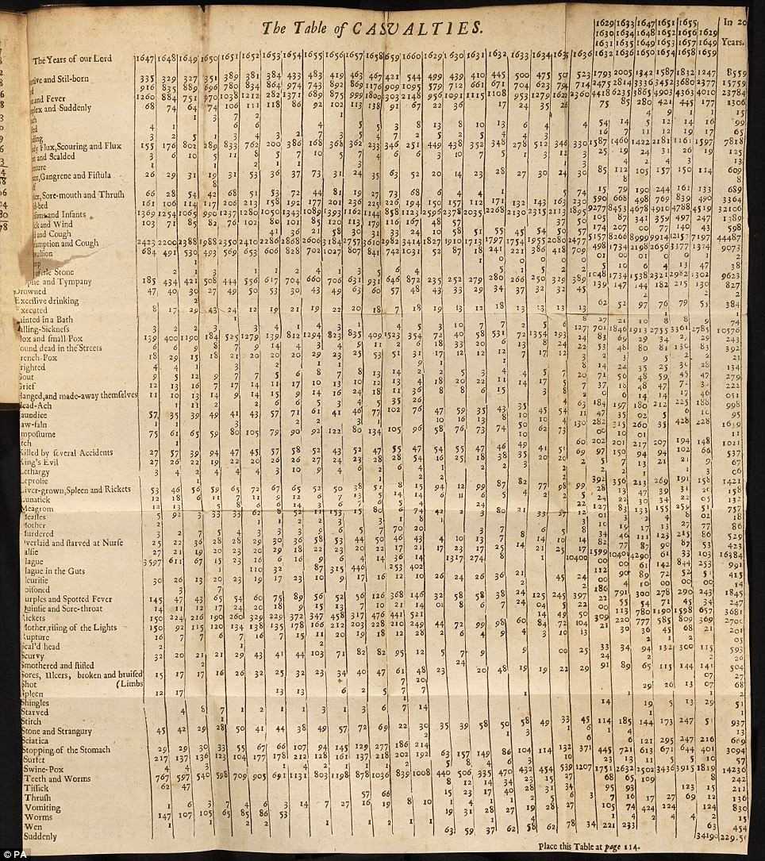
What is big data?
1663: John Graunt is the first person credited w/ statistical data analysis in his studies of the bubonic plague in Europe, dealing with what he referred to as “overwhelming amounts of information”
https://www.dataversity.net/brief-history-big-data/

Slide 5
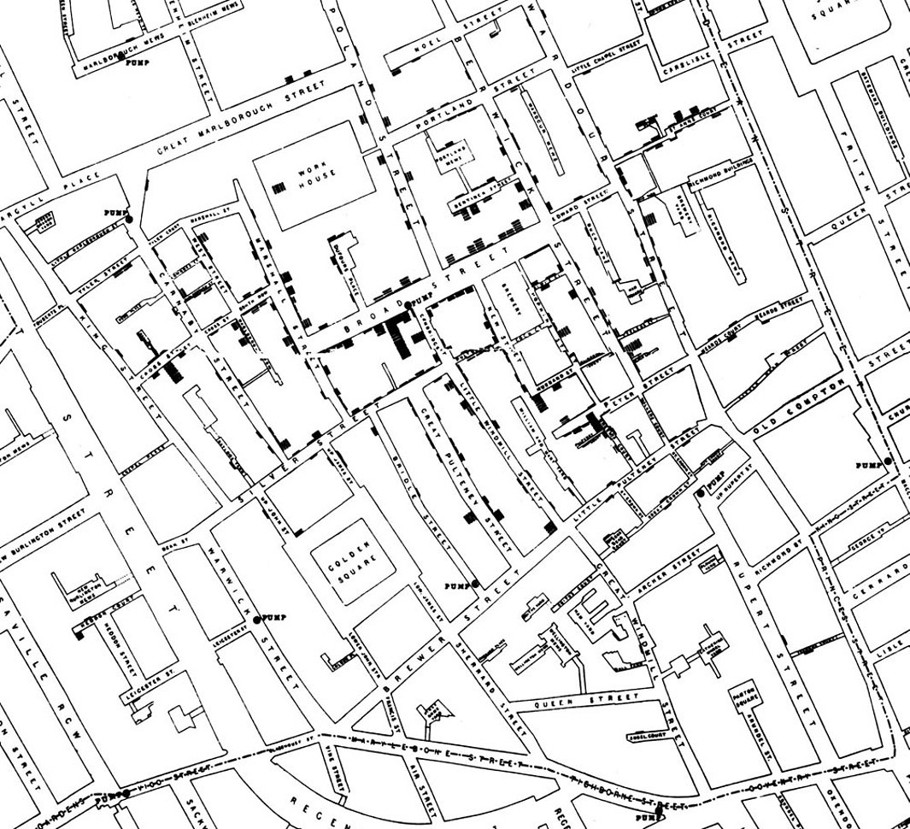
What is big data?
1854: John Snow maps London Cholera outbreaks and finds that they are clustered around a single pump; it was found that a cesspit was leaking into that pump
https://www.inferentialthinking.com/chapters/02/1/observation-and-visualization-john-snow-and-the-broad-street-pump

Slide 6
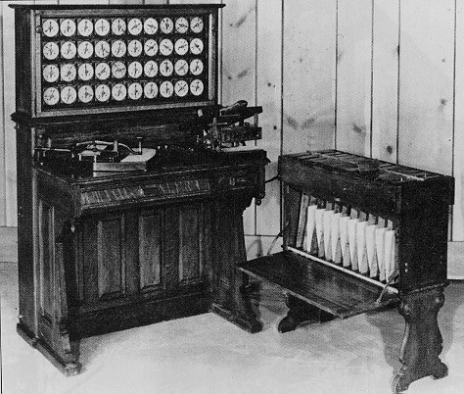
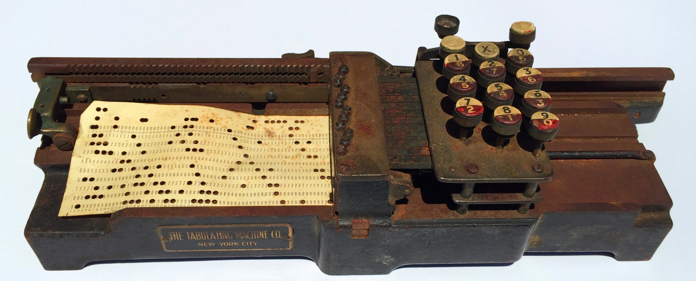
What is big data?
1880: US Census Bureau estimates it will take eight years to process the data collected in the 1880 census, and over 10 years to process 1890 census data
Hollerith Tabulating Machine
(punch card tabulation) reduces to ~3 months
https://www.dataversity.net/brief-history-big-data/

Slide 7
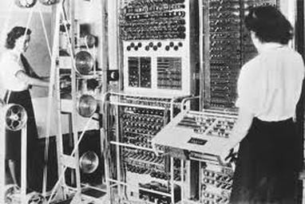
What is big data?
WW2: British invent the Colossus machine to scan for patterns in intercepted Nazi codes. Scans 5,000 characters a second, reducing workload from weeks to hours
https://www.dataversity.net/brief-history-big-data/

Slide 8
What is big data?
1944: Librarian Fremont Rider @ Wesleyan estimates American university libraries doubling in size every 16 years:
“the Yale Library in 2040 will have approximately 200,000,000 volumes, which will occupy over 6,000 miles of shelves…
[requiring] a cataloging staff of over six thousand persons”
https://www.forbes.com/sites/gilpress/2013/05/09/a-very-short-history-of-big-data/#1fed7fb865a1

Slide 9
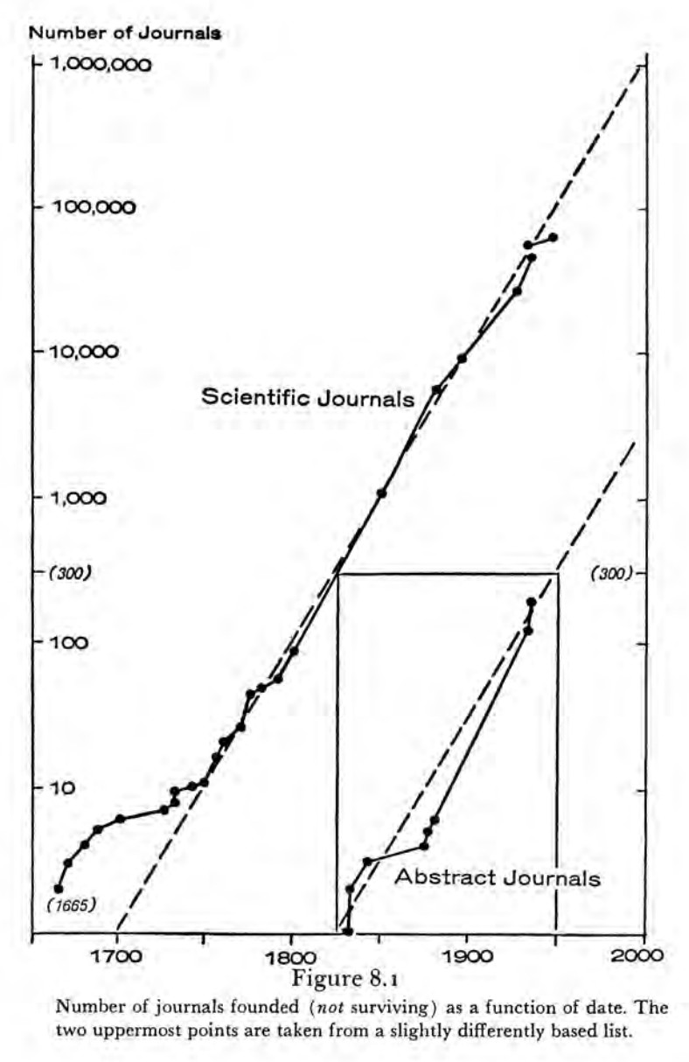
What is big data?
1961: Derek Price shows # of new scientific journals growing exponentially rather than linearly
“each advance generates a new series of advances at a reasonably constant birth rate, so that the number of births is strictly proportional to the size of the population of discoveries at any given time”
https://www.forbes.com/sites/gilpress/2013/05/09/a-very-short-history-of-big-data/#1fed7fb865a1

Slide 10
What is big data?
1969: ARPANET kicks off the Internet
1977: First personal computers come on the market
1989: Tim Berners-Lee introduces the concept of the World Wide Web and the underlying protocols that support it (HTML, URL, HTTP)
1993: CERN announces WWW will be free for everyone to develop and use
1990s– 2000s: The explosion of the internet
2005: Roger Mougalas coins term ‘Big Data’, referring to the scale of data that is nearly impossible to manage and process w/ available tools
https://www.dataversity.net/brief-history-big-data/

Slide 11
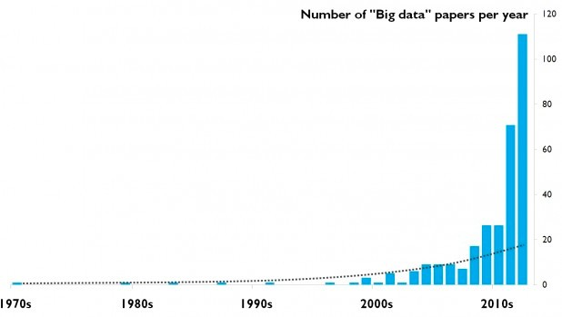
What is big data?
https://www.researchtrends.com/issue-30-september-2012/the-evolution-of-big-data-as-a-research-and-scientific-topic-overview-of-the-literature/

Slide 12
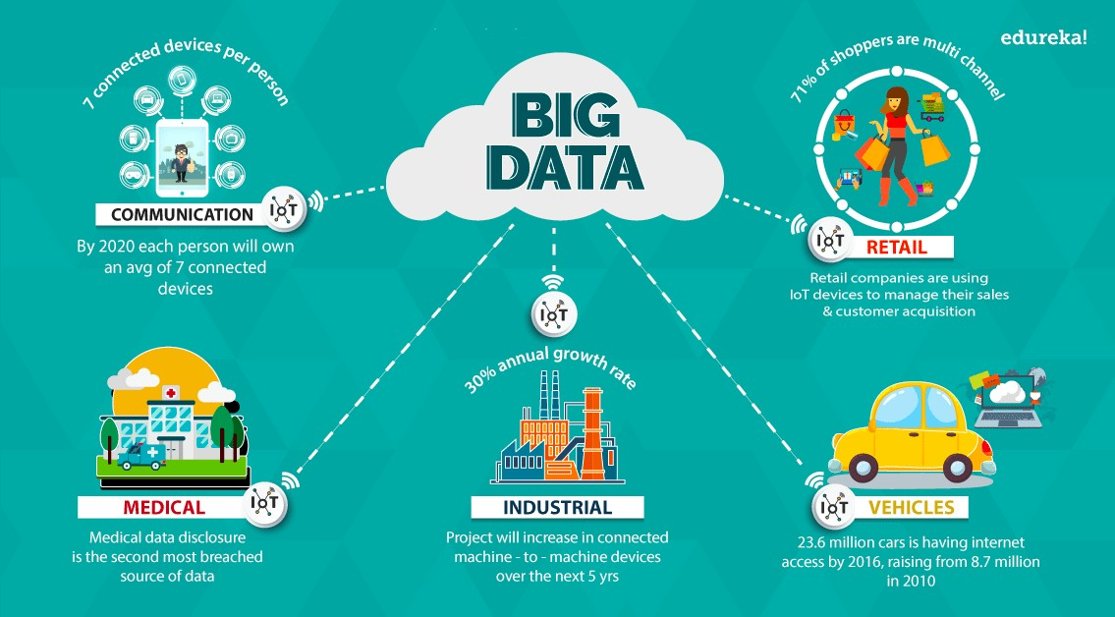
Where is big data?
https://www.edureka.co/blog/big-data-applications-revolutionizing-various-domains/

Slide 13
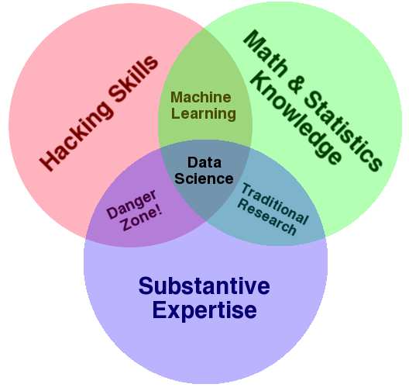
What is data science?
http://drewconway.com/zia/2013/3/26/the-data-science-venn-diagram

Slide 14
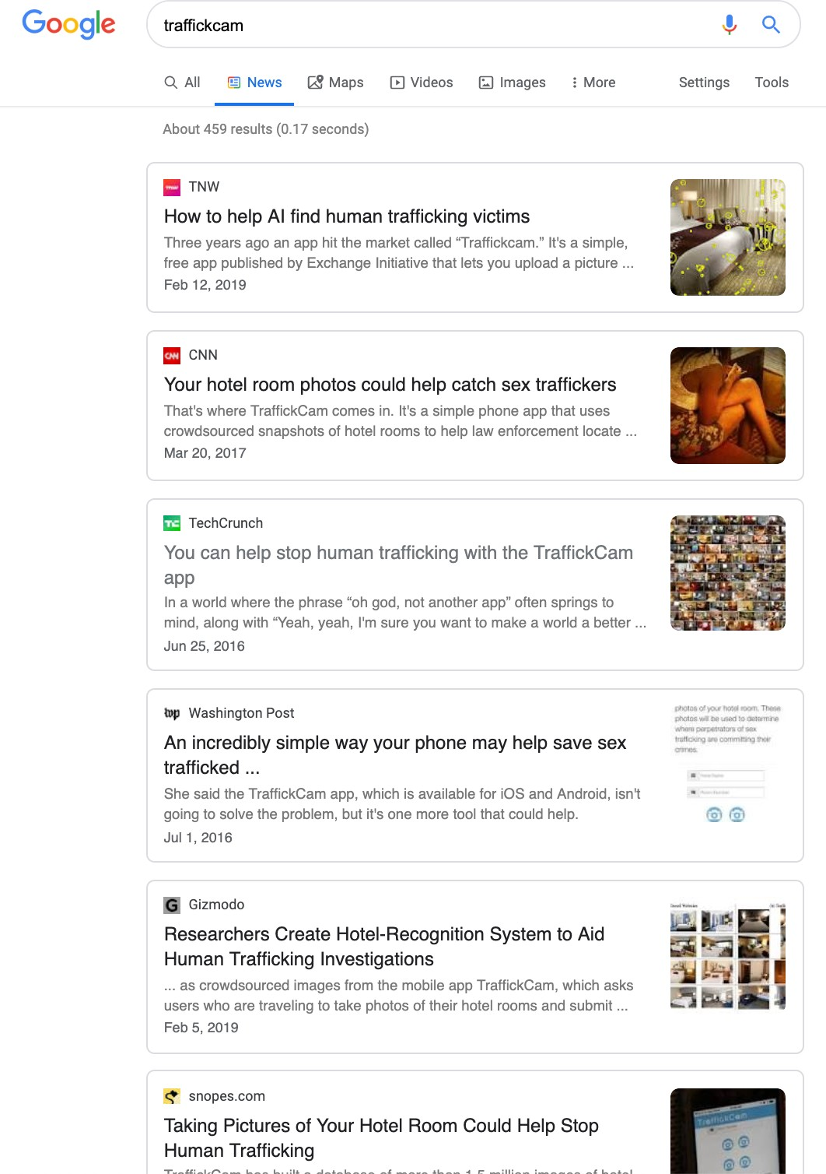
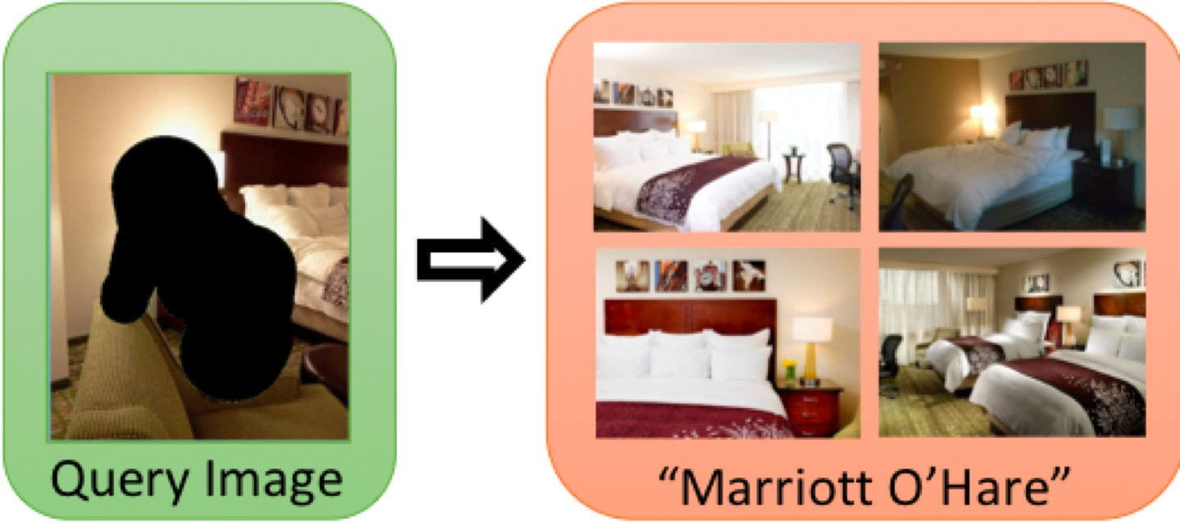
The Big Data that I Work With

Slide 15
What’s the plan for this class?
Learn the data science tools to collect, clean, understand, manipulate big data
Exploration, Prediction and Inference

Slide 16
What’s the plan for this class?
Learn the data science tools to collect, clean, understand, manipulate big data
Exploration, Prediction and Inference
Exploration: Identify patterns in information
Tools: Visualization + Descriptive Statistics

Slide 17
What’s the plan for this class?
Learn the data science tools to collect, clean, understand, manipulate big data
Exploration, Prediction and Inference
Exploration: Identify patterns in information
Tools: Visualization + Descriptive Statistics
Prediction: make informed guesses about what we want to know, based on the
patterns that we identified
Tools: Machine Learning + Optimization

Slide 18
What’s the plan for this class?
Learn the data science tools to collect, clean, understand, manipulate big data
Exploration, Prediction and Inference
Exploration: Identify patterns in information
Tools: Visualization + Descriptive Statistics
Prediction: make informed guesses about what we want to know, based on the
patterns that we identified
Tools: Machine Learning + Optimization
Inference: quantify our certainty about our predictions
Tools: Statisticals Tests + Models

Slide 19
Intro to Python, Data Types, Sequences

Slide 20
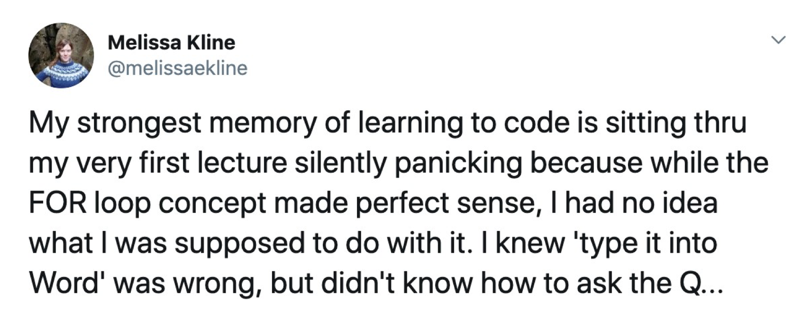

Slide 21
Programming / Coding / Hacking
Instruct a computer to carry out tasks
“Add 2 + 4”
“Round 3.14159265”

Slide 22
Programming / Coding / Hacking
Instruct a computer to carry out tasks
“Add 2 + 4”
“Round 3.14159265”
Combine multiple tasks into programs
“Add 2 + 4, then round 3.14159265, add the outputs together”
“Read in a file with the stock prices for a stock over the last 5 years and compute the average return”

Slide 23
Programming / Coding / Hacking
Instruct a computer to carry out tasks
“Add 2 + 4”
“Round 3.14159265”
Combine multiple tasks into programs
“Add 2 + 4, then round 3.14159265, add the outputs together”
“Read in a file with the stock prices for a stock over the last 5 years and compute the average return”
Write these instructions in a language the computer can understand

Slide 24
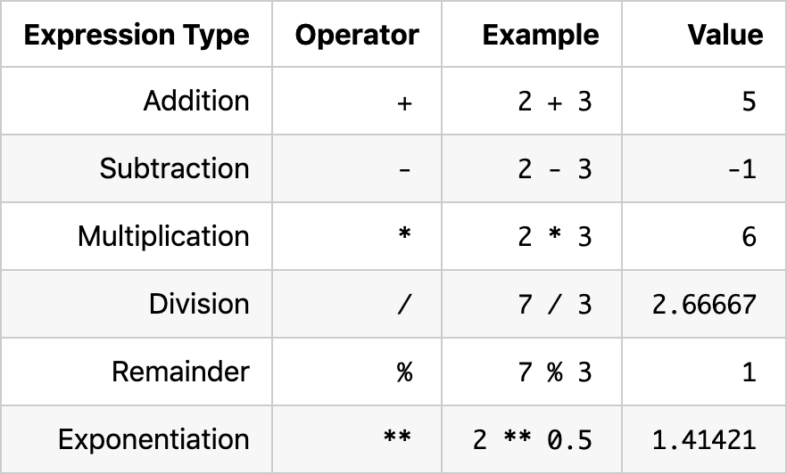
Parts of a Program
Expressions
Inferential Thinking, 3.1

Slide 25
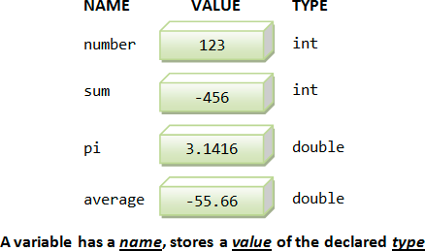
Parts of a Program
Variables
https://www.ntu.edu.sg/home/ehchua/programming/cpp/c0_Introduction.html

Slide 26
Parts of a Program
Operations
a = 1
b = 2
c = a + b

Slide 27
Parts of a Program
Operations
a = 1
b = 2
c = a + b
Functions (named operations)
max(2, 2 + 3, 4)
give_everyone_in_class_an_a(class_list)

Slide 28
Python
Free & widely used (including in CSCI 1300)

Slide 29
Python
Free & widely used (including in CSCI 1300)
Compatible w/ different systems

Slide 30
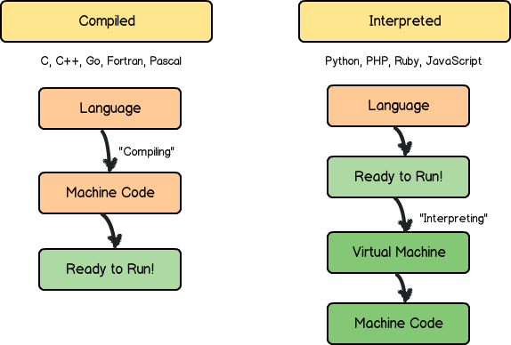
Python
Free & widely used (including in CSCI 1300)
Compatible w/ different systems
Interpreted rather than compiled
https://medium.com/@astermanuelg/blurred-lines-is-ruby-an-interpreted-language-2d3d6bca3d37

Slide 31
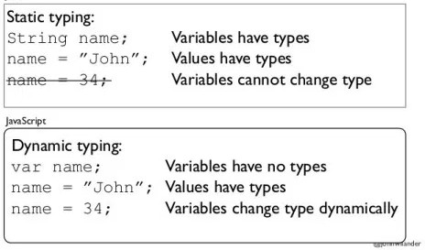
Python
Free & widely used (including in CSCI 1300)
Compatible w/ different systems
Interpreted rather than compiled
Dynamically typed
http://techtales.co/2017/09/05/dynamic-typing-vs-static-typing-mean/

Slide 32
Python
Free & widely used (including in CSCI 1300)
Compatible w/ different systems
Interpreted rather than compiled
Dynamically typed
Built in memory management

Slide 33
Python
Free & widely used (including in CSCI 1300)
Compatible w/ different systems
Interpreted rather than compiled
Dynamically typed
Built in memory management
Lots of built in modules + tons of very useful, well developed external libraries (NumPy, Pandas)

Slide 34
Python
Free & widely used (including in CSCI 1300)
Compatible w/ different systems
Interpreted rather than compiled
Dynamically typed
Built in memory management
Lots of built in modules + tons of very useful, well developed external libraries (NumPy, Pandas)
Readable!

Slide 35




Hello World:
Python
vs.
Java
https://en.wikipedia.org/wiki/%22Hello,_World!%22_program
public class HelloWorld { public static void main (String[] args) {
System.out.println("Hello, world!");
}
}
def hello_world(): print("Hello, world!")
hello_world()

Slide 36










Whitespace in Python
public class HelloWorld { public static void main (String[] args) {
System.out.println("Hello, world!");
}
}
def hello_world(): print("Hello, world!")
hello_world()
def hello_world()
print("Hello, world!")
hello_world()
public class HelloWorld {
public static void main (String[] args) { System.out.println("Hello, world!");
}
}
public class HelloWorld { public static void main (String[] args) {System.out.println("Hello, world!"); }}

Slide 37
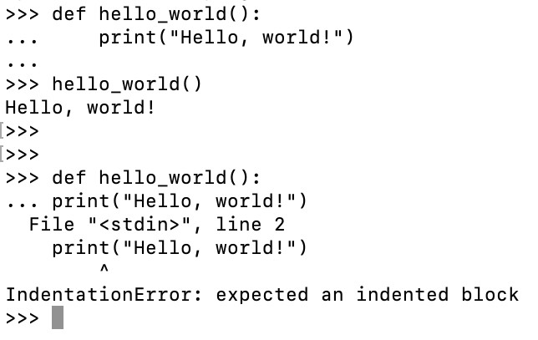

Whitespace in Python
def hello_world(): print("Hello, world!")
hello_world()
def hello_world()
print("Hello, world!")
hello_world()

Slide 38
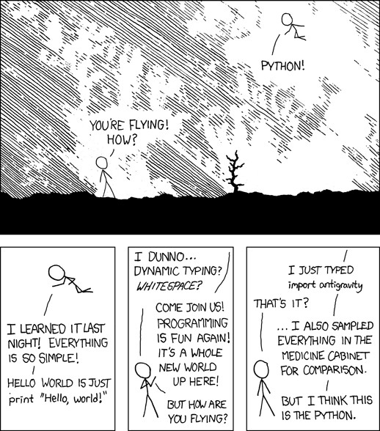
Python
https://xkcd.com/353/

