Slide 1
Prediction
Prof. Abby Stylianou

Slide 2
Logistics

Slide 3
“Data Mining” and Prediction
“Data Mining” attempts to extract patterns from data

Slide 4
“Data Mining” and Prediction
“Data Mining” attempts to extract patterns from data
o Associative patterns
What data attributes occur together ?

Slide 5
“Data Mining” and Prediction
“Data Mining” attempts to extract patterns from data
Associative patterns
What data attributes occur together ?
Classification
What indicates a given category ?

Slide 6
“Data Mining” and Prediction
“Data Mining” attempts to extract patterns from data
Associative patterns
What data attributes occur together ?
Classification
What indicates a given category ?
Sequential/temporal patterns
What sequences of events occur frequently ?

Slide 7
Example Patterns
Associative pattern
When Bob is in the living room he likes to watch TV and eat popcorn with the light turned off.

Slide 8
Example Patterns
Associative pattern
When Bob is in the living room he likes to watch TV and eat popcorn with the light turned off.
Classification
Action movie fans like to watch Terminator, drink beer, and have pizza.

Slide 9
Example Patterns
Associative pattern
When Bob is in the living room he likes to watch TV and eat popcorn with the light turned off.
Classification
Action movie fans like to watch Terminator, drink beer, and have pizza.
Sequential patterns
After coming out of the bedroom in the morning, Bob turns off the bedroom lights, then goes to the kitchen where he makes coffee, and then leaves the house.

Slide 10
Data Mining and Prediction
Prediction attempts to form patterns that help to predict the next event(s) given the available input data.

Slide 11
Data Mining and Prediction
Prediction attempts to form patterns that help to predict the next event(s) given the available input data.
o Deterministic predictions
If Bob leaves the bedroom before 7:00 am on a workday, then he will make coffee in the kitchen.

Slide 12
Data Mining and Prediction
Prediction attempts to form patterns that help to predict the next event(s) given the available input data.
Deterministic predictions
If Bob leaves the bedroom before 7:00 am on a workday, then he will make coffee in the kitchen.
Probabilistic sequence models
If Bob turns on the TV in the evening then he will 80% of the time go to the kitchen to make popcorn.

Slide 13
What to Predict
Behavior of Individuals
Location
Tasks / goals
Actions
Behavior of the Environment
Device behavior (e.g. heating, AC)
Interactions

Slide 14
Example: Location Prediction
Where will Bob go next?
Location_{t+1} = f(x)
Input data x:
oLocation_{t}, Location_{t-1}, … oTime, date, day of the week oSensor data

Slide 15
Example: Location Prediction
Time | Date | Day | Location_{t} | Location_{t+1}
6:30 | 02/25 | Monday | Bedroom | Bathroom
7:00 | 02/25 | Monday | Bathroom | Kitchen
7:30 | 02/25 | Monday | Kitchen | Garage
17:30 | 02/25 | Monday | Garage | Kitchen
18:00 | 02/25 | Monday | Kitchen | Bedroom
18:10 | 02/25 | Monday | Bedroom | Living room
22:00 | 02/25 | Monday | Living room | Bathroom
22:10 | 02/25 | Monday | Bathroom | Bedroom
6:30 | 02/26 | Tuesday | Bedroom | Bathroom

Slide 16
Example: Location Prediction
Learned pattern
o If Day = Monday…Friday & Time > 0600
& Time < 0700
& Location_{t} = Bedroom
Then Location_{t+1} = Bathroom

Slide 17
Prediction Techniques
Classification-Based Approaches
Nearest Neighbor
Neural Networks
Bayesian Classifiers
Decision Trees
Sequential Behavior Modeling
Hidden Markov Models
Temporal Belief Networks

Slide 18
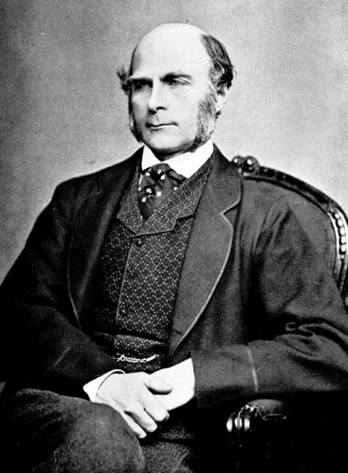
Prediction: Sir Francis Galton
1822 – 1911 (knighted in 1909)
A pioneer in making predictions
Particular interest in heredity (father of eugenics)
Charles Darwin’s half-cousin

Slide 20
Introduction to Linear Regression
Any straight line can be represented by an equation of the form y = mx + b, where m and a are constants.
m: slope, determines the direction and degree to which the line is tilted ( = Δy – Δx )
b: the Y-intercept, determines the point where the line crosses the Y-axis
25

Slide 22
Introduction to Linear Regression
How well a set of data points fits a straight line can be measured by calculating the distance between the data points and the line.
The total error between the data points and the line is obtained by squaring each distance and then summing the squared values.
Simple linear regression: find the equation of the straight line that produces the minimum sum of squared errors.
27

Slide 23
Introduction to Linear Regression
How well a set of data points fits a straight line can be measured by calculating the distance between the data points and the line.
The total error between the data points and the line is obtained by squaring each distance and then summing the squared values.
Simple linear regression: find the equation of the straight line that produces the minimum sum of squared errors.
27

Slide 24
Introduction to Linear Regression
How well a set of data points fits a straight line can be measured by calculating the distance between the data points and the line.
The total error between the data points and the line is obtained by squaring each distance and then summing the squared values.
Simple linear regression: find the equation of the straight line that produces the minimum sum of squared errors.
27

Slide 25
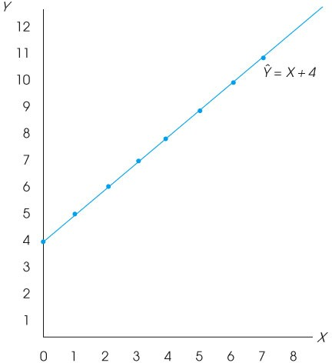

Slide 26
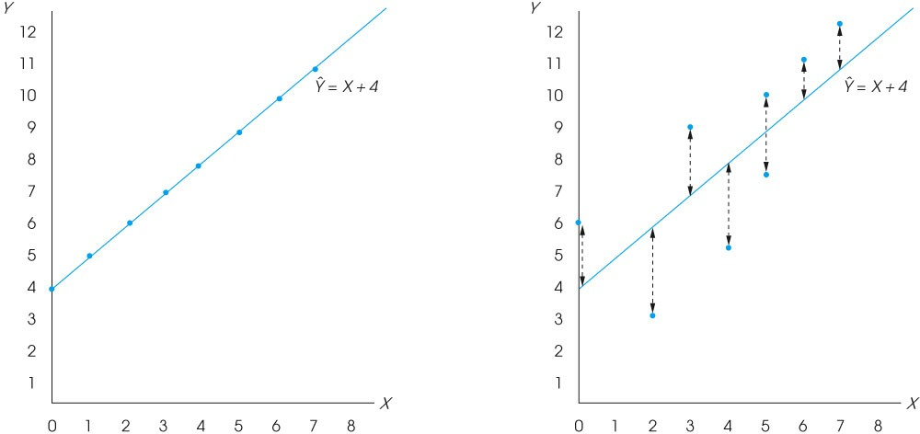

Slide 27
Introduction to Linear Regression
Can use this ‘line’ to make predictions about the values of unseen or new data
30

