Slide 1
CS1070: Taming Big Data
Lab Time

Slide 2
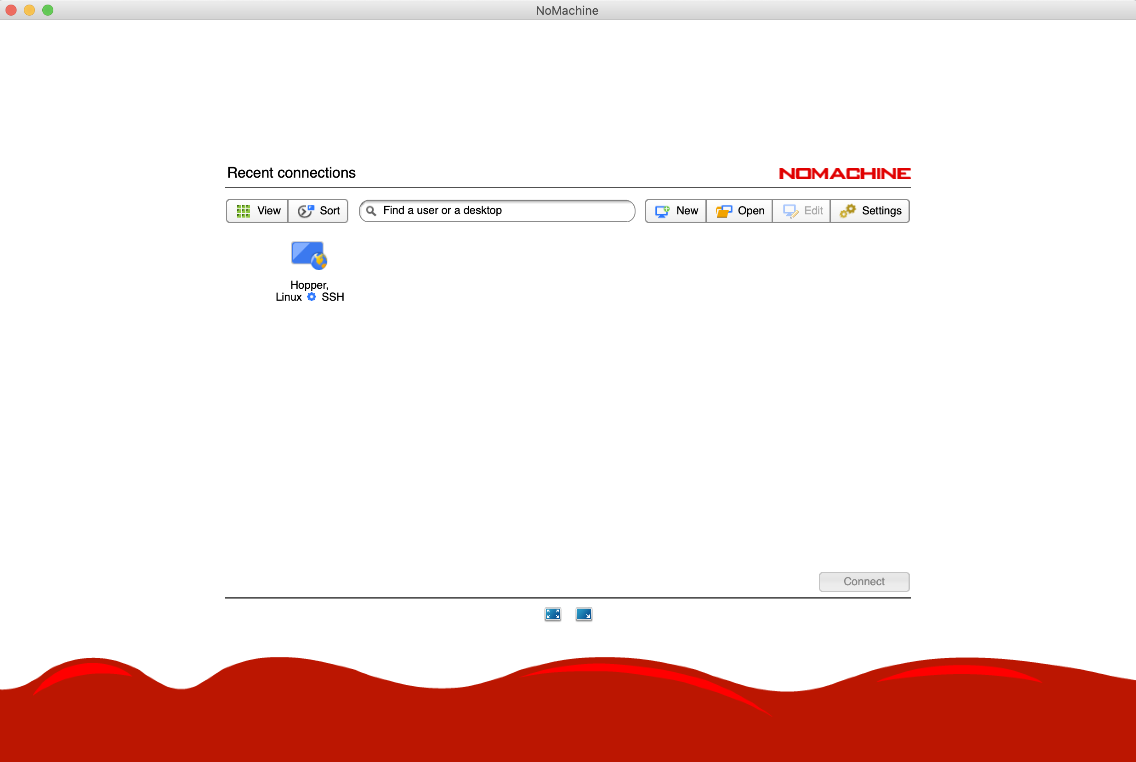
Log on to Hopper

Slide 3
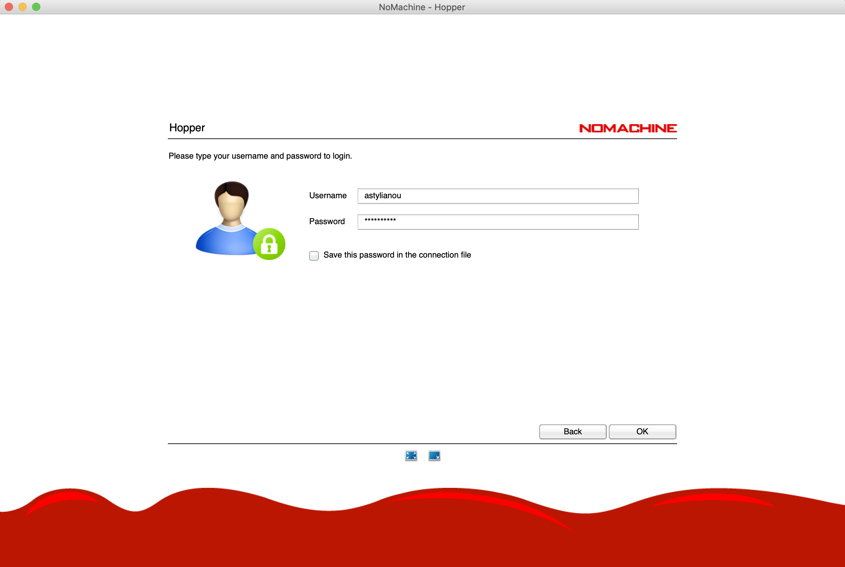
Log on to Hopper

Slide 4
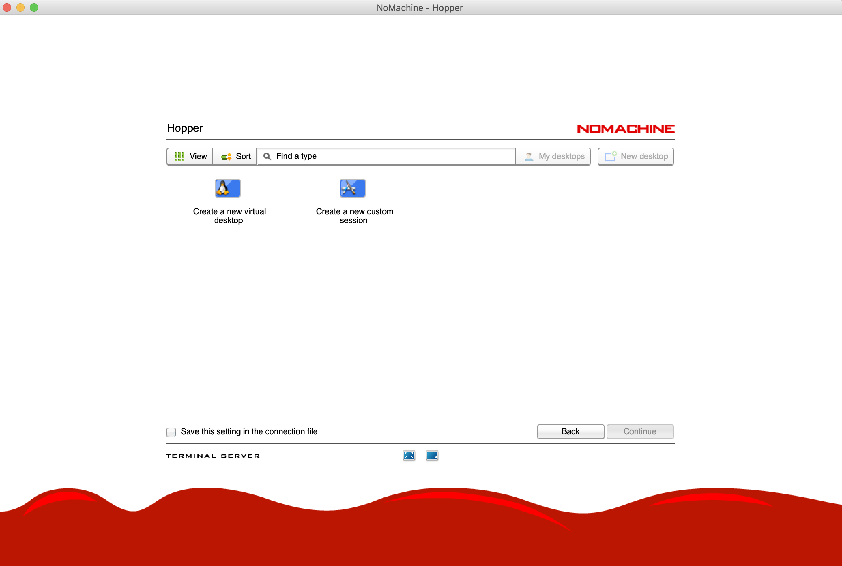
Log on to Hopper

Slide 5
Set Chrome as Default Browser

Slide 6
Run Jupyter Notebooks
To start a new notebook, first navigate to your home directory in Terminal (what was the command?)
Then, run:
jupyter notebook

Slide 7
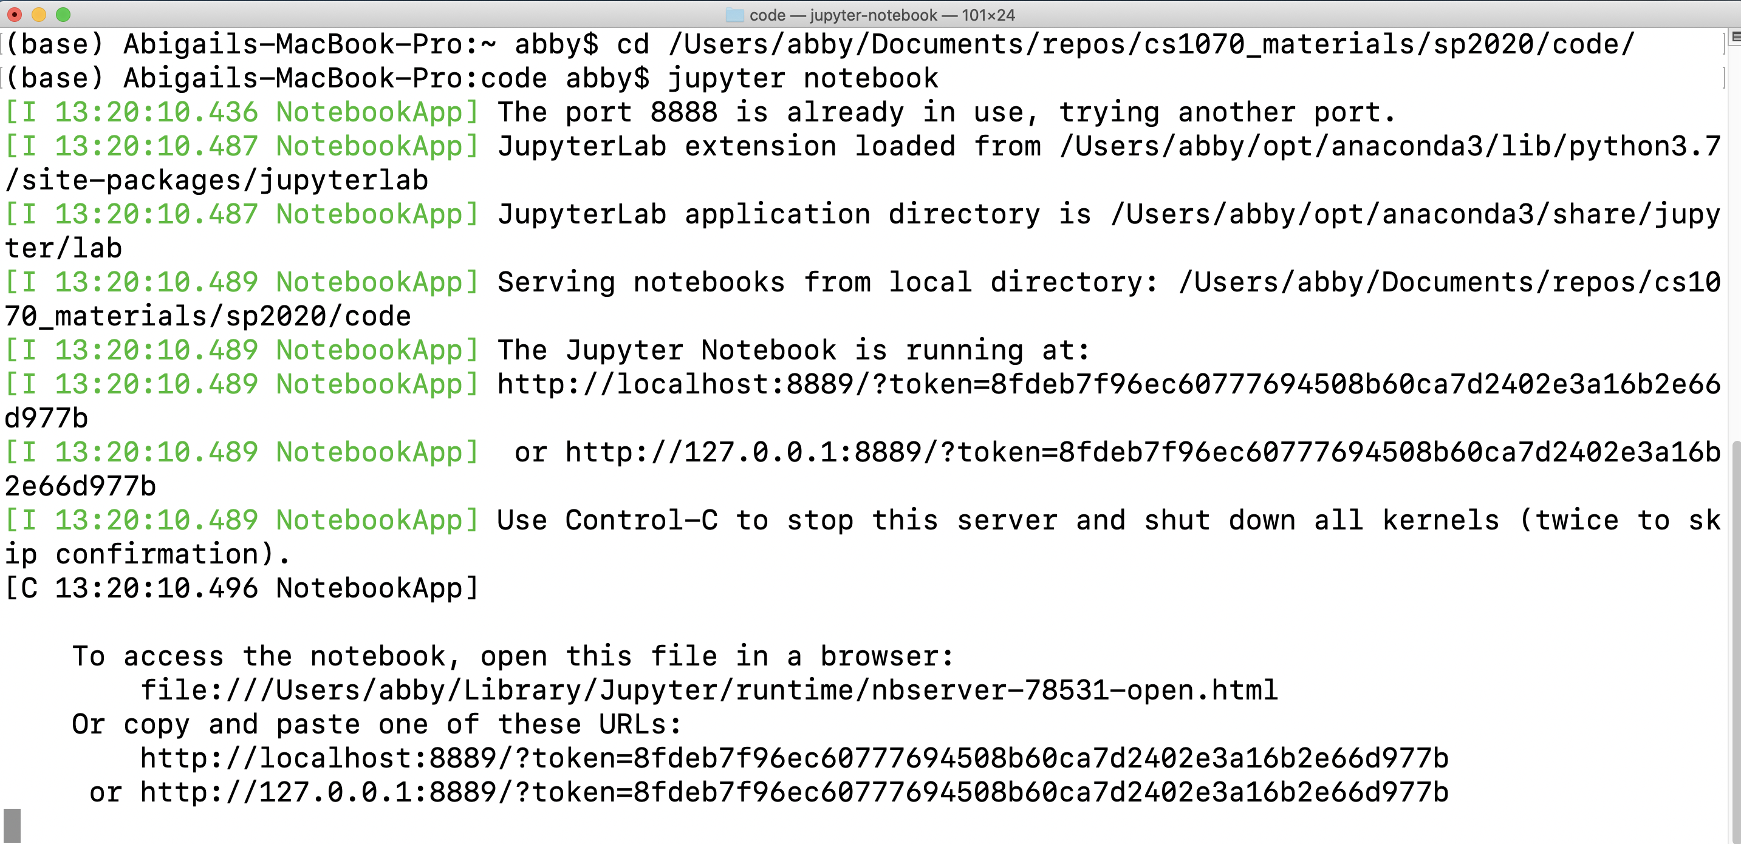

Slide 8
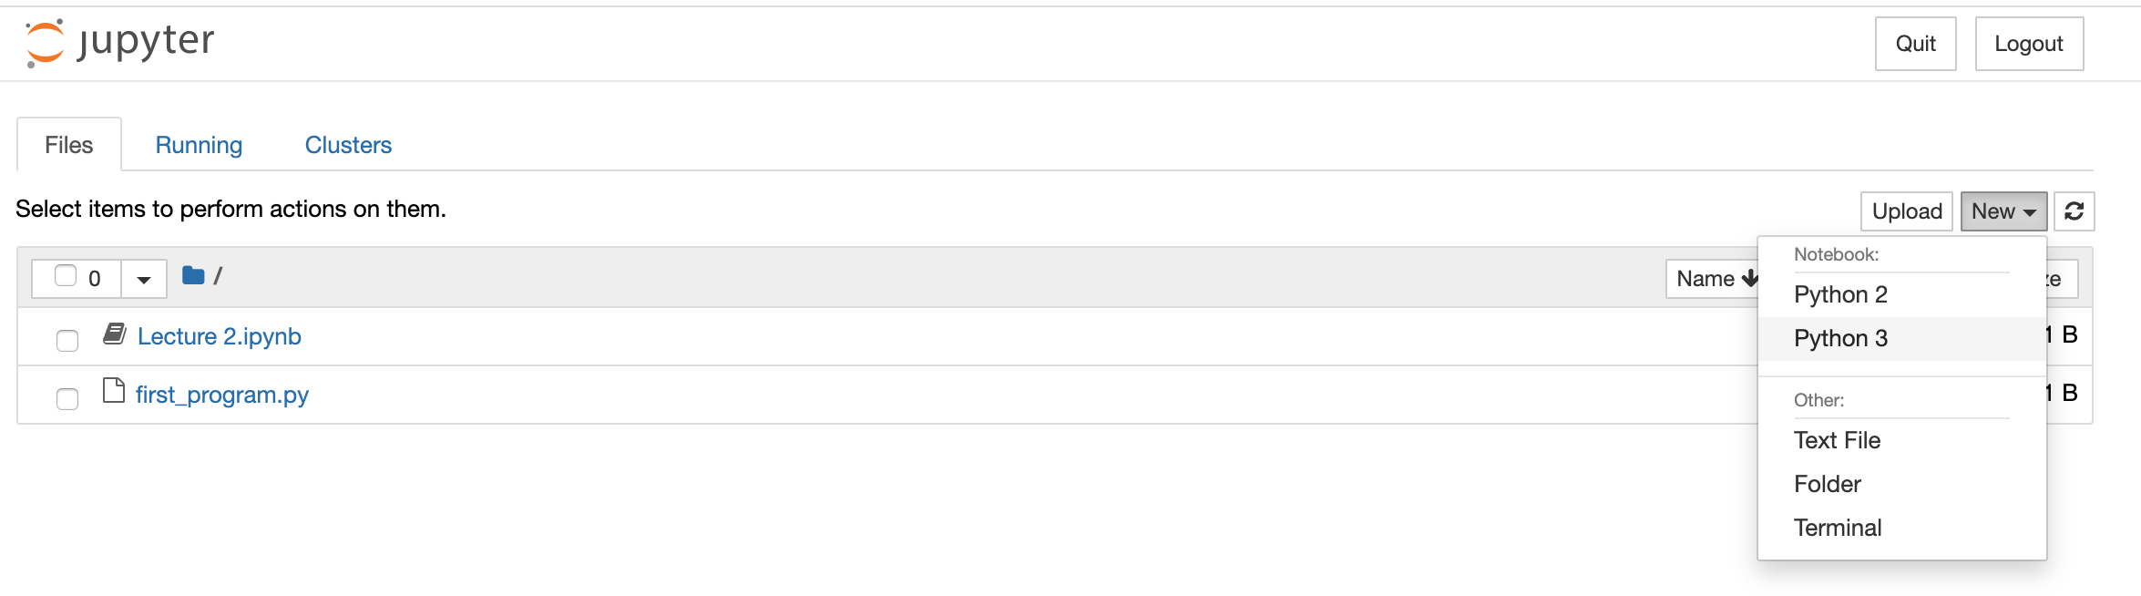

Slide 9
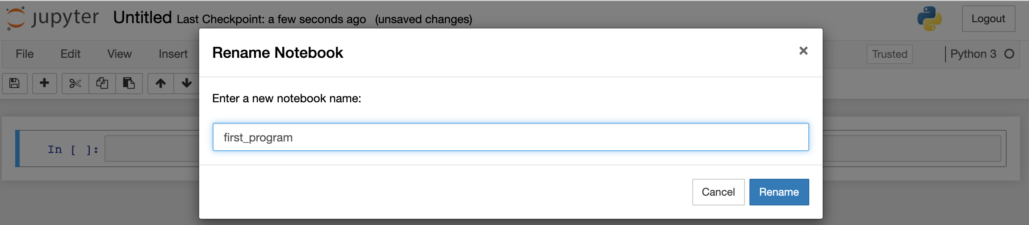

Slide 10
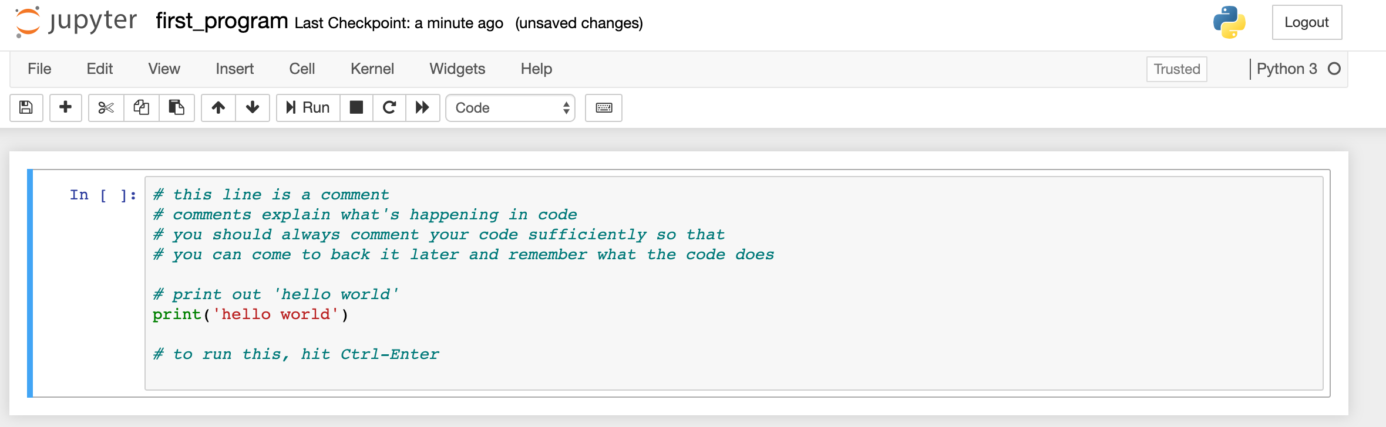

Slide 11
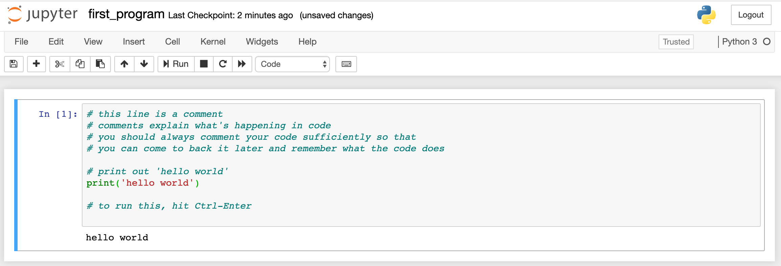

Slide 12
Complete Assignment 0 and Turn In

Slide 17
Control Structures
Direct the order of execution of statements in a program
if / else: “If the weather is nice, I will mow the lawn, otherwise I’ll watch tv”
loops:
for loop: for every element in X, do Y
while loop: while condition is True, do Y

Slide 18
For Loops
L = [‘yellow’, ‘red’, ‘blue’, ‘green’, ‘black’, ‘pink’, ‘orange’, ‘cyan’]
for color in L:
print color

Slide 19
For Loops
L = [‘yellow’, ‘red’, ‘blue’, ‘green’, ‘black’, ‘pink’, ‘orange’, ‘cyan’]
for color in L:
print color
yellow
red
pink
orange
green
cyan
blue black

Slide 20
For Loops
L = [‘yellow’, ‘red’, ‘blue’, ‘green’, ‘black’, ‘pink’, ‘orange’, ‘cyan’]
for idx in range(len(L)):
print color[idx]
yellow
red
pink
orange
green
cyan
blue black

Slide 21
range
Outputs numbers in a range that is inclusive on the lower end and exclusive on the upper end
range(5): [0, 1, 2, 3, 4]
range(1, 5): [1, 2, 3, 4]
range(0,15,5): [0, 5, 10]
Caveat: if you want to store the range as a list variable, you need to put it in a list – list(range(5)). You don’t have to do this if your doing a foor loop like on the previous slide.

Slide 22
range
Outputs numbers in a range that is inclusive on the lower end and exclusive on the upper end
range(5): [0, 1, 2, 3, 4]
range(1, 5): [1, 2, 3, 4]
range(0,15,5): [0, 5, 10]
Caveat: if you want to store the range as a list variable, you need to put it in a list – list(range(5)). You don’t have to do this if your doing a foor loop like on the previous slide.

Slide 23
range
Outputs numbers in a range that is inclusive on the lower end and exclusive on the upper end
range(5): [0, 1, 2, 3, 4]
range(1, 5): [1, 2, 3, 4]
range(0,15,5): [0, 5, 10]
Caveat: if you want to store the range as a list variable, you need to put it in a list – list(range(5)). You don’t have to do this if your doing a foor loop like on the previous slide.

Slide 24
range
Outputs numbers in a range that is inclusive on the lower end and exclusive on the upper end
range(5): [0, 1, 2, 3, 4]
range(1, 5): [1, 2, 3, 4]
range(0,15,5): [0, 5, 10]
Caveat: if you want to store the range as a list variable, you need to put it in a list – list(range(5)). You don’t have to do this if your doing a for loop like on the previous slide.

Slide 25
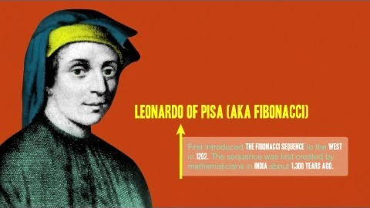
Fibonacci Sequence

Slide 26
Fibonacci Sequence
Group activity:
Form groups of 2-3
Create a new Jupyter notebook called Fibonacci
Use your knowledge of python operations, lists and for loops to write code that creates a list with the first 15 elements of the Fibonacci sequence
At the end, check that your list is actually 15 elements long
Hints:
The first two elements of your list should be [0,1]
The last element should be 377

