Slide 1
Prediction: Correlation and Regression

Slide 2
Prediction
Predicting one characteristic based on another:
Given my height, how tall will I be next year?
Given my height, how tall will my kid be as an adult?
Given my height, how much will I spend on a boat?
There’s something I know, and something I want to determine
Characteristics of an example: known and unknown
Assumption of prediction: for some sample, we know all the characteristics
Notes:
Based on the trends I observed before, let me predict the future
Requires that things be *correlated* -- or an association; if there’s no relationship b/w my height now and my height next year, there’s no way for me to use that predict that
We’ve talked about correlation informally before, but we’re going to talk about it formally now

Slide 3
Relation Between Two Variables
Association
Trend
Positive association
Negative association
Pattern
Any discernible “shape”
Linear
Non-linear
Good protocol: visualize first, then quantify
(Demo)

Slide 4
The Correlation Coefficient, r
Measures linear association
Based on standard units
-1 <= r <= 1
r = 1: scatter plot is perfect straight line sloping up
r = -1: scatter plot is perfect straight line sloping down
r = 0: no linear association; uncorrelated
(Demo)

Slide 5
The Correlation Coefficient, r
Convert both variables to standard units
Subtract off the mean, divide by the standard deviation
Multiply them together
Average the products
That’s r

Slide 6
The Correlation Coefficient, r
r is a pure number, with no units
r is not affected by changing units of measurement
r is not affected by switching the the horizontal and vertical axes

Slide 7
X | Y
1.00 | 2.00
2.00 | 3.00
3.00 | 1.00
4.00 | 5.00
5.00 | 2.00
6.00 | 7.00
Computing Correlation
Step 1: ?

Slide 8
X | Y
1.00 | 2.00
2.00 | 3.00
3.00 | 1.00
4.00 | 5.00
5.00 | 2.00
6.00 | 7.00
Computing Correlation
Step 1: Visualize!

Slide 9
X | Y
1.00 | 2.00
2.00 | 3.00
3.00 | 1.00
4.00 | 5.00
5.00 | 2.00
6.00 | 7.00
Computing Correlation
Step 1: Visualize!

Slide 10
X | Y
1.00 | 2.00
2.00 | 3.00
3.00 | 1.00
4.00 | 5.00
5.00 | 2.00
6.00 | 7.00
Computing Correlation
Step 1: Visualize!
Step 2: ?

Slide 11
X | Y
1.00 | 2.00
2.00 | 3.00
3.00 | 1.00
4.00 | 5.00
5.00 | 2.00
6.00 | 7.00
Computing Correlation
Step 1: Visualize!
Step 2: Convert to standard units
Subtract off the mean and divide by the standard deviation

Slide 12
X | Y
1.00 | 2.00
2.00 | 3.00
3.00 | 1.00
4.00 | 5.00
5.00 | 2.00
6.00 | 7.00
Computing Correlation
Step 1: Visualize!
Step 2: Convert to standard units
Subtract off the mean and divide by the standard deviation
X(su) | Y(su)
-1.34 | -0.59
-0.80 | -0.15
-0.27 | -1.04
0.27 | 0.74
0.80 | -0.59
1.34 | 1.63
Mean | 3.50 | 3.33
St.D. | 1.87 | 2.25

Slide 13
X | Y
1.00 | 2.00
2.00 | 3.00
3.00 | 1.00
4.00 | 5.00
5.00 | 2.00
6.00 | 7.00
Computing Correlation
Step 1: Visualize!
Step 2: Convert to standard units
Subtract off the mean and divide by the standard deviation
Step 3: ?
X(su) | Y(su)
-1.34 | -0.59
-0.80 | -0.15
-0.27 | -1.04
0.27 | 0.74
0.80 | -0.59
1.34 | 1.63
Mean | 3.50 | 3.33
St.D. | 1.87 | 2.25

Slide 14
X | Y
1.00 | 2.00
2.00 | 3.00
3.00 | 1.00
4.00 | 5.00
5.00 | 2.00
6.00 | 7.00
Computing Correlation
Step 1: Visualize!
Step 2: Convert to standard units
Subtract off the mean and divide by the standard deviation
Step 3: Multiply X(su) * Y(su)
Step 4: ?
X(su) | Y(su)
-1.34 | -0.59
-0.80 | -0.15
-0.27 | -1.04
0.27 | 0.74
0.80 | -0.59
1.34 | 1.63
X(su) | Y(su) | Product
-1.34 | -0.59 | 0.79
-0.80 | -0.15 | 0.12
-0.27 | -1.04 | 0.28
0.27 | 0.74 | 0.20
0.80 | -0.59 | -0.47
1.34 | 1.63 | 2.18
Mean | 3.50 | 3.33
St.D. | 1.87 | 2.25

Slide 15
X | Y
1.00 | 2.00
2.00 | 3.00
3.00 | 1.00
4.00 | 5.00
5.00 | 2.00
6.00 | 7.00
Computing Correlation
Step 1: Visualize!
Step 2: Convert to standard units
Subtract off the mean and divide by the standard deviation
Step 3: Multiply X(su) * Y(su)
Step 4: Average the products
X(su) | Y(su)
-1.34 | -0.59
-0.80 | -0.15
-0.27 | -1.04
0.27 | 0.74
0.80 | -0.59
1.34 | 1.63
X(su) | Y(su) | Product
-1.34 | -0.59 | 0.79
-0.80 | -0.15 | 0.12
-0.27 | -1.04 | 0.28
0.27 | 0.74 | 0.20
0.80 | -0.59 | -0.47
1.34 | 1.63 | 2.18
Mean | 3.50 | 3.33
St.D. | 1.87 | 2.25
r = (0.79 + 0.12 + 0.28 + 0.20 + -0.47 + 2.18) / 6
r = 0.51

Slide 17
This is the regression line!

Slide 18
Its slope = r

Slide 19
Regression Line Equation
Equation of a line: y = mx + b
y: the y-value for a given x-value
x: a given x-value
m: slope of the line (r!)
b: y-intercept
In standard units, b = 0
So the equation is just:
y = mx

Slide 20
Regression Line Equation
Equation of a line: y = mx + b
y: the y-value for a given x-value
x: a given x-value
m: slope of the line (r!)
b: y-intercept
In standard units, b = 0
So the equation is just:
y = mx

Slide 21
Regression Line Equation
Equation of a line: y = mx + b
y: the y-value for a given x-value
x: a given x-value
m: slope of the line (r!)
b: y-intercept
In standard units, b = 0
So the equation is just:
y = rx

Slide 22
Regression Line Equation
y = rx
slope < 0 slope = 0 slope > 0

Slide 23
Regression Line Equation
y = rx
slope < 0 slope = 0 slope > 0
The slope of the regression line describes how much we expect y to change, on average, for every unit change in x.

Slide 25
Regression Line Equation
y = rx
We can use this to predict
new y-values
But they’d be in standard units

Slide 26
Regression Line Equation
y = rx
We can use this to predict
new y-values
But they’d be in standard units

Slide 27
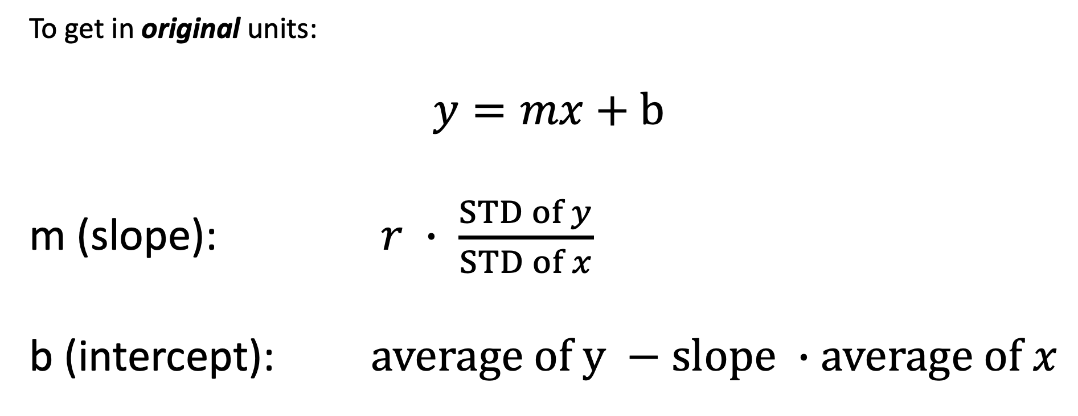
Regression Line Equation
To get in original units:
$$y=mx+b$$
m (slope): $r ∙ \frac{STD of y}{STD of x}$
b (intercept): $average of y −slope ∙average of x$

Slide 28
Regression Line Equation
To get in original units:
$$y=mx+b$$
m (slope): $r ∙ \frac{STD of y}{STD of x}$
b (intercept): $average of y −slope ∙average of x$
So now you can make your twizzler length estimates in centimeters!

