Slide 1
CS1070: Taming Big Data
Comparisons, Conditionals, Control Structures

Slide 2
Logistics
Try using lab machines during class hours
Homework 1 out today, due in 1 week

Slide 3
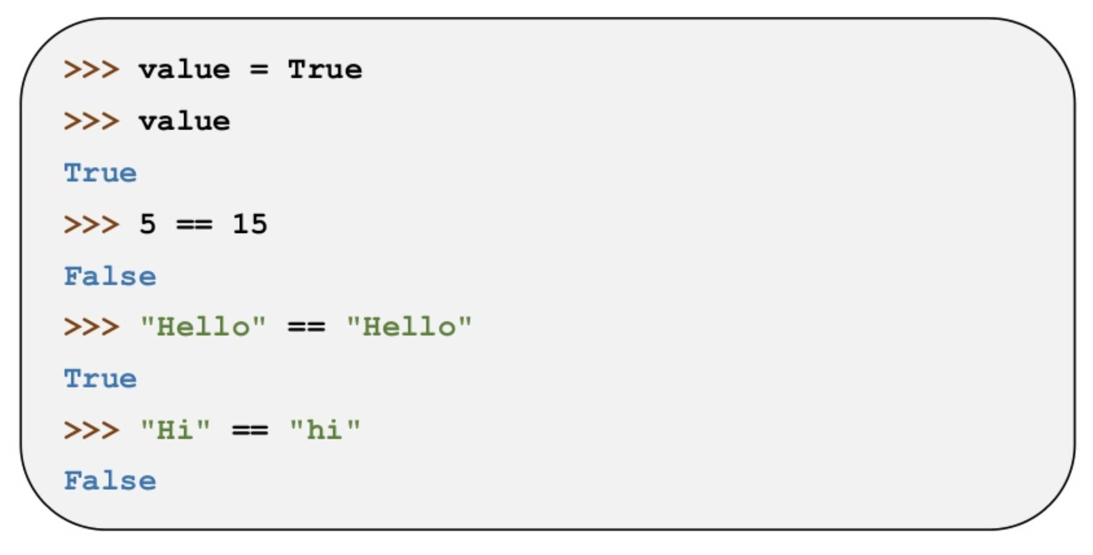
Booleans & Comparisons
Two Boolean values: True and False
Can create directly or through comparisons:

Slide 4
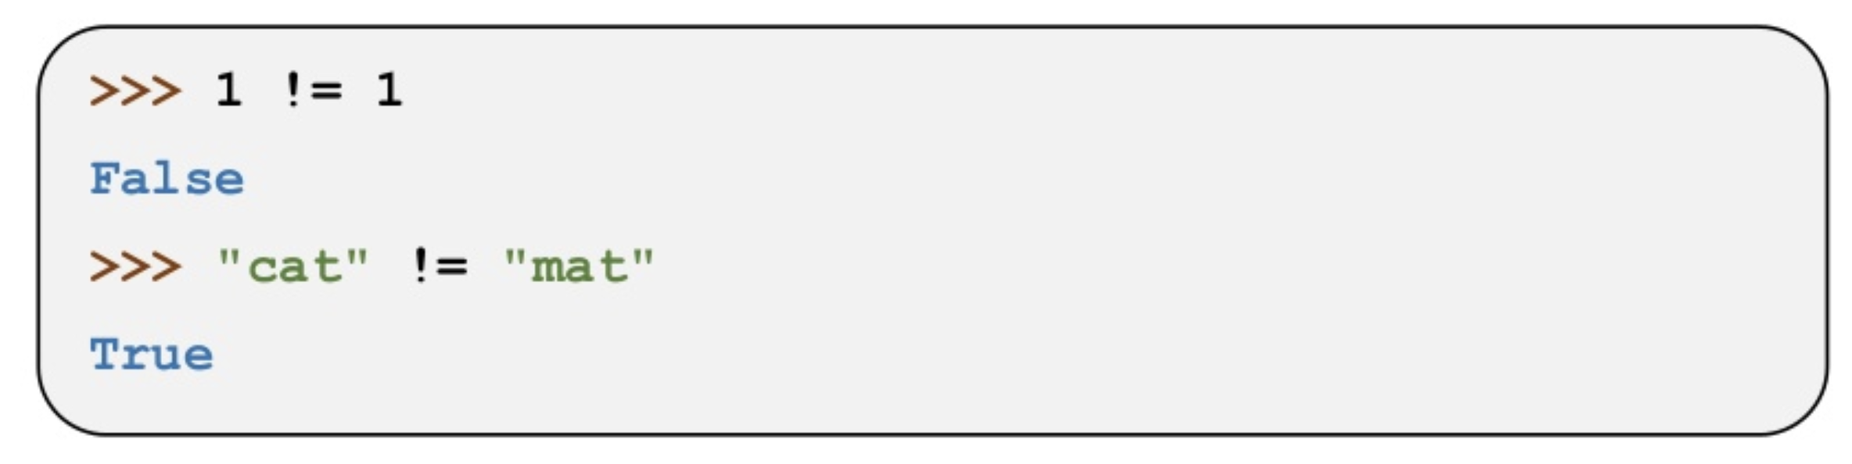
Booleans & Comparisons
'is equal’ comparison: ==
Evaluates to true if items being compared (left and right sides) are equal, and False if they’re not
‘is not equal’: !=
Evaluates to true if items being compared (left and right) are NOT equal, and False if they are

Slide 5
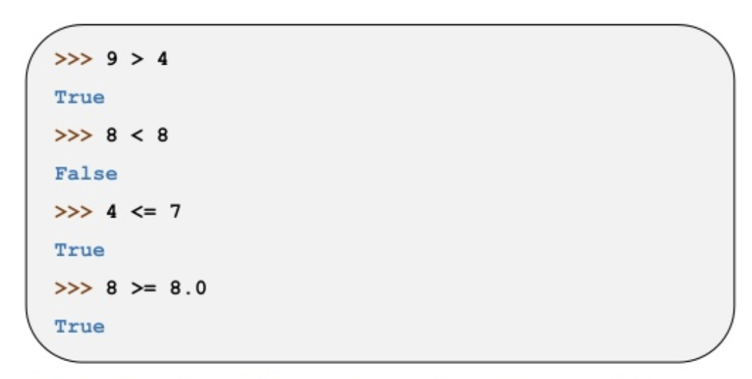
Booleans & Comparisons
Comparisons work for numbers, strings, bools, etc
Additional comparisons: < , >, <=, >=

Slide 6
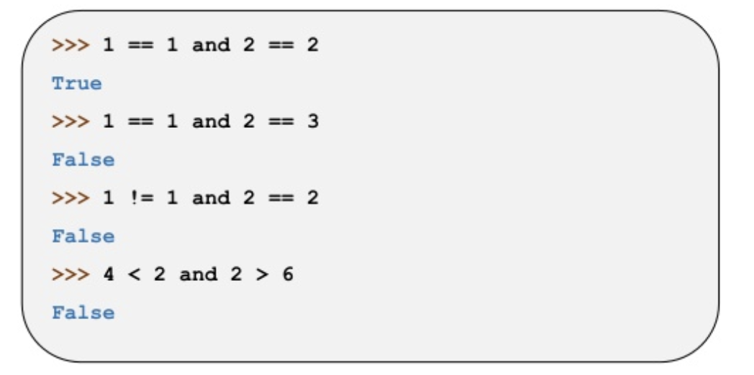
Boolean Logic
Boolean operators: and, or and not
and: takes two arguments, and returns True if and only if both arguments are True; otherwise returns False

Slide 7
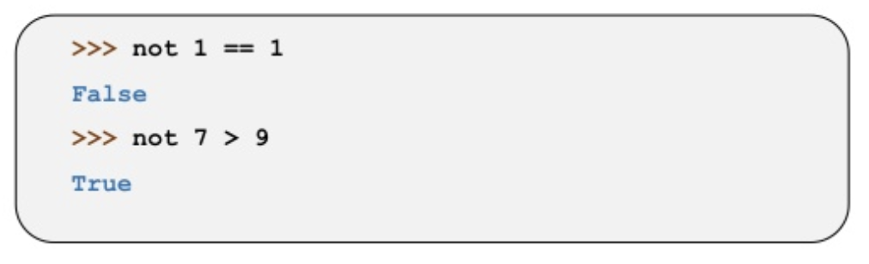
Boolean Logic
or: takes in two arguments and returns True if either (or both) arguments are True; otherwise returns False (if both arguments are False)
not: if an argument is True, returns False; if it’s False, returns True

Slide 8
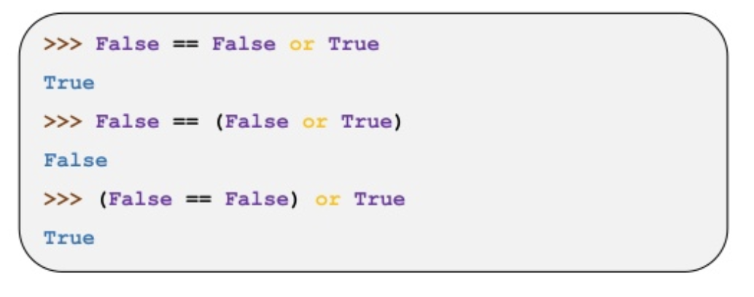
Operator Precedence
Extension of mathematical order of operations
== / != have higher precedence than Boolean logic operators (and/or)

Slide 9
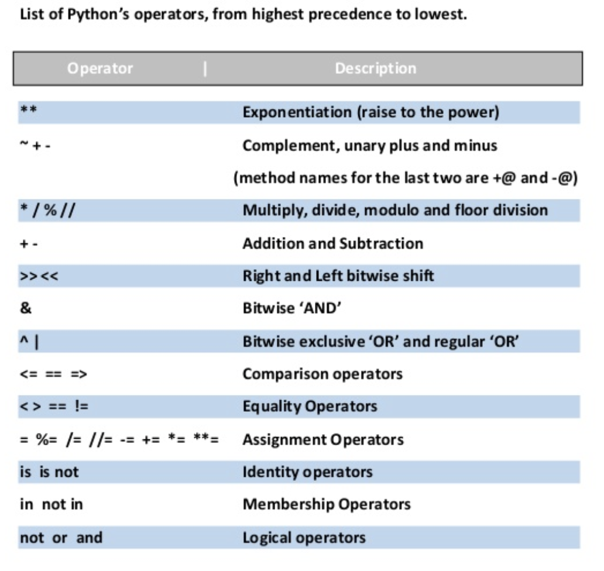
Operator Precedence

Slide 10
Control Structures
Direct the order of execution of statements in a program
conditionals (if / else): “If the weather is nice, I will mow the lawn, otherwise I’ll watch tv”
iterators / loops:
for loop: for every element in X, do Y
while loop: while condition is True, do Y

Slide 11
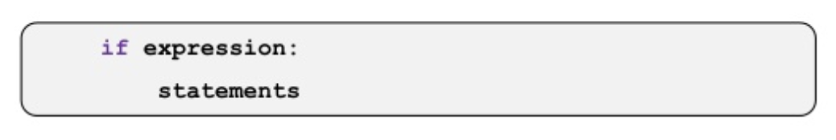
If Statements
Use if statements to run code if a condition is True
Python uses indentation (white space at start of the line) to note blocks of code
Note the colon at the end of the if statement

Slide 12
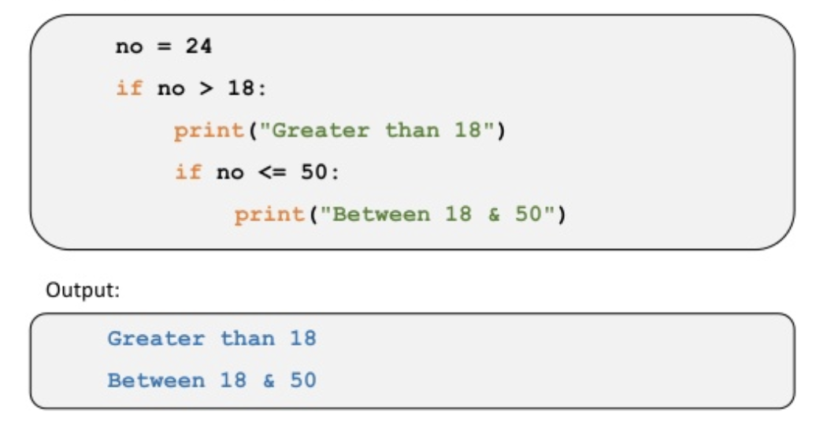
If Statements
If statements can be nested to perform more complicated checks

Slide 13
If Statements
If statements can be nested to perform more complicated checks

Slide 14
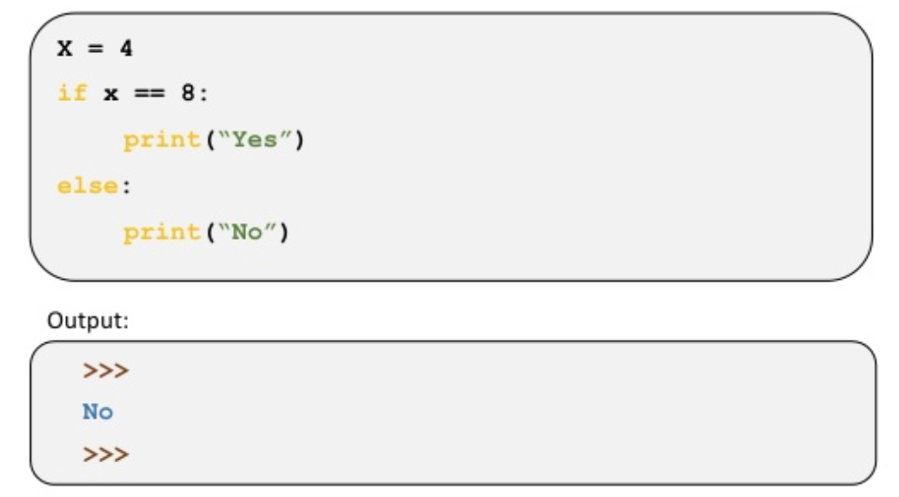

Else Statements
An else statement follows an if statement
The code in the else statement block gets executed if the if statements evaluates to False:

Slide 15
Else Statements
An else statement follows an if statement
The code in the else statement block gets executed if the if statements evaluates to False:

Slide 16
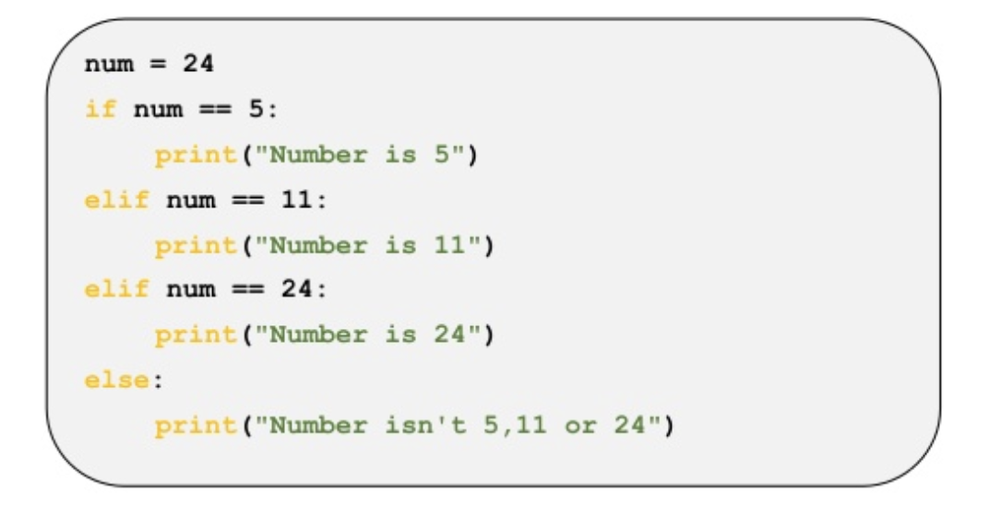
Elif Statements
elif : stands for ‘else if’
Used to create a chain of conditional checks

Slide 17
while Loops
An if statement is run once if it evaluates to true and is never run if it evaluates to false
A while statement is similar, except it keeps running as long as the condition is true.
Once it is evaluated to be False, the program moves on to the next block of code

Slide 18
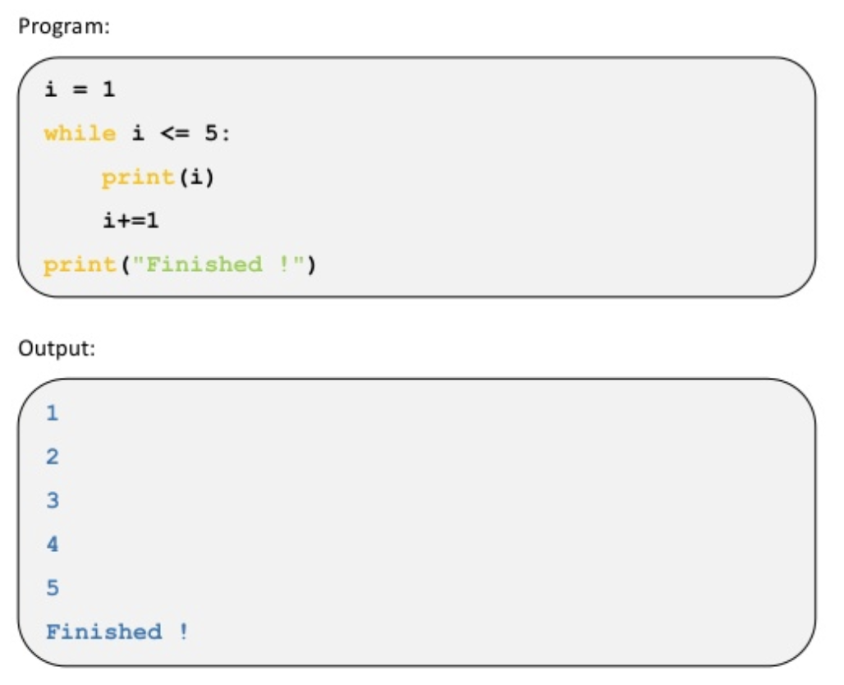
while Loops

Slide 19
while Loops

Slide 20
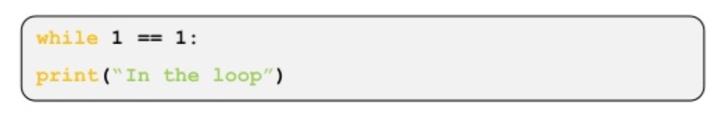


Infinite Loop
Can stop the execution by pressing Control-C (or closing the window/program)

