Slide 1

Data Analyst Job Salary Prediction
Abby Liu

Slide 2
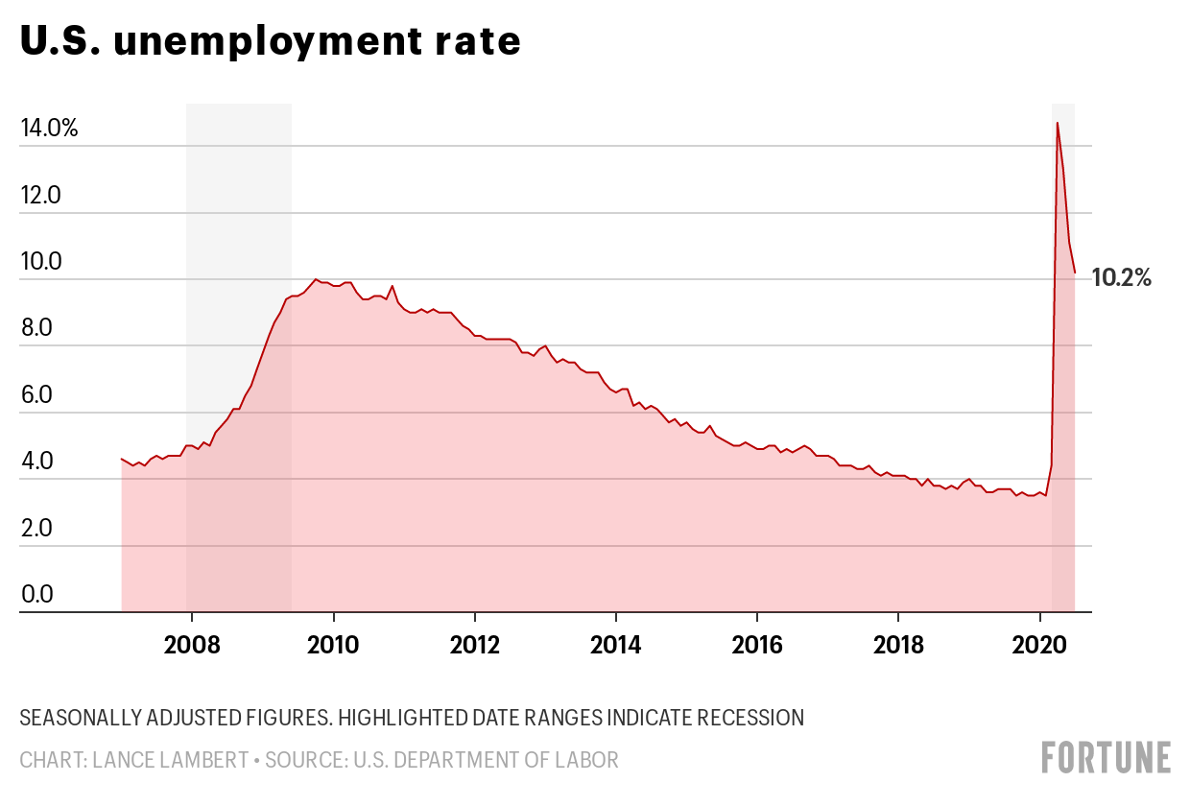
Brutal job market due to COVID-19 pandemic
The US unemployment rate reached the highest point in the past 10 years…
Notes:
As you're aware, the COVID-19 pandemic has severely affected the global economy and financial markets, which has caused a rise in the number of unemployed workers across the globe. Here’s a chart from the US Department of Labor, it shows that the US unemployment rate reached the highest point in the past 10 years…
In a brutal job market like this, it becomes harder for people to find a good job with a salary proportionate to their market values. On one hand, employers want to empower their teams and attract more high-quality job candidates by setting competitive salary levels; on the other hand, job seekers want to understand their current worth in the job market, find out if they are being paid fairly, and explore ways to increase their pays. Based on my observations, a lot of jobs posted on the job search platform don’t include information about salary.

Slide 3
Questions From Two Perspectives:
For job seekers: What limits or expectations can job applicants have about salary when looking for Data Analyst jobs?
For employers: How to set a competitive and reasonable salary to attract and retain talent?
Notes:
I’ve built a salary prediction model that aims to provide a means to help estimate/predict the salary ranges of data analyst jobs based on information about sector, location, company size, skills required, and company rating.

Slide 4
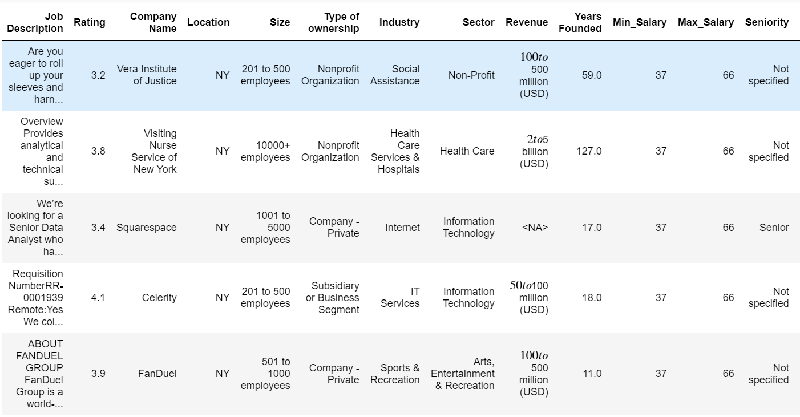
Data
Data Source: https://www.kaggle.com/andrewmvd/data-analyst-jobs/metadata
Notes:
Here’s a snapshot of the dataset I used. I’ve analyzed over 2000 data analysts job listings on Glassdoor, which contain information about their salary estimate, location, industry, company rating, job description, and more.

Slide 5
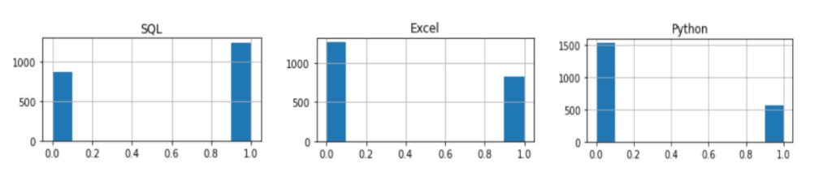
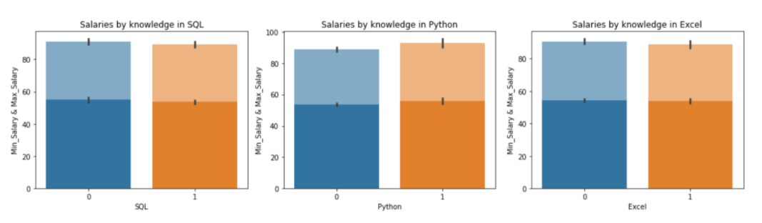
EDA: Skills Required
Notes:
Turning our attention now to the Exploratory data analysis. Based on my findings, SQL, Excel, and Python were the top three most popular skills mentioned in the job description for data analyst positions.
We can see that SQL is the only skill that is required by more than 50% of the jobs. 39% of the jobs require experience in Excel, followed by Python (27%).
However, as it’s shown in the bar plots below, if we grouped our data by a specific skill and tried to compare their minimum salary and maximum salary, we would see that having a specific skill mentioned in the job descriptions does not have a direct impact on salary.

Slide 6
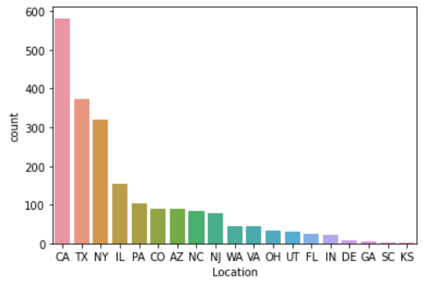
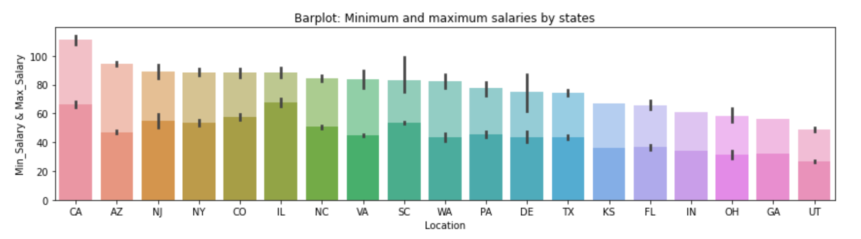
EDA: Location
Notes:
The chart on the top is a count plot for location. It shows that more than 550 job postings are from CA, which indicates that there is a great demand for data analysts in California. Also, from the chart at the bottom, we can see that California not only has the highest amount of job postings, but it also has the highest mean maximum salary and the second highest mean minimum salary. The job market for data analysts in California seems to be the greatest.
Besides the findings about California, Illinois has the highest mean minimum salary, and Utah has both the lowest mean minimum salary and the lowest mean maximum salary among all states in the United States.

Slide 7
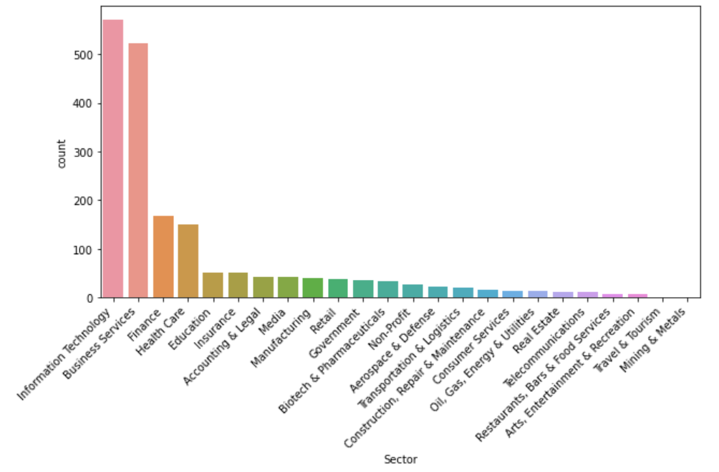
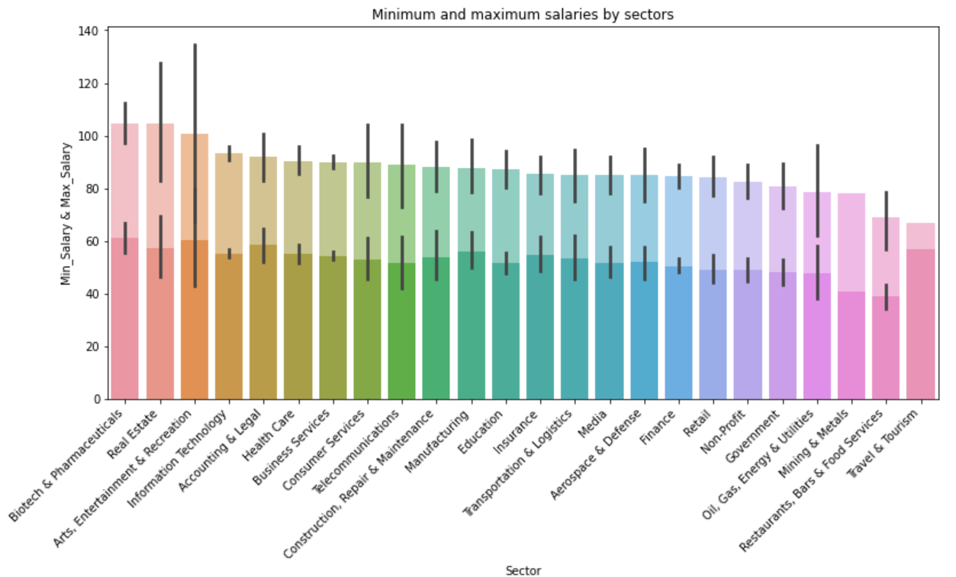
EDA: Sector
Notes:
On the left-hand side is the count plot for sector which shows us that IT is the number 1 sector/industry hiring data analysts. Some other top sectors that hire data analysts include business services, finance, and health care. As for salary, it does not vary too much by sectors compared to locations, but both the biotech & pharmaceuticals sector and real estate sector offer great pay($60K-$105K) to data analysts. We can also see that the restaurant and food sector has the lowest pay($42K-$70K) to data analysts.

Slide 8
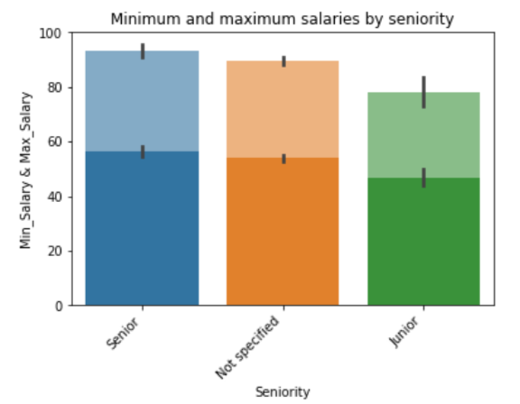
EDA: Seniority and Salary
Notes:
To determine if senior positions offer better salaries, I grouped the data by seniority and compared the mean minimum salary and mean maximum salary of each group. According to this barplot, not surprisingly, senior data analysts($58K-$92K) are paid a lot more than junior data analysts($48K-78K).
So, seniority is also an important factor when determining salary for a job.

Slide 9
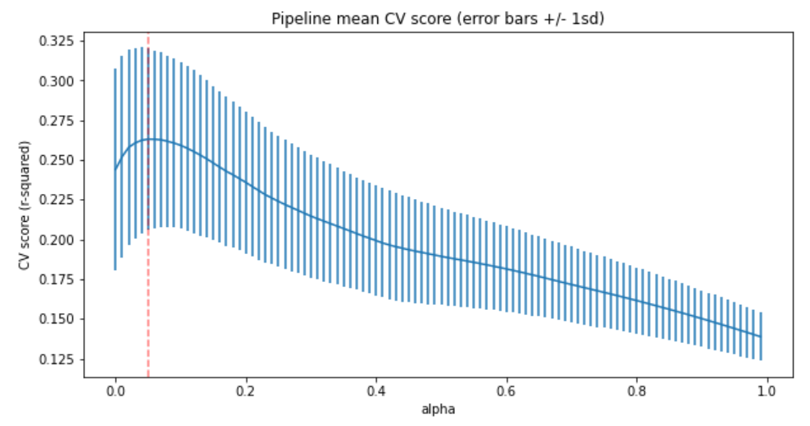
Model Selection
Lasso Regression
Random Forest Regressor
Support Vector Regression (SVR)
Notes:
Let’s move on to modeling…
Before start building my models, I’ve done some data preprocessing steps including
Train-test split
Impute missing numerical values using their corresponding medians
Standardize the numerical data
Impute missing categorical data using their most frequent values
Create dummy or indicator features for categorical variables
Since my goal was to predict salaries, I had a regression problem. Here I had tried out some regression models including Lasso Regression, Random Forest Regressor, and Support Vector Regression (SVR).
I also carried out the grid search CV for hyperparameter tuning for all models separately, then I evaluated the r-squared score with the optimized hyperparameters. The chart we see here is an example from the hyperparameter tuning for the Lasso model. It indicates that our cross-validation r-squared score will be the highest when we choose alpha = 0.05

Slide 10
Hyperparameter Tuning
R-squared Increase by Model
Lasso: 0.137 to 0.263
Random Forest: 0.174 to 0.234
SVR: 0.092 to 0.226
Grid Search Cross Validation
Notes:
Hyperparameter tuning is a very important step. It helps us find an optimal combination of hyperparameters that minimizes a predefined loss function to give better results.
The cross-validation r-squared scores for all our models have been improved after hyperparameter tuning, which means that our models now fit the data better.

Slide 11
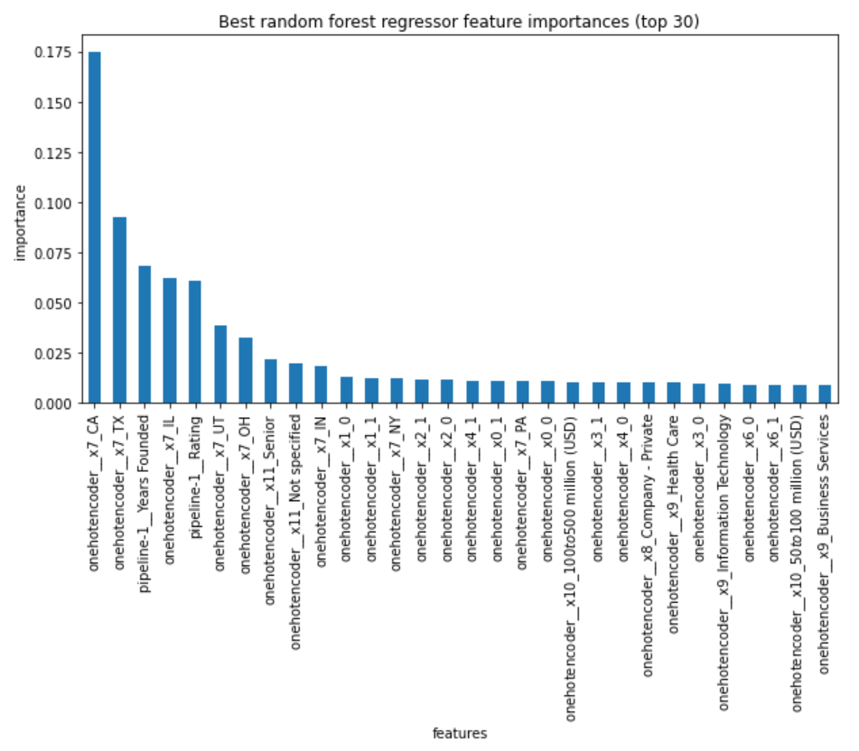
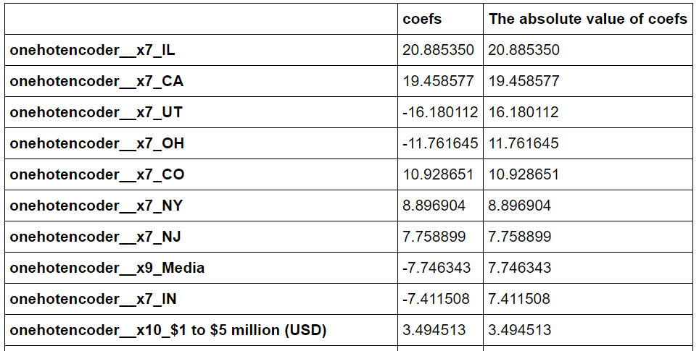
Feature Importance
Lasso Coefficients
Notes:
Here are two charts that can help us get an idea of the importance of the features. The graph on the left-hand side shows us how important each feature is for our random forest model.
The chart on the right-hand side shows the coefficient of the top features selected by our Lasso model. The features with the highest absolute coefficient value are considered the most important.
Both our Lasso and Random Forest models show that the locations CA and IL have a big positive impact on data analyst salary, and the locations UT ad OH have negative impact on data analyst salary. Furthermore, the features 'YearsFounded' and 'Rating' are shown to be important by the random forest model as well, while they don't seem important at all for the lasso model.

Slide 12
Model Performances
Model | MAE | R-squared
Lasso(alpha =0.05) | 11.72 | 0.263
RandomForestRegressor(max_depth = 10, max_features = sqrt, and n_estimators = 780) | 12.17 | 0.234
SVR(C = 21 and epsilon = 5) | 12.02 | 0.226
Notes:
Finally, we have evaluated each models in terms of mean absolute error and r-squared. According to the chart above, Lasso has the lowest MAE score and the highest R-squared score, which makes it the best model in our case.

Slide 13

Takeaway
Based on my findings, when determining the expected salary for a data analyst position, location, seniority, sector, rating of the company, and the number of years the company has been founded may be the most important features to be considered, especially location.

Slide 14
Recommendation
Recruiting firms or the department of Human Resources of businesses can use my models as a guide for salary benchmarking to confirm your company’s compensation levels are in line with the current market, as well as to manage employees’ salary expectations.

Slide 15

Thank You!

