Slide 1
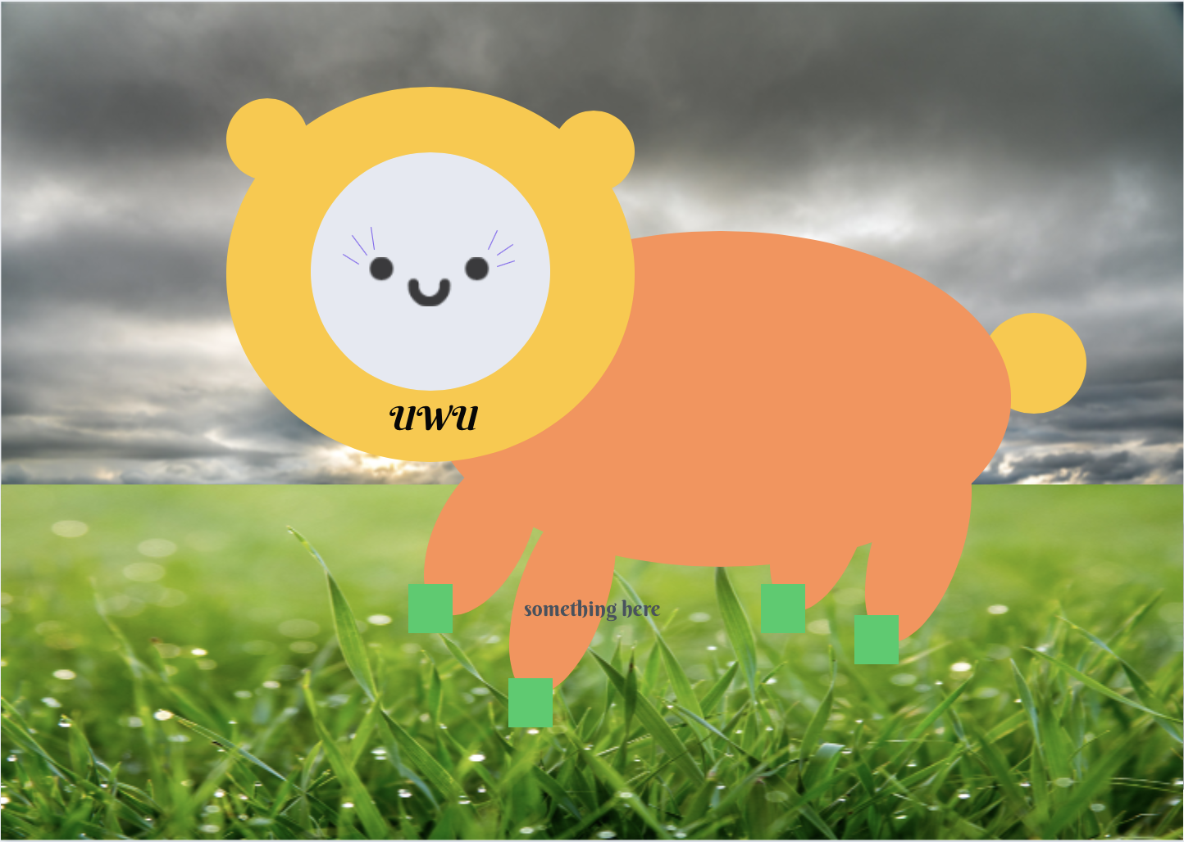
BULLETIN BOARD
GROUP NAH: Nivashini Suresh, Abby Carr, and Hadeel Farhan
Notes:
We are team NAH and our project is BulletinBoard.

Slide 2
OUR TAKEAWAY
People are Unpredictable
Notes:
Even though we learned about human behavior and tried to look at it from the point of view of a user, it doesn’t prepare us for the way people behave and interact with systems. Testing and iterative design will always continue to highlight unpredictable actions.

Slide 3
OUR PROBLEM
And the Post-Pandemic World
Notes:
DESCRIBE THE INTERFACE
Bulletin Board is a website that allows for people to connect with their neighbors.

Slide 4
During the Pandemic
Post-Pandemic
Problem
People started to lose touch
Find a way to connect with your neighbors
How can we connect to those closest to where we live?
Notes:
Neighbors have had a harder time communicating with each other during the pandemic. Communities that were already close-knit found it hard to social distance and maintain their connections while neighbors who were not already connected felt more isolated than ever. Although we cannot create that connection ourselves, we want to allow more fluid communication between members of a community in the hopes that we can help them help each other during the post-pandemic world.
During the pandemic, people started to lose touch. So, we wanted to create easier communication with the people that are physically close during the post-pandemic world. We wanted to emphasize creating a stronger community.
- post-pandemic world: easier communication with the people that are physically close to you, they were helpful during the pandemic, strong community, etc
- problem: not much of a problem, but a possible improvement
- most interfaces that help get you in touch with communities overwhelm you with info, spamming posts, and are ugly/hard to use

Slide 5
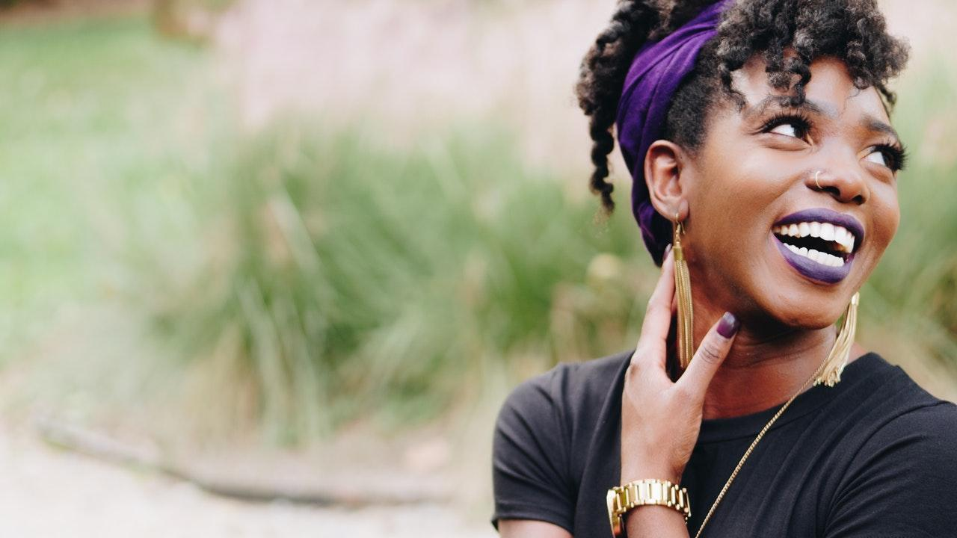
POV
Meeting Joanne
A member of the community
On the neighborhood council
Would like to hear the community voice
Notes:
For our POV,
WE MET Joanne, a member of the community who helps on the neighborhood council.
WE WERE AMAZED TO REALIZE Joanne’s role in the neighborhood council could assist in
not only providing a tertiary point of view but could also give us a new end user functionality.
IT WOULD BE GAME-CHANGING TO include a post option in order to help get community voice
to the neighborhood council or other authoritative bodies.
- This POV motivated us to think about the microrelationships in a community and how we can help
everyone individually and not just look at the bigger picture.

Slide 6


STAYING CLOSE TO HOME
Notes:
There are some interfaces that seem similar to our project, however:
Facebook can be too distracting because it has too many functions such asGames, private chat, home, stories, groups-
Nextdoor is also not just about the individuals, it's about businesses nearby and it spans a bigger neighborhood
Our interface is more about personal neighborhood connections between small groups of neighbors.
We wanted a simple way to focus on connecting neighbors to neighbors in the form of a Bulletin Board.

Slide 7

DEMO
Functionalities:
Add a Post
Delete a Post
Edit a Post
Get a Calendar Link
Navigate between boards
Notes:
Overall, our interface has the functionality of … read off
I’m going to play a short demo of a user adding information about a bake sale

Slide 8
WORKING WITH EVENTS
Paper Prototyping
Adding Calendar Functionality
People Want Confirmation
Notes:
Moving on, I’m going to talk about two of our usability challenges- focusing on what we thought had the most impact on us when it came to understanding the value of testing.
One of the ideas we kept coming back to when discussing our concept was this idea of having events. The way people interact and meet up within a neighborhood would be important for getting our interface on track to fulfill its purpose.
So, when we were implementing that idea we had this moment during paper prototyping where we were getting feedback and it was ‘well how do I know I want to go to this event?’ ‘how do I remember?’
People want confirmation that they’ve completed a task, and what we ended at was adding calendar functionality- but it wasn’t a straightforward path. We started out with a Interested button that users could click to get a pop up with the calendar link of the event. But, during our in-class testing we found that users wanted confirmation still- ‘I clicked this button and added the event, but there’s still something asking if I’m interested- I already said I was’. Which is how we got down to the calendar link only. We knew we needed to give users the option to keep track of events, but we didn’t want to make our interface more clunky with different buttons and checks to indicate interest in an event, so we took advantage of calendars to give users the ability to add events to an already existing scheduling management system.

Slide 9
HAVING A GENERAL BOARD
In-class Interface Development
How Do We Talk with Others?
Future Goals and the Value of Testing
Notes:
Our second big takeaway had to do with our general or casual chat board. In-class testing gave us the same feedback both times- the whole purpose of this board is to communicate with your neighbors, but we do not have a reply feature. We had gotten so lost in the idea of posts and of having similar features across the entire interface that we had forgotten to think about how people talk to each other- not in disconnected posts but in chains of replies to and from each other.
Unfortunately, finding out we had made this mistake during class testing led to a big technological challenge- we were struggling to see how we could implement this feature in time and also had a bit of a Visual Challenge -- not knowing how it should look.
This ended up being a feature we couldn’t fix for our final interface- but it was one of the most important items we learned. If we had taken the time to do even more paper prototyping, talked to more people, undoubtedly we would have been introduced to these issues ahead of time. I hope that this is a point we can take us with us- so that next time we build an interface we remember the value of testing.

Slide 10
EVALUATING OUR INTERFACE
User Testing
Test with Primary Users: Adults in Suburban Neighborhoods
Try out more complicated tasks with the interface
Notes:
When formally assessing the interface, the people testing our interface should be part of our primary user group (adults who live in neighborhoods)
We would ask them to complete tasks of varying difficulties to see if they can complete them, and also how they complete them. We will also take note of if they can use the interface easily
Ideally, we would ask a large group of people from a neighborhood to use it. Then we would monitor the board activity and possibly use eye tracking technologies to learn more about how they use it. We would also interview the users before and after the trial to learn more about their experiences using the interface.
During the interviews, we can find out what they liked and disliked about the interface, and listen to their input or suggestions.

Slide 11
REFLECTIONS
Code
Familiarity with languages
Debugging
Process
Feedback on Idea
User Testing
Notes:
We found that we wasted some time revisiting the syntax of html, css, and javascript as a couple of us haven’t used these languages in a while. We wished that we had revised them more beforehand so that we could focus on implementing as much functionality as we could.
We found debugging hard, as we did not/could not write any tests. This meant that we ended up finding some bugs through demos or coincidentally. We also utilized “Developer Tools”, something we didn’t necessarily plan on using
We wish that we had gotten more feedback on our initial idea. We visualized the interface before fully fleshing out the idea and our goals for this project. If we were starting over we would get more feedback on our idea from potential users as well as fully lay it out before building it.
We wish we did more user testing. It would be ideal if we reached a point where none of the feedback was new, and that would be achieved through having more iterations.

Slide 12
OUR TAKEAWAY
People are Unpredictable
Notes:
To reiterate, people are unpredictable and we will always continue to test and design our interfaces around realistic human behavior.

Slide 13
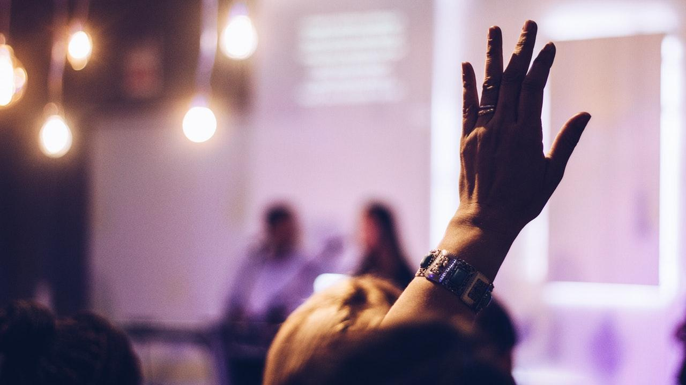
THANKS!
Any questions?
Team Website:
http://www.developinginteractions.com
Interface:
https://bulletinboard.abbyccarr.repl.co/

