Slide 1
软件特征对bug定位的影响分析
周慧聪
MF1933128

Slide 2
01
研究背景
目录 CONTENT
02
bug定位方法的综述
03
软件特征总结
04
软件特征对bug定位所产生的影响
05
参考文献

Slide 3
背景
定位bug非常重要、困难且代价高，对于大型系统尤其如此。
为了解决这个问题，越来越多地使用自然语言信息检索技术来分析错误报告，定位潜在错误源文件。尽管这些技术具有很强的延展性，但在实践中，它们的将错误精确定位到少量文件方面的有效性仍然很低。
现在的定位方法大多通过分析软件的各种特征来进行bug定位，本报告将总结各种软件所用到的特征，并比较各个特征在定位bug中的影响。

Slide 4
软件特征总结
报告和源代码的相似
相似报告
代码结构
堆栈跟踪
版本历史

Slide 5
BLUiR
所用特征：类似的报告和代码结构

Slide 6
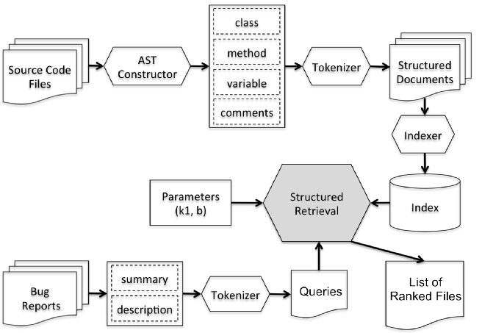
BLUiR

Slide 7
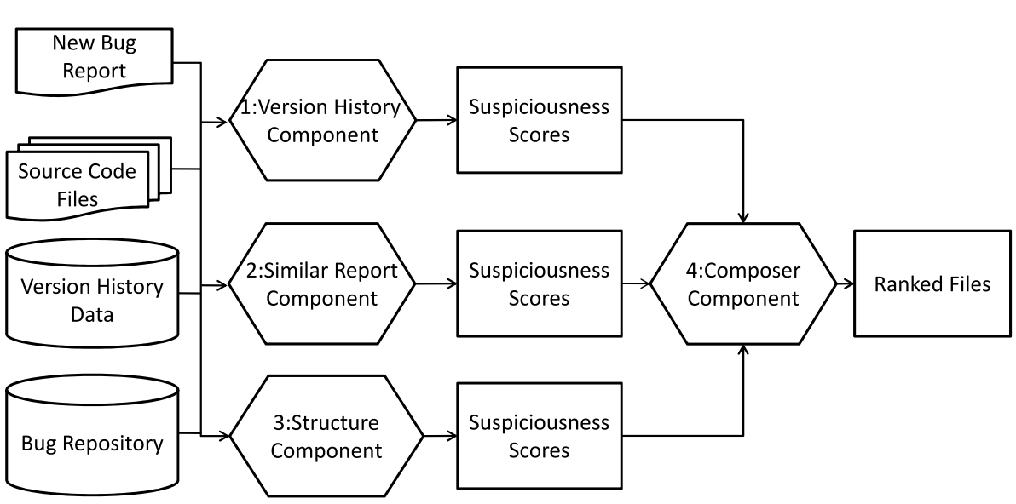
Amalgam

Slide 8
Lobster

Slide 9
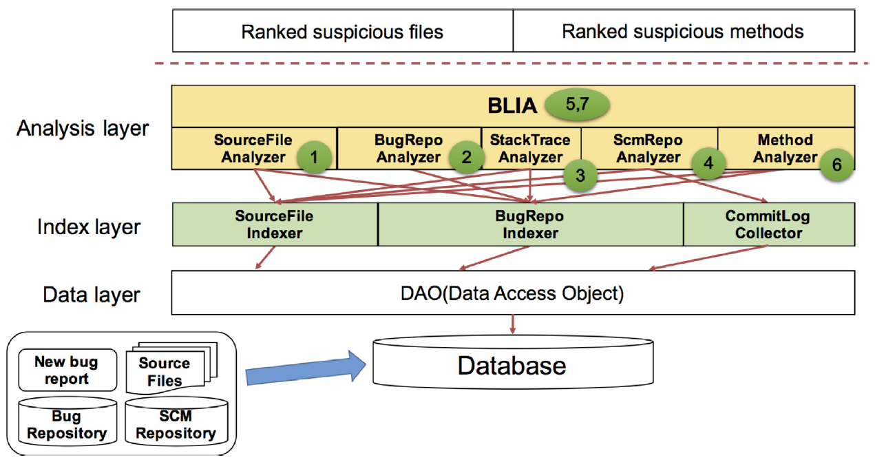
Amalgam

Slide 10
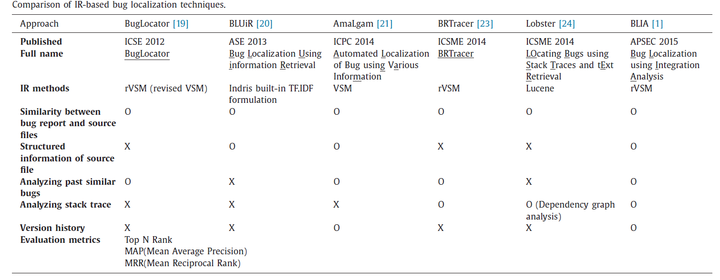
方法特征总结

Slide 11
参考文献
[1] Tantithamthavorn, Chakkrit, Abebe, et al. The impact of IR-based classifier configuration on the performance and the effort of method-level bug localization[J]. IST 2018:160-174.
[2] Wang SW, Lo D. Version history, similar report, and structure: putting them together for improved bug localization. ICPC 2014: 53-63.
[3] Zhang W, Li ZQ, Qing Wang, Juan Li. FineLocator: A novel approach to method-level fine-grained bug localization by query expansion. Information & Software Technology, 2019,110:121-135.
[4] Koyuncu A, Bissyande TF, Kim DS, Liu K, Klein J, Monperrus M, Traon YL. D&C: A divide-and-conquer approach to IR-based bug localization. IEEE Trans. on Software Engineering, 2019.
[5] Youm KC, Ahn J, Lee E. Improved bug localization based on code change histories and bug reports. Information & Software Technology, 2017,82:177-192. IST
[6] Dilshener T, Wermelinger M, Yu YJ. Locating bugs without looking back. Automated Software Engineering, 2018,25(3):383-434.
[7] Rahman MM, Roy CK. Improving IR-based bug localization with context-aware query reformulation. In: Proc. of the 26th ACM SIGSOFT Int’l Symp. on Foundations of Software Engineering. ACM Press, 2018:621-632.
[8] Rath M, Lo D, Mäder P. Analyzing requirements and traceability information to improve bug localization. MSR 2018:442-453.
[9] Wang YJ, Y Yuan, Tong HH, Huo X, Li M, Xu F, Lu J. Bug localization via supervised topic modeling. ICDM 2018: 607-616.
[10] Loyola P, Gajananan K, Satoh F. Bug localization by learning to rank and represent bug inducing changes. CIKM 2018:657-665.

Slide 12
谢谢观看！

