Slide 1
An Examination of the Measurement and Correlations of Air Quality
Team von-Neumann
Abby Lemon
Alan Riveros
Brandon Uhler

Slide 2
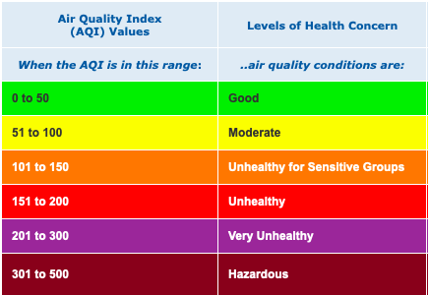
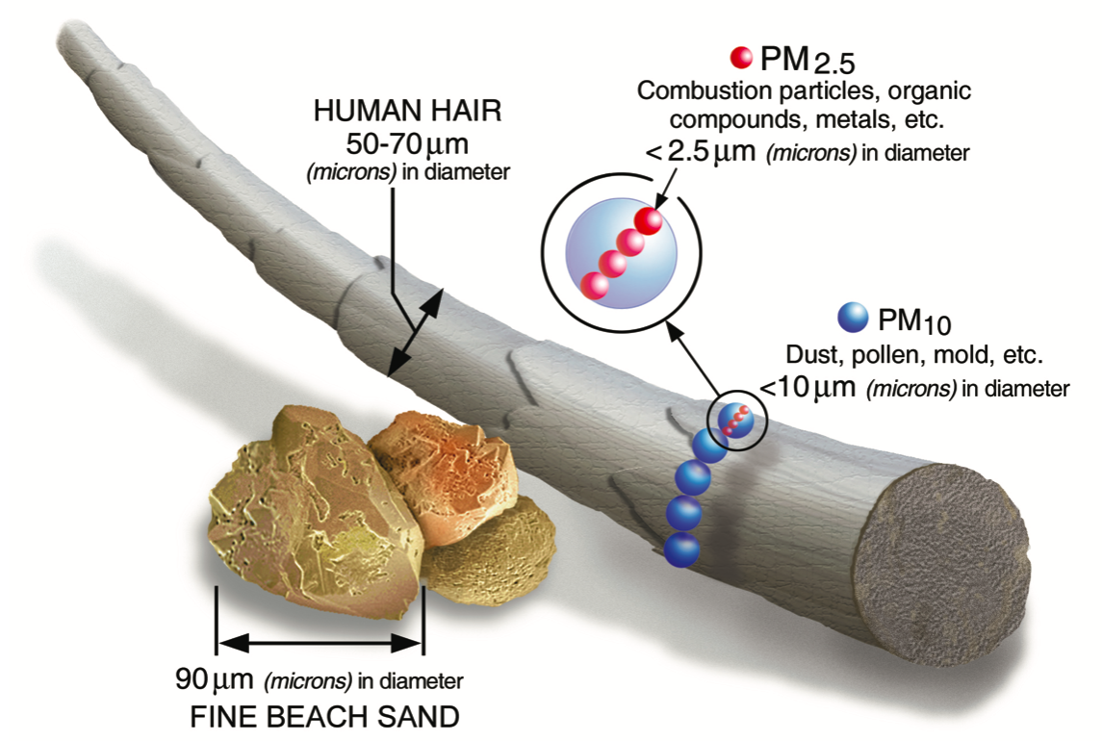
https://www.epa.gov/sites/production/files/2016-09/pm2.5_scale_graphic-color_2.jpg

Slide 3
Motivation and Plan
What is the relationship between the population of an area and its air quality?
Prior to any analysis: population is inversely proportional to air quality
Is there a correlation between population and the air quality?
If there is a correlation, what is the strength of the correlation?
To accomplish this, data will be taken from the Environmental Protection Agency (EPA) and the Census
This will provide data about the air quality of an area and the population of it
Use the counties of Minnesota as the subject

Slide 4
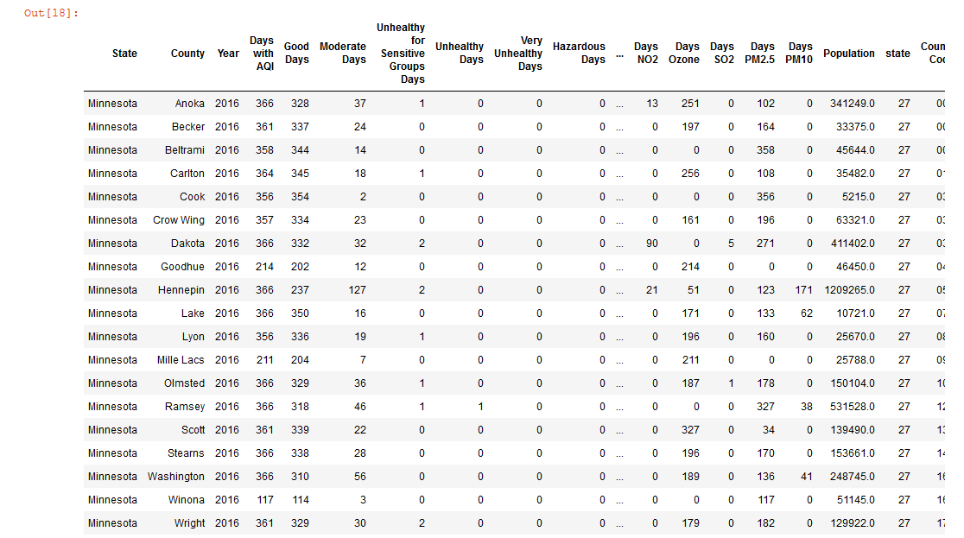
Data Manipulation
Demonstrating correlation can be achieved by plotting the data* using a scatterplot
To achieve this, a data frame containing county population and air quality information would be ideal
*Population provided by Census API and EPA data provided by the EPA’s AirData database

Slide 5
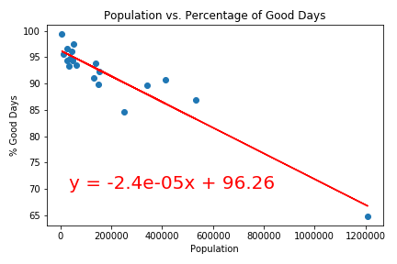
Population and Air Quality in 2016
After plotting population (along the x) and air quality (along the y) we can perform a linear regression analysis on the data to evaluate the potential correlation
The metric used for air quality is the percentage of “good days” of a county

Slide 6
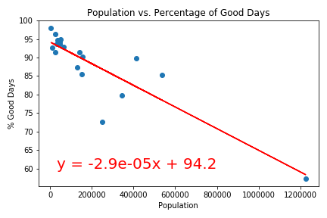
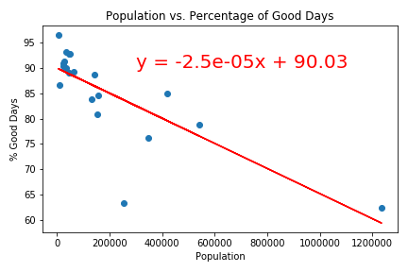
2016 2017 2018
R2 = 0.8899
R2 = 0.7655
R2 = 0.6004

Slide 7
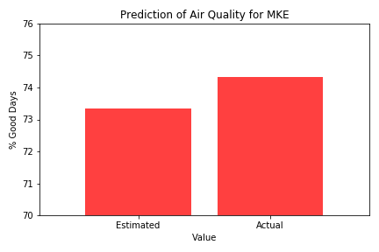
Predicting Air Quality
Using the result of the linear regression from Minnesota’s 2016 data, we can evaluate its ability to forecast
Using the same method as before, Milwaukee’s air quality for 2016 is estimated

Slide 8
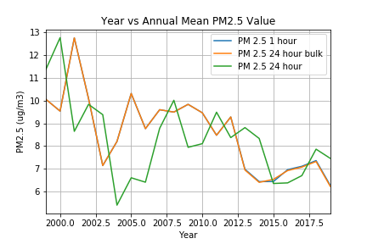
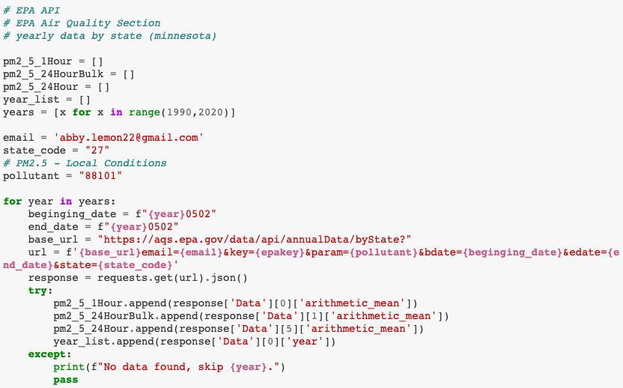
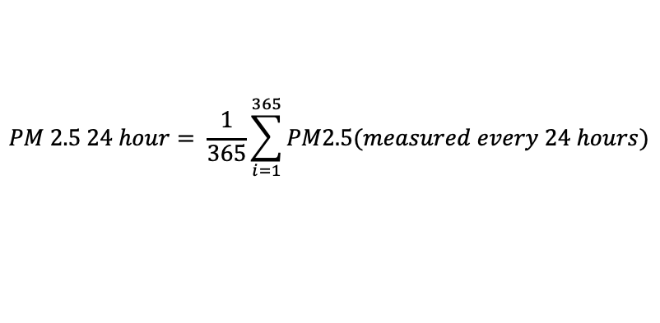
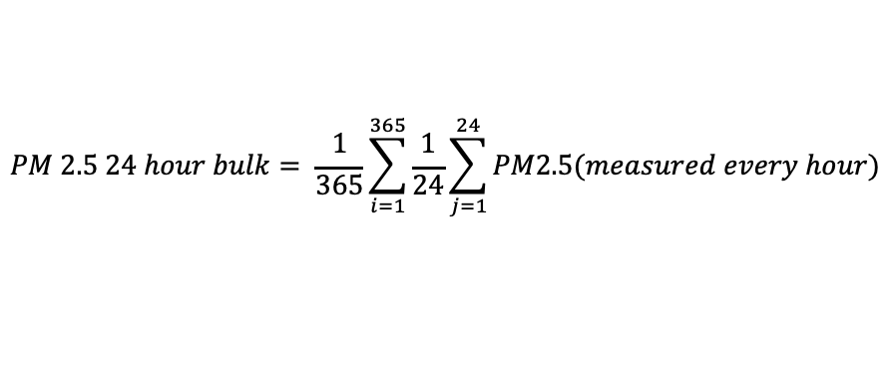
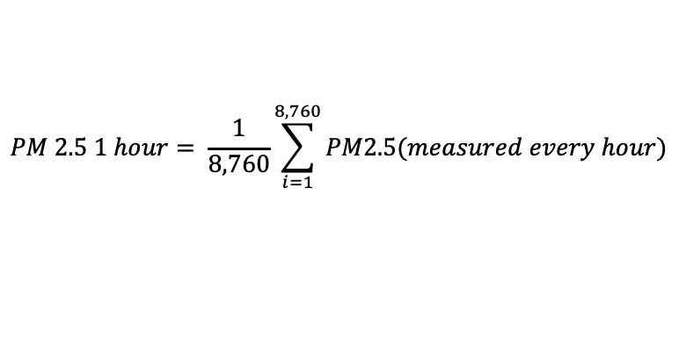
Yearly EPA PM2.5 API Data
$$PM 2.5 1 hour= \frac{1}{8,760}\sum_{i=1}^{8,760}{PM2.5(measured every hour)}$$
$$PM 2.5 24 hour bulk= \frac{1}{365}\sum_{i=1}^{365}{\frac{1}{24}\sum_{j=1}^{24}{PM2.5(measured every hour)}}$$
$$PM 2.5 24 hour= \frac{1}{365}\sum_{i=1}^{365}{PM2.5(measured every 24 hours)}$$

Slide 9
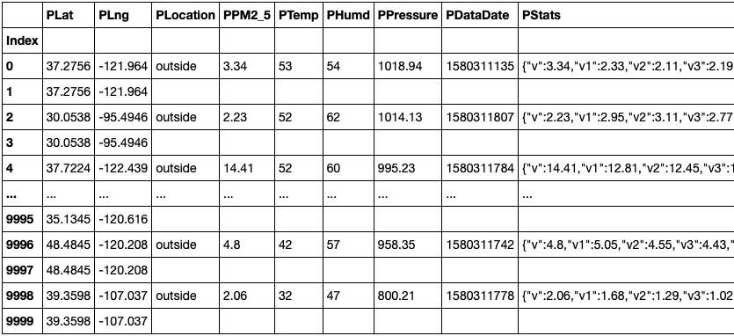
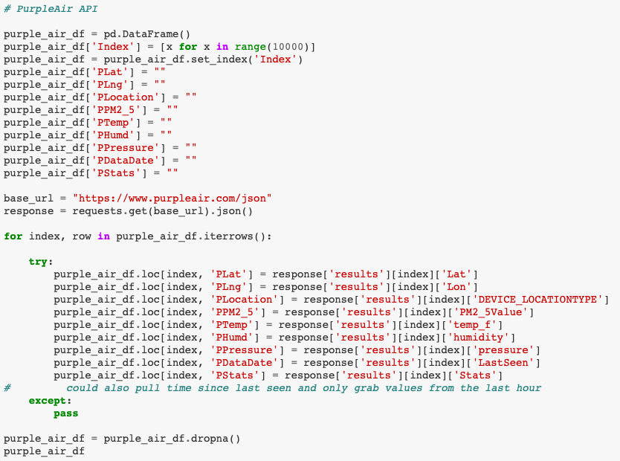
Purple Air Data – API request

Slide 10
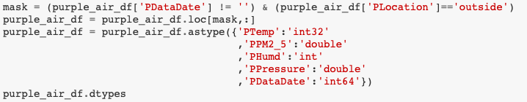
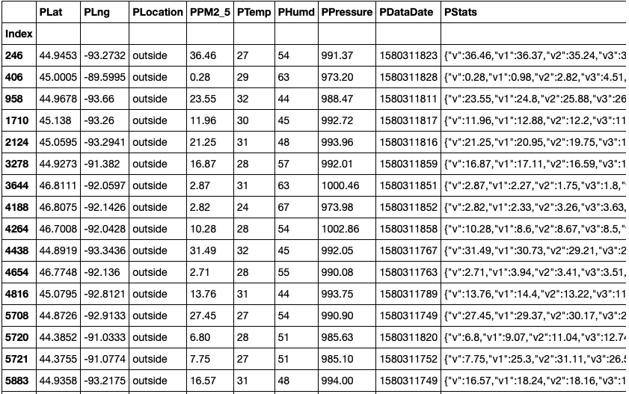
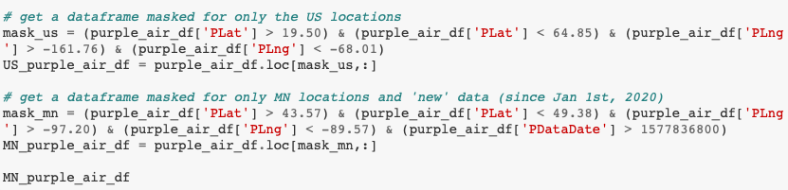
Purple Air Data – data cleaning

Slide 11
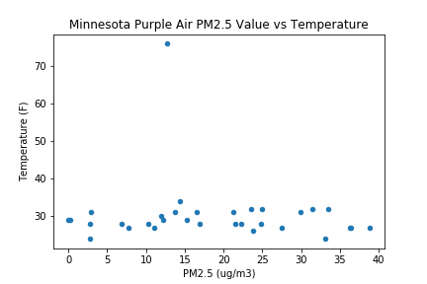
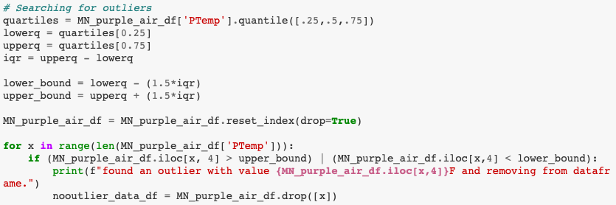
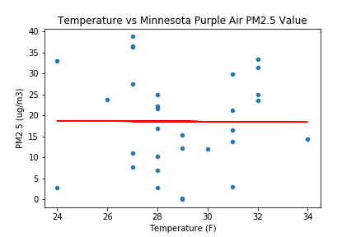
Temperature vs PM2.5 in MN From Purple Air

