Slide 1
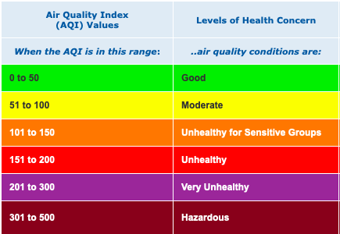
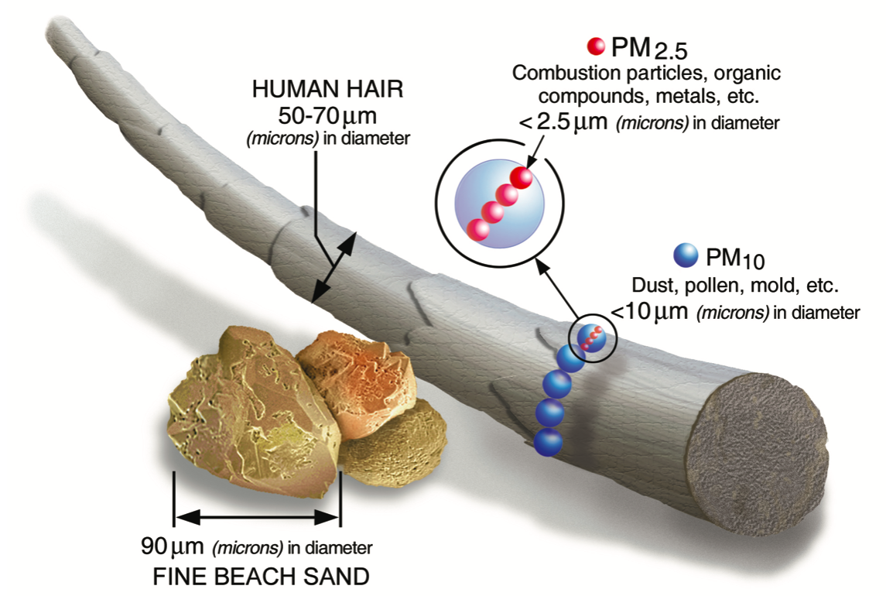
https://www.epa.gov/sites/production/files/2016-09/pm2.5_scale_graphic-color_2.jpg

Slide 2
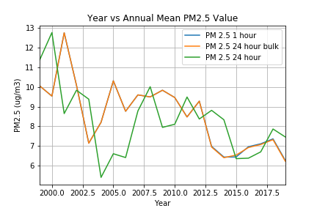
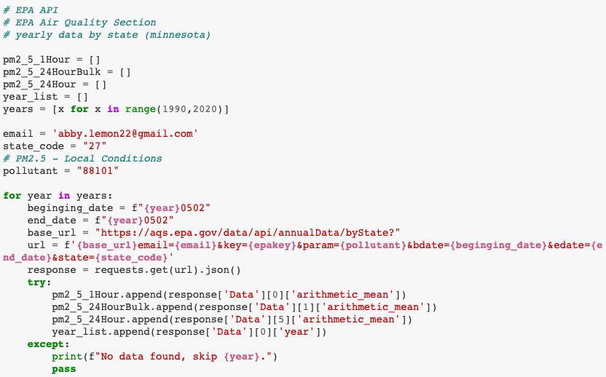
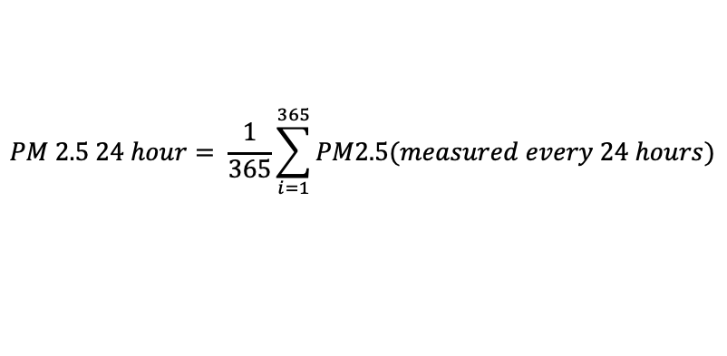
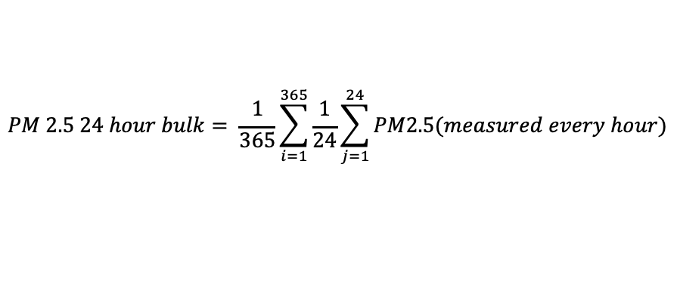
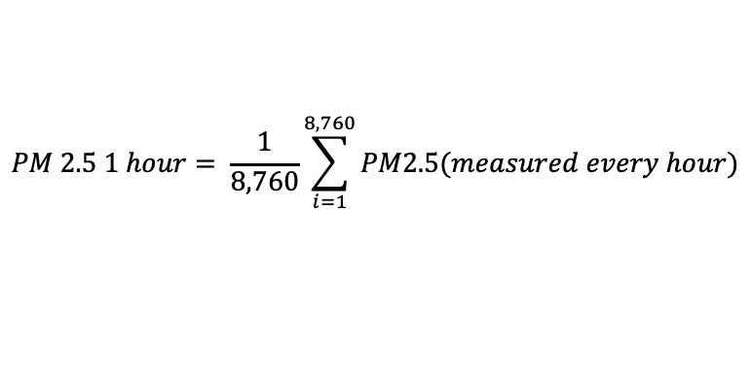
Yearly EPA PM2.5 API Data
$$PM 2.5 1 hour= \frac{1}{8,760}\sum_{i=1}^{8,760}{PM2.5(measured every hour)}$$
$$PM 2.5 24 hour bulk= \frac{1}{365}\sum_{i=1}^{365}{\frac{1}{24}\sum_{j=1}^{24}{PM2.5(measured every hour)}}$$
$$PM 2.5 24 hour= \frac{1}{365}\sum_{i=1}^{365}{PM2.5(measured every 24 hours)}$$

Slide 3
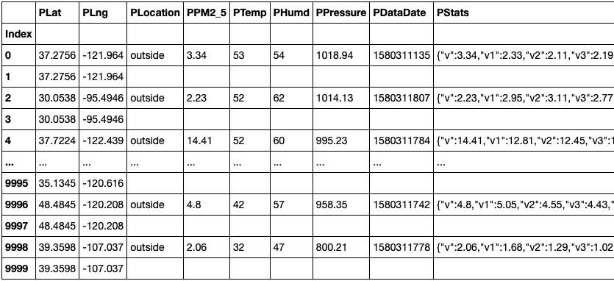
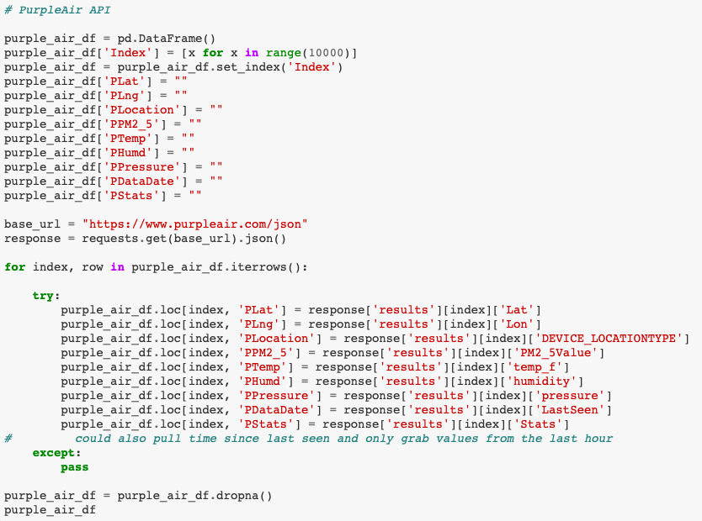
Purple Air Data – API request

Slide 4
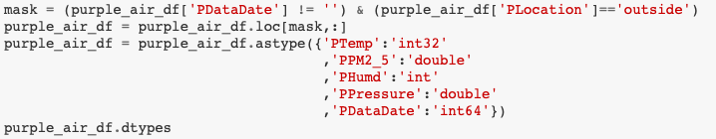
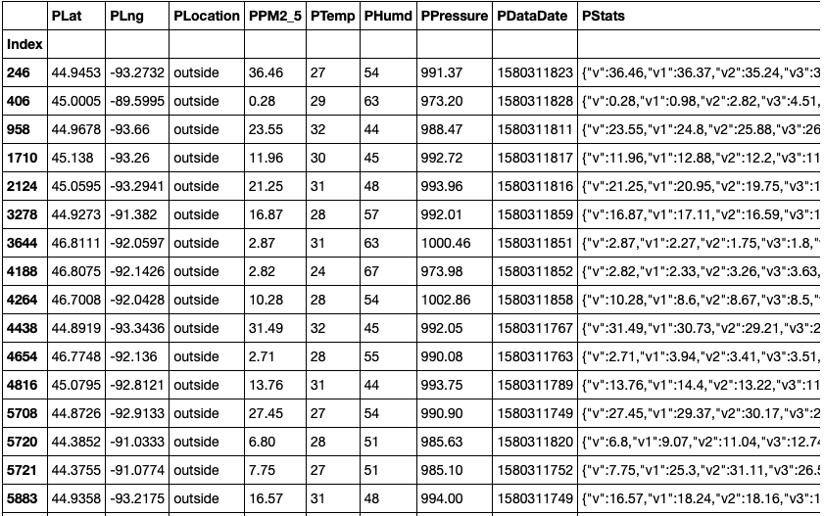
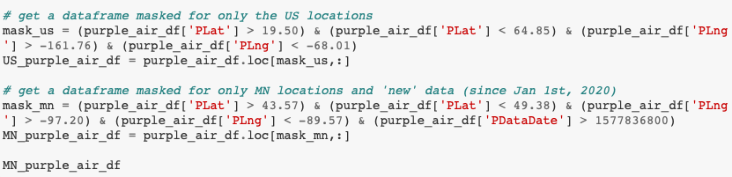
Purple Air Data – data cleaning

Slide 5
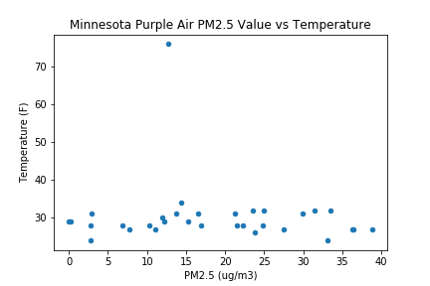
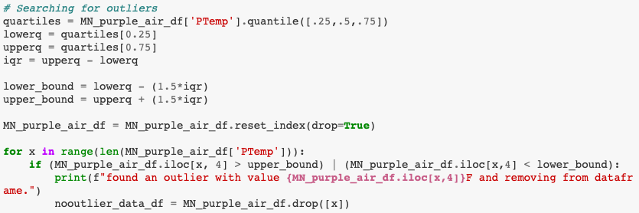
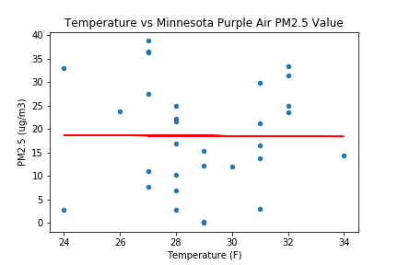
Temperature vs PM2.5 in MN From Purple Air

