Slide 1
Debugging in R: Basics, tips, and Tricks for Fixing mistakes
Elizabeth Sicking
November 16, 2023

Slide 2
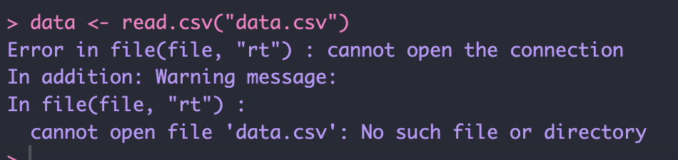
Debugging
Anatomy of a basic error message:
Error in [what you tried to run] : [what the problem is]

Slide 3
Basic approach after getting an error message
Google the error message! Google is your friend ☺
Make errors easily reproduceable
Isolate errors by removing code, simplifying data, and figuring out inputs that don’t trigger the errors
Take a systematic approach to find the bug
Once you’ve found the bug, determine how to fix it, and have measures in place to check that the fix was effective

Slide 4
Interactive debugging
browser()
Opens a window within your function that pauses execution and allows you to explore the current state
browser() commands
Next- n : executes the next step in the function
Step into- s : same as above, but can step into a function
Finish- f : finishes executing function
Continue- c : leaves debugging, continues execution. Good for checking fixes!
Stop- Q : stops debugging, returns to global environment
Notes:
The main tool for debugging in R is browser, which we began talking about in class. It is a function that can be inserted where within a function and is helpful for solving more complex errors. It pauses execution and opens a window within your function, putting you in “browse” mode and allowing you to explore the current state of the function. You can interactively type in the browser to go through different parts of the function. N executes the next step in the function, which allows you to work through the function line by line and isolate the error line.

Slide 5
Other tips and tricks
Open a new R session and try running the code again
This is helpful if you can’t figure out the source of an error
There may be hidden objects stored that are causing issues
Along the same lines, double check the objects you’re working from- make sure everything you’re trying to use exists!
Simplify your code
Have a system:
Insert the browser function halfway through whatever chunk you’re working on, and eliminate from there

Slide 6
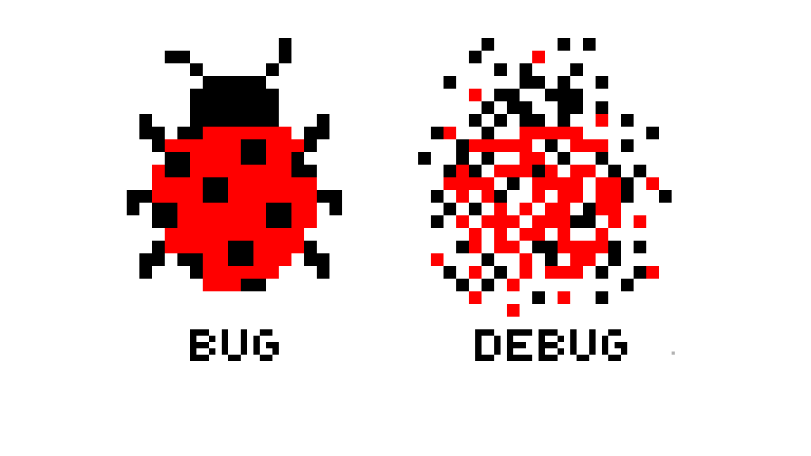
Questions?
Sources:
Wickham, H. (2019). Advanced R. Second Edition. Chapter 22: Debugging. Chapman & Hall/CRC. https://www.youtube.com/watch?v=PrWaE0_fUTo
https://www.youtube.com/watch?v=9vABzGCQeqU&t=204s

