Slide 1

Getting familiar with ARC
Advanced R Programming: BIOL 6064
Fall 2023
Gabriel Borba

Slide 2
What is ARC?
ARC is Advanced Research Computing, a unit from the Division of Information Technology.
ARC's resources include:
High-performance computing systems,
Large-scale data storage,
Visualization facilities,
Software,
Consulting services
ARC?
ARC?
ARC?

Slide 3

Why use ARC?
Very large jobs to run (e.g., high resolution or large-scale datasets)
Many jobs to run (parameter sweeps, many datasets)
Need for specialty hardware (GPU, memory, high bandwidth storage, fast network, scale)

Slide 4
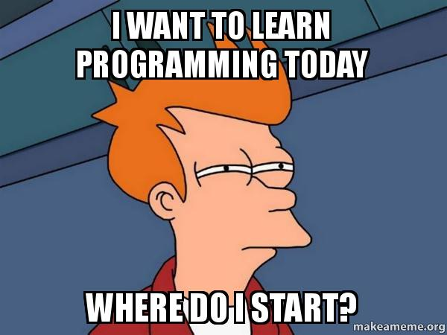
How to access it?
HOW TO ACCESS ARC
Get an account
Get an allocation
Decide which hardware you want to use
Find or install your software (e.g., R)
Develop your workflow, possibly via interactive jobs

Slide 5
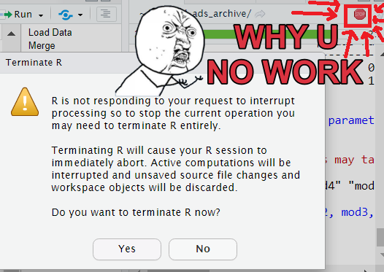
How it works?
Login OnDemand
Connect on Open Pulse Secure
Select :
Software of use
Software version
Account
Partition
Number of hours (min-1, max-48)
Number of nodes (min-1, max-2)
Number of cores per node (min-1, max-128)

Slide 6

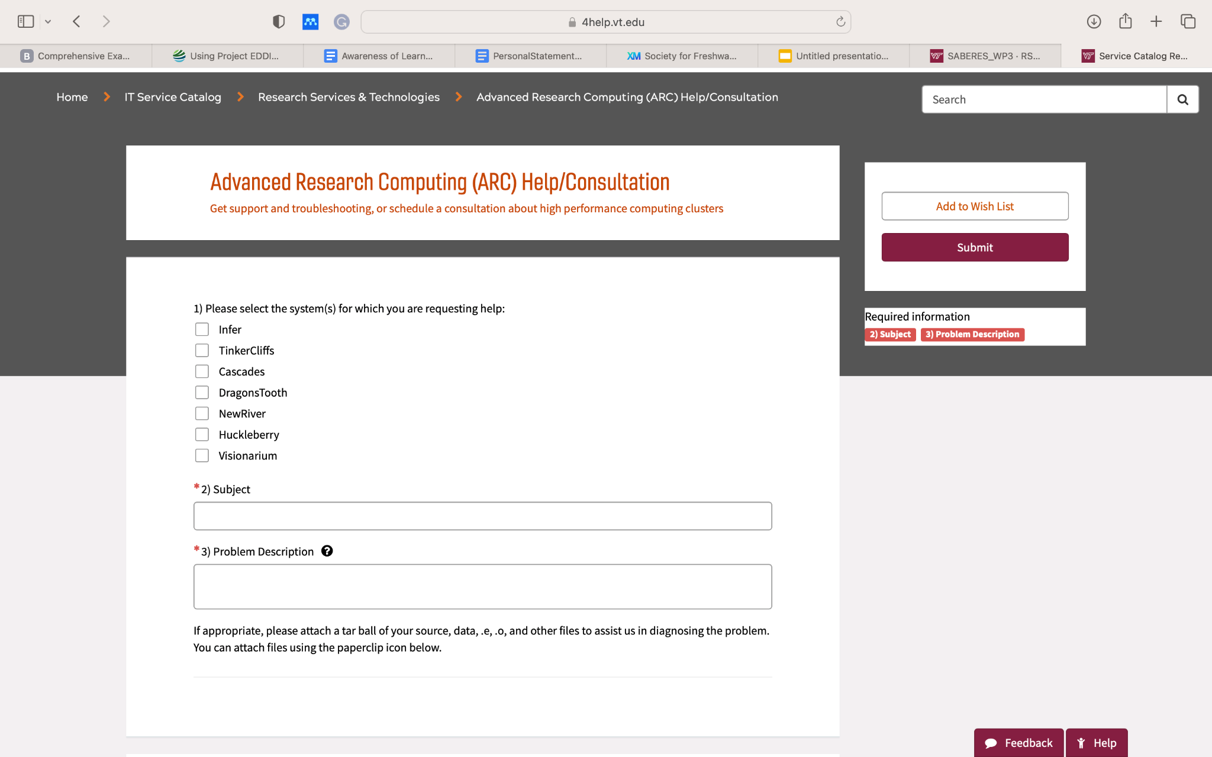
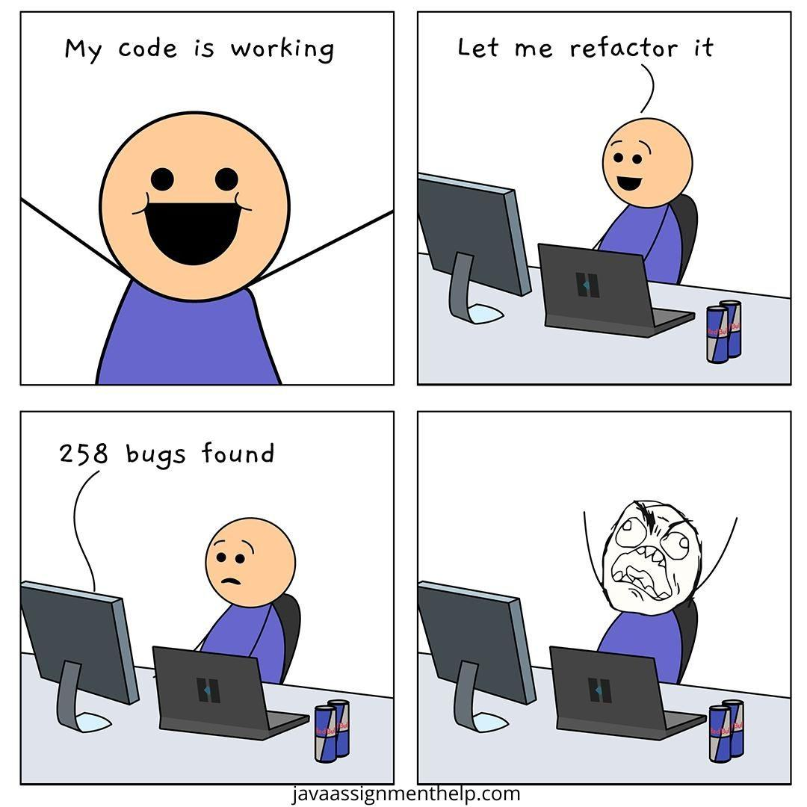
Getting help
https://4help.vt.edu/sp?id=index

Slide 7






Step-by-Step Synthesis
2nd
4th Interactive apps
Outside VT
1st Create an account
3rd ARC dashboard
At VT
5th
ColdFront: Interface for requesting compute or storage allocations
E.g. my case

Slide 8
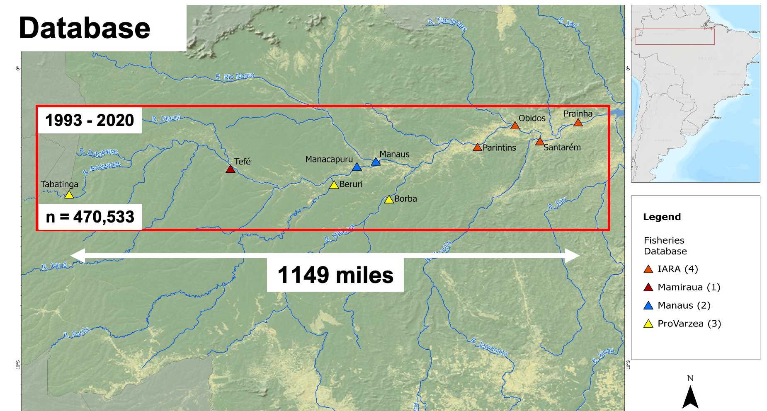
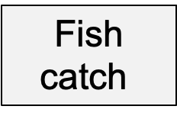
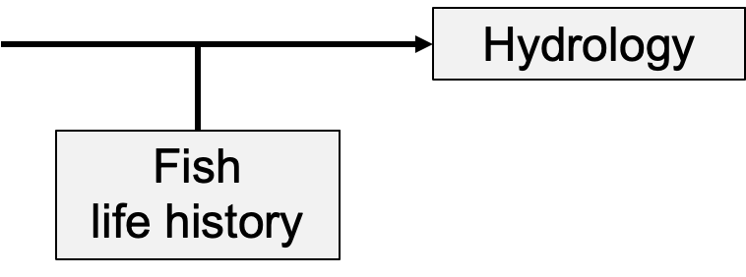
How am I using ARC?
Flood pulse effects on fish catch in the Amazon Basin
1. Key flood pulse effects on fish catch
2. Most susceptible fish taxa to flood pulse
3. Future flood pulse impacts on fish catch
Daily information:
Fishing landing
River water level

Slide 9

Let’s putting it into action!

Slide 10
LINKS
https://ood.arc.vt.edu/pun/sys/dashboard/
https://ood.arc.vt.edu/pun/sys/dashboard/batch_connect/sys/bc_vt_rstudio_singularity_docker_141717/session_contexts/new
https://ood.arc.vt.edu/rnode/tc015/56938/
https://www.docs.arc.vt.edu/index.html (ARC user)
https://www.docs.arc.vt.edu/usage/faq.html#when-will-my-job-start (Frequent questions)

