Slide 1
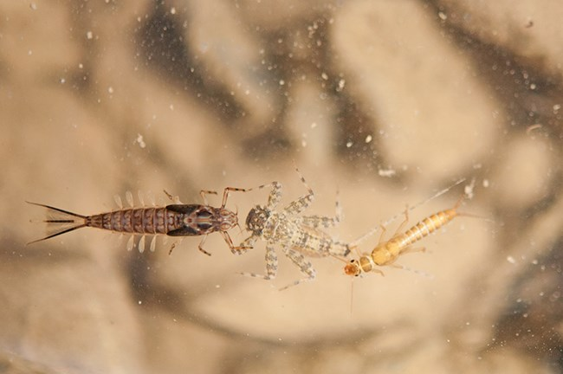
Vegdist: Intentionally choosing dissimilarity matrices in community data
Kelley Sinning

Slide 2

What is the vegan package?
The vegan package provides tools for descriptive community ecology. It has most basic functions of diversity analysis, community ordination, and dissimilarity analysis.
Most of its multivariate tools can be used for other data types as well.
The vegan package is developed at GitHub and provides up-to-date information

Slide 3
Vegdist
The function computes dissimilarity indices that are useful for and popular with community ecologists
What is a dissimilarity matrix?
Dissimilarity: how unalike things are, almost every ordination technique starts with dissimilarity
All similarity/distance metrics can be calculated as a single measure between two observations (Q-mode) or two variables (R-mode)
Reduced dimensionality: regardless of how many variables (Q) or observations (R), you end up with a single number
Given more than 2 observations (Q) or 2 variables (R), you can create a matrix (common in multivariate ecological data)

Slide 4
2 types of dissimilarity indices
A
B
Metric distance: triangular inequality
Similarity of 2 sides must be greater or equal to length of 3rd side
A + B ≥ C
Non-metric distance
Does not satisfy triangle inequality
To not satisfy means you are not in 2D space, space is warped and not flat
C

Slide 5
Vegdist arguments
x = where you define the rows and columns you are pulling from in your dataset
method = dissimilarity index, “bray” is referring to the Bray-curtis method
binary = is “TRUE” when you have presence absence data
diag = returns a diagonal matrix, which has non-zero elements in the diagonal
upper = return only the upper diagonal
na.rm = a way of removing missing values from the data if they are coded as NA
*If not wanting to use a diagonal matrix or don’t have any data coded as NA, diag, upper, and na.rm function don’t have to be invoked. The options you don’t specify will prioritize the R default options.

Slide 6
Vegdist methods
"manhattan", "euclidean", "canberra", "clark", "bray", "kulczynski", "jaccard", "gower", "altGower", "morisita", "horn", "mountford", "raup", "binomial", "chao", "cao", "mahalanobis", "chisq", "chord", "hellinger", "aitchison", or "robust.Aitchison".

Slide 7
Common dissimilarity matrices in ecology
Bray-Curtis
Used to quantify compositional dissimilarity between 2 sites, based on counts
Jaccard
Uses incidence data
Have to tell vegdist to use presence absence data (Binary=TRUE)
Euclidean
Based on abundance measures in a Cartesian coordinate system
Notes:
Chi-square compares observed and expected results

Slide 8
Common dissimilarity matrices in ecology
Chi-squared
Euclidean distances of Chi-square transformed data
Incorporates a weight that is inversely proportional to the total of each row (or column) → increases the importance of small deviations in the rows (or columns)
altGouer
Omits double-zeros and divides by the number of pairs with at least one above-zero value, and does not scale columns
Notes:
Chi-square compares observed and expected results
Benefit of omitting double zeroes?

Slide 9

Application to class
1 example… Tidyverse
Once you have a dissimilarity matrix, you can use “ggplot2” for data visualization
Different ordinations could be used to accomplish this
NMDS
PCoA
Boxplots

Slide 10
Main takeaways
It is important to understand why options are chosen in a function and think critically about data being entered
Needs for analysis and data type will determine whether a default option should be chosen or not
vegdist is a great example of a common function for community analysis and ordination
Can be complemented by other skills learned in this class

Slide 11
References
Brown, Bryan. (2023). Quantitative Ecology: Diversity [Lecture notes].
Chi-square distance. (n.d.). The Concise Encyclopedia of Statistics, 68–70. https://doi.org/10.1007/978-0-387-32833-1_53
Classification Analysis-R Tutorial. Classification analysis - R tutorial . (n.d.). http://ecovirtual
Rstudio Help Function

