Slide 1
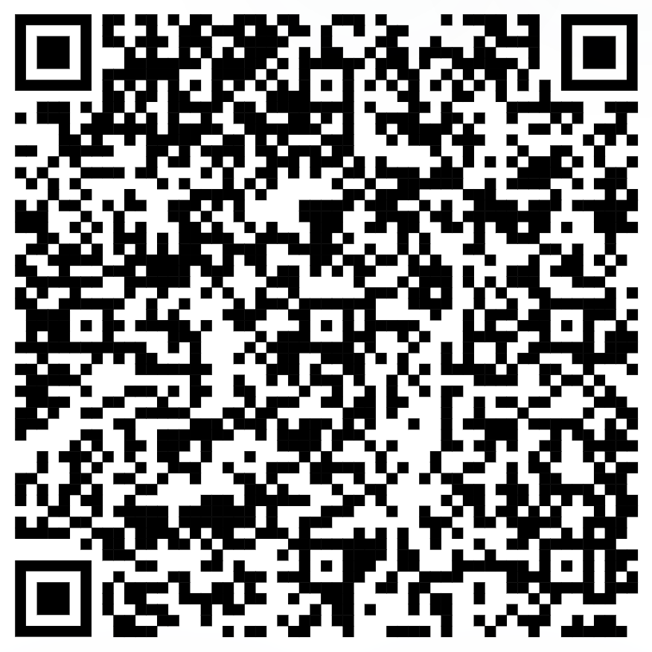
Week 4: Functions
How to write functions
NOTE: Optional assignment on GitHub
Collaborative playlist

Slide 2
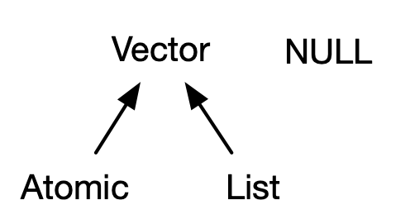

Slide 3
