Slide 1
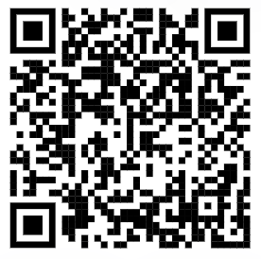
Week 2: Memory
Fill out office hour survey
GitHub demo
Warm up exercise
Lecture: Memory in R
Office hour when2meet

Slide 2
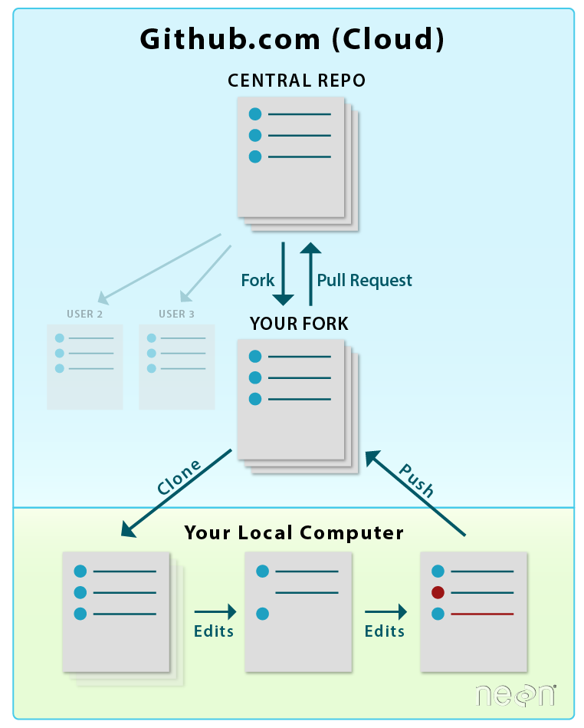
git is a tool that is used to manage version control for various files. GitHub.com is a website that runs git behind the scenes
Diagram from EarthLab

