Slide 1
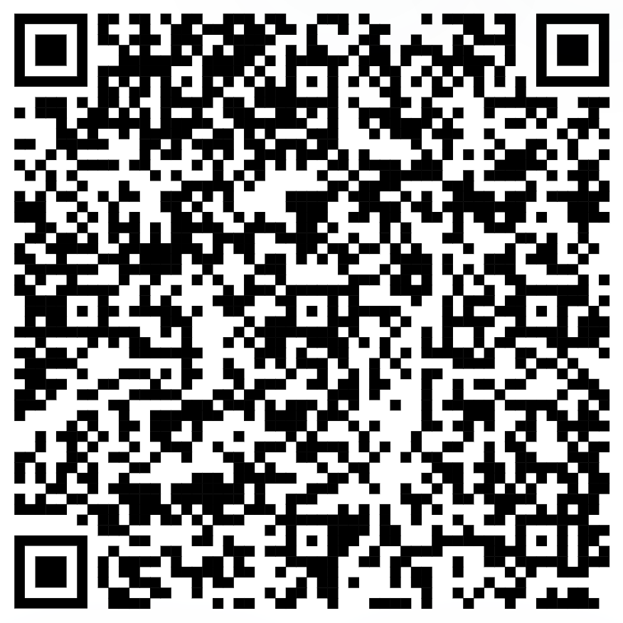
Week 3: Memory and functions
Subsetting and assignment in R
Lecture: Memory in R
If time: Intro to functions in R
NOTE: Optional assignment on GitHub
Collaborative playlist

