Slide 1
09 Code Review Overview
5 min: Background on code review in ecology
10 min: Explanation of overarching structure for code review assignment
30 min: Code review rubric co-development
5 min: Wrap up

Slide 2
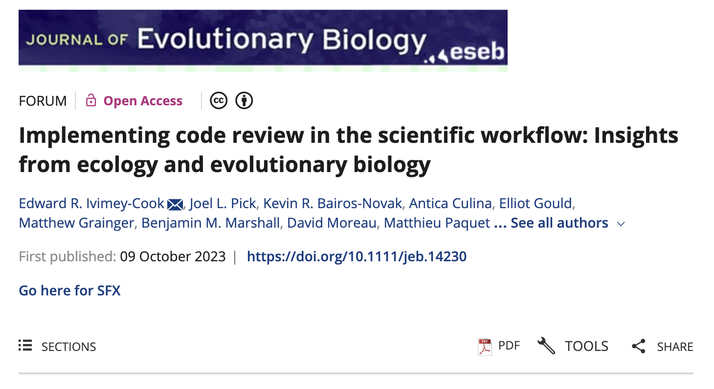
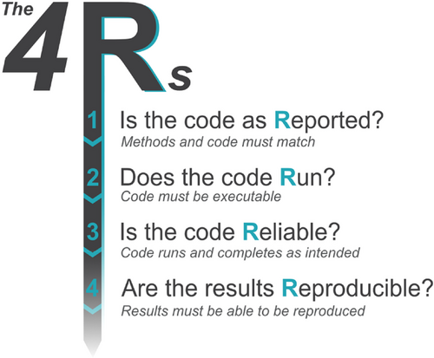
Notes:
Is the code Reported? (consistency with the manuscript)
Statistical method listed in methods is what is run in the code
Methods states the version number of the packages integral to analysis or visualization
Does the code Run?
Data and code provided
If data sharing is not possible, simulated data or a data snippet should be provided so the code can be rerun
In cases where it would take a long period of time to rerun code (e.g., some Bayes modelling), code should accompanied with appropriate model outputs
Is the code Reliable?
This type of error is common and hard to pick up with someone without a deep familiarity with the dataset and code.
Are the results Reproducible?
Note that there are times when obtaining the exact same result is not possible, so some level of tolerance must be applied. E.g., with stochastic methods where parameter estimates change between subsequent runs
It is worth noting and mentioning in your review how closely the numbers and conclusion matched with the reported results.

Slide 3
Discussion questions
Have you ever done code review for someone else, or had someone review your own code? What did you/they assess?
What should we as a field be assessing when we do code review?
Are there things that are beyond the scope of code review and should not be discussed?
Make notes to expand on our class code review rubric

