Slide 1


Terra Package in R
Alison Ritz
11/16/23

Slide 2
What is the Terra Package?
Used for spatial data analysis with spatial objects like points, lines, polygons, and rasters.
This package did replace the ‘raster’ package, but it can do all the same things as ‘raster’ and more.
It is capable of processing very large files
The two main classes (data types) implemented are SpatRaster and SpatVector
Requires R >= 3.5.0

Slide 3
Why would I use this package?
Great for analyzing spatial information of most formats.
Locate your study area on a DEM
Change the value of cells for storage
Create a sample area bounding box
Apply models to areas of spatial data
Calculate buffers
Crop your data into smaller pieces
Export information into different formats
Plot and interact with maps in R

Slide 4
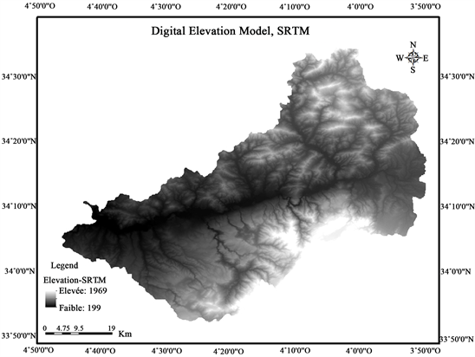
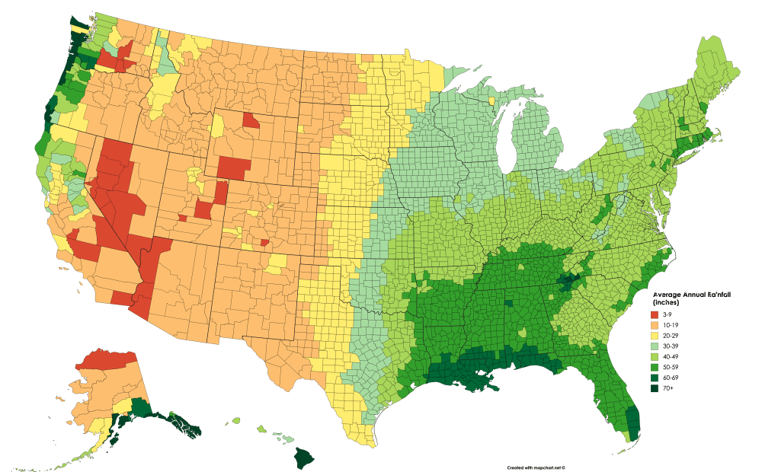
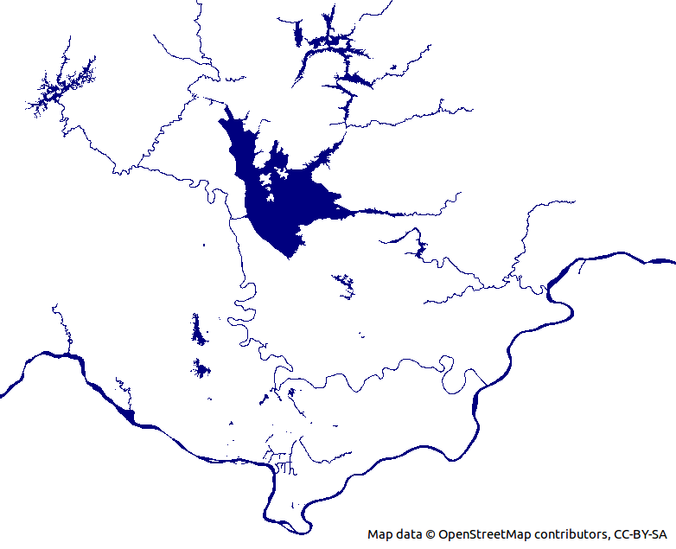
Some examples
Digital Elevation Models (DEM’s)
Canopy Height Models (CHM’s)
Rainfall amounts
Imagery (single and multiband)
Study area polygons
Streams/rivers
Property boundaries
Sub-meter, meter, 10, 30, county level, state level, etc.
Water or vegetation indices
Watersheds
Etc!

Slide 5
Example Code
1: plotting the raster
2: changing the extent of a raster with a bounding box
3: manipulating the raster values

Slide 6
Sources
R. Hijmans, R. Bivand, E. Pabesma, and M. Sumner. 2023. Package ‘terra’. CRAN. https://cran.r-project.org/web/packages/terra/terra.pdf and https://cran.r-project.org/web/packages/terra/index.html
Kadyb. 2023. terra ReadMe. GitHub. https://github.com/rspatial/terra/blob/master/README.md
The Terra Package. RSpatial. https://rspatial.org/pkg/index.html

