Slide 1
Week 2: Memory
GitHub demo
Warm up exercise
Lecture: Memory in R

Slide 2
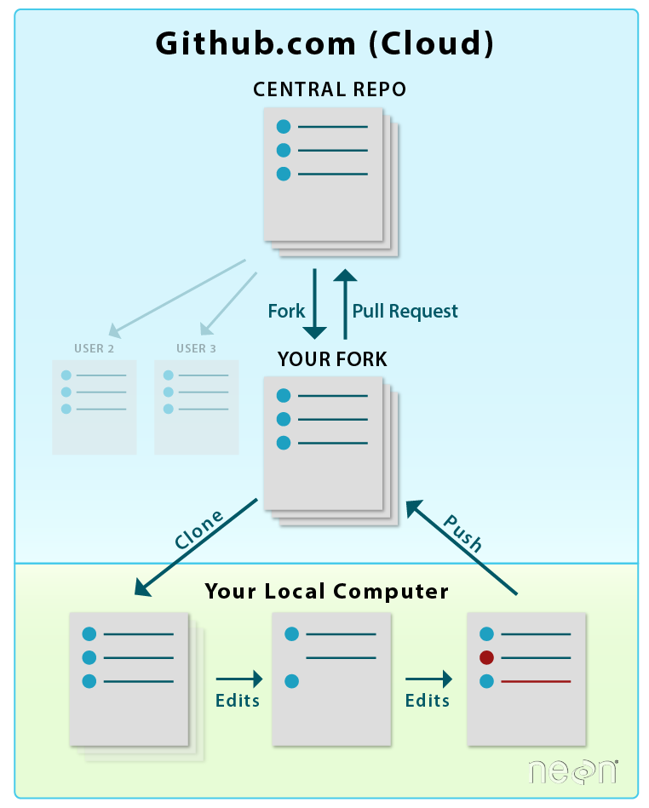
git is a tool that is used to manage version control for various files. GitHub.com is a website that runs git behind the scenes
Diagram from EarthLab

