Slide 1
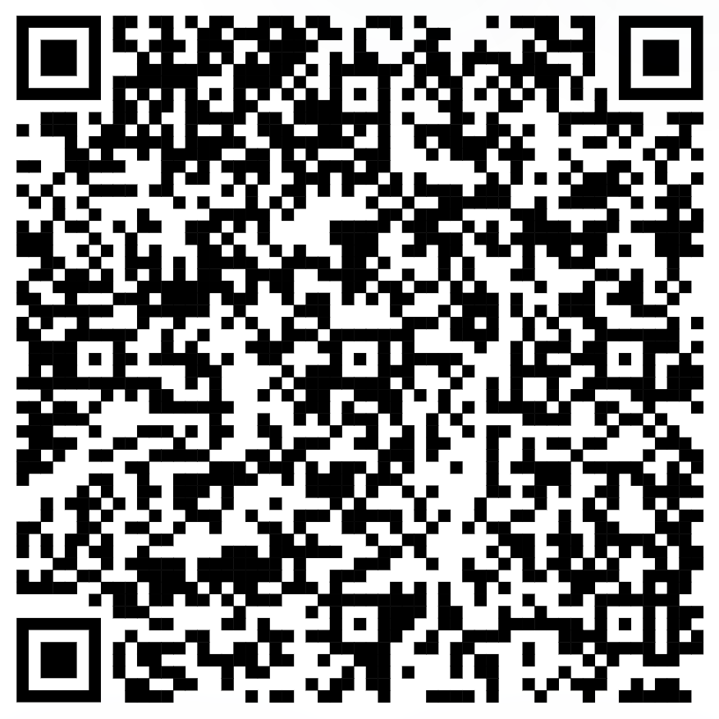
Week 4: Functions
Final comments on memory
How to write functions
Functional programming
NOTE: Optional assignment on GitHub
Collaborative playlist

Slide 2
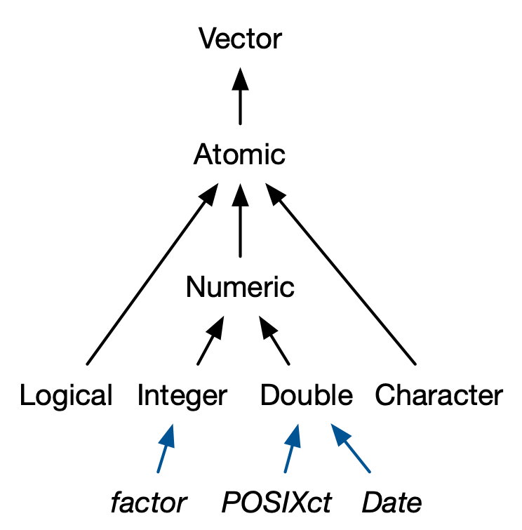
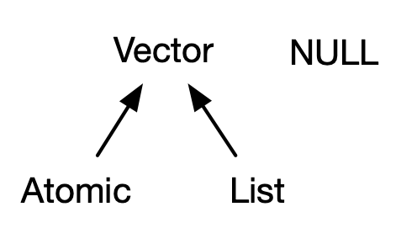
Can contain any combination of atomic elements, as well as functions, dataframes, etc
Notes:
Playlist link

Slide 3
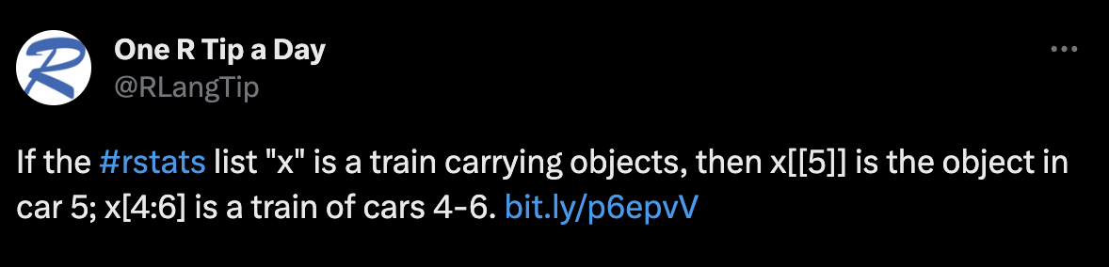
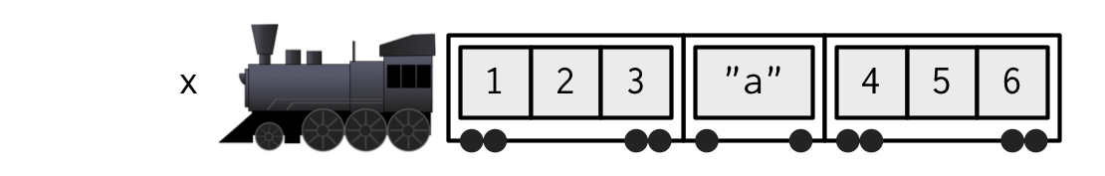
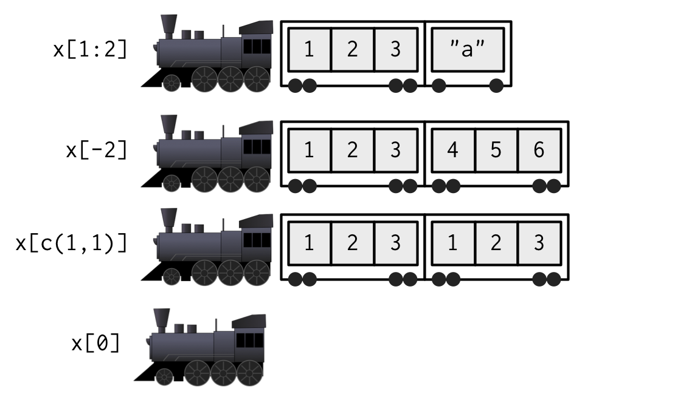
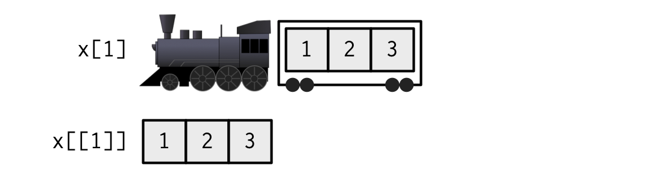
x[c(T, T, F)]
x[c(T, F, T)]
x[c(F, F, F)]

