Slide 1
IRON, man
Like DUDE

Slide 2
Relevance of Fe in broader biogeochemical cycles
Fe(ii) oxidation can result in N2O emissions
Anoxic carbon mineralization
Methane oxidation paired with fe(iii) reduction
Phosphorus

Slide 3
Microorganisms are involved
Spatial overlap between reduction and oxidation
But HOW
Cryptic iron cycling

Slide 4
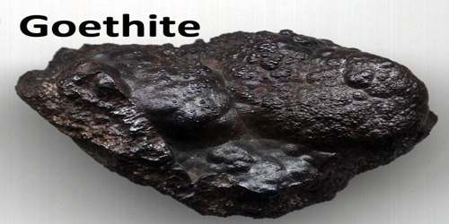
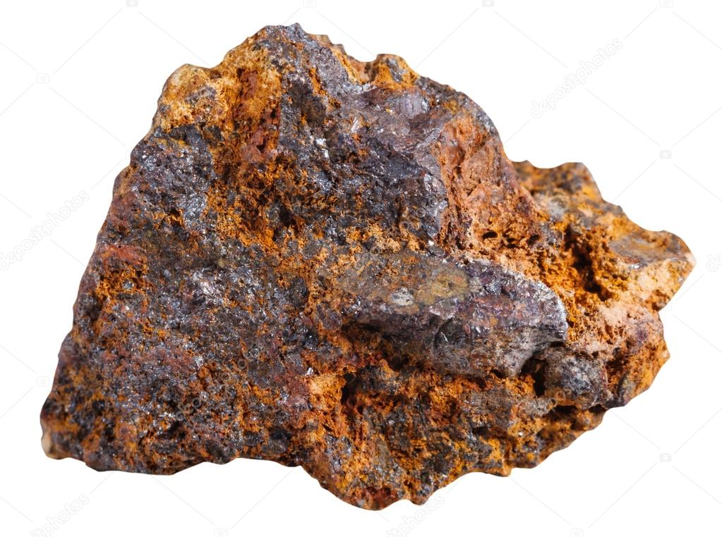
Redox potentials are wild
NOT ALL THE SAME
Hierarchy (fastest to slowest):
Poorly crystalline ferrihydrite
Crystalline iron(iii) (oxyhydr)oxide
Geoethite
Haematite
Clays
Microbial reduction decreases redox potential (but isn’t this obvious?)

Slide 5
Fe2
More soluble
More bioavailable
But changes under oxic conditions
Unless attached to organic matter

Slide 6
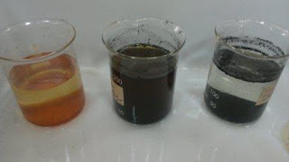
Colloid vs particulate
Colloids are easier to transport
(so what I’m hearing is that colloid =/= particulate. Cool)
Colloid = milk
Particles smaller than 1,000 nm in at least one dimension that are dispersed in a substance of another physical state (for example, mineral particles in a liquid).
Particulate
larger than 1,000 nm in all dimensions

Slide 7
Methods Maddy might want to do
Transmission electron microscopy
Scanning electron microscopy

Slide 8
Iron oxidation
Abiotic
Homogenous fe(ii) oxidation (both dissolved)
Heterogeneous fe(ii) oxidation (one dissolved one solid)
Pseudo first order
Biotic
Microaerophilic Fe(ii) oxidation
lithoautotrophic bacteria: fe(ii) = electron acceptor, o2 = donor
aquatic oxic–anoxic interfaces with opposing gradients of O2 and Fe(ii)
Have to compete with abiotic reactions, so they tend to live where oxygen is low. They wind the competition below 1.5 mg/L (approx.)
Optimum growth at approximately 0.15–0.7 mg/L
If you oxidize iron in the cell now your body is literally rusting. Most likely happens outside the cell
in situ rates of microbial Fe(ii) oxidation depend on water flow leading to advection and turbulent mixing

Slide 9
The Bright Side
Photoautotroph/photoferrotroph
use light energy and electrons from Fe(ii) to fix bicarbonate into organic carbon
Purple sulfur bacteria, non-sulfur bacteria
Green sulfur bacteria
Crazy cool ways of avoiding getting encrusted in iron!!!
lowering pH around the cell
Creating fibers to template mineralization
Secreting organic iron-binding ligands
Don’t need as much light as oxygenic photoautotrophs

Slide 10
The bright side pt 2: Fe(iii) reduction
Ligand to metal charge transfer (LMCT)
Only organic carbon bound to certain ligands
Reduced by superoxide that is produced from photochemical reactions of OM and O2
Interesting. Apparently this is something that happens, who knew
Primary pathway for ROS production
Can break apart Fe(III) (oxyhydr)oxides (LMCT can’t)
Phytoplankton and some bacteria produce superoxide!!
Cyanos can reduce fe using enzymes
Increased Fe(ii) during the day!!

Slide 11
One nitro pls
Iron oxidation can be coupled to nitrate reduction to n2 or ammonium
NRFeOx
More often nitrate reduction is coupled to carbon oxidation (generating energy). Fe is then oxidized by nitrite, other reactive species – this is called chemodentirification
Creates N20 ???
Role of microbes is being resolved
Oxidation of FeS and FeS2 (pyrite) can be coupled to nitrate reduction

Slide 12
Manganese and iron, sitting in a tree
Mn oxides oxidize fe(II)
Manganese reduction occurs first, then iron reduction

Slide 13
Breathing iron
Lots of bacteria do it, energy gained depends on the form of fe(III)
ferrihydrite, goethite, haematite, magnetite, etc
CHALLENGES
Electron acceptor poorly soluble
touch the solid with cell membrane
“microbial nanowires”
electron shuttles (reduce something else, that thing transfers an electron to Fe, becomes reoxidized rinse and repeat

Slide 14
So how does this relate to climate change
Anaerobic methane oxidation using Fe
Also ammonium oxidation: Fe-ammox
Fe-ammox can cause N20 emissions

Slide 15
Cryptic
Re-reduction can mask oxidation
Within Fe cycle
Between Fe and S
Between Fe and N

