Slide 1
set up more o-a and a-o
DOC (60 mL)
Fe (ferrozine; 10)
Fe-OC in sediment
pH (20 mL)
oxygen
oxic
oxic
21 days
o-o and a-a
7 days x 3 x 2 = 42
o-a and a-o
10 days x 3 x 2 = 60
Wednesday (sample reservoir, set up incubation)
Take 4 sediment samples
4 iron measurements, 4 DOC samples
DO, pH
Friday (sample day 2)
Tuesday (sample day 6)
Friday (sample day 9)
Tuesday (sample day 13) - switch the o-a and a-o bottles
For o-a this means bringing them all (n = 15) up to the anaerobic chamber
Wednesday (14)- switch only
Thursday (15) – switch only
Friday (sample day 16)
Tuesday (sample day 20)
Friday (sample day 23)
Tuesday extra sampling???
anoxic
anoxic

Slide 2
DOC sampling
~40 mL of water (10-15 required, plus some need reps)
Freeze this in a nutrient bottle

Slide 3
Fe sampling
10 mLs
If you only care about total iron: just take a sample and acidify to pH 1-2. Should be stable for 6 months
Think about doing ferrozine for Fe2+
Total and soluble?
Filters and tubes (order these)
Do ferrozine a few (~3) times

Slide 4
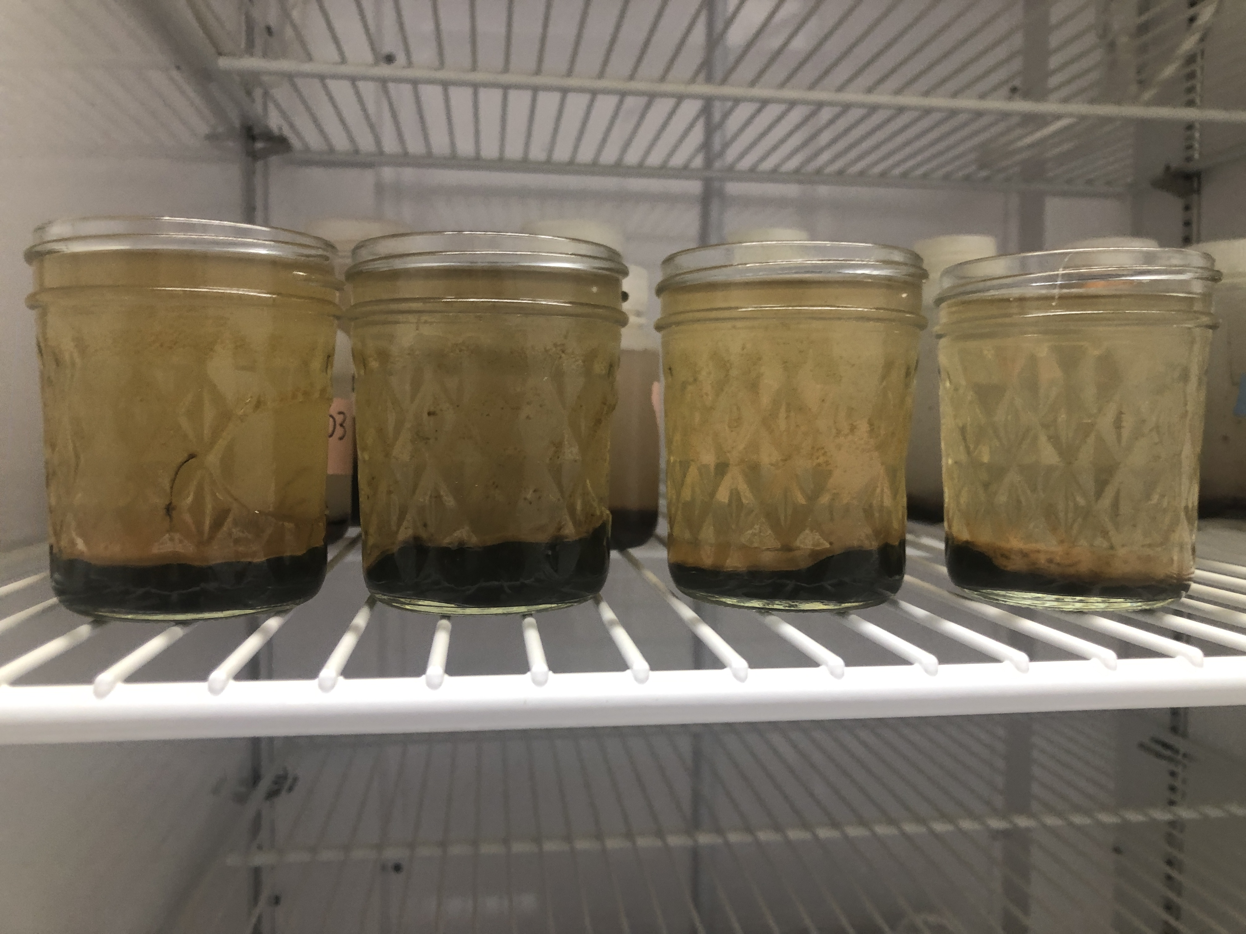
Set up
175 mls, 15 mls of sed using syringe

Slide 5
pH
measure pH in separate bottle?

Slide 6
Sediment
Need to clean out bottle and get it into a container that can be frozen
Syringe/pour out water
Use some scraper to get sediment out

Slide 7
Oxygen
DO probe

Slide 8
TO DO
Labels for metals samples
Box for frozen samples

Slide 9
Ordering needs
Ordered
Jars and lids
Things we have
Syringes (normal acid washed)
Scrapers (probably use metal ones from lab)
Container to freeze sediment in (probably EEMs vials)
Other – for later
Falcon tubes!

