Slide 1
Fe-OC results share

Slide 2
Figure list
Whole ecosystem:
Heatmaps (2019 and 2021, BVR and FCR): fix oxygenation lines
Oxygen
Fe
DOC
Fe-OC
Sed traps
Fe, OC, Fe-OC
Incubation: add significance
Fe-OC
Combined figure: Fe, OC, DO
Sediment OC
ICP
SI
Correlation between different metrics of Fe

Slide 3
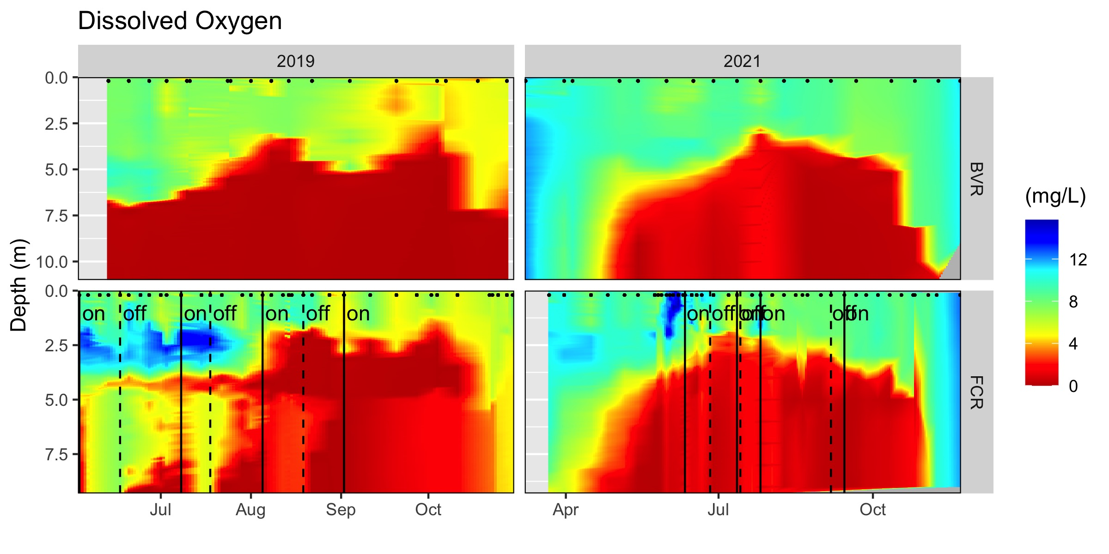
Whole ecosystem oxygen

Slide 4
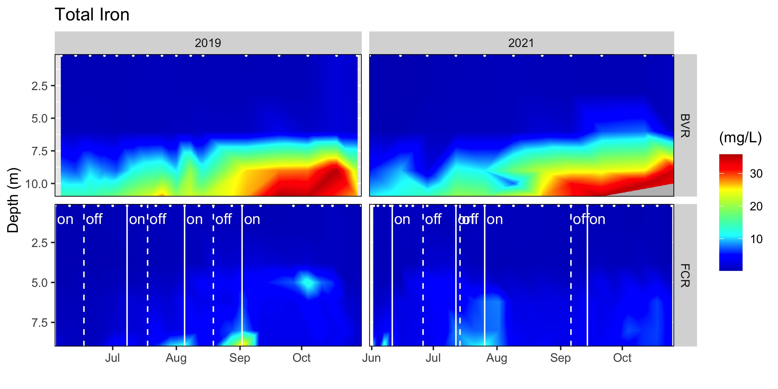
Whole ecosystem Fe

Slide 5
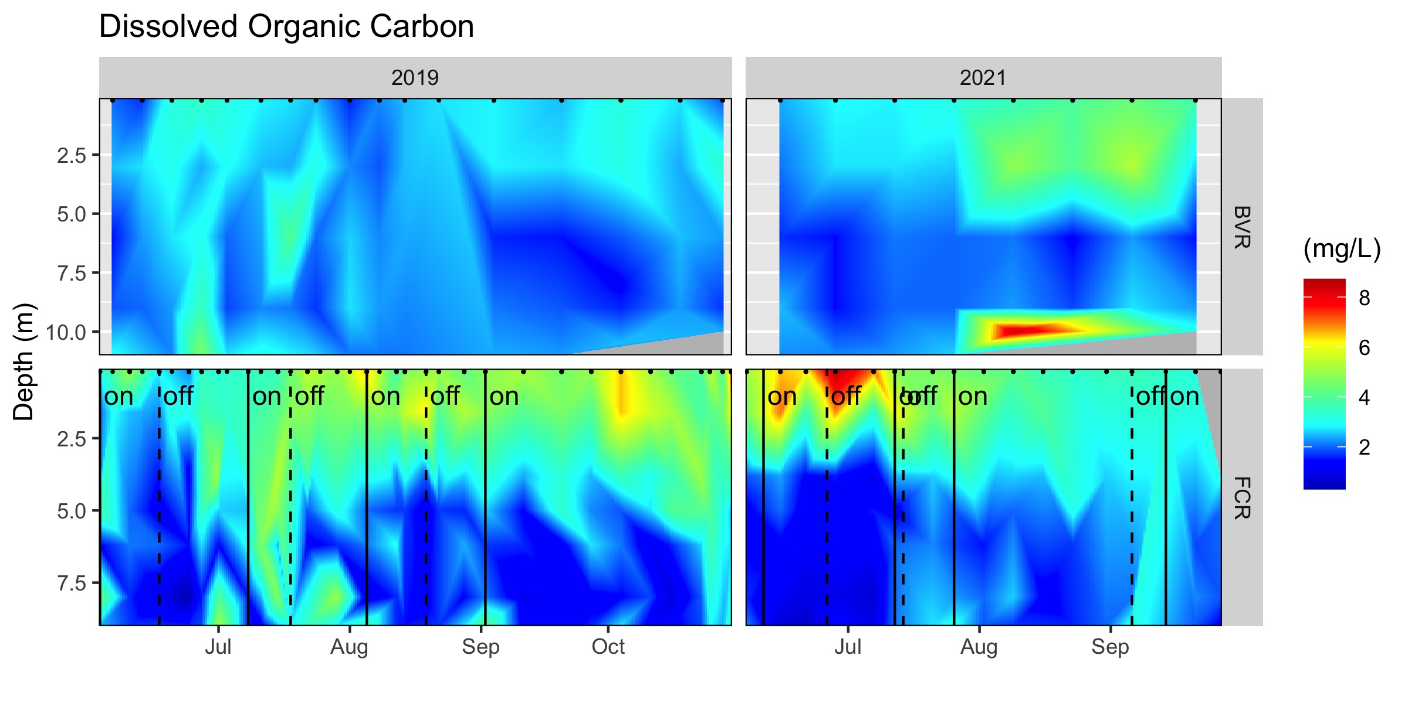
Whole ecosystem DOC

Slide 6
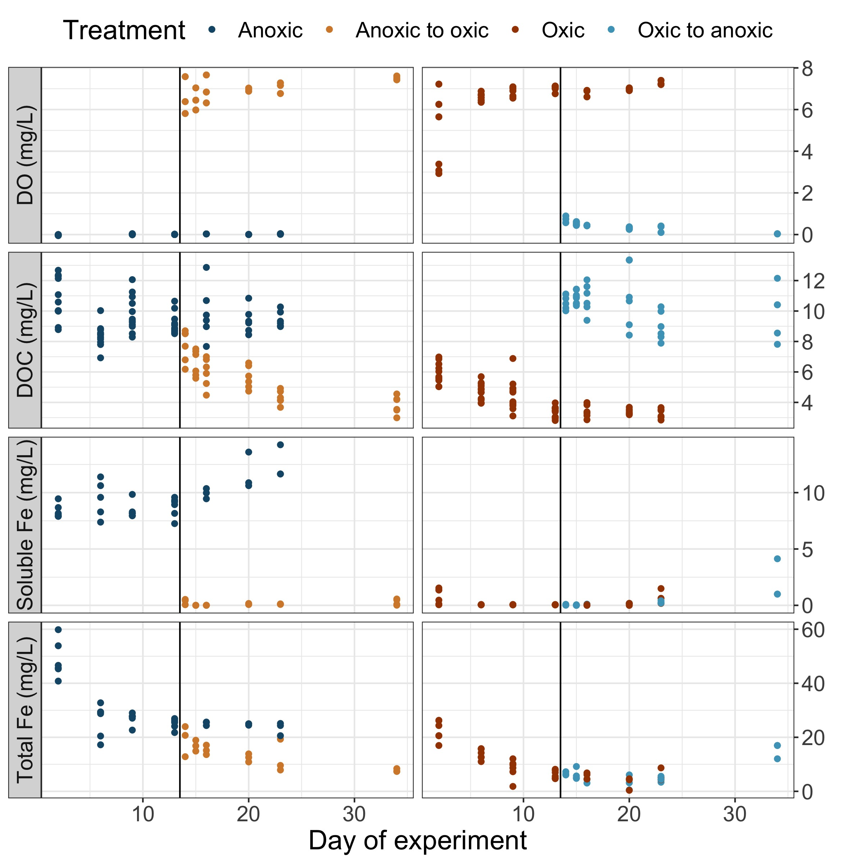
Incubation (all water column data)

Slide 7
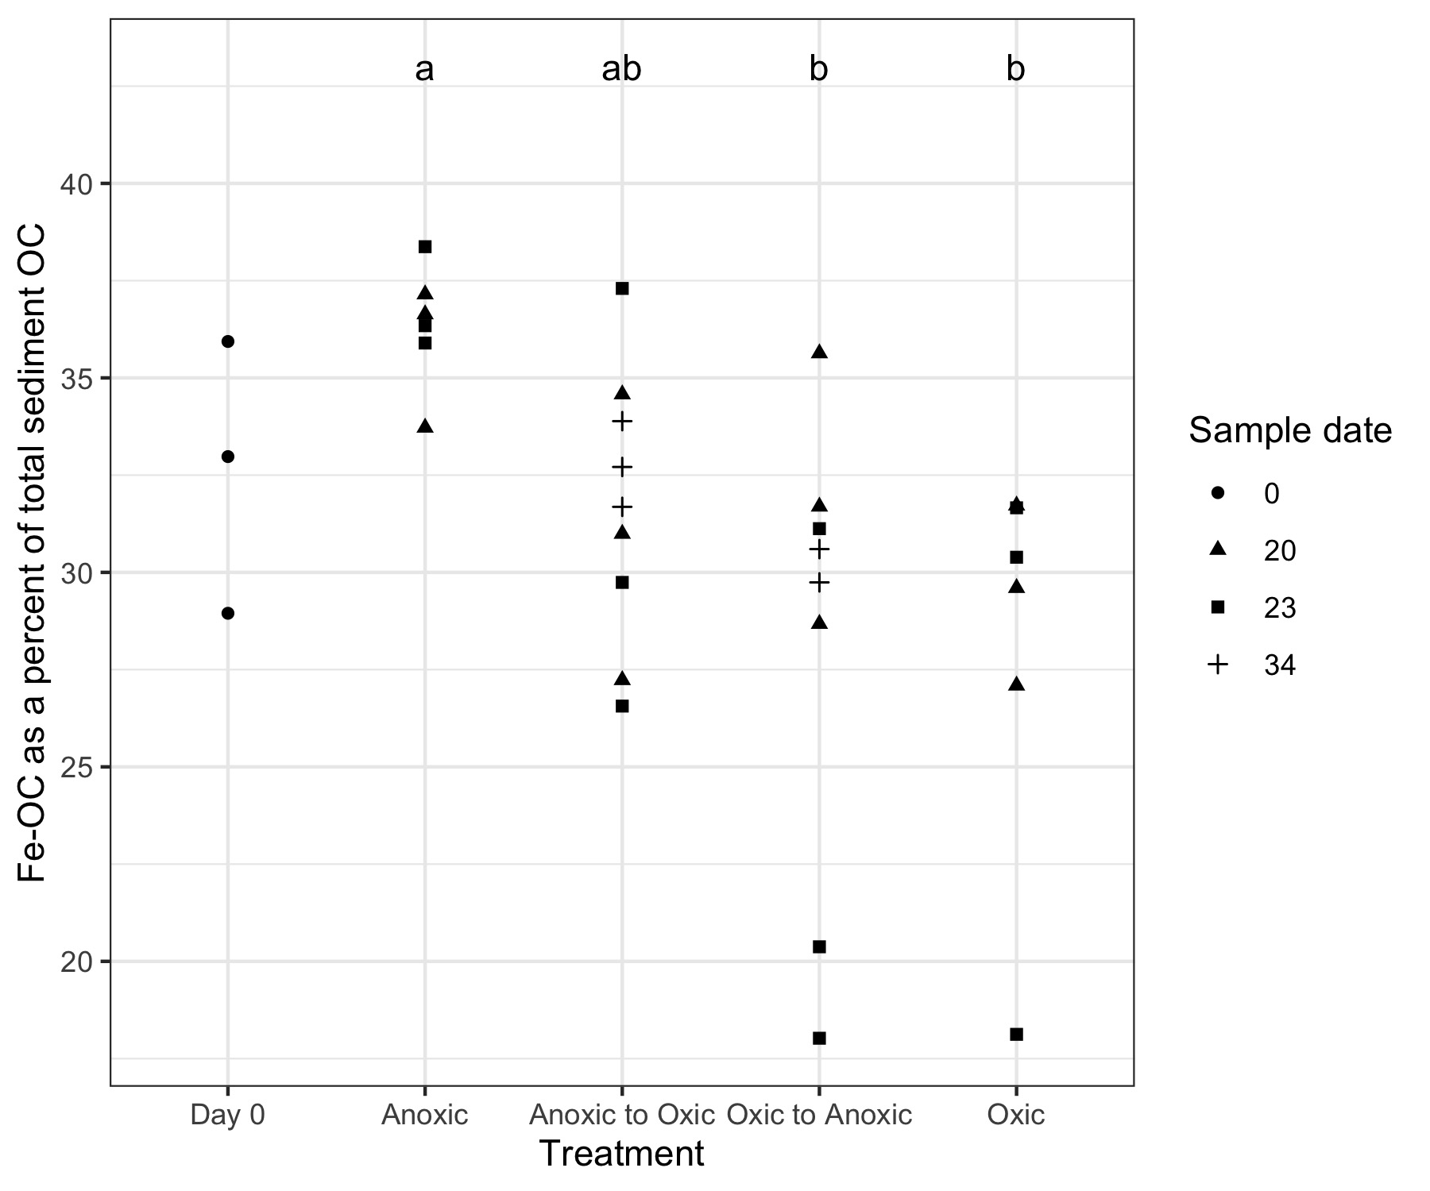
Incubation Fe-OC

Slide 8
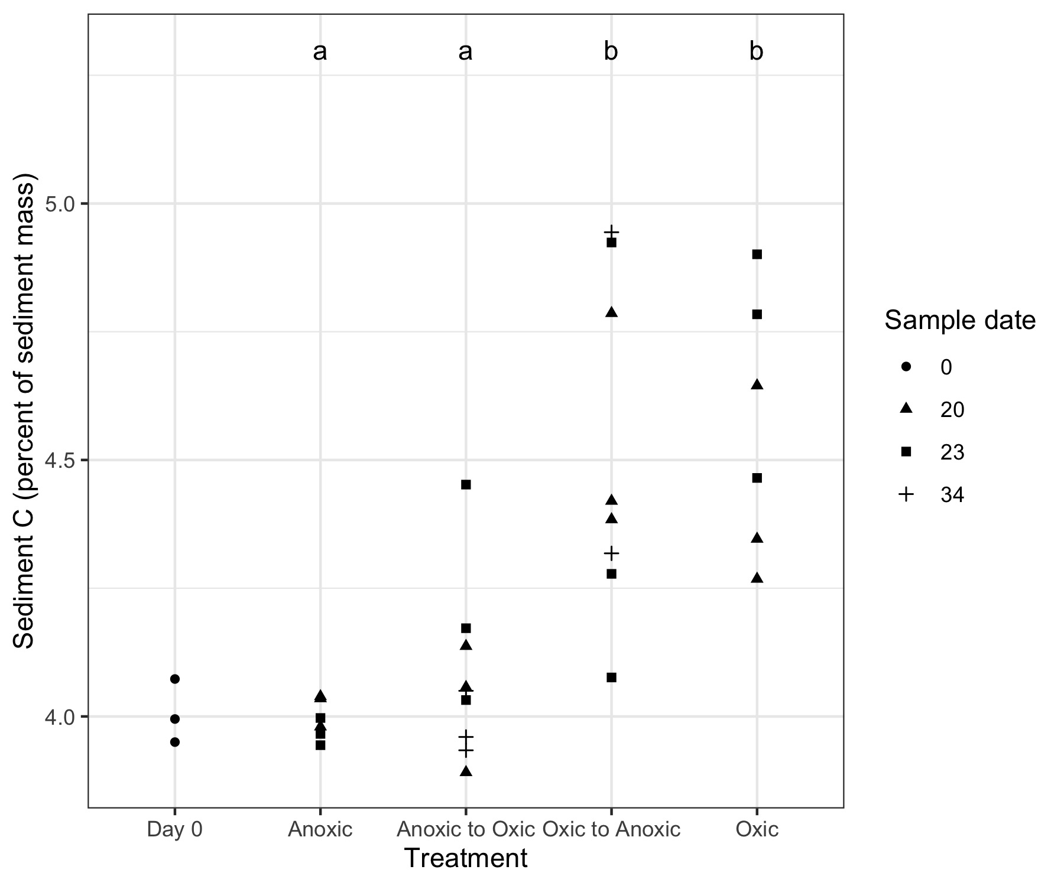
Incubation Sediment OC

Slide 9
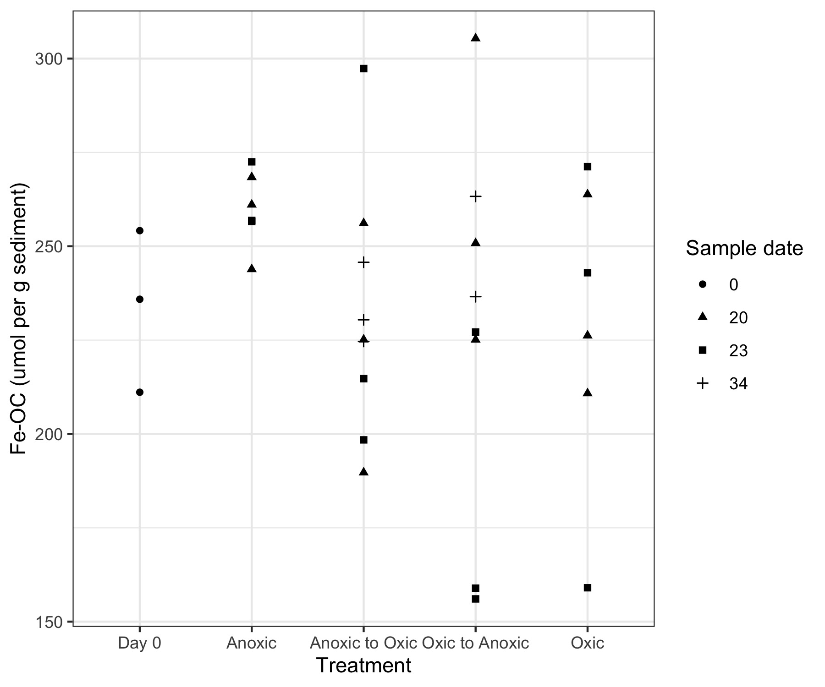
Incubation Fe-OC (per unit sediment mass)

Slide 10
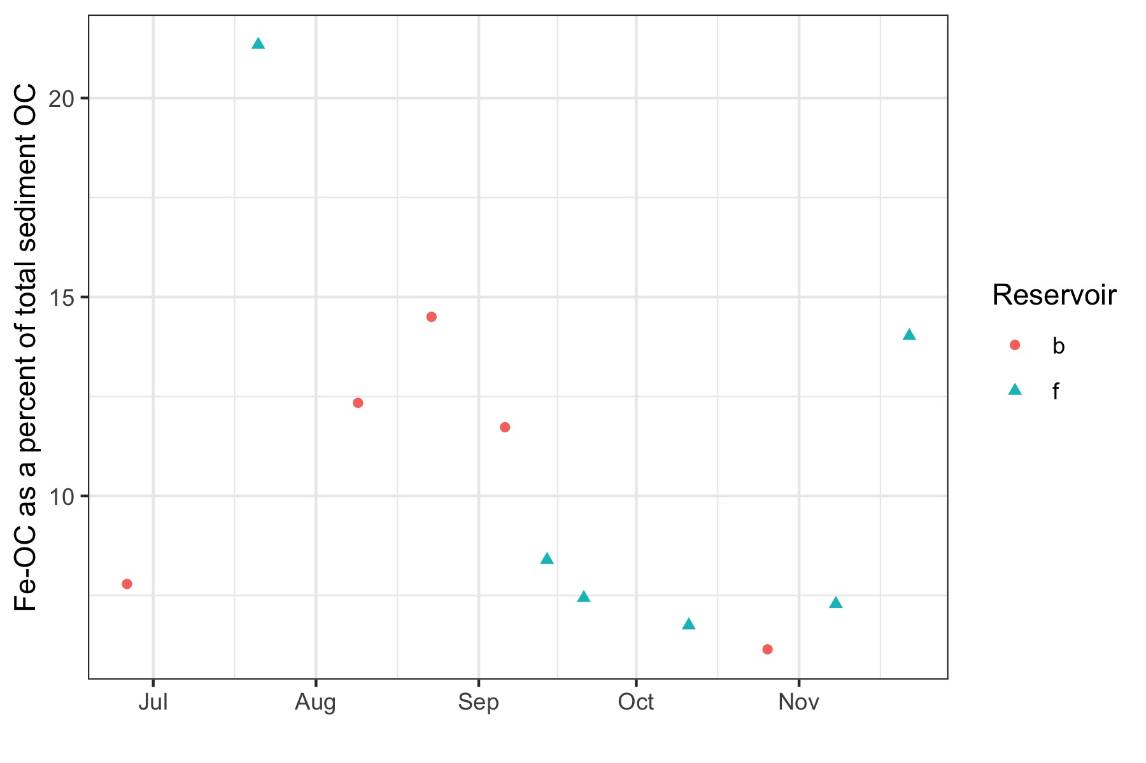
Sed trap

Slide 11
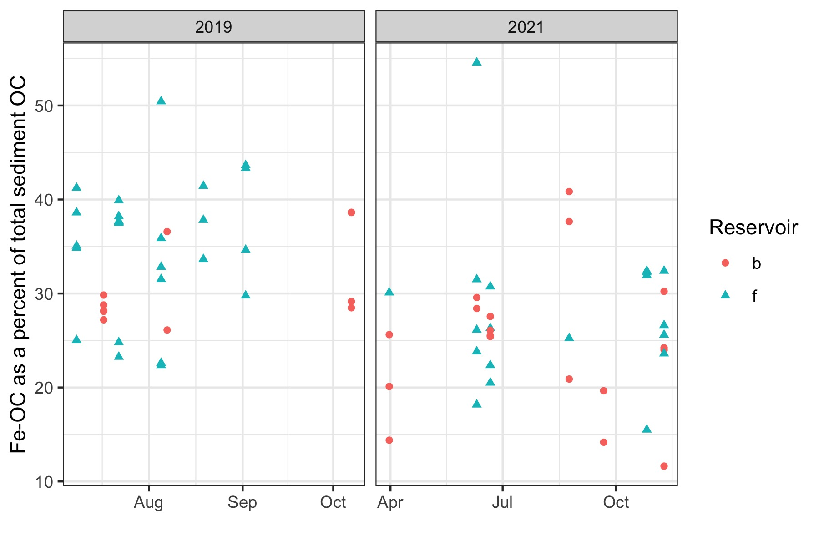
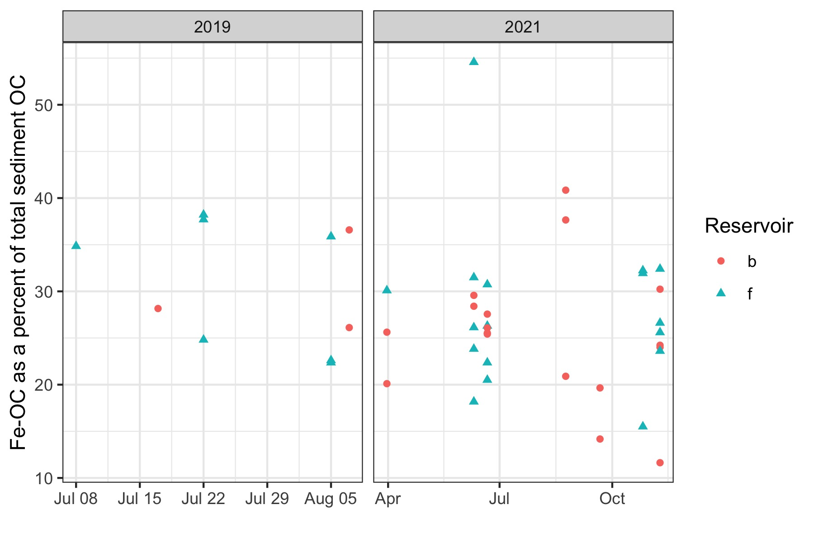
Whole ecosystem Fe-OC

Slide 12
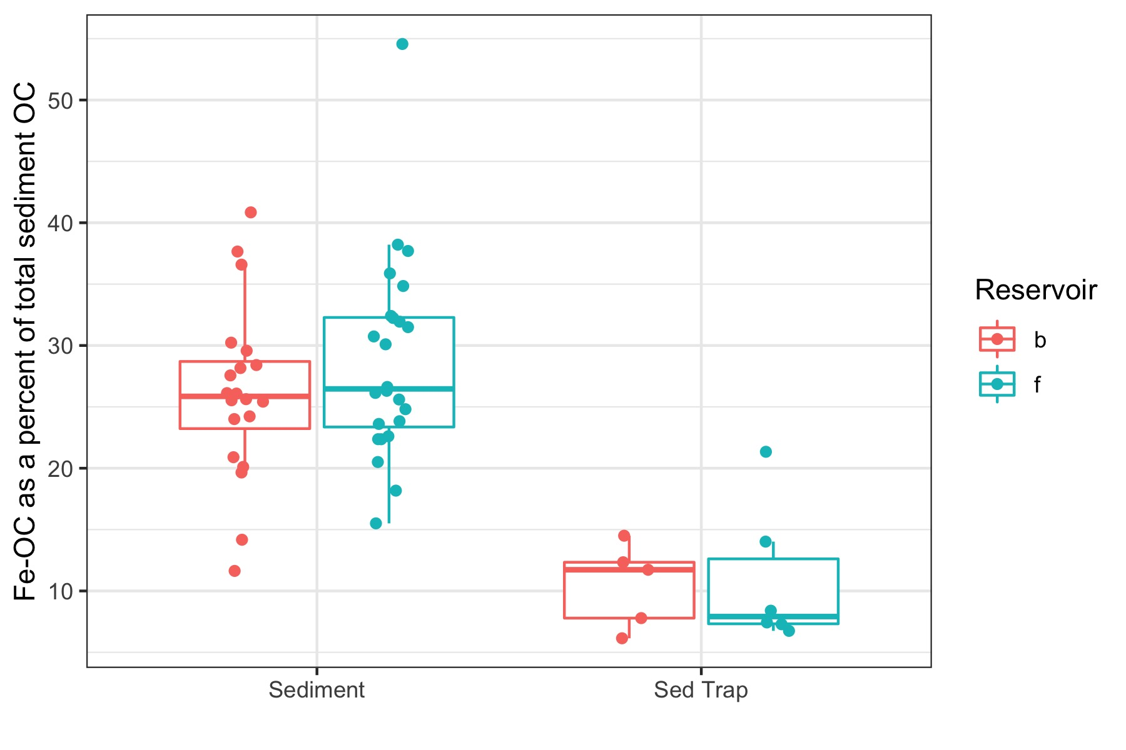
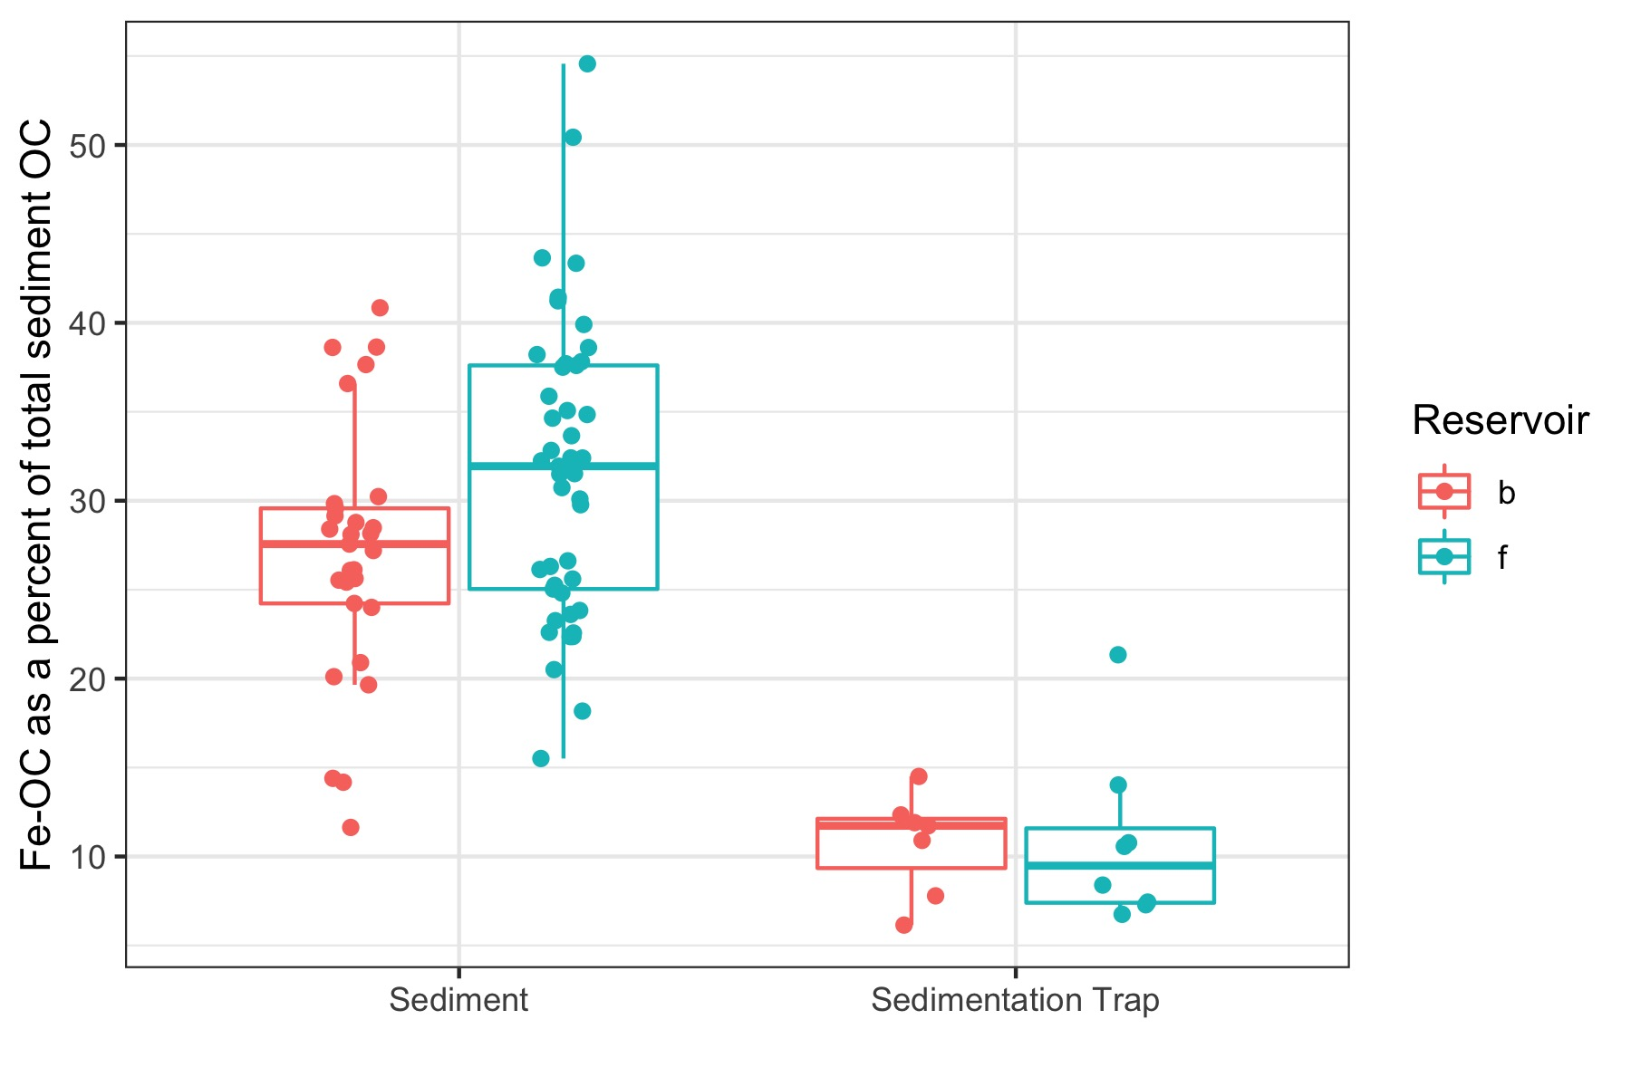
Sed trap comparison

Slide 13
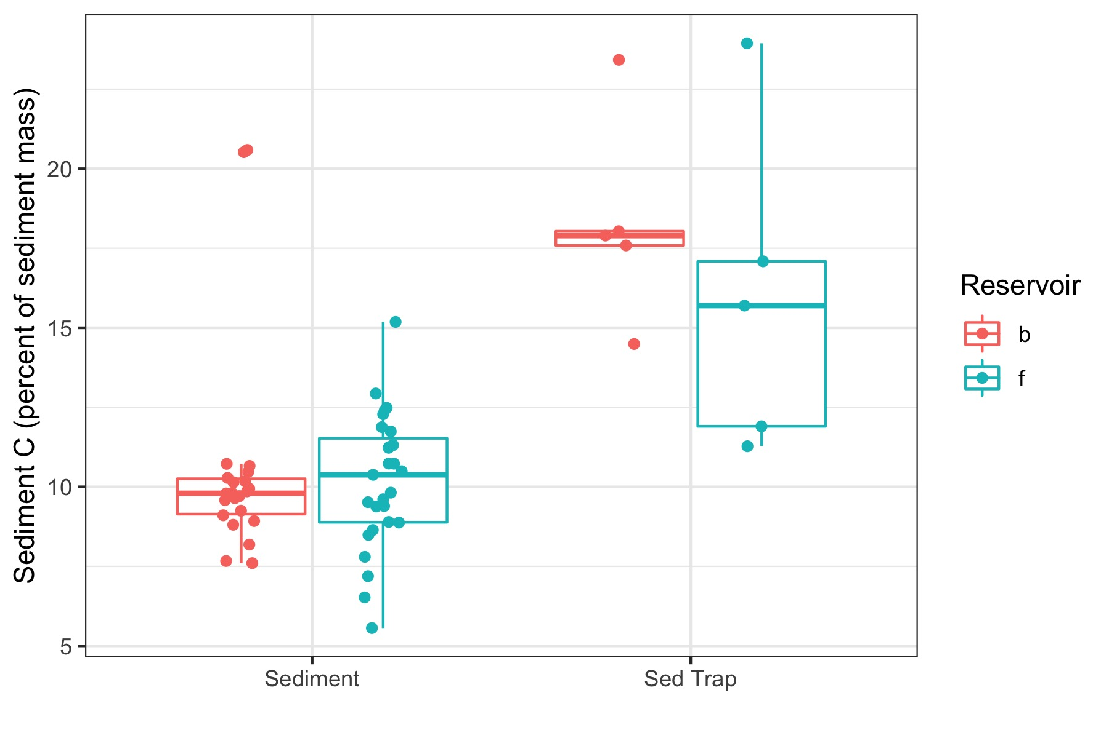
Sed trap comparison

Slide 14
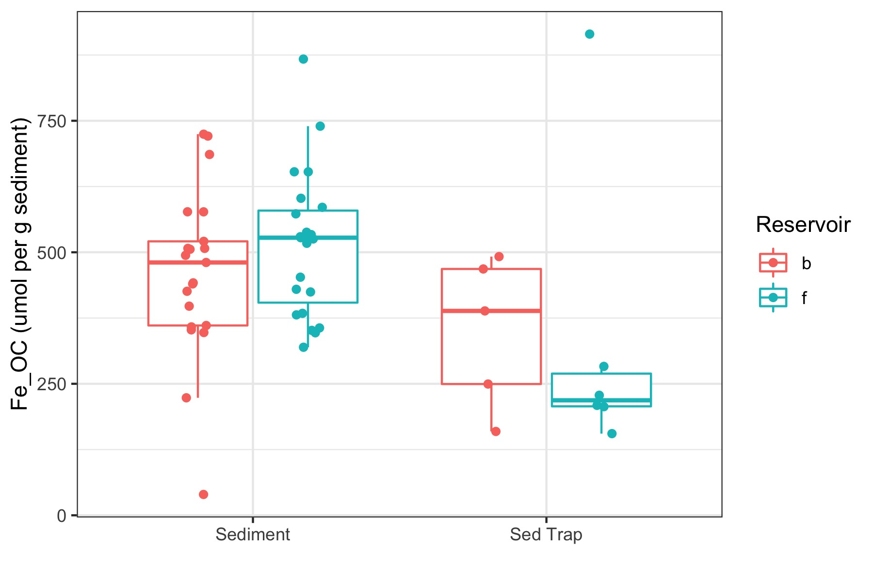
Sed trap comparison

Slide 15
Ferrihydrite vs quartz

