Slide 1
Decisions, Decisions
3
A
4
5
1
B
6
S
7
2
C
8
9
D
0

Slide 2
You crashed
Pick lighter
pick water bottle
create a shelter
Go hunting
go upstream
go down stream
catch too many fish (just incase) then get mauled by a bear
Catch just enough to survive
make a bow and kill a deer and survive
Find berries that kill you and are poisonous
Build it inside a cave and survive
Build it outside and Die of hypothermia
walk to the source of the river and get help and survive
Stay and starve to death waiting for help

Slide 3





S
It’s the year 2020, and you just crashed into a forest being the only one to survive. No one is around to help you. Now its your job to survive.
Collect an Item to carry around for the rest of the game.

Slide 4
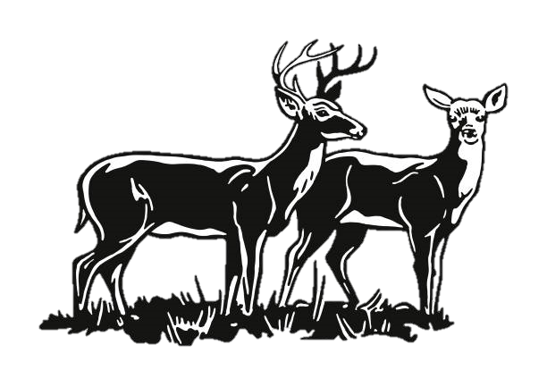


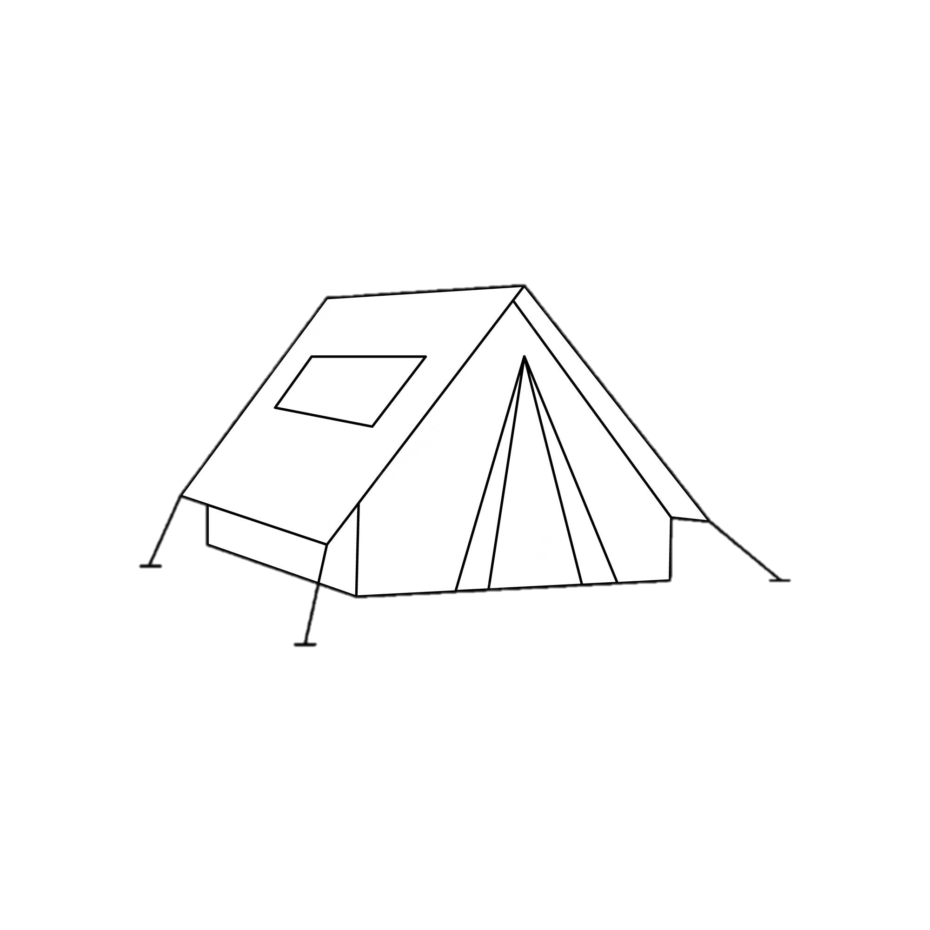

S1
Go gather some wood to start a fire
Should we create a shelter or go hunting.

Slide 5
S1A
Its starting to get dark.
Let's create a shelter.
Should you build it inside or outside?

Slide 6

S1A3
This seems nice.
12hrs later you died of hypothermia.
I guess it wasn’t so nice.

Slide 7
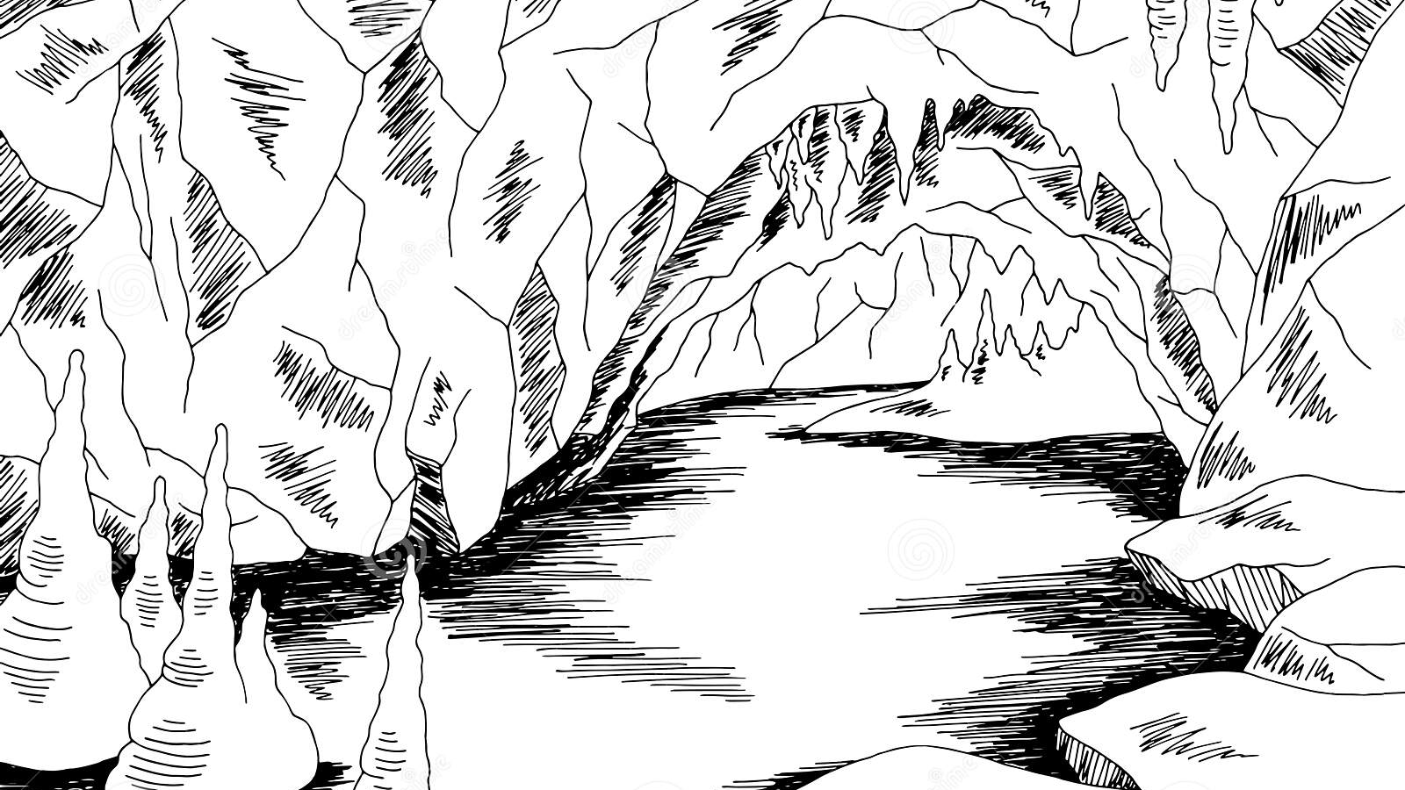
S1A4
This echo is cool.
12hr later the plane was discovered, and a rescue team found you.

Slide 8
S1B
We need to find some food.
We should go hunting

Slide 9

S1B5
A bow seems to be an efficient weapon.
Let's hunt some deer.
12hr later the plane was discovered, and a rescue team found you.

Slide 10

S1B6
The berries you ate were poisonous
You died

Slide 11
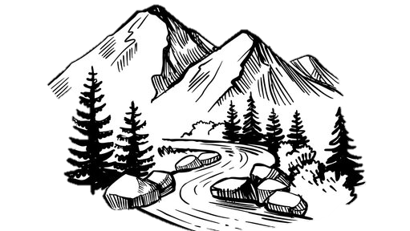
S2
Look around and find a river.
Collect some water

Slide 12
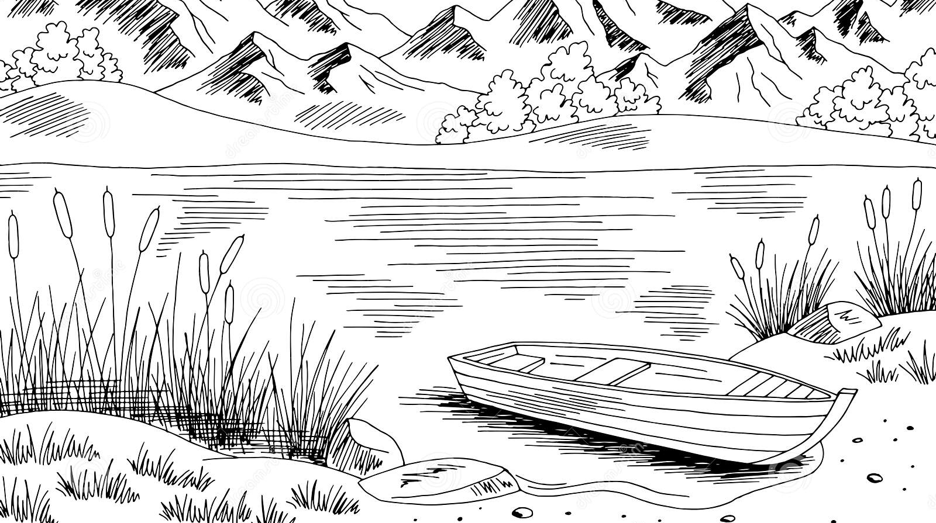
S2C
You found clean water!

Slide 13
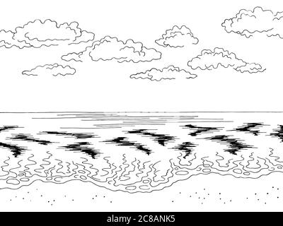
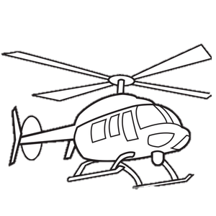

S2C7
walk to the source of the river and get help and survive
SOS

Slide 14

S2C8
Stay and starve to death waiting for help

Slide 15
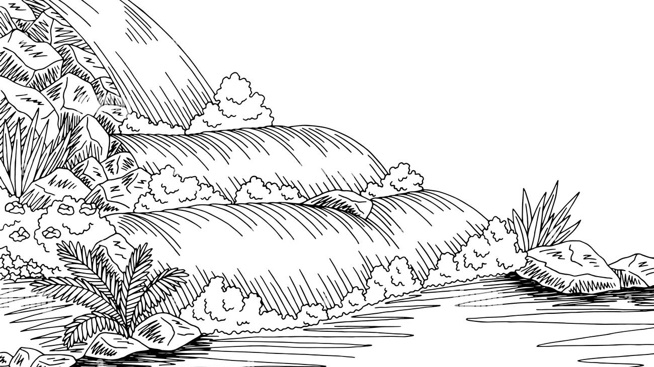


S2D
You found food!
Collect the fish.

Slide 16


S2D9
You got mauled by a bear

Slide 17

S2D0
You survived long enough to get rescued

