Slide 1

Person Re-identification in Videos
using 3 dimensional Fully Convoluted Networks
Shivansh Rao
(2K15/EC/150)
Mentor - Prof. Rajesh Rohilla
Department of Electronics & Communication Engineering
Delhi Technological University

Slide 2
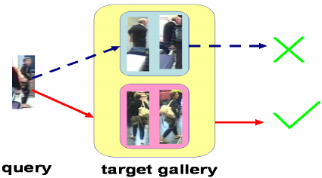
Aim of the our task in hand

Slide 3
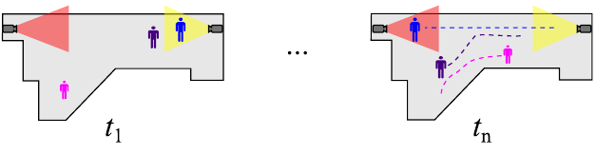
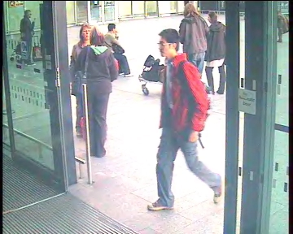
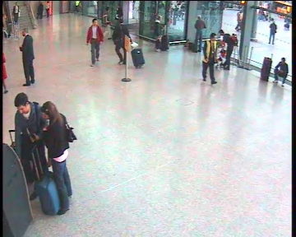
ReIDentification (ReID)
Recognizing individuals over different camera views
(we focus on Re-ID based on the attention we calculate)
Camera A, time t
Camera B, time t+∆t
Notes:
The ReID problem has lately received increasing attention especially due to its important role in surveillance systems.
First, let’s define what ReID means.
Given a camera network covering non-overlapping fields of view on a site as for example an airport or a shopping mall,
we would want to be able to find correspondence between two appearances of the same subject captured in different location and time.
Thought ReID can use different kind of cues, in our work we focus on appearance based cues.

Slide 4
Introduction
In the present world filled with CCTV cameras at every corner the data generated from digital surveillance has become so massive that it is impossible for human operators to make sense out of. The rise of machine vision algorithms (and advances in hardware that can handle parallel processing) that can plough through such data and return meaningful insights has offered some solutions. Vision techniques such as face detection and face recognition has found their ways into cameras and social medias.

Slide 5
Facebook can automatically identify the images that you are in even though nobody tagged you in it. Their algorithms learn the features of your face from the manually tagged images and look for such features in new images. To create such systems that work on billion of people it requires some serious engineering.
The vision technique that we are going to explore is slightly different. It is person re-identification. We have to find a matching person (in a gallery of images) for a given image using not (just) the facial features but features found in his/her entire body (like clothing, height etc). Face recognition works only when the subject is close enough and facing towards to the camera. But usually in CCTV footage this is not the case, and one can even cover his face from the camera! Before diving into coding let’s attempt to formalize our discussion.

Slide 6
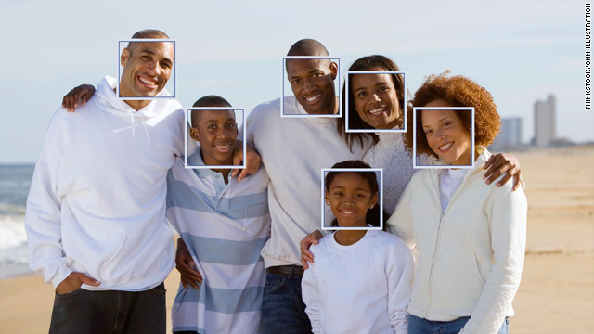

Slide 7
Person re-identification is associating images of the same person taken from different cameras or from the same camera in different occasions. In other words assigning a stable ID to a person in multi-camera setting. Usually the re-identification is constrained to a small time period and a small area covered by cameras. Humans are easily able to Re-ID others by leveraging descriptors based on the person’s face, height, and build, clothing, hair style, walking pattern, etc but this seemingly easy problem is extremely difficult for a machine to solve.

Slide 8
Person Re-Id challenges
The main challenge comes from the intra-class variations, i.e. the variations in appearance of the same person across different cameras. Main challenges are discussed below.
1.Prior to Re-ID the system has to detect a person and define the bounding box of the person in an image. As you can see in the Figure 4 human body is very deformable. Detecting such deformable objects is a challenge in itself.

Slide 9
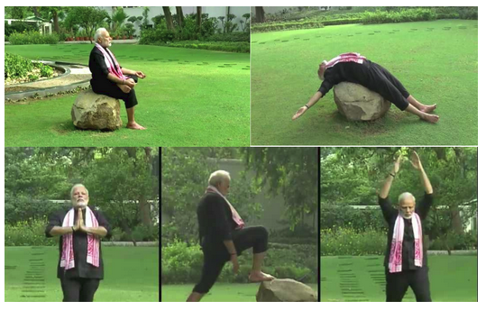

Slide 10
2. A Re-ID system may take an image (called single-shot) or a video (multi-shot) as input. In a video input we need to be able to establish correspondence between detected subjects across frames. This process is called tracking. Tracking multiple persons is also a challenging task.
3. Illumination changes. Intensity of daylight, shade, reflected light from colored surfaces, indoor lighting can cause the same subject to appear in different shades and colors across cameras.
4. Low resolution. Many old CCTV systems are with cameras of low resolution. Due to the lack of information person Re-ID becomes even more difficult

Slide 11
5. Occlusion. In crowded environments partial or even complete occlusion of persons by others presents challenge in extracting features
6. Uniform clothing at schools and even some workplaces will confuse Re-ID algorithms which extract information from clothing/appearance
7. Scalability. Public areas are covered by thousands of cameras and current technologies are only beginning to address multi-camera surveillance problem

Slide 12
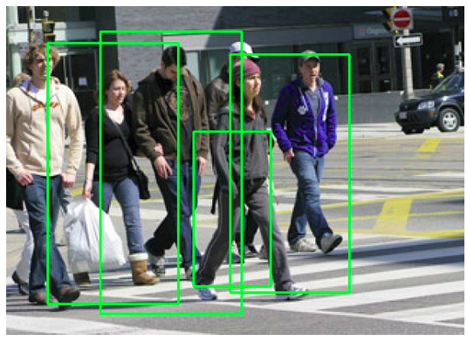

Slide 13
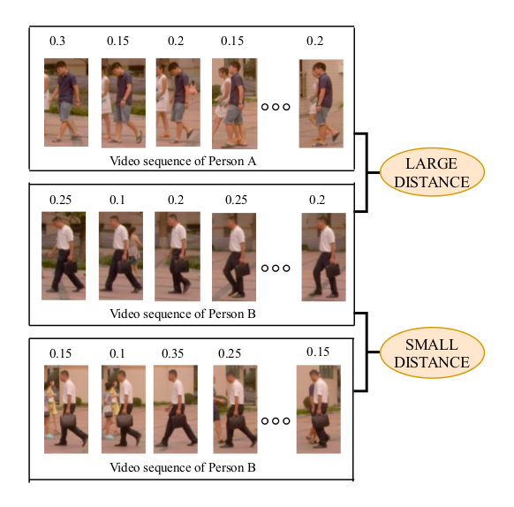
Algorithm

Slide 14
Image – Based Person Re-Identification (ReID)
Given an image (probe image) including a person captured by one camera, the goal of image-based person re-identification is to match the same person in a set of images (gallery images) captured by another different and non-overlapping camera.
Existing approaches usually involve on two steps:
(1) extracting feature vectors
(2) computing the similarity of feature vectors of two persons.
To a large extent, the quality of feature vectors is crucial for the performance of person re-identification.
After extracting features from images, a distance metric is used to calculate the similarity/dis-similarity between features of two images. Ideally, the distance should be small if the two images contain the same person.

Slide 15
Video – Based Person Re-Identification (ReID)
Compared with static images, videos provide richer information for person re-identification. In addition, video-based person re-identification is closer to real-world settings. In recent years, video-based person re-identification has received
lots of attention in the research community.
Some earlier works consider frame-level similarity for identifying the person. Recently, deep learning approaches are adopted to obtain more discriminative video-level features.
McLaughlin et al.propose a method that uses optical flows and recurrent neural networks (RNN) as well as temporal pooling layers to extract temporal information.
Recent trends have focussed on proposing a new spatiotemporal attention model to automatically discovers a diverse set of distinctive body parts.

Slide 16
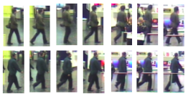
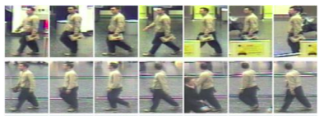
Datasets Used in this work

Slide 17
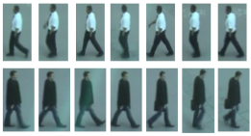
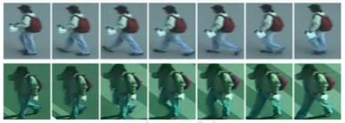

Slide 18
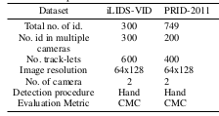

Slide 19
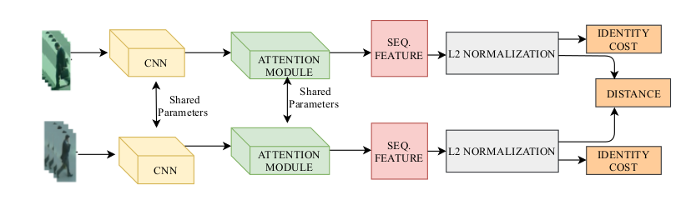
Our Approach
In our approach, we use a Siamese network architecture which takes a pair of input video sequences as its input. The network architecture has two identical branches with shared model parameters. Each branch takes a video sequence as the input and produce a video-level feature vector representation that summarizes the input video.

Slide 20
The distance of the video-level feature vectors of the two input videos is used to indicate how likely these two videos contain the same person. Each branch of the Siamese network contains several modules.
First, a frame feature extraction module is applied to extract a feature representation from each frame in the input video.
Then we adopt an efficient non-local attention mechanism to assign an attention score between every pair of frames in the video. These attention scores are used to compute a weighted frame feature for each frame.

Slide 21
For each frame, the corresponding weighted frame feature is computed based on information from all frames in the video, so the weighted frame feature captures non-local information of the video.
Finally, a video-level feature is obtained by temporal pooling on the combination of the weighted frame features and the raw frame features.

Slide 22
Frame Level Features
We use both RGB color and optical flow channels to extract the frame-level features. The color channels provide the information about the appearance of a person, while the optical flow channels provide the information about the movement of the person. Intuitively, both sources of information are useful for person re-identification.
We convert an input image (i.e. a video frame) from RGB to YUV color space and normalize each color channel to have a zero mean and unit variance. We also resize each frame to have a spatial dimension of 56×40. In the end, each frame is represented as a 56×40×5 tensor, where the 5 channels correspond to 3 color channels and 2 optical flow channels.

Slide 23
We use the same backbone CNN architecture to extract feature-level features. It consists of three stages of convolution, max-pooling, and non-linear (tanh) activation. Each convolution filter uses 5 × 5 kernels with 1 × 1 stride and 4 × 4 zero padding. If the input video contains N frames, the CNN model is applied on each frame of the video to produce a C × H × W dimensional feature x i ∈ R C×H×W (i= 1,2,...,N ), where C is the channel dimension and H × W is the spatial dimension of the feature map.

Slide 24
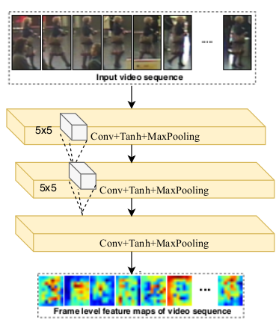
CNN Architecture

Slide 25
3 Dimensional Fully Convoluted Networks
In video-based person re-identification, a key challenge is how to combine frame-level features into a video-level feature, so that the video-level features of two input videos can be compared for the re-identification.
Previous work has used temporal pooling and recurrent neural network (RNN) to compute the video-level feature. However, both of these approaches have some limitations. These techniques do not calculate both spatial and temporal attention together.

Slide 26
In 2D CNNs, convolutions are applied on the 2D feature maps to compute features from the spatial dimensions only. When applied to the video-based problem, it is desirable to capture the temporal information encoded in multiple contiguous frames. The 3D convolutions are achieved by convolving 3D kernel on the cube formed by stacking multiple consecutive frames together. In other words, 3D convolutions can directly extract a whole representation for a video track, while 2D convolutions first extract a sequence of image-level features and then features are aggregated into a single vector feature.

Slide 27
We adopt 3D FCN architecure that uses 3D convolution kernels with FCN architecture to extract spatial-temporal features. However, 3D ConvNet [37] is hard to optimize because of a large number of parameters. In order to address this problem, we decompose the 3d filter as a multiplication of one 1D filter and one 2D filter. The 1D filter in our case calculates the attention of the time frames of the video that is it evaluates the temporal attention across all the frames of a video whereas the 2D filter calulates the spatial attention across a single frame of a video that is it evaluates the spatial attention across all the frames of a video. Hence this computation is much more easier than carrying out straightaway 3 dimensional convoltuion of the input images. Hence in this way we make use of the 3 dimensional fully convolutional network to extract both the spatial and temporal attention feratures of the input images.

Slide 28
Setup and Implementation details
We follow the same experiment protocol as McLaughlin et al.on both datasets (iLIDS-VID and PRID-2011) in which we randomly split the dataset into two equal subsets where one subset is used for training and the other one for testing. For the SDU-VID dataset, we follow the experiment protocol of with the same splitting strategy above. We have repeated all experiments 10 times for stable results. For evaluating our proposed method, we use the Cumulative Matching Characteristics (CMC) curve which is a ranking based evaluation metric. In the ideal case, the
ground-truth video sequence should have the highest rank.

Slide 29
Standard data augmentation techniques, such as cropping and mirroring, are applied to increase the amount of training data. To mitigate the influence of class imbalance, we use equal number of positive and negative samples during training.
In the hinge loss, the margin is set as m = 2. The network is trained for 3000 epochs with a batch size of one. In the non-local block, the 1 × 1 convolution layer in θ(·) maps the channel dimension from 32 to 64. The learning rate in the stochastic gradient descent is set to be 1e −4 . The value of momentum is set to be 0.9. Due to the variable-length of video sequences in these datasets, we use sub-sequences of 16 consecutive frames ( N = 16 ) during training.

Slide 30
In the case where a video has less than 16 frames, we consider the whole set of images (frames) as the sub-sequence. During testing,we consider a video sequence captured by the first camera as the probe sequence and a video sequence captured by the second camera as a gallery sequence. We use at most 128 frames in a testing video sequence. Again, if a test video has less than 128 frames, we consider the whole set of images as the video sequence. Similar strategies have been used in previous work.

Slide 31
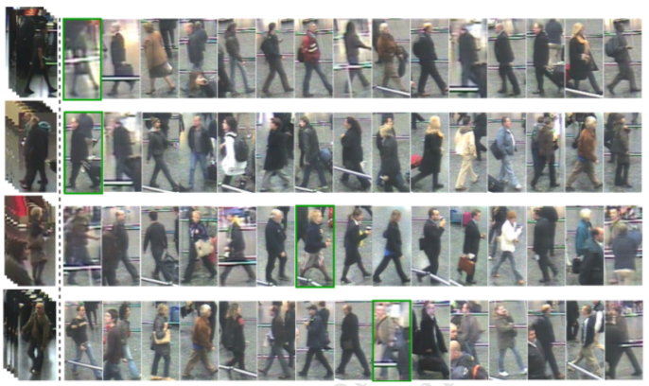
RESULTS

Slide 32
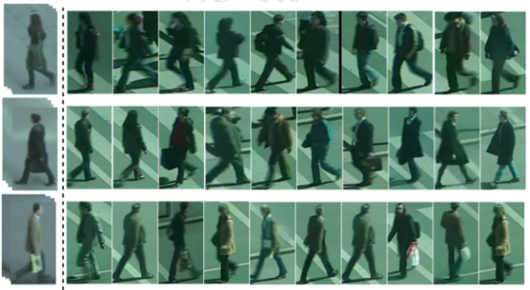

Slide 33
Summary
We have proposed an attention-based deep architecture for video-based re-identification. The attention module calculates frame-level attention scores, where the attention score indicates the importance of a particular frame. We perform experiments on two benchmark datasets and compare with other state-of-the-art approaches. We demonstrate that our proposed method outperforms to other state-of-the-art approaches
Notes:
So to summarize,
In this work, we suggest the observation that when performing ReID in multiple camera site, we no longer have to choose between the less accurate direct method and the computationally expensive learning based method, but we can also choose a third way. We may perform limited learning, such that requires reasonable resources. We have shown that transitively using such learning gives good ReID performance.
In particular, we suggested a specific algorithm based on marginalization: the TRID algorithm , which presents a new approach of transitivity in ReID.
We have shown that its accuracy is superior to that of a state-of-the-art non learning based approach.
The presented algorithm is in fact a general framework that may be combined with different probabilistic classifiers, not necessarily ICT, and of course with different features.

