Slide 2
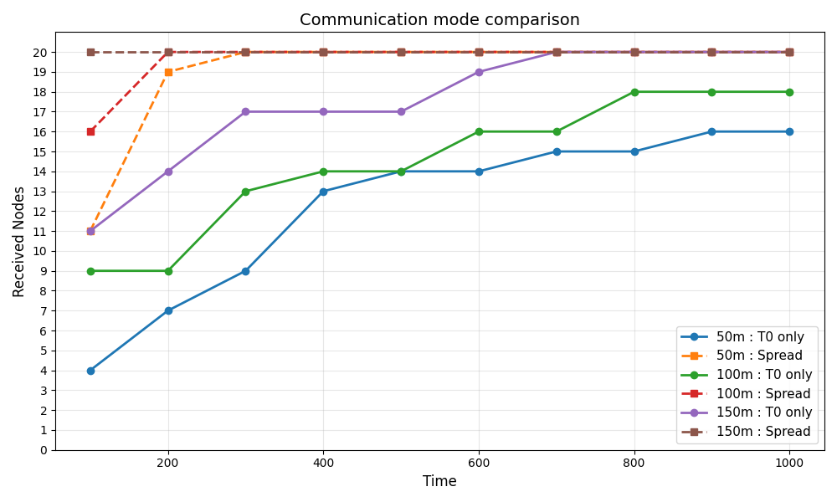
通信可能領域が全部TOのみと拡散。通信距離それぞれの結果
=== Communication range 50m ===
=== T0 only (no spread) ===
time: 100, received: 4
time: 200, received: 7
time: 300, received: 9
time: 400, received: 13
time: 500, received: 14
time: 600, received: 14
time: 700, received: 15
time: 800, received: 15
time: 900, received: 16
time: 1000, received: 16
=== Received nodes also send (spread enabled) ===
time: 100, received: 11
time: 200, received: 19
time: 300, received: 20
time: 400, received: 20
time: 500, received: 20
time: 600, received: 20
time: 700, received: 20
time: 800, received: 20
time: 900, received: 20
time: 1000, received: 20
=== Communication range 100m ===
=== T0 only (no spread) ===
time: 100, received: 9
time: 200, received: 9
time: 300, received: 13
time: 400, received: 14
time: 500, received: 14
time: 600, received: 16
time: 700, received: 16
time: 800, received: 18
time: 900, received: 18
time: 1000, received: 18
=== Received nodes also send (spread enabled) ===
time: 100, received: 16
time: 200, received: 20
time: 300, received: 20
time: 400, received: 20
time: 500, received: 20
time: 600, received: 20
time: 700, received: 20
time: 800, received: 20
time: 900, received: 20
time: 1000, received: 20
=== Communication range 150m ===
=== T0 only (no spread) ===
time: 100, received: 11
time: 200, received: 14
time: 300, received: 17
time: 400, received: 17
time: 500, received: 17
time: 600, received: 19
time: 700, received: 20
time: 800, received: 20
time: 900, received: 20
time: 1000, received: 20
=== Received nodes also send (spread enabled) ===
time: 100, received: 20
time: 200, received: 20
time: 300, received: 20
time: 400, received: 20
time: 500, received: 20
time: 600, received: 20
time: 700, received: 20
time: 800, received: 20
time: 900, received: 20
time: 1000, received: 20
(.venv) PS C:\Users\kazu

Slide 3
============================================================
Experiment 1: Limited communication area comparison
============================================================
=== Limited area: 100×100 (comm_range=100m) ===
No spread:
Final received: 14/100
Spread enabled:
Final received: 1/100
=== Limited area: 200×200 (comm_range=100m) ===
No spread:
Final received: 21/100
Spread enabled:
Final received: 100/100
=== Limited area: 300×300 (comm_range=100m) ===
No spread:
Final received: 76/100
Spread enabled:
Final received: 100/100
=== Full area (no limitation) ===
No spread:
Final received: 98/100
Spread enabled:
Final received: 100/100

Slide 4
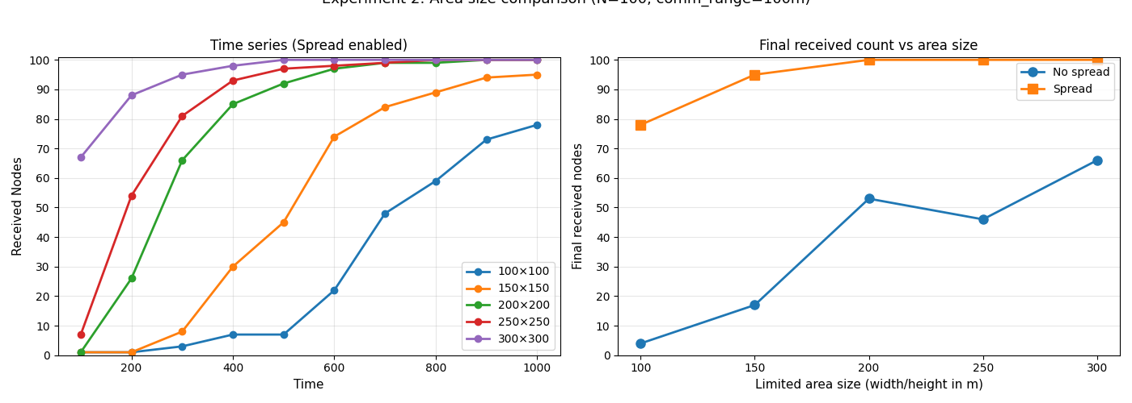
============================================================
Experiment 2: Communication area size comparison (fixed N)
============================================================
100×100: No spread=4, Spread=78
150×150: No spread=17, Spread=95
200×200: No spread=53, Spread=100
250×250: No spread=46, Spread=100
300×300: No spread=66, Spread=100

Slide 5
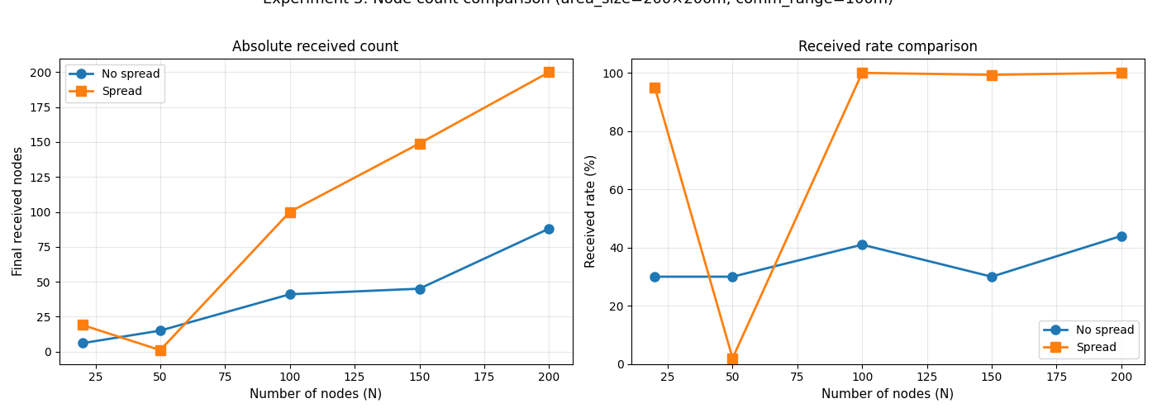
============================================================
Experiment 3: Node count comparison (fixed area size)
============================================================
N=20: No spread=6/20 (30.0%), Spread=19/20 (95.0%)
N=50: No spread=15/50 (30.0%), Spread=1/50 (2.0%)
N=100: No spread=41/100 (41.0%), Spread=100/100 (100.0%)
N=150: No spread=45/150 (30.0%), Spread=149/150 (99.3%)
N=200: No spread=88/200 (44.0%), Spread=200/200 (100.0%)

