Slide 1
LIKELIHOOD OF AN INDIVIDUAL’S SUCCESS IN PAYING BACK THE LOAN
Submitted by
Group 6 Sec A
Deepak Namdev
Sourabh Mahajan
Manas Bhageria
Preeti
Rajat Agrawal
Notes:
Photo by rawpixel on Unsplash

Slide 2
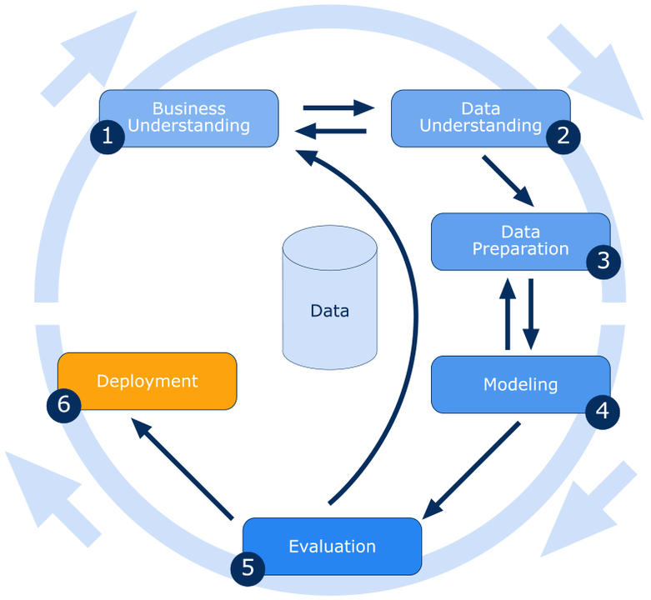
CRISP DM LIFECYCLE

Slide 3
Devising a classification model to estimate the likelihood of an individual’s success in paying back the loan
PROBLEM STATEMENT

Slide 4
DATA UNDERSTANDING
PHASE

Slide 5
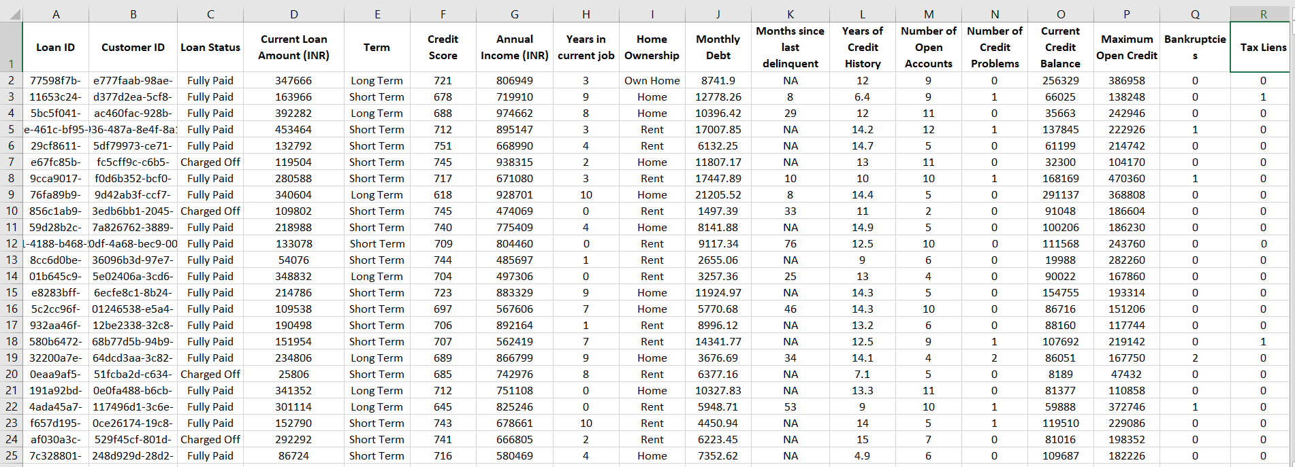
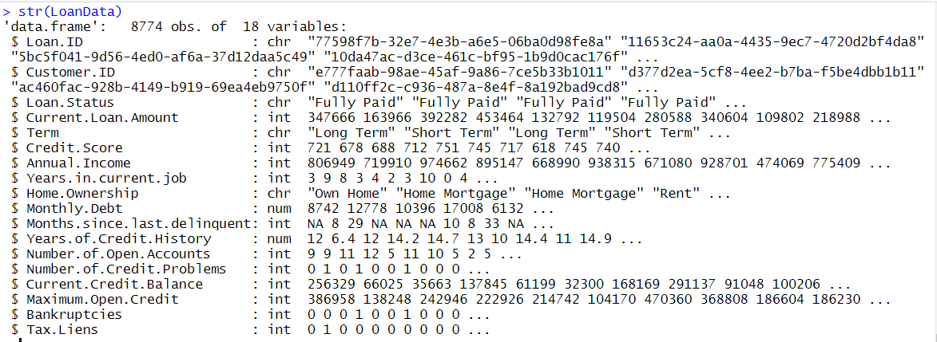

Slide 6
DATA PREPARATION
PHASE

Slide 7
Creating dummy variables for variables such as Home Ownership
Checking for NA values
Removing the customer ID and Loan ID variables
Omitting the cells with NA
Partitioning the dataset into training data and test data
Removing the Independent variable with more than 50% data missing.
Checking proportion of Y variable in Full, training and Test dataset
ifelse(LoanData$Loan.Status == "Fully Paid", 1, 0)
ifelse(LoanData$Term == "Long Term", 1, 0)

Slide 8
MODELLING

Slide 9
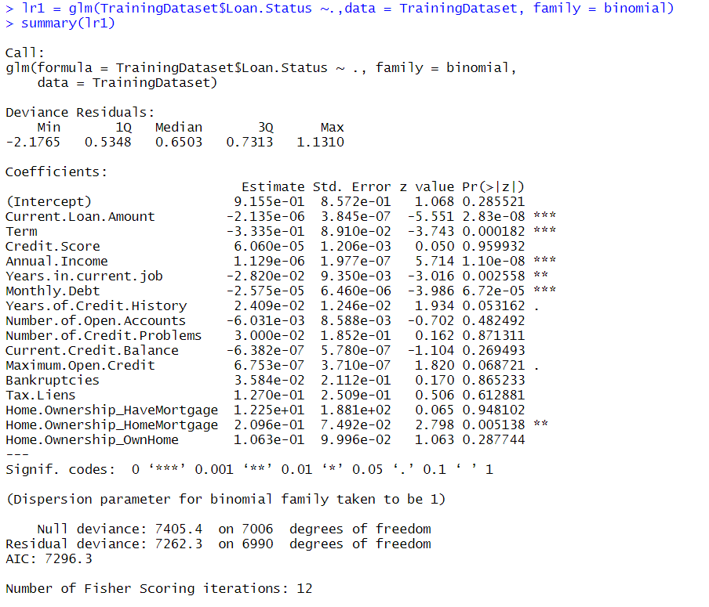
INITIAL LOGISTIC REGRESSION MODEL

Slide 10
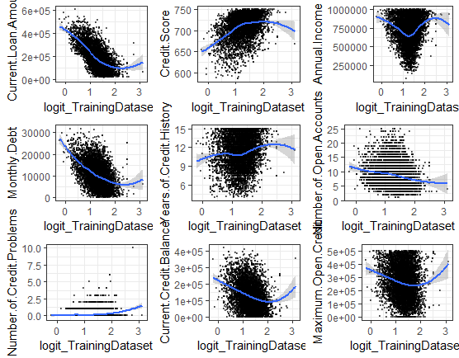
CHECKING FOR LINEARITY ASSUMPTIONS

Slide 11
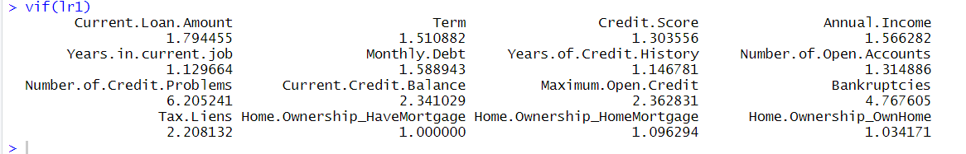
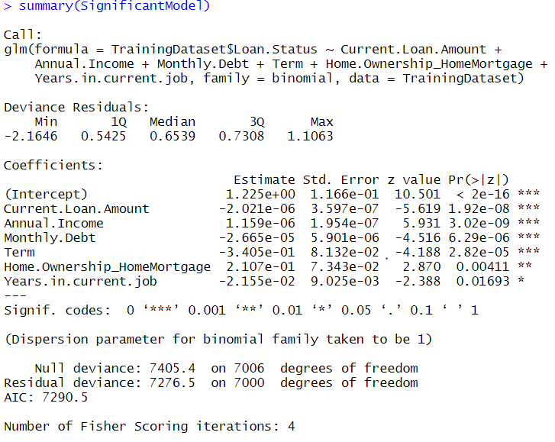
MULTICOLINEARITY AND REMEDIAL MEASURES

Slide 12
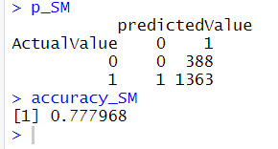
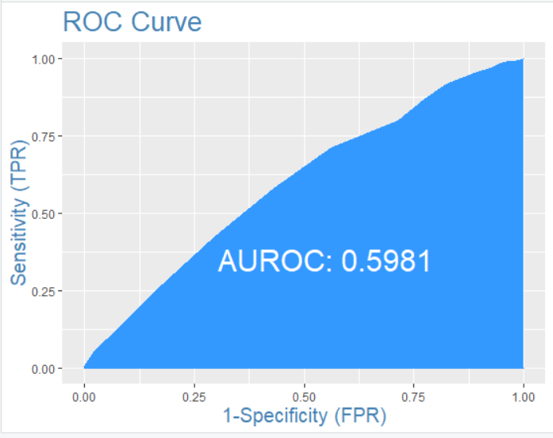
EVALUATION

Slide 13
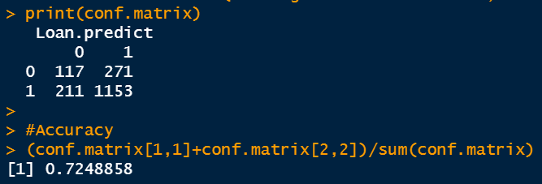
DECISION TREE
Build Model
We build the model on the training dataset.
With control conditions: minsplit = 1 and complexity parameter = 0
.
Plot Decision Tree
To visualize the classification starting from root node.
Prediction
1. Predict the classification on the testing dataset from the model.
2. Build the contingency table (predicted and actuals values) to check the accuracy of the model.

Slide 14
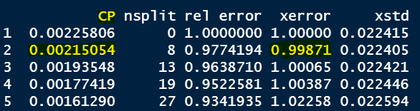
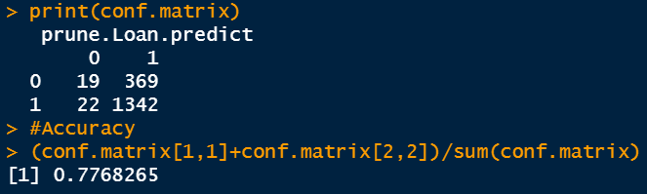
DECISION TREE PRUNING AND EVALUATION
Pruning
Complexity parameter of 0.00215 is used to prune as it is giving the minimum error.
The complexity parameter (cp) in rpart function is the minimum improvement in the model needed at each node.
Classification after Pruning

Slide 15
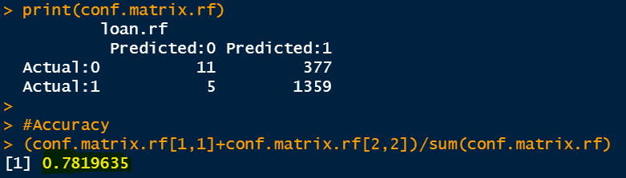
RANDOM FOREST
Build Model
With mtry = 4, as number of variables are 16.
mtry = sqrt(predictors) -- Standard
01
02
Prediction
1. Predict the classification on the testing dataset from the model.
2. Build the contingency table (predicted and actuals values) to check the accuracy of the model.
We conducted the random forest over bagging as it overcomes the problem of multi-collinearity.

Slide 16
THANK YOU
Notes:
Photo by rawpixel on Unsplash

