Slide 1
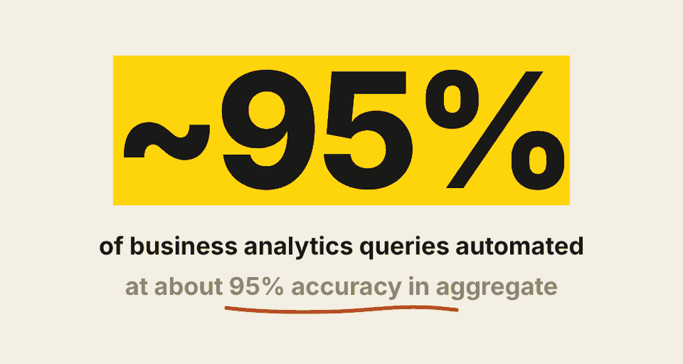
SINGLE BIG NUMBER
Almost all routine analytics questions now go through Claude
Anthropic, self-service data analytics article.

Slide 2
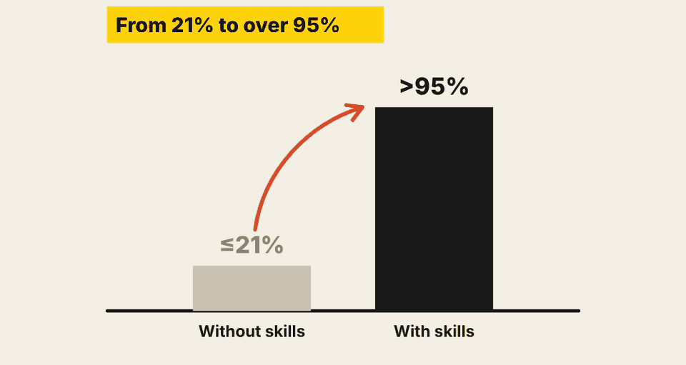
BEFORE VS. AFTER
Skills took accuracy from about a fifth to over 95%
Anthropic's internal evals: accuracy without and with skills.

Slide 3
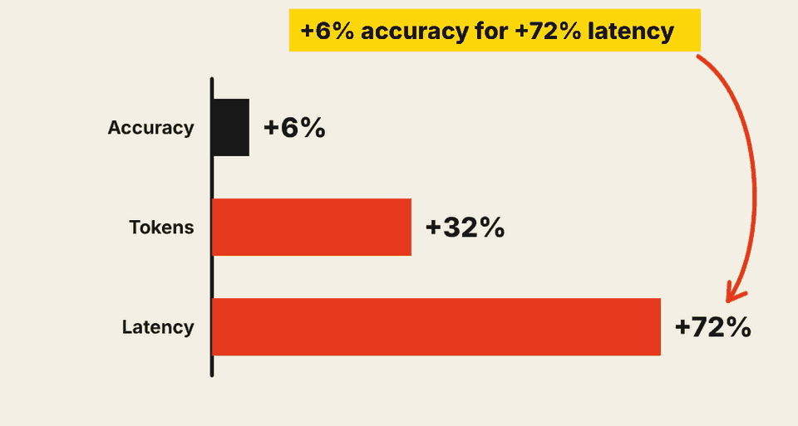
TRADE-OFF
Adversarial review bought six points of accuracy at a steep price
Anthropic's ablation: effect of adding an adversarial reviewer.

Slide 4
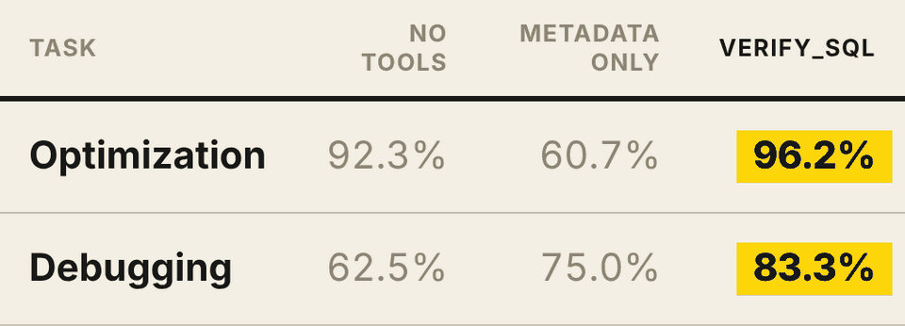
TABLE
The optional verify tool beat both alternatives on both tasks
Robinhood, 120 tasks: accuracy by tooling.

Slide 5
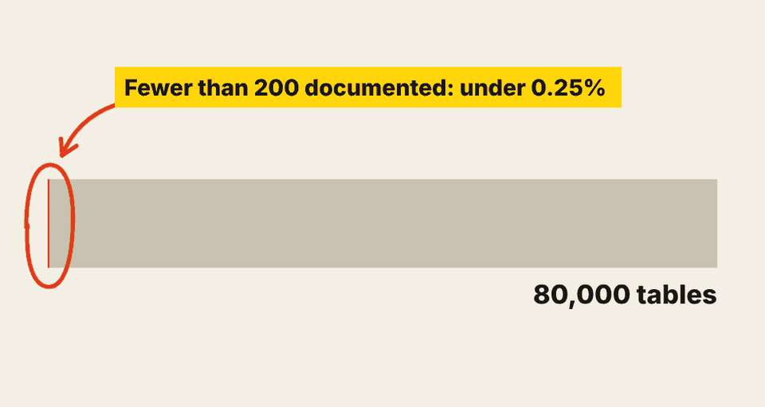
PART OF WHOLE
Of 80,000 tables, almost none were documented
Robinhood: fewer than 200 of 80K tables were adequately documented.

Slide 6
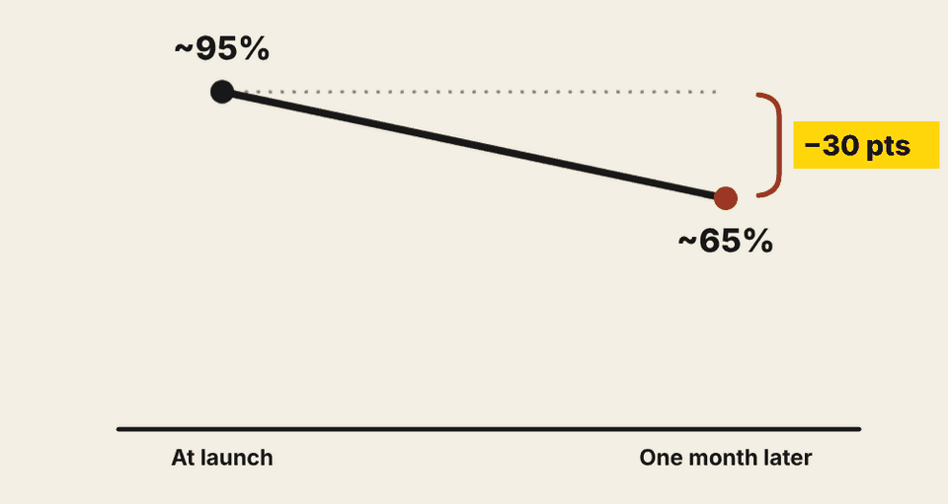
TREND
Left alone, accuracy fell about 30 points in a month
Anthropic: offline accuracy drifted from about 95% to about 65% before skill maintenance was added.

