Slide 1
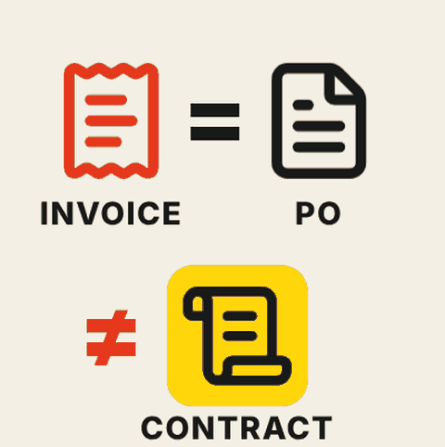
LESSON 1
Start from the business question, not the data that happens to match
A specific question tells the workflow which evidence it needs for the decision.

Slide 2
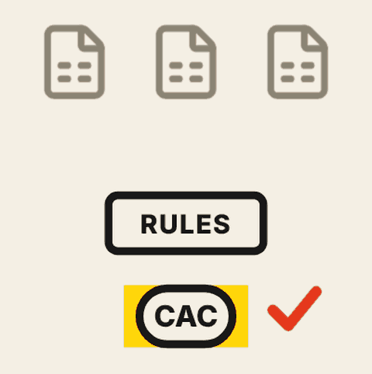
LESSON 2
Give AI the definitions finance has agreed, or it will reproduce the disagreement
The agent needs the team's own rules for what counts and how shared costs are split.

Slide 3
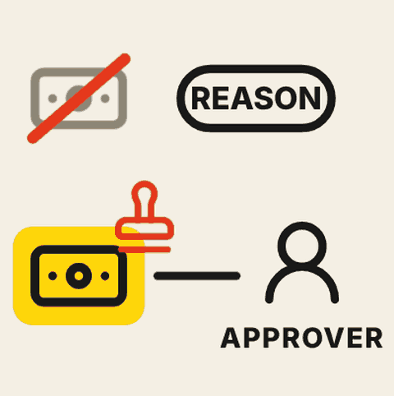
LESSON 3
An approval needs evidence and a named approver. "Be careful" is not a control.
Reviewers need to see which constraints a recommendation meets and why the alternatives were rejected.

Slide 4

LESSON 4
Judge a workflow by the work it leaves behind, not the output it produces
The value is in how much checking, correction and follow-up remains for the team.

Slide 5
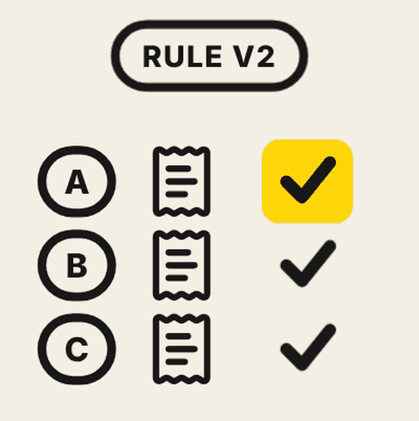
LESSON 5
Test a rule change on the cases it should move and the ones it should leave alone
A fix is only safe when the right decisions change and unrelated ones stay the same.

