Slide 1

Handwritten Digit Recognition
Name |  | Roll No.
Awab Ahmed |  | 20-CS-02
Rizwan Sajid |  | 20-CS-17
M. Zeeshan Ali |  | 20-CS-79
AI Project

Slide 2

Introduction

Slide 3

Introduction
Handwritten digit recognition is a computer vision task involving Machine Learning.
It is a classification problem.
The goal is to associate the image of a handwritten digit with its correct numerical label as shown in figure.
5

Slide 4
Implementation

Slide 5
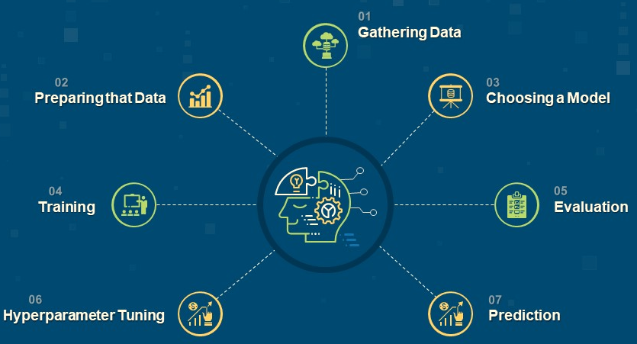
Implementation
The implementation of a digit classifier involves the following different steps:

Slide 6
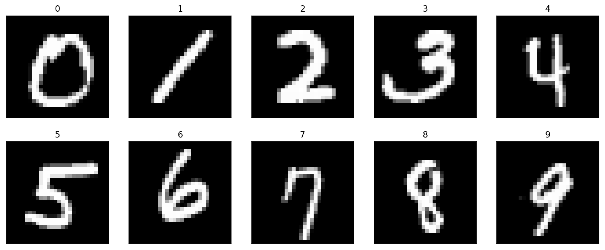
Gathering Data
The MNIST dataset was used for this project.
It was compiled by NIST.
It consists of 70,000 images of handwritten digits.
The images are 28x28 pixels in size.
Following are some sample images from this dataset:

Slide 7
Preparing Dataset
Preparing the dataset entails the following things.
Loading the dataset.
Scaling the dataset in order to make it usable to the model.
The pandas library can help us prepare the dataset.
The main data structure of the pandas library is called data frame. It is a table like data structure with rows and columns.
Data frames are used to load datasets into programs.
Data frames also provide the functionality to scale the dataset.

Slide 8
Choosing Model
Following are the characteristics of the problem:
Classification Problem.
Image as input.
Neural networks work well as classification devices.
Furthermore, Convolutional Neural Networks provide an excellent method for processing image inputs in machine learning problems.

Slide 9
Training & Evaluation
Training
In this step, the model tries to classify a subset of the training dataset.
Different metrics (loss, accuracy) are calculated for those predictions to asses how well the model is doing.
Based on those metrics, the model updates its understanding of the dataset.
These steps are repeated for the whole training dataset.
Evaluation
In this step, the model tries to classify the testing dataset. The model does not update its understanding of the data based on the metrics of its predictions. Evaluation is mostly just done to gauge how much more the model needs to be trained.

Slide 10
Hyperparameter Tuning
Hyperparameters
Hyperparameter are the type of parameters that cannot be directly learned through the training process. For this reason, these parameters have to be trained manually. These parameters include number of layers, activation functions etc.
Merits for Hyperparameter Tuning
Model Optimization.
Avoiding Overfitting and Underfitting.

Slide 11
Code Walkthrough

Slide 12
Thank You.

