Slide 1





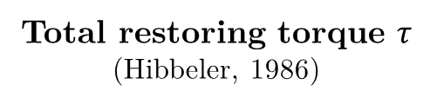

A
B
For one end of the rod:
A
For small angles ($φ→0$)
Total restoring torque $τ$
(Hibbeler, 1986)
$$φ$$
$$φ$$
(2)
$$M′$$
M
r
O
P
M
$$M′$$
for both ends of the rod
$$P′$$

Slide 2









For small angles ($θ→0,φ→0$):
A
B
A
M
d
$$φ$$
$$M′$$
$$φ$$
Length of filar
l
r
l
$$l′$$
$$l′$$
$$θ$$
$$M′$$
Angle of gyration
d
r
$$θ$$
M
d
M
O
P
$$M′$$
Radius of gyration
O
$$P′$$
(3)

Slide 3



Retort Stand
Rods (as cantilever beam)
Precaution 1
r
B
Precaution 2
A
r
B
Filar suspended by Capstan effect
A
Filar
Precaution 3
l
$$→$$
disturbed from equilibrium
Suspending rod
Location of G-clamp
P
O
$$M′$$
M
$$P′$$
Camera
Precaution 4

Slide 5
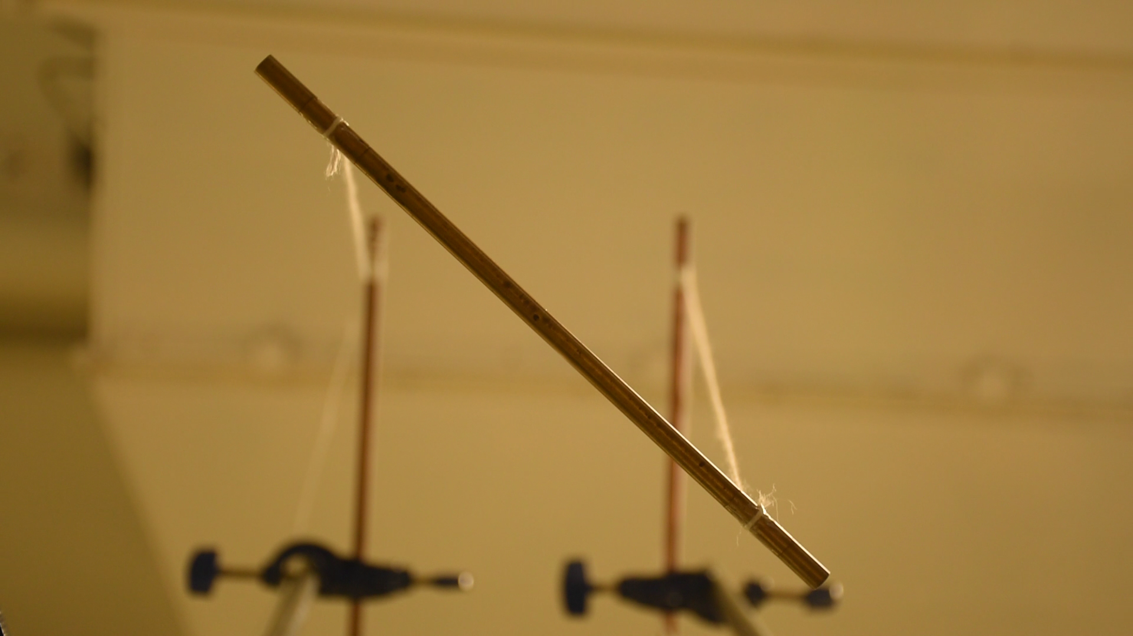
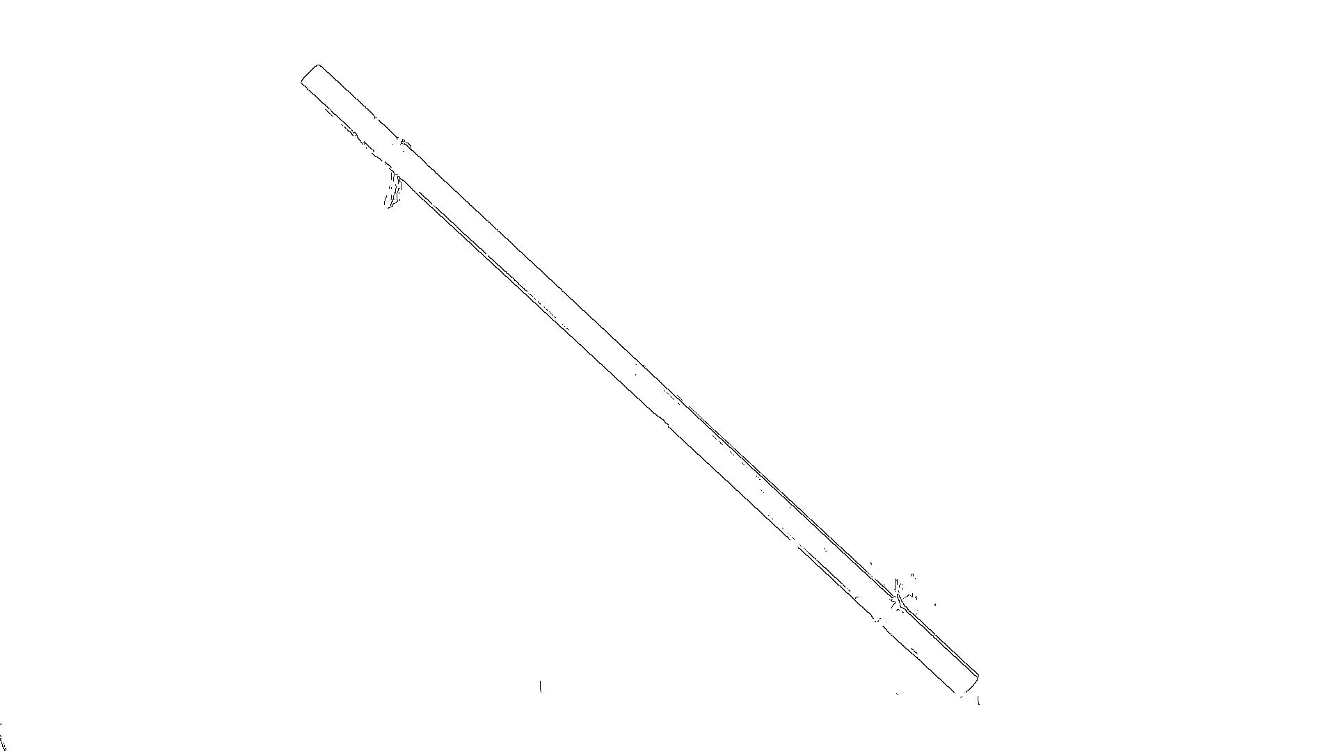
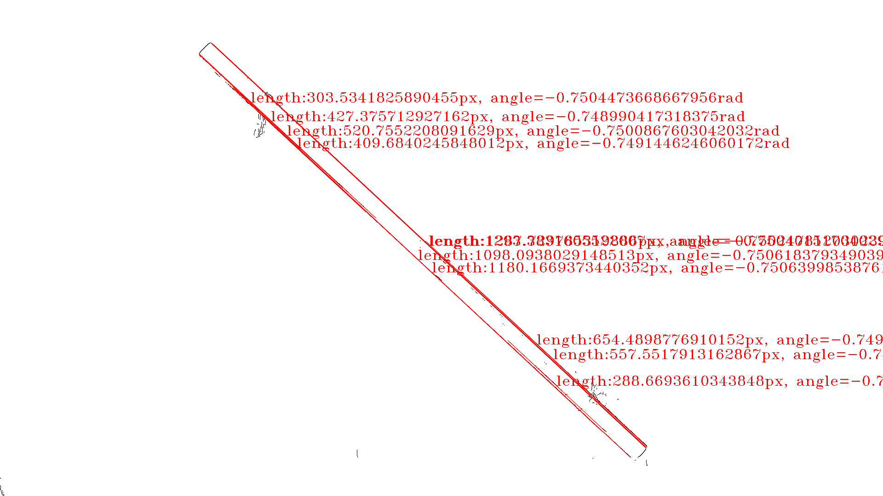
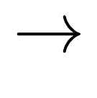




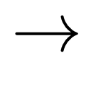
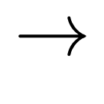

Original frames
captured at 60 frames per second
Outline of rod
with Canny edge detection
Locations of rod
with probabilistic Hough transform
$$→$$
$$→$$
$$⋮$$
$$⋮$$
$$⋮$$
$$θ/rad$$
$$θ/rad$$
$$⋮$$
Savitzky-Golay
filter + extraction of locations of maxima
t/s
$$→$$
t/s
Noisy data
45 oscillations

Slide 6
Plotted on y-axis
Slope of graph
Plotted on x-axis
y-intercept

Slide 7
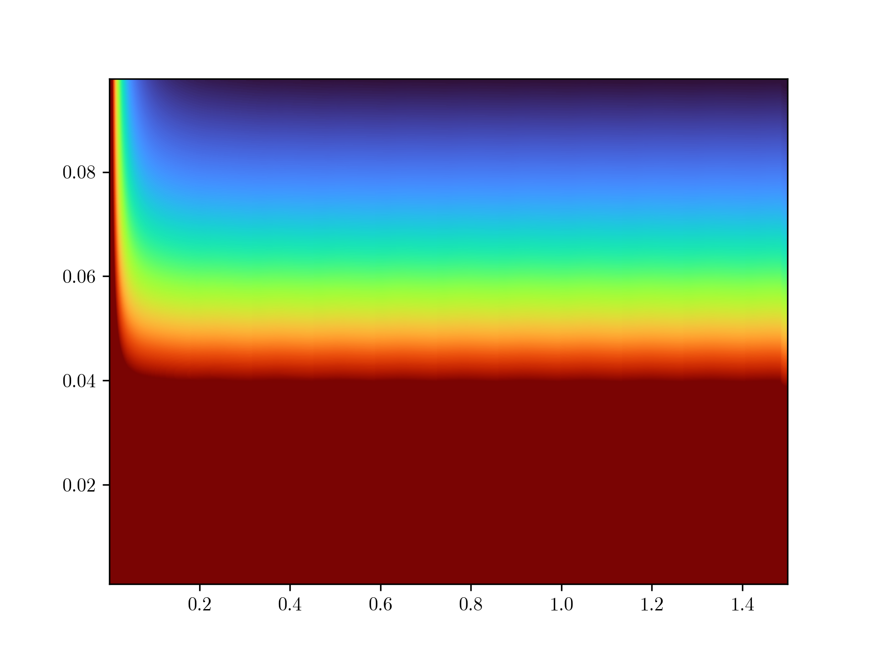

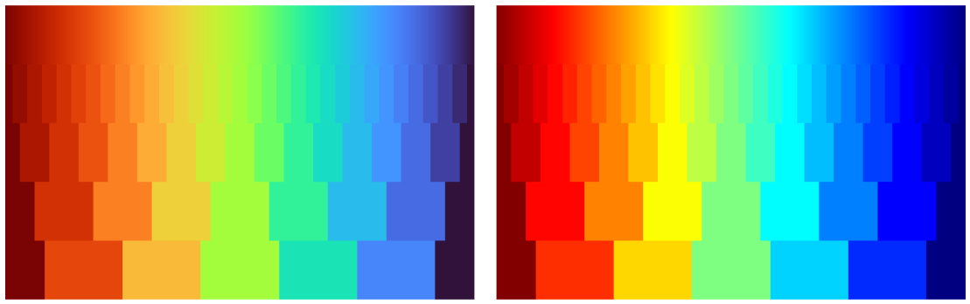
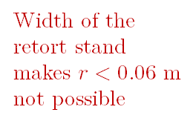
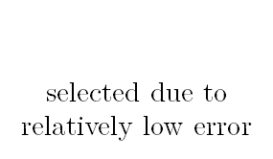
Mattey (1974), Kane and Tseng (1967) suggested filar lengths should be at least 4 times the radius of gyration to avoid chaotic motion
Height of table and the clamp and stand is 1.2 m
$$0.5<l<1.0$$
$$r=0.075$$
selected due to relatively low error
>2.5%
Width of the retort stand makes $r<0.06 m$ not possible
Percentage error in period T
Radius of gyration r / m
Error for
r < 0.015 m is high
<1.0%
Length of filars l / m

Slide 8




$$ΔT=0.339$$
$$ΔT=0.443$$
Period $T$ / s
Same interval $Δl=0.5m$
Length of filars l / m

Slide 9

Graph for $−0.1<T<0.1$
0.10
-0.1000
0.1000
-0.10

Slide 10
Graph for $−0.1<T<0.1$
0.10
-0.1000
0.1000
-0.10

Slide 12
Horizontal asymptote of regression line

Slide 13
Current setup
Proposed setup
4
4
Free to move if chaotic motion occurs, highly unstable
Horizontal simply supported beam stabilises chaotic motion
Pendulum clamp ensures stability and safety
2
2
Friction between filar and capstan
improvements
Use of metal filars reduces elasticity
Introduces chaotic motion
3
3
String over-tensioned
String slacking
Computer-controlled electromagnets ensures both ends of rods are released at the same instance
1
Often hard to keep rod parallel to ground when released, hand trembling can worsen stability
1

