Slide 1






A
B
A
$$φ$$
For small angles ($φ→0$)
Total restoring torque
$$φ$$
(2)
$$M′$$
M
r
O
P
M
$$M′$$
$$P′$$

Slide 2








For small angles ($θ→0,φ→0$):
A
B
A
M
d
$$φ$$
$$M′$$
$$φ$$
l
r
l
$$l′$$
$$l′$$
$$θ$$
$$M′$$
d
r
$$θ$$
M
d
M
O
P
$$M′$$
O
$$P′$$
(3)

Slide 3



Retort Stand
Rods (as cantilever beam)
Precaution 1
r
B
Precaution 2
A
r
B
Filar suspended by Capstan effect
A
Filar
Precaution 3
l
$$→$$
disturbed from equilibrium
Suspending rod
Location of G-clamp
P
O
$$M′$$
M
$$P′$$
Camera
Precaution 4

Slide 5
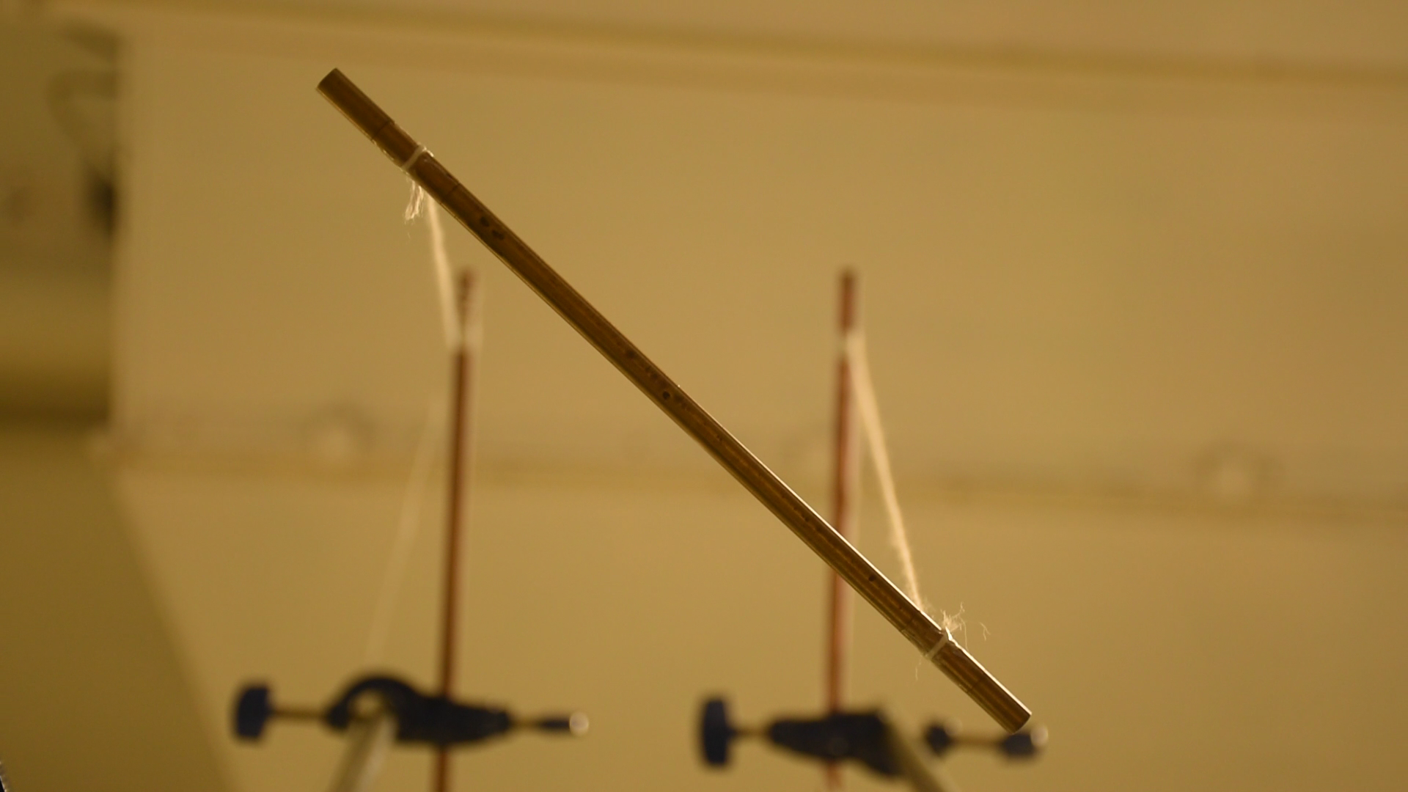
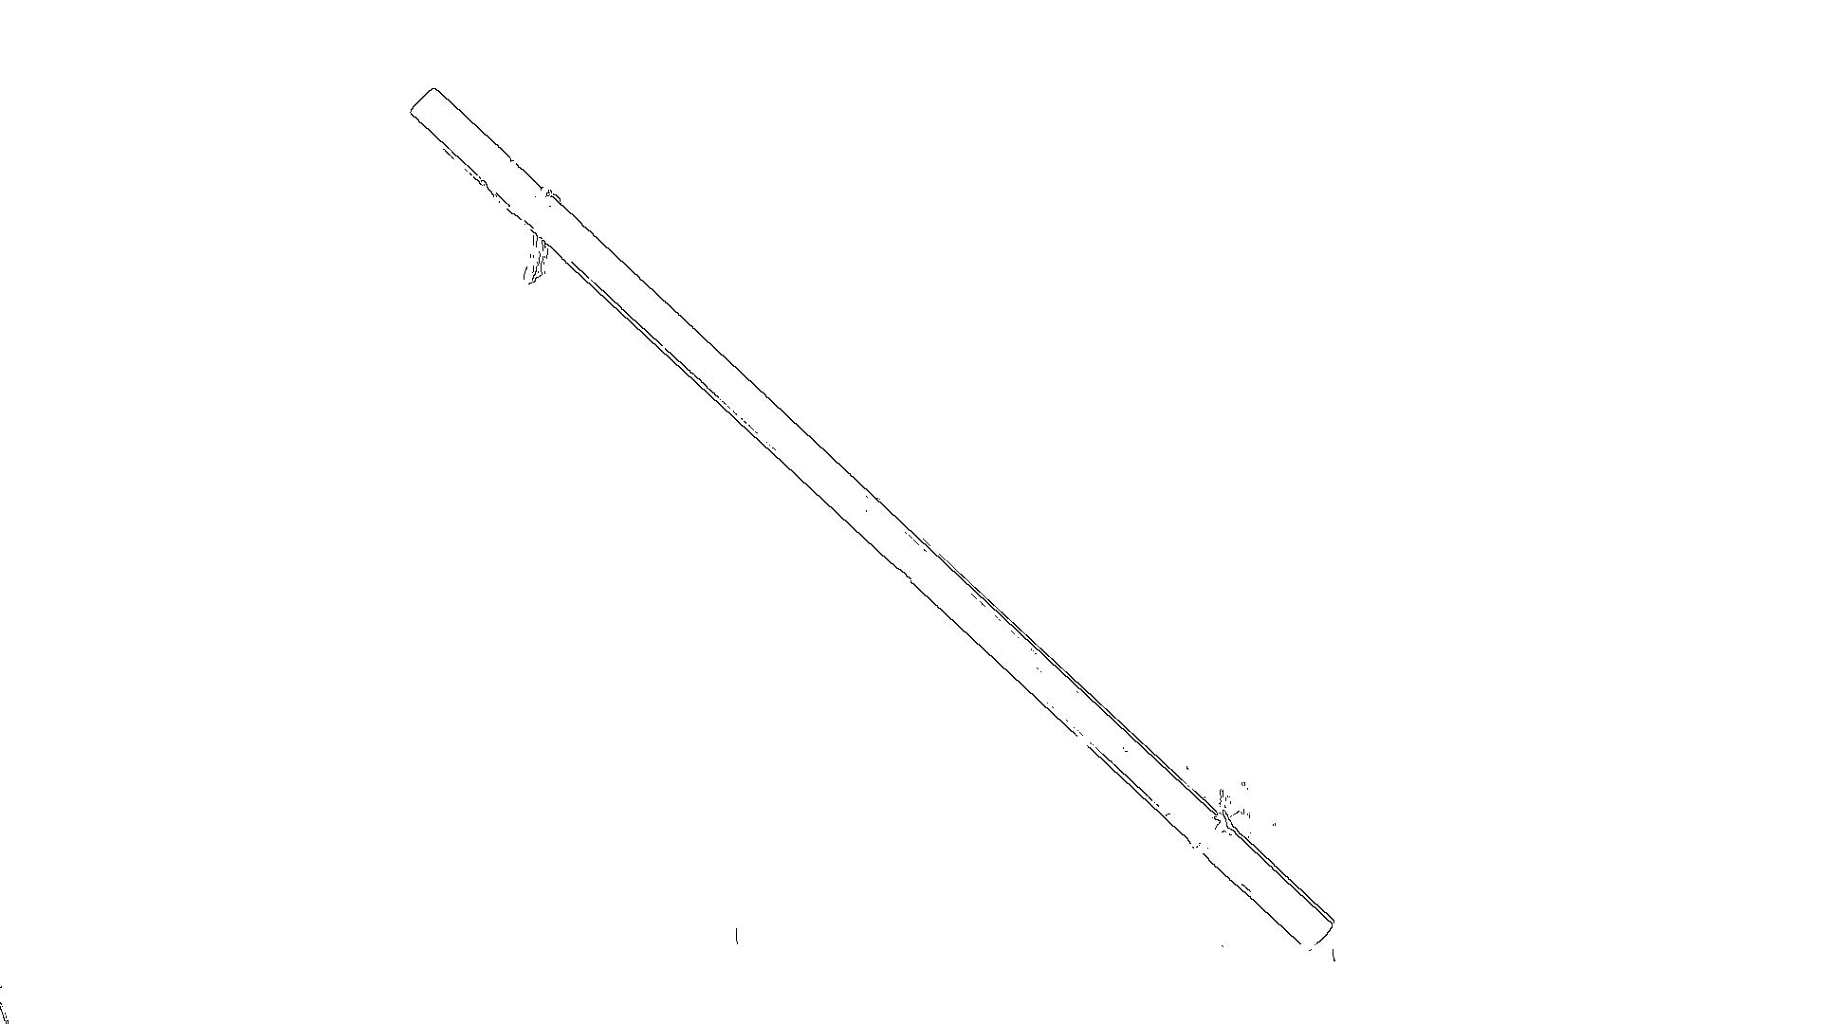
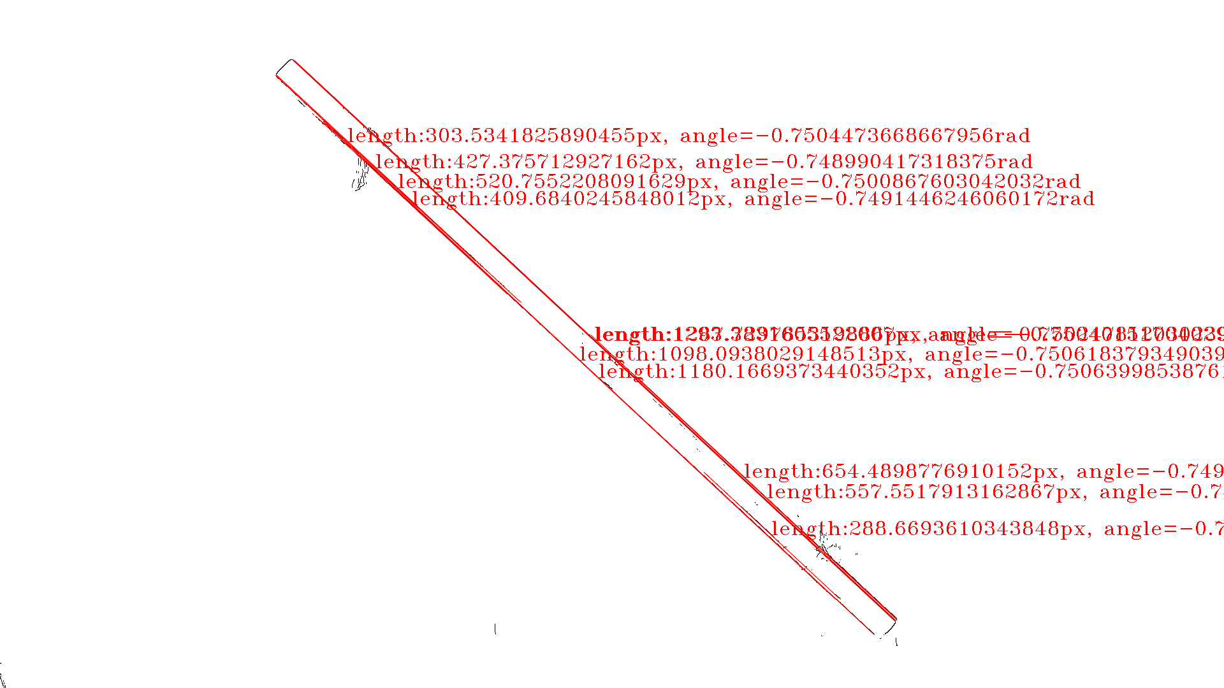
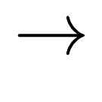






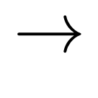
Original frames
captured at 60 frames per second
Outline of rod
with Canny edge detection
Locations of rod
with probabilistic Hough transform
$$→$$
$$→$$
$$⋮$$
$$⋮$$
$$⋮$$
$$θ/rad$$
$$θ/rad$$
Savitzky-Golay filter
$$→$$
t/s
t/s
Extraction of locations of local maxima
Noisy data
2 oscillations

Slide 6
Plotted on y-axis
Slope of graph
Plotted on x-axis
y-intercept

Slide 7
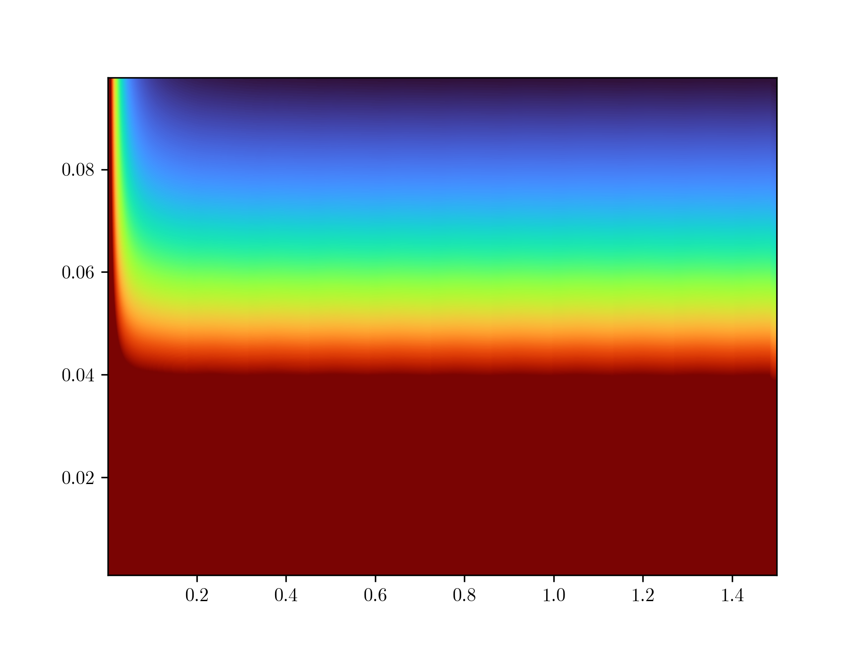

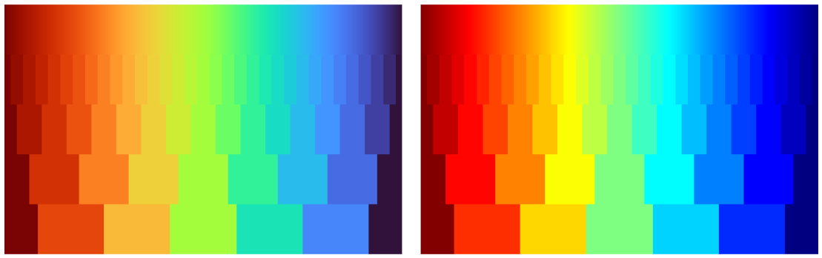
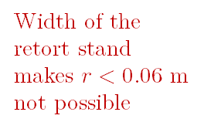
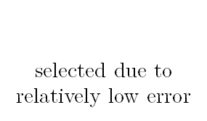
Mattey (1974), Kane and Tseng (1967) suggested filar lengths should be at least 4 times the radius of gyration to avoid chaotic motion
Height of table and the clamp and stand is 1.2 m
$$0.5<l<1.0$$
$$r=0.075$$
selected due to relatively low error
>2.5%
Width of the retort stand makes $r<0.06 m$ not possible
Percentage error in period T
Radius of gyration r / m
Error for
r < 0.015 m is high
<1.0%
Length of filars l / m

Slide 8




$$ΔT=0.339$$
$$ΔT=0.443$$
Period $T$ / s
Same interval $Δl$
Length of filars l / m

Slide 9

Graph for $−0.1<T<0.1$
0.10
-0.1000
0.1000
-0.10

Slide 10

Theoretical ($θ=0$)
Maximum gradient line
Minimum gradient line

Slide 12
Current setup
Proposed setup
4
4
Free to move if chaotic motion occurs, highly unstable
Horizontal simply supported beam stabilises chaotic motion
Pendulum clamp ensures stability and safety
2
2
Friction between filar and capstan
improvements
Use of metal filars reduces elasticity
Introduces chaotic motion
3
3
String over-tensioned
String slacking
Computer-controlled electromagnets ensures both ends of rods are released at the same instance
1
Often hard to keep rod parallel to ground when released, hand trembling can worsen stability
1

