Slide 1
SWARM / MEMORYNET + AGENT SYSTEMS
A firm that remembers, works, and learns
The systems we designed today
memoryNet
Persona manager
Runtime
Evolution engine
Find the work and its evidence
Define the job and its skills
Run and coordinate the agents
Test better ways of working
Three goals
Survive interruptions
Keep learning evidence
Improve without chaos
SWARM / 12 SEPTEMBER 2026 / DESIGN REVIEW
01
Notes:
Purpose: summarize the systems designed in this conversation, with a clear distinction between working local scaffolding and future runtime/evaluation work. Source: README.md, FIRM.md, MEMORYNET.md, PERSONAS.md, LEARNING.md, ROLE_SKILLS.md. No claim of autonomous investment performance or complete remote trace backup.

Slide 2
SYSTEMS DESIGN
Four systems, four different responsibilities
Memory and role definitions feed each run; every run should leave evidence for later review.
01
memoryNet
Threads, identities, original evidence, outputs, judgments
LOCAL SCAFFOLD
02
Persona manager
Roles, OODA loops, skills, standards, escalation paths
STARTERS + DRAFTS
03
Runtime
Start agents, assign tasks, deliver messages, collect results
PLANNED
04
Evolution engine
Compare role versions under controlled historical tests
PLANNED
The runtime uses memory and personas. The evolution engine tests changes before they are adopted.
SWARM / 12 SEPTEMBER 2026 / DESIGN REVIEW
02
Notes:
Built: local retrieval, thread maps, persona resolution, six verified starter skill files, review UIs. Planned: automatic swarm dispatch, live message routing, reliable automatic capture/backup, controlled evolution. Existing independent agent tools are not an integrated runtime in this repository. Sources: README.md; MEMORYNET.md; PERSONAS.md; FIRM.md.

Slide 3
SYSTEMS DESIGN
memoryNet keeps four kinds of evidence
A handoff helps the next agent move quickly. The original trace lets it check what actually happened.
Core trace
Checkpoint
Recorded messages, actions, tool inputs and results, errors, and ordering.
Current state, unfinished work, open questions, and the next action.
Investigation and training evidence
Fast continuation
Synthesis
Assessment
Conclusions, explanations, and lessons drawn from the work.
What succeeded or failed, the supporting evidence, and who judged it.
Retrieval and understanding
Evaluation and learning
A saved pointer or Rose summary is not proof that the raw transcript is backed up.
SWARM / 12 SEPTEMBER 2026 / DESIGN REVIEW
03
Notes:
Assessments are called judgments in the local model. Thread records collect references and annotations, not automatic copies of raw trace bytes. A source needs its origin, locator, capture cutoff and type. The search projection excludes recorded thinking, injected instructions and binary/encrypted fields; original native files remain distinct. Sources: README.md (Evidence and limits), MEMORYNET.md, FIRM.md.

Slide 4
SYSTEMS DESIGN
Identity follows the work without inventing agents
A thread can span many sessions. One session can contain several separately identified agents.
THREAD / the continuing line of work
Keep the identifiers separate
Native IDs
Session A
Session B
Original session and agent identities
Provider + native session ID
Continues the same thread
Catalogue UUID
The indexed record in memoryNet
Persona / skill ID
Reusable definition, with version
Agent A1
Agent A2
Fingerprint
Checks exact content; not quality
Execution parent ≠ manager ≠ reviewer
Unknown native IDs stay unknown. New agents continue the thread with their own identities.
SWARM / 12 SEPTEMBER 2026 / DESIGN REVIEW
04
Notes:
Diagram labels Session A/B and Agent A1/A2 are illustrative labels, not claimed UUIDs. Catalogue UUIDs, native provider identities, thread UUIDs and specification identities are distinct. Known ancestry is recorded; sharing a handoff label does not establish parentage. A task is a bounded assignment linked to a run and thread; current scaffolding does not automatically register future executions. Sources: README.md catalogue format; MEMORYNET.md; FIRM.md.

Slide 5
SYSTEMS DESIGN
A new agent needs two inputs
Choose an agent type and a thread ID; the same API feeds the human inspector and the agent.
The request
The resume response
New execution
Agent type
data_engineer
Thread ID
The saved thread UUID
Selected persona + skill text
Continuation brief
Original source references
Outputs, capture dates, and gaps
Read the relevant evidence
Take the current assignment
Work or escalate
Leave a linked checkpoint
GET /api/thread/resume?id=<thread UUID>&role=data_engineer&format=json
SWARM / 12 SEPTEMBER 2026 / DESIGN REVIEW
05
Notes:
Local base URL: http://127.0.0.1:8819. The server resolves recorded personas and verifies skill files; it does not start a model or launch the original agent. Copied prompts pin the persona version and content hash. GET /api/personas lists available runtime roles; the draft firm model includes additional roles that are not runnable. The current assignment is still needed; reading old work does not supply new authority. Sources: MEMORYNET.md, PERSONAS.md, memorynet_resume.py.

Slide 6
SYSTEMS DESIGN
Every agent follows the same small loop
Its persona defines the job, standards, relationships, and when to ask for help.
OBSERVE
ORIENT
Read the assignment, prior work, and current evidence.
Resolve definitions, uncertainty, dependencies, and scope.
ACT + CHECK
DECIDE
Produce the output, check it, and record the result.
Choose the next action, a targeted question, or an escalation.
Escalation names the gap, needed input, owner, and deadline. A tag alone does not deliver a message.
SWARM / 12 SEPTEMBER 2026 / DESIGN REVIEW
06
Notes:
OODA is our first-principles mapping of the role loop, not a historical Grove runtime protocol. Real communication requires a bound recipient and a runtime. Current valid authorization persists; the agent should escalate actual missing inputs or decisions, not repeatedly ask for the same permission. Source: FIRM.md, PERSONAS.md, MEMORYNET.md.

Slide 7
SYSTEMS DESIGN
The firm coordinates work and independent judgment
PMs own portfolio decisions. CIO coordinates investment priorities; CRO supplies an independent risk view.
Independent challenge
CIO
CRO
CRO → PM: risk review
Portfolio managers
DATA
RESEARCH
SIGNALS
RISK
IMPLEMENTATION
Collect + validate
Explain + challenge
Build + backtest
Measure + monitor
Plan + reconcile
Firm loop: Frame → Observe → Assign → Produce + challenge → Decide → Act → Review + learn
SWARM / 12 SEPTEMBER 2026 / DESIGN REVIEW
07
Notes:
This is the proposed 16-role model, not a claim that all roles are active. The lanes contain: data lead, data engineer, source researcher, data reviewer; investment analyst; investment engineer and model reviewer; risk analyst and monitor; trading implementation. Support includes developer, frontend, and client service. With CIO, CRO and PM these total 16. Domain manager, task owner, execution parent and reviewer are separate relationships. Sources: FIRM.md, firm/operating-model.v1.json.

Slide 8
SYSTEMS DESIGN
Many workers can share one persona
Example: collect oil-demand evidence country by country, then review it before synthesis.
Data lead
Worker 1
Independent
review
Data engineer
Country A
Scope, definitions, deadline
Combine results; check total coverage.
Check sources
Check definitions
Accept or rework
Keep missing coverage visible
Worker 2
Country B
Analyst → PM
Worker N
Research brief and portfolio decision
Country N
One researcher persona; many task scopes and execution IDs. Every returned result still needs a judgment.
SWARM / 12 SEPTEMBER 2026 / DESIGN REVIEW
08
Notes:
Illustrative planned workflow; no workers were launched by this deck. Source-level review and collection-level validation are distinct. The data lead resolves missing/late branches under a stated budget and stop condition; accepted partial coverage must stay explicit. Each task has inputs, expected output, owner, reviewer, resource budget and next recipient. Country workers are not new personas. Source: FIRM.md country-research workflow.

Slide 9
SYSTEMS DESIGN
Skills are procedures for finishing real jobs
The persona owns responsibilities. A skill supplies the inputs, steps, checks, and expected output.
Development
Change a repo • fix a bug • edit a website • deploy and roll back
Data engineering
Pull vendor data • align units and dates • publish and refresh
Research + quant
Write a brief • build a calculation • verify and backtest a signal
Risk + implementation
Reconcile records • calculate scenarios • check expiries • plan execution
PM / CIO / CRO
Assign work • review evidence • compare proposals • record decisions
Client service
Read client context • explain approved findings • prepare reports
35 library entries = 23 procedure drafts + 6 starter files + 6 named placeholders
SWARM / 12 SEPTEMBER 2026 / DESIGN REVIEW
09
Notes:
Current library counts on September 12: 16 draft roles, 35 skill records. New procedure cards are metadata outlines, not installed SKILL.md files. Existing six starter files remain separately versioned and pinned in persona v2. Managers should load specialist mechanics only for a separately assigned specialist task. Every role has the proposed Pick up work and leave a handoff skill. Sources: ROLE_SKILLS.md; firm/operating-model.v1.json; role_skills/registry.json.

Slide 10
SYSTEMS DESIGN
Rose and vendor access need explicit procedures
Use a shared data workflow, with the connection details for the particular vendor loaded when needed.
Seven Rose jobs
One recipe per provider
1
Read an object
Client / host + access
Identifiers + definitions
Dates + expected response
2
Follow a map
3
Choose a code
4
Upload a table
5
Build a calculated series
Haver: local recipe documented
Grove BBG updater: calls unfinished
Yahoo refresh: endpoint to resolve
6
Refresh a dataset
7
Make a notebook
Naming starts with the project’s existing convention, then an exact collision check. No invented global pattern.
SWARM / 12 SEPTEMBER 2026 / DESIGN REVIEW
10
Notes:
Scope of findings: inspected local files, not a complete inventory of all possible vendor connectors. The oil handoff documents Haver DLX catalogue and data calls; grove/quant/bbg_updater.py has TODO provider implementations; inspected duration notes name a Yahoo refresh service without its endpoint. No vendor call or Rose write was made during this role/skill audit. Naming does not reserve or create an object. Sources: ROLE_SKILLS.md and source notes on the cards in firm/operating-model.v1.json.

Slide 11
SYSTEMS DESIGN
The risk work reveals three different historical jobs
Each answers a different question and needs different evidence.
Broker reconciliation
Historical book replay
Signal backtest
What actually happened?
Match snapshots to activity statements and contract records.
Output: explained changes and unresolved differences.
What if this book stayed fixed?
Reprice a dated set of positions through market history.
Output: a hypothetical P&L path and assumptions.
What would this rule have done?
Change positions using the information available at each date.
Output: trades, returns, costs, and sensitivity.
Alongside these: current exposures, scenario shocks, expiry review, and data-freshness monitoring.
SWARM / 12 SEPTEMBER 2026 / DESIGN REVIEW
11
Notes:
The saved risk system supplied examples for these skills. It is historical evidence, not current verification of holdings or services. Local source references include PortfolioRisk, timetraveler and broker snapshot/cross-check helpers; the audit inspected code without executing these calculations. Frozen volatility, proxy prices, financing, costs, missing positions and omitted trades are relevant replay assumptions. No current trading recommendation or result is asserted. Sources: ROLE_SKILLS.md and risk draft source notes.

Slide 12
SYSTEMS DESIGN
Learn from old work before writing more instructions
A cheaper model finds candidate lessons; Campbell and a reviewer decide what belongs in the system.
SCREEN
READ
PROPOSE
SORT
Corrections, frustration, praise, failures, successes, neutral examples
Read the surrounding episode and inspect the outcome evidence
A scoped principle with source quotes and uncertainty
Persona, skill, process fix, more evidence, or dismiss
The inbox records human review. It does not rewrite active instructions.
A reaction is a lead, not proof. A principle becomes a skill only when it becomes a concrete procedure.
SWARM / 12 SEPTEMBER 2026 / DESIGN REVIEW
12
Notes:
The first bounded review used gpt-5.6-luna. The local mining script screens indexed passages and saves immutable evidence batches; the review UI checks source references and exact quotes. Screening is not a claim to have read every raw session. Praise/frustration alone cannot establish technical correctness or causality. Human sorting appends a review and does not install or activate a candidate. Current source: LEARNING.md, learning_mine.py, learning_store.py. The opening paragraph in LEARNING.md uses older skill terminology; actual inbox candidates are principles to review.

Slide 13
SYSTEMS DESIGN
Evolution means controlled comparisons
Change one role specification while keeping the other agents and test conditions fixed.
Keep fixed
Baseline role
Compare and review
Other role versions
Model and tools
Data known at each date
Tasks and budgets
Scoring rules
Same historical tasks.
Save the evidence.
Task quality and correctness
P&L, risk, and exposures
Time, tokens, and cost
Human judgment
Stability across test periods
Candidate role
Same historical tasks.
Save the evidence.
Tune on one set of periods; evaluate on held-out periods. Adopt a new version only after review.
SWARM / 12 SEPTEMBER 2026 / DESIGN REVIEW
13
Notes:
Planned engine, not implemented or run. This is controlled role/prompt evaluation; it is not a claim of RL training or measured improvement. P&L/risk/correlation metrics apply where relevant; a data engineer should also be scored on source correctness and coverage, rather than P&L alone. Repeated runs may be needed to separate stochastic variation from improvement. Preserve the baseline and exact versions. Sources: FIRM.md and user design requirements.

Slide 14
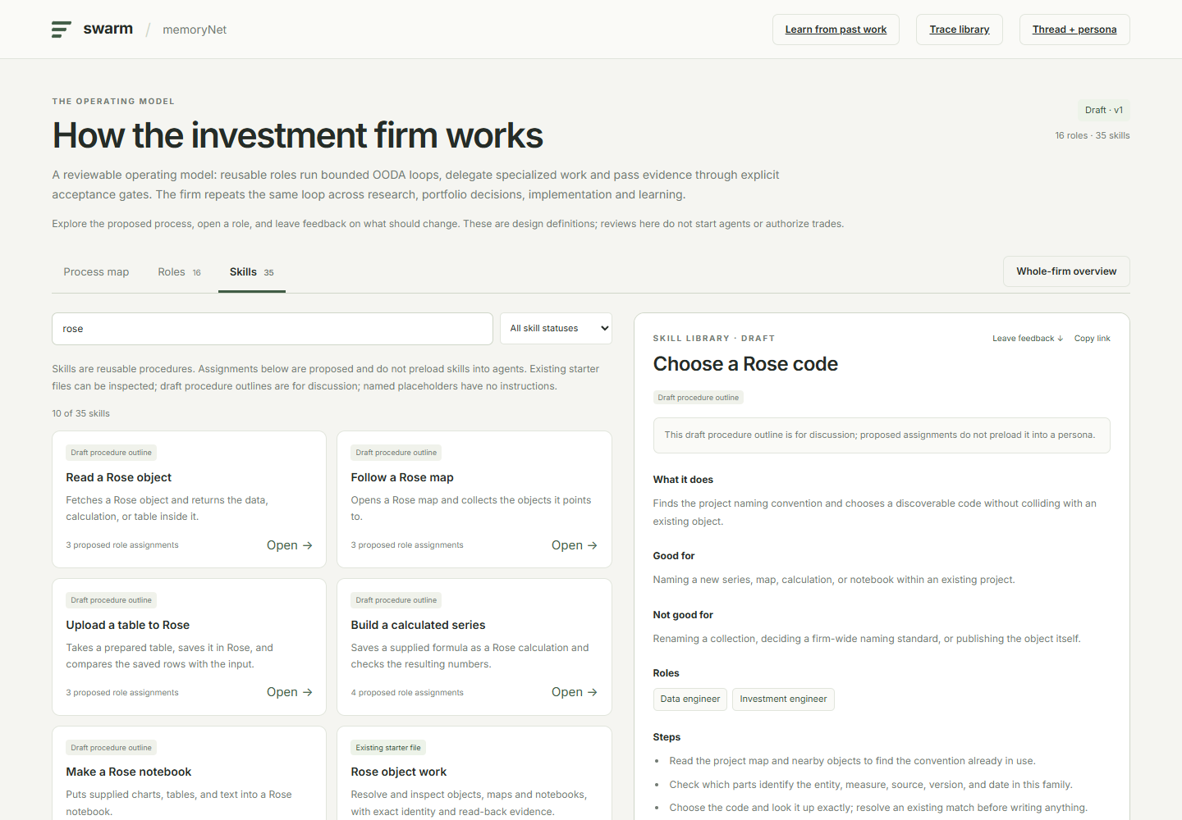
SYSTEMS DESIGN
The local interface makes the design inspectable
People can see the same saved context and role definitions that another agent can retrieve.
Trace library
Find records and inspect source events.
Thread + persona
Load role, skills, saved work, and gaps.
Firm + skills
Click through roles, procedures, and feedback.
Learning inbox
Read evidence and sort proposed lessons.
SWARM / 12 SEPTEMBER 2026 / DESIGN REVIEW
14
Notes:
Screenshot captured from the actual local /firm UI after the role/skill update. Links require the local memoryNet server. Trace library: http://127.0.0.1:8819/threads ; inspector: http://127.0.0.1:8819/resume ; firm: http://127.0.0.1:8819/firm ; learning: http://127.0.0.1:8819/learning . Browser inspection verified draft fields, role assignments, category search and starter file reading. No live external service state is implied.

Slide 15
SYSTEMS DESIGN
What exists today—and what still needs building
The design is broader than the running software. Keep that boundary visible.
WORKING LOCAL TOOLS
DEFINED FOR REVIEW
NEXT ENGINEERING
Catalogue, keyword search, and source-event lookup
16-role firm and communication map
Reliable capture and off-machine backup
Threads and resume API
Agent and firm OODA loops
Automatic run registration and dispatch
Versioned persona + starter-skill loading
23 draft task procedures
Bound message and escalation delivery
Firm, skill, and learning review screens
Escalation and independent review rules
Historical role evaluation
Local model search depends on its configured model server. A local catalogue is not a remote archive.
SWARM / 12 SEPTEMBER 2026 / DESIGN REVIEW
15
Notes:
Counts: 8 current runtime starter personas, 16 proposed firm roles, 35 skill catalogue entries (23 outlines, 6 registered starter files, 6 named placeholders). Semantic/hybrid search and local-model answer integration exist, but availability and semantic coverage depend on the model server and encoded passages. Reindexing does not discover newly created sessions or advance snapshot cutoffs. The new drafts are not active persona changes. Sources: README.md; MEMORYNET.md; PERSONAS.md; ROLE_SKILLS.md.

Slide 16
SYSTEMS DESIGN
Next: prove one complete loop
Start with one thread, one role, one useful output, and one independent judgment.
1
2
3
4
Resume
Produce
Review
Preserve
Supply the role, thread ID, and current assignment.
Read the evidence.
Do the task.
Return the result.
Accept it, request corrections, or identify a concrete blocker.
Link the trace, checkpoint, output, and judgment to the thread.
Automate the loop. Compare role versions. Preserve the evidence.
SWARM / 12 SEPTEMBER 2026 / DESIGN REVIEW
16
Notes:
Suggested next milestone, not an action performed by the presentation: use the oil data-engineering thread or risk reconciliation thread for a bounded task. Select an available persona; additional firm roles remain drafts. Automated execution identity registration, source capture and message delivery remain runtime work. Once end-to-end evidence is reliable, add controlled evaluation. Full design references: README.md, MEMORYNET.md, PERSONAS.md, FIRM.md, ROLE_SKILLS.md, LEARNING.md. Local workspace: C:/Users/campbell/Dropbox/Snow/Inv/Data/client/swarm.

