Slide 1

AML 2304 – Natural Language Processing
Movie Sentiment Analysis
(Mid Submission)
November 14, 2023
Submitted to :
Prof. Bhavik Gandhi
Submitted by Group 3 :
Abhishek Natani
Auradee Castro
Bhumika Rajendra Babu Miraj Sinya Olivia Deguit
Rochan Mehta
Roger Mais
Varun Sharma

Slide 2
Case Background
Movie Reviews have always been a reference point for the audience to decide weather or not to watch movies but from a production standpoint it has not be utilized to its full extent.
This application will allow the producers in the mass media and entertainment industry to not only understand the sentiment of the audience but also the reasons behind those sentiments.
Behind the scenes, the application uses Natural Language Processing models along with clustering techniques to make sense of the sentiment and get the intent behind those sentiments giving deeper insights into audience opinions, preferences, and pain points.
Help potential clients to potentially get insights on trends in the audience’s sentiment towards specific genre over the years, actors, directors which will aid them in making informed decisions.
Dataset containing movie reviews, details of the movie (genre, budget, cast and crew, ratings) is taken from Kaggle along with the data accessible to the public on IMDb, which is used for cross-validating the data collected from Kaggle.
Dataset containing 500K reviews for movies
Notes:
Video Game Sales with Ratings | Kaggle

Slide 3
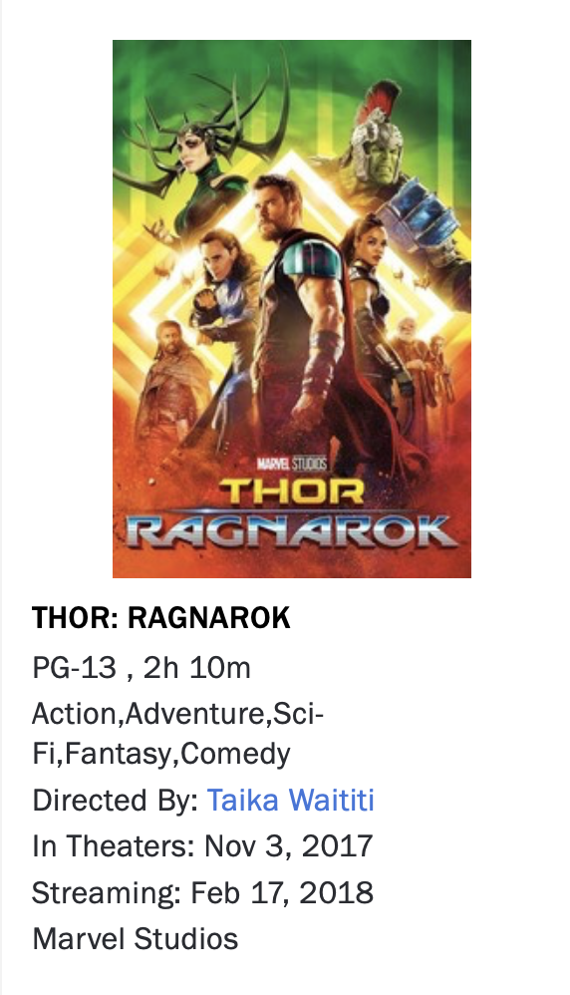
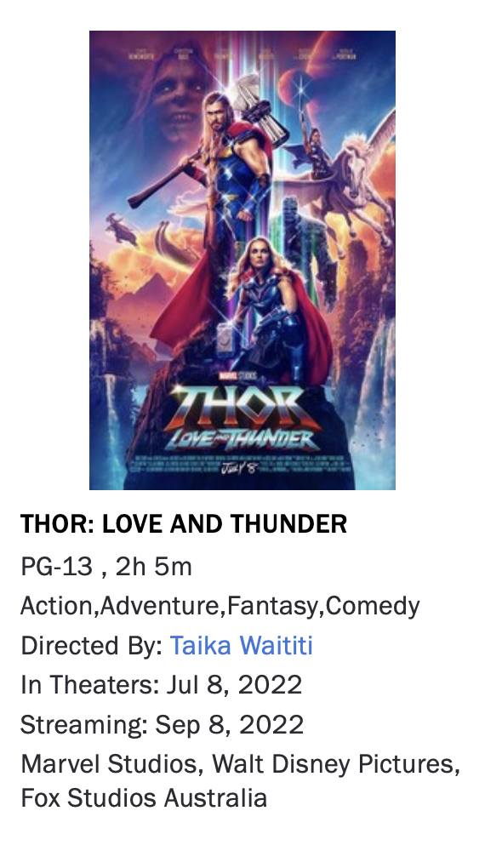
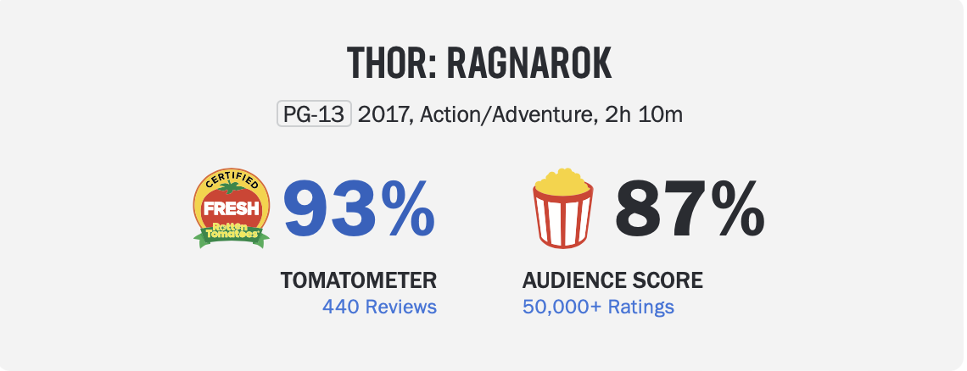
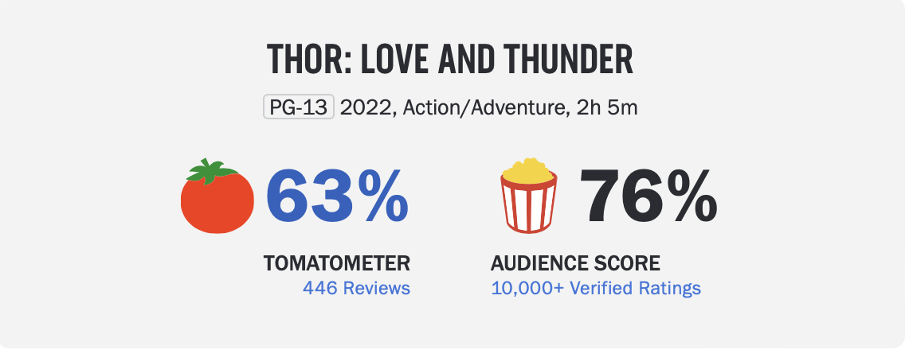
Case Study (1/4) : Marvel Studios
Thor: Love and Thunder released in 2022 rated significantly lower than its prequal Thor: Ragnarok released in 2017

Slide 4
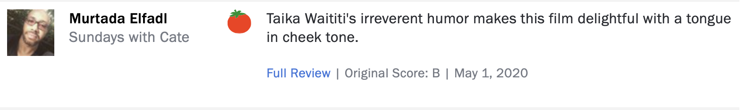
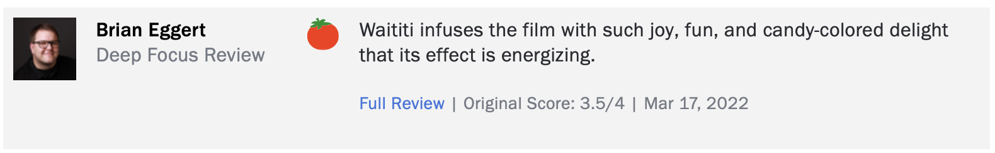
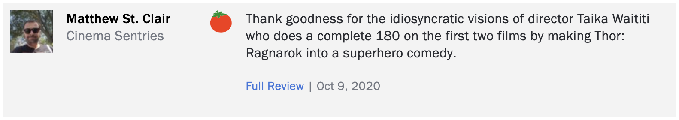
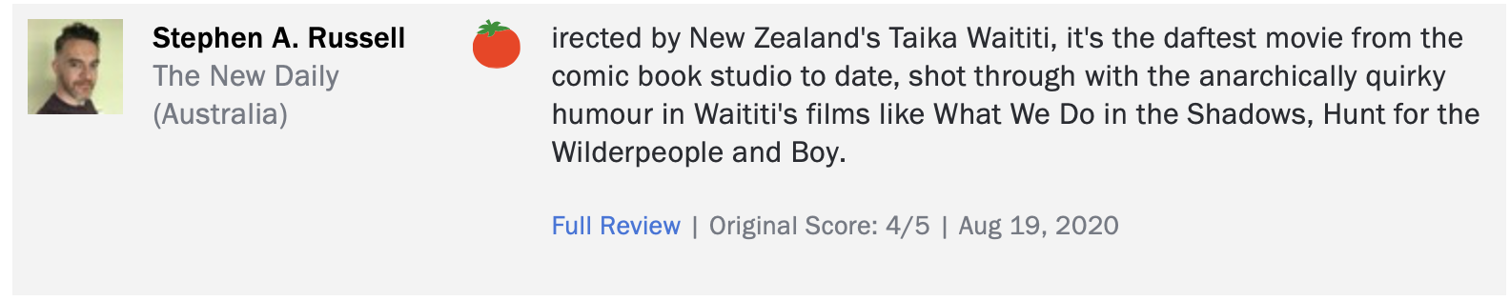
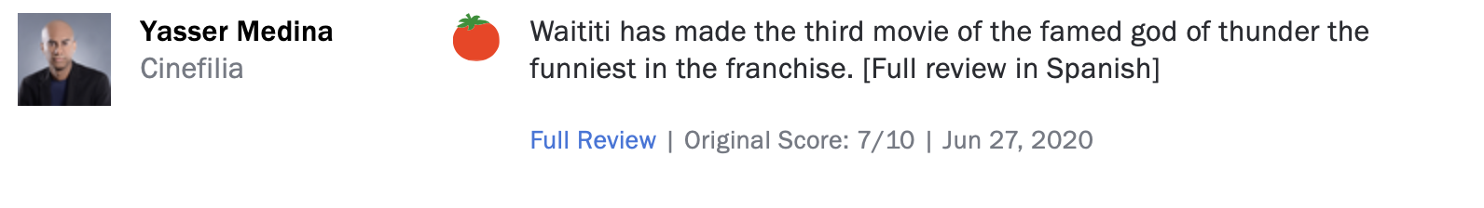
Case Study (2/4)
Factors contributing to the movie being well received by the audience
Thor: Ragnarok Reviews
Significant mentions of director Taika and directing style infusing comedy into the franchise in the positive reviews of the first movie

Slide 5
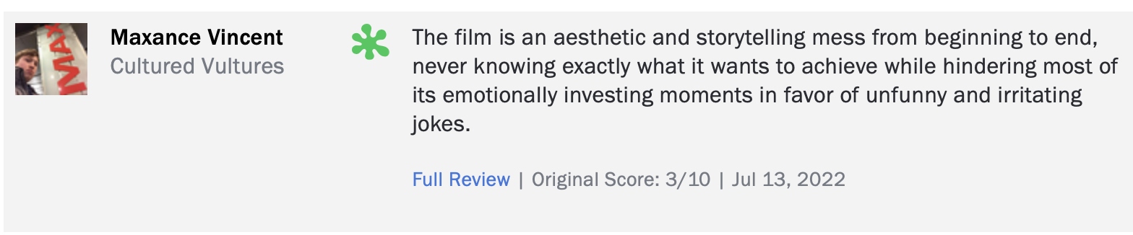
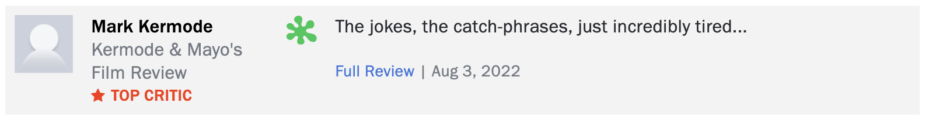
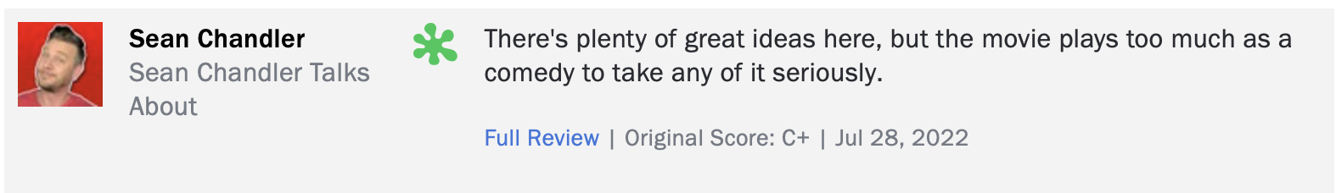
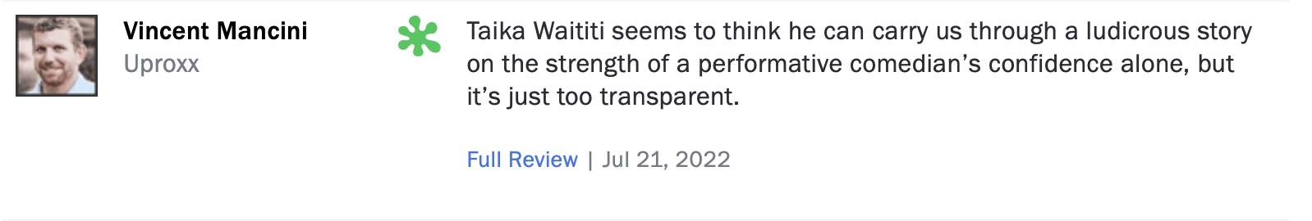
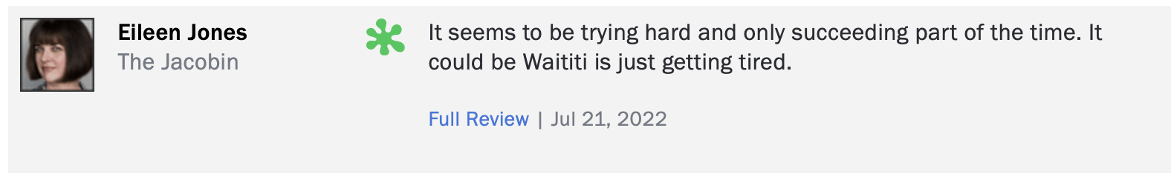
Case Study (3/4)
Factors contributing to the movie being criticized by the audience
Thor : Love and Thunder Reviews
Significant mentions of director Taika, movie humor and story in the negative reviews of the first movie

Slide 6
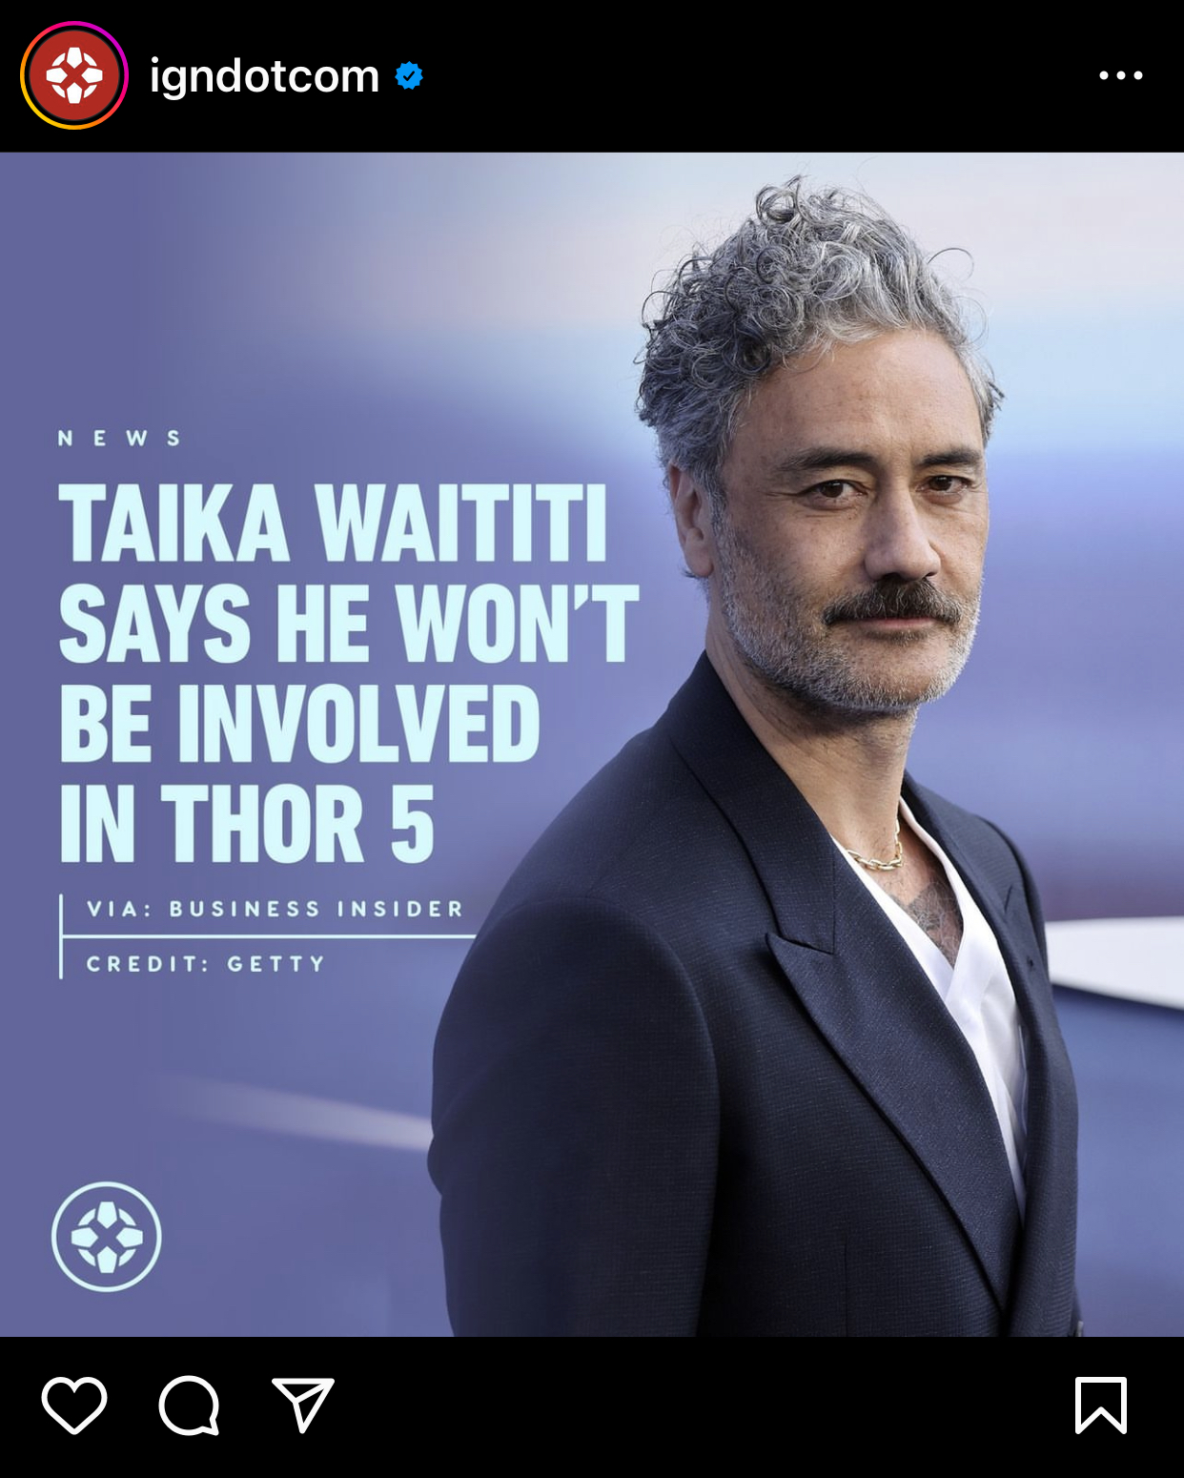
Case Study (4/4)
Failure of sequel along with negative reviews of movies potentially led to Director Taika Waititi’s subsequent departure from the Thor franchise

Slide 7
Mass Media & Entertainment Domain (1/2)
Producers, a potential customer for the movie review sentiment analyzer
Business Model
Details
Description
Movie Production Studios establish contractual relation with Distributors to distribute their original content
Distributors own the distribution rights to movie content which is shown across cinema or OTT platforms
Theatrical distributors distribute film content to movie theatre for a portion of revenue generated from ticket sales
OTT distributors make film content available to audience on demand on their platform in exchange for subscription fees
Producer
Distributor
Cinema
Key Resource: Distribution Rights
Cost: Distribution Costs
Key Resource: Cinema Theatre
Cost: Distributor’s share of Ticket sales
Key Resource: Content
Cost: Production Costs
Contract
Contract
*OTT Distributor
Theatrical Distributor
Fees
Distributor ‘s
share
Subscription
Ticket Sales
On Demand Content
Cinema Experience
Top Players
Movie Production Studio:
The Walt Disney Studios (Global Box Office Sales: $79B)
Warner Bros. Entertainment Inc. (Global box Office Sales: $48B)
Universal City Studios LLC (Global Box Office Sales: $47.9B)
Audience
: Revenue
: Content
* OTT : Over-The-Top (Film content over the internet)
Global Box Office Sales figures based on 2022 data

Slide 8
Mass Media & Entertainment Domain (2/2)
Movie Review Sentiment Analyzer a useful tool for OTT Distributors Original Content creation
Business Model
Details
Description
Some OTT distributors like Netflix, Amazon prime Video, Disney+ have also entered the content production space
Inhouse production unit to develop and stream original content
Subscription models adopted by popular OTT distributors:
Subscription Video On Demand (SVOD): Monthly plan for unlimited access to content anytime
Transactional Video On Demand (TVOD): Only pay for content audience want to watch
Hybrid Model: Combination of SVOD & TVOD
OTT Distributor
In-House Producer
Key Resource: Content
Cost: Production Costs
Producer
Key Resource: Content
Cost: Production Costs
OTT Streaming Platform
Contract
Third-Party
Content
Original Content
Fees
Top Players
OTT Distributor:
Netflix (Global Subscribers: 231M)
Amazon Prime Video (Global Subscribers: 200M)
Disney+ (Global Subscribers: 138M)
On Demand Content
Subscription
: Revenue
: Content
Audience
* OTT : Over-The-Top (Film content over the internet)
Global Subscriber figures based on 2023 data

Slide 9


Data Pipeline (1/3) : Overview
Stage 1:
Data Acquisition
Stage 2:
Model Development
Stage 3:
Model Deployment
Sentiment Analysis
Model Building
*Intent Clustering
*Model Integration
Activities
Sourcing relevant data to address the identified business problem
Cross-validating dataset
Data Sources used:
Labelled Data Generation for model training
Steps involved:
Intent Clustering Technique Evaluation
Steps Involved:
Integrating intent clustering & sentiment model on business queries.
Steps Involved:
Deployment of the model together with User Interface allowing the user to get the sentiment and the intent behind the sentiment that helps them in the movie production process
Movie Reviews Sentiment label generation using Roberta Model
Apply Clustering technique
Movie Review
Data Preprocessing
Movie Review Dataset
Best Performing
Intent Clustering Technique
Model Training & Evaluation
Intent Clustering Technique Evaluation
Best Performing Sentiment Analysis Model
- Naïve Bayes
- *RNN (LSTM)
- *SVM
* To be performed after the mid-point delivery

Slide 10
Data Pipeline (2/3) : Data Preprocessing & Creation
Data Flow
Details
Data Acquisition
Description
RoBERTa Sentiment Model for generating sentiment labels on movie reviews since it has higher accuracy than Vader
Kaggle (IMDB dataset)
Original Movie Reviews Dataset
Data Pre-Processing
Null values and duplicate records
* * Non-grammatical text (emails and URLs)
Non-ascii and diacritics characters
Emojis, Slangs and * Abbreviations
Word contractions
Name Entity Recognition
*Spellchecker and * POS Tagging
Lowercasing and * * whitespaces
Non-alphanumeric characters
* * Stopwords and lemmatization (Spacy)
Basic Data Preprocessing
Roberta Sentiment Model
Movie Reviews with Sentiment
Original Movie Metadata Data
Data Preprocessing
Feature Selection & Engineering
Feature Selection
& Engineering
Count Vectorizer (better than TF-IDF)
Label encoding:
Sentiment Labels → Numbers
0: Negative
1: Neutral
2: Positive
Model Dataset
Model Selection & Training
* Excluded from the most recent sentiment analysis model
* * Basic data pre-processing used on sentiment generator for movie reviews
Notes:
RoBERTa outperforms VADER due to its ability to capture contextual nuances in language, resulting in superior overall performance and accuracy

Slide 11
Data Pipeline (3/3) : Model Building and Evaluation
Data Flow
Details
Model Creation
Employed Multinomial Naïve Bayes for the initial model as it is robust for overfitting
Percentage of training data : 80%
Model Dataset
Model Selection & Training
Model Building
Train-Test Split
Model Evaluation
Classification Report
Accuracy: 0.71
Precision: 0.64 (Negative), 0.63 (Neutral), 0.78 (Positive)
Recall
F1-score
*ROC curve and AUC:
0.88 (Negative, Positive), 0.76 (Neutral)
Training
Data
Testing
Data
Hyperparameter Tuning
Model
Hyperparameter
Tuning
GridSearchCV for hyperparameter tuning
Parameter: Alpha
Note: Minor change when adjusting alpha; higher alpha values improve accuracy, while lower alpha values improve precision. Alpha 1 has an optimal balance across accuracy, precision, recall, and F1-score
Model Evaluation
Tuned Sentiment Analysis Model
* ROC (Receiver Operating Characteristic) and AUC (Area Under the ROC Curve)

Slide 12
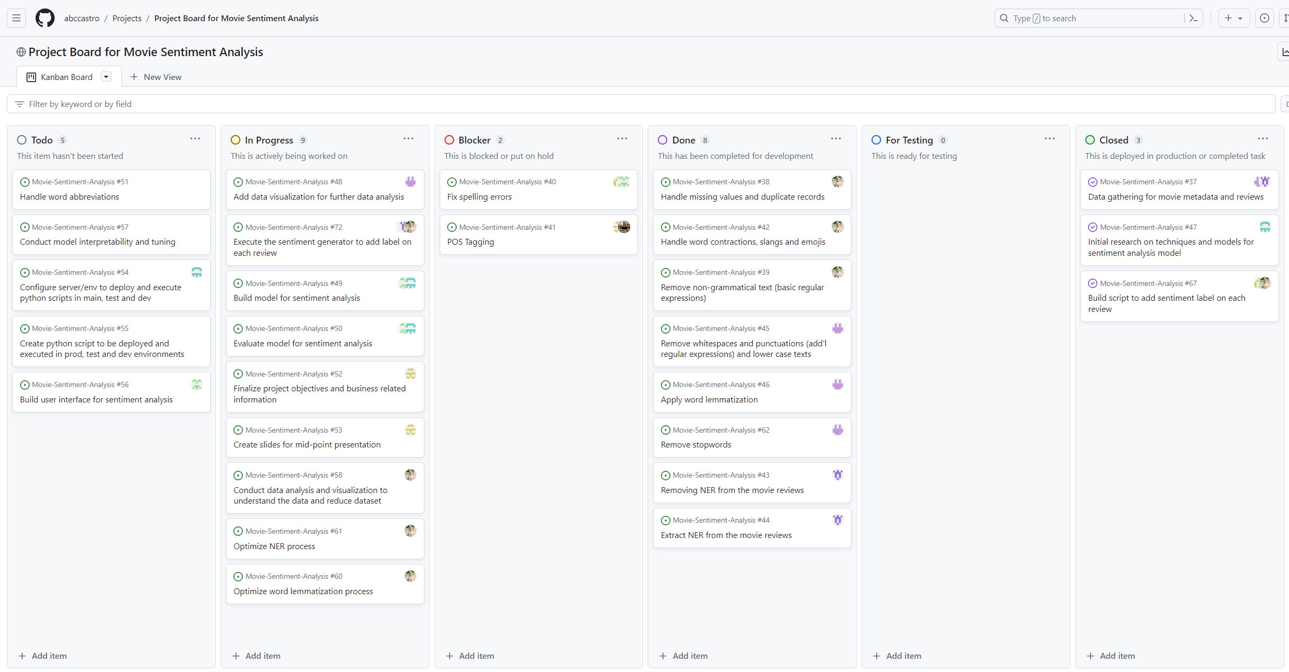
Project Board Walkthrough
Using Github’s Project to create Kanban Board for model development
* Project Board for Movie Sentiment Analysis: https://github.com/users/abccastro/projects/1

Slide 13
Team’s Best Practices
Feature Breakdown: Dividing features into smaller tasks for better prioritization and more manageable components
Distributed Responsibilities: Assigning tasks to individual team members to ensure clear responsibility and accountability
Project Progress Checkpoint: Conducting regular team meetings, via MS Teams or in person, for updates, blockers and planning next task
Model Development Workflow: Leveraging * GitHub as a model development repository, adhering to industry standards with distinct branches for production, testing, development, and tasks, and conducting code reviews before merging
task
dev
test
prod
* Movie Sentiment Analysis repository: https://github.com/abccastro/Movie-Sentiment-Analysis

Slide 15
References
Cheema, Ramish. (2022, November 14). 5 Biggest Movie Production Companies in the World. Insider Monkey. https://www.insidermonkey.com/blog/5-biggest-movie-production-companies-in-the-world-1085847/?singlepage=1
Violini, Marcello. (2023, October 15) Top 10 OTT Video Streaming Services 2023. Teyuto. https://teyuto.com/blog/top-10-ott-video-streaming-services-2023#:~:text=Which%20ott%20platform%20has%20the,200%20million%20subscribers%20in%202023
(2022 December 07). The Business Model in Film and Television Industries https://www.storybiz.tech/entertainment/business-model-film-television/
Banik, R. (n.d.). The Movies Dataset. Kaggle. https://www.kaggle.com/datasets/rounakbanik/the-movies-dataset
Zhang, X. (n.d.). IMDb Vision and NLP Dataset. Kaggle. https://www.kaggle.com/datasets/raynardj/imdb-vision-and-nlp/data

