Slide 1
OOP
Final Project
鄭祐丞B123245001
簡才斌B123245003
陳展皝B123245006

Slide 2
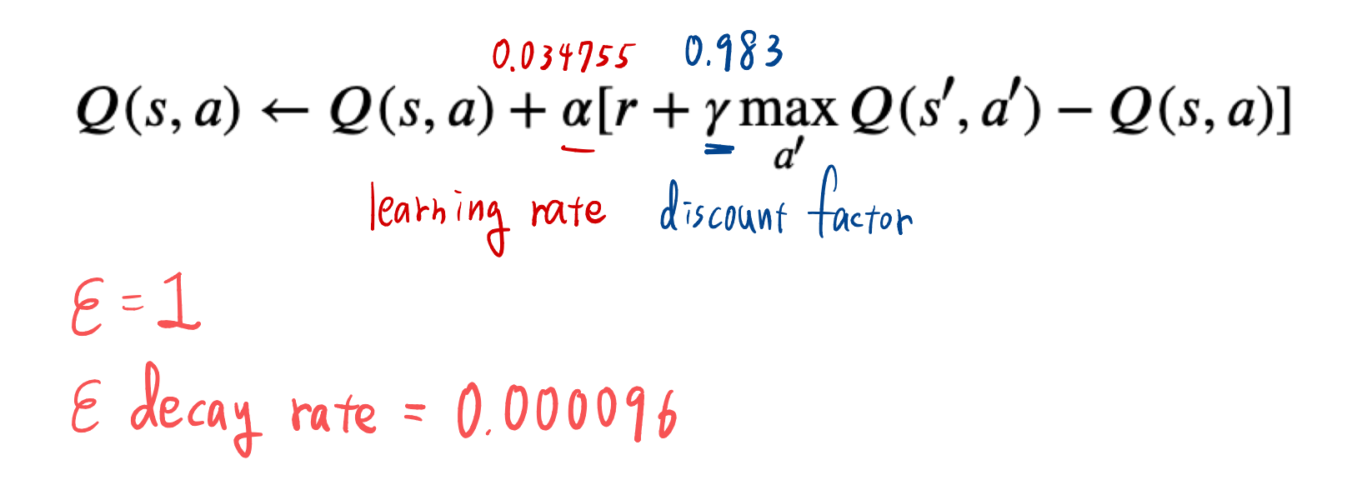
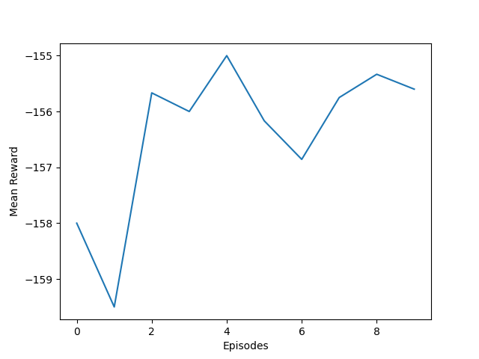
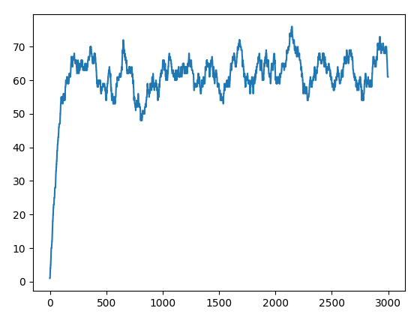
Part 1 & 2
Part 1: We successfully installed and ran
Part 2:We tuned the parameters to:
Mountain Car
Training Score per episode (pt.1)
Training Score per episode (pt.2)

Slide 3
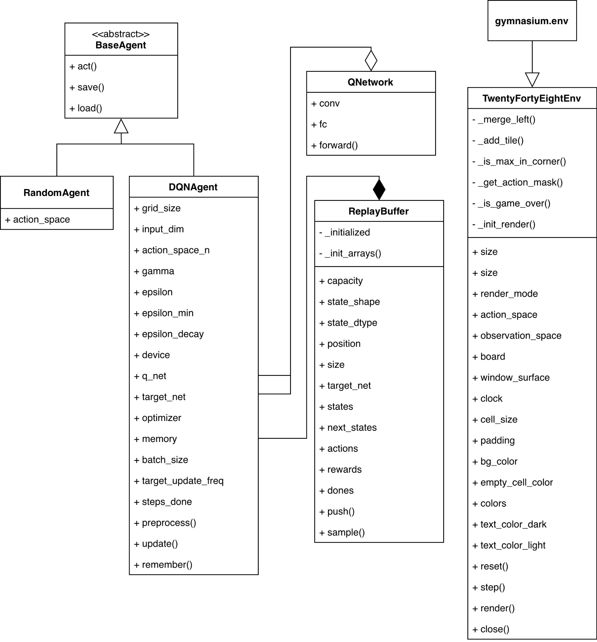
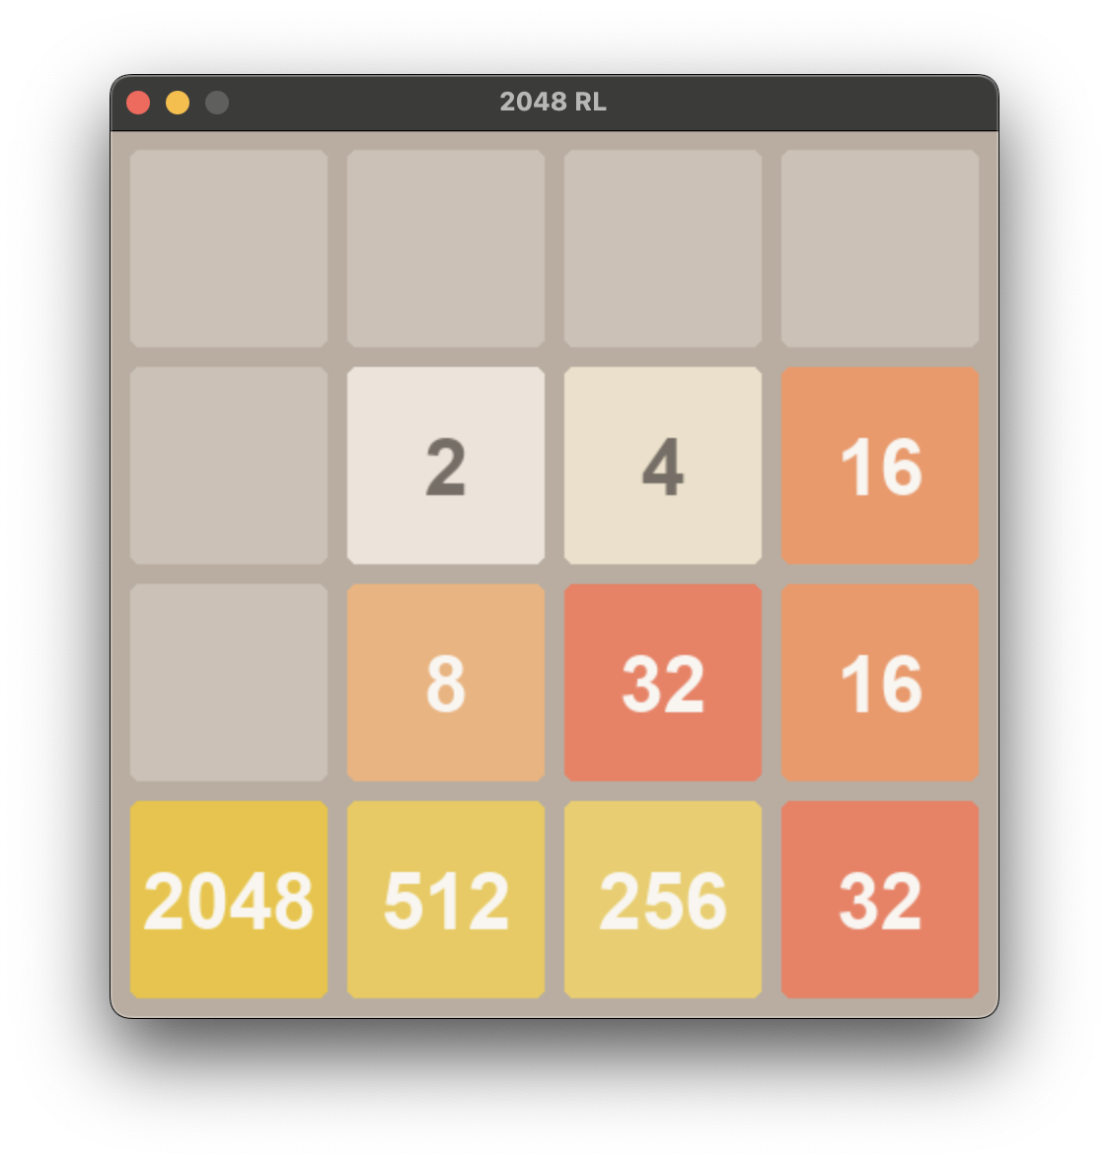
Part 3
Goal: Build an agent that runs 2048 by itself

Slide 4
Part 3
Periodically Copy
Input Layer
Flatten
Conv2d (1→64)
Linear Layer
Q Network
Target Network
ReLU
ReLU
Conv2d(64→128)
Linear Layer
ReLU
Output Layer
Calculate Loss
Implementation: Deep Q-Network

Slide 5
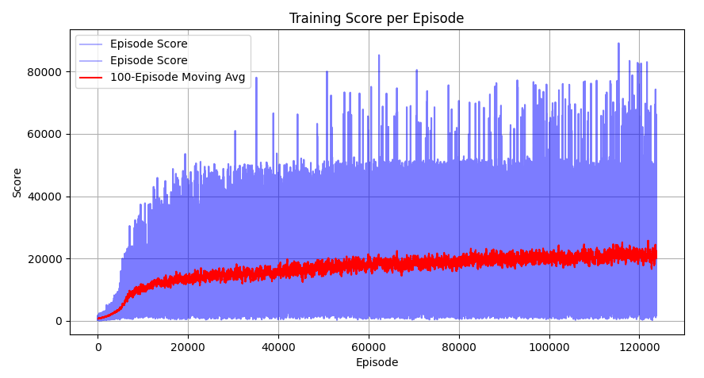
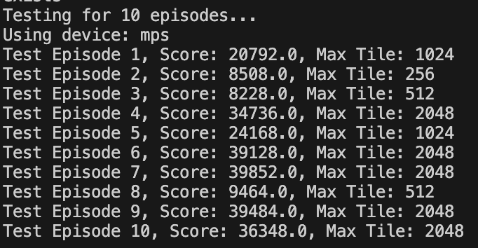
Part 3

Slide 6


