Slide 1
Exploring the relationship between information technology and business process reengineering
第六組
M11123036 梁淯愷、M11123038 曾治程
M11123016 陳秉言、M11223004 蕭淳芸
M11223003 江婕綺、M11123057 劉昱辰

Slide 2
01
02
03
04
Introduction
IT capabilities and reengineering
The current state of reengineering
Barriers to implementation
05
Conclusion

Slide 3
Introduction
01

Slide 4
Background
Reengineering, the aim of this radical improvement approach is quick and substantial gains in organizational performance by redesigning the core business process.

Slide 5
Background
IT has been used to expedite office work rather than to transform it. Top executives consider IT a potent source of competitive advantage.
It can fundamentally reshape the way business is done and enable the process design.

Slide 6
02
IT capabilities and reengineering

Slide 7
IT capabilities and reengineering
IT capabilities involve improving information access and coordination across organizational units.
IT’s promise and its ultimate impact is to be the most powerful tool for reducing the costs of coordination.
Notes:
IT is more than a collection of tools for automating or mechanizing processes. It can undamentally reshape the way business is done and enable the process design.

Slide 8
BPR
BPR is a strategic action and requires a clear understanding of customers, market, industry and competitive directions. It requires consistency between the company’s business strategy and vision.
Notes:
IT is more than a collection of tools for automating or mechanizing processes. It can undamentally reshape the way business is done and enable the process design.

Slide 9
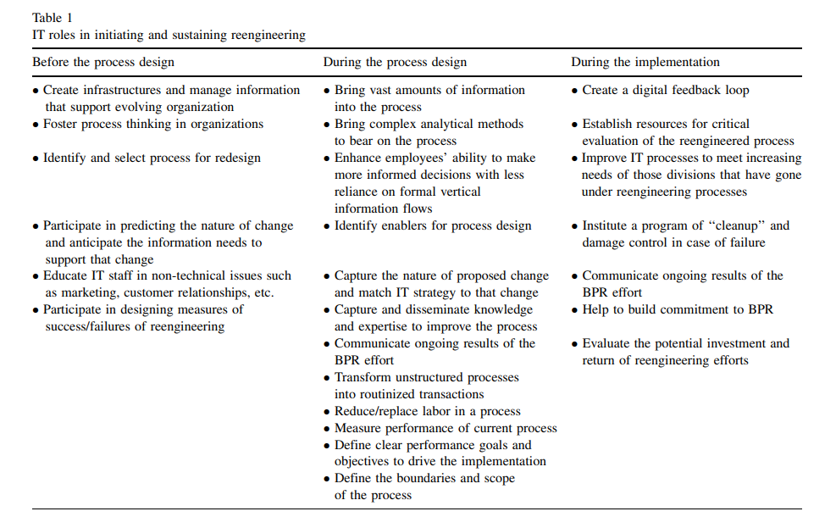
Notes:
IT is more than a collection of tools for automating or mechanizing processes. It can undamentally reshape the way business is done and enable the process design.

Slide 10
Phase 1: before the process is designed
Utilize newer and better technology to develop a strategic vision.
Communication technology.
Finding different approaches to manage a process.
BPR requires a flexible organization design.
To achieve effective teamwork, each worker should develop several competencies.
Alliances and other methods of cross company coordination are becoming common-place.
Notes:
IT is more than a collection of tools for automating or mechanizing processes. It can undamentally reshape the way business is done and enable the process design.

Slide 11
Phase 2: while the process is being designed
This stage involves two activities: technical and social design.
Information is consolidated.
Who will affect corporate changes.
Test and rollout plans.
The existing processes are mapped, measured, analyzed, and benchmarked.

Slide 12
Phase 2: while the process is being designed
These help identify, structure, and estimate BPR activities.
Gathering and analyzing information about the performance and structure of a process is an important step.
Computing technologies have facilitated a process-oriented approach to system development.
The development cycle time for various products decreased substantially.
Not only improve inventory control, but to provide key information to management.

Slide 13
Phase 2: while the process is being designed
Employees and information on customer requirements is essential in reengineering.
IT capabilities are used for information exchange and to improve inner organizational collaboration.
Expert systems.

Slide 14
Phase 3: after the design is complete
The reengineering efforts include planning and managing people, processes, and technology and driving the implementation toward the businessvision.

Slide 15
Phase 3: while the process is being designed
Project management and process analysis tools.
IT helps to overcome geographic barriers.
Potential investments.
A fundamental source of difficulties is the fact that process are reengineered but infrastructure is not.
Where the unit was previously technology focused, reengineering brought about a focus on using technology to meet business strategies.
Digital feedback loop.

Slide 16
The current state of reengineering
03

Slide 17
The current state of reengineering
Some users achieved large cost reductions, higher profits and throughput, etc.

Slide 18
04
Barriers to implementation

Slide 19
Misunderstanding of the concept
Lack of understanding of the concept and inappropriate application will all contribute to organizations’ failure to appreciate the promise of reengineering.

Slide 20
Misapplication of the term
Business process reengineering should not replace TQM or other organizational initiatives.

Slide 21
Lack of proper strategy
A major reason given for the high failure rates of BPR efforts was that the efforts had not been connected to the corporate goals.

Slide 22
Unrealistic objectives
Reengineering always takes longer than expected, always involve more people resources than are available, and always presents problems no one anticipates.

Slide 23
Management failure to change
Lack of leadership is a frequent cause for the high failure rate of BPR projects.
Reengineering forces managers to reevaluate not only what they do, but also who they are.

Slide 24
Failing to recognize the importance of people
When a process changes, the jobs of those who do the work in that process must also be changed.
Employees’ resistance to change and their fears about job displacement need to be alleviated and explained.

Slide 25
IS failure to change
Radical change would require IS redesign.
Resistance on the part of IS personnel has more often been a failure in implementation than an enabler.

Slide 26
Conclusion
05

Slide 27
Conclusion
The rapid evolution of IT and its declining costs are creating.
The organizations adopt a change in mindset regarding the role of the IT function.
radical change required IS redesign.
It requires a new perspective on the part of management.
Notes:
最後結論
研究結果表明
數據品質是提取商業價值的一種方式
如果有一個適當的數據品質框架，BDA和IOT的擴散可以增加
歐洲和美國的公司被認為在數據品質和如何創造競爭價值方面的行為是相似的

Slide 28
Thanks for listening

