Slide 1
Understanding dark side of artificial intelligence (AI) integrated business analytics: assessing firm’s operational inefficiency and competitiveness

Slide 2
Table of contents
01
02
03
04
Introduction
Research Background
Hypothesis Development
Conclusion

Slide 3
01
Introduction

Slide 4
Background
Researchers grapple with the challenges of how to leverage AI integrated BA for the creation of business values that would supplement competitive advantage.
The solution as the analytical insights provided by intelligent machines.

Slide 5
Background
The system developers ensure that these data are valuable, usable, and curated.
Proper training is to be imparted to the employees of the firms to improve their level of understanding and absorptive capacity for the selection of the right and appropriate outputs.

Slide 6
Background
Big data analytics has been widely studied in the context of IS with regard to big data investments, information sources, big data infrastructure, information value chain, firm performance and innovation capabilities.
An AI-BA opacity and its salient negative consequences, such as operational inefficiency, employee’s dissatisfaction and firm’s competitive disadvantages.

Slide 7
Problem
RQ1: What are the components and effects of an AI-BA opacity?
RQ2: Is there any moderating effect of contingency plan between suboptimal business decision and operational inefficiency and perceived risk and operational inefficiency of a firm?

Slide 8
The emergence of AI integrated BA
The extant literature identifies both the positive and negative effects of AI integrated BA on operational efficiency and employee empowerment.
This risk may include many issues like technical risk, privacy risk as well as a security risk.

Slide 9
02
Research Background

Slide 10
03
Hypothesis Development

Slide 11
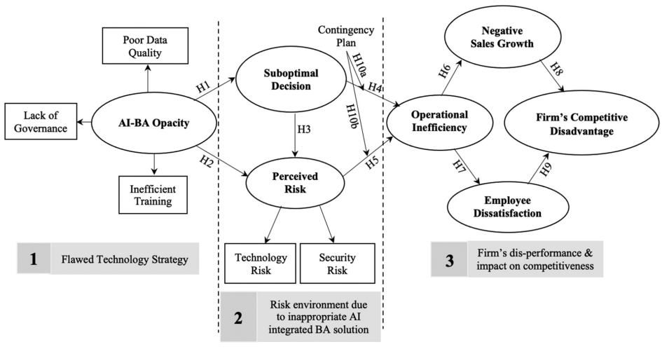
H6: Higher firm’s operational inefficiency will result in superior negative sales growth.

Slide 12
H7: Higher firm’s operational inefficiency will lead to higher employee’ dissatisfaction.

Slide 13
H8: Higher negative sales growth of a firm will lead to a firm’s competitive disadvantage.

Slide 14
H9: Higher employee’s dissatisfaction will result in a firm’s competitive disadvantage.

Slide 15
H10a: The contingency plan has a considerable moderating effect on the SOD → OPI (H4) linkage

Slide 16
H10b: The contingency plan has a considerable moderating effect on the PRI → OPI (H5) linkage

Slide 17
04
Conclusion

Slide 18
Ripple effects of an AI-BA opacity on decision qualities, employee outcomes and firm’s competitiveness.
Contingency plan in place to overcome any unexpected and untoward incident that might occur due to the deployment of an inappropriate AI integrated BA solution

Slide 19
Thanks for listening

