Slide 1
# Data Analysis on ACT and SAT # in 2017 and 2018
Ken:
General Assembly – DSI 27

Slide 2

# Background
In the US, some states do not require students to take either ACT or SAT. (No mandatory test!)
In order to foster and improve the education system, recommendations are made for states who have no mandatory test:
to mandate either ACT or SAT
or to remain as it is

Slide 3
# But why?
Provide all students in general to have a chance to get into college admissions.
Encouraging students who have not planned ahead to have the opportunity to progress academically with at least 1 educational syllabus.

Slide 4
# Data Sets & Methods
ACT 2017 Data (State, Participation, Individual Test Score Average, Composite Score Average)
ACT 2018 Data (State, Participation, Composite Score Average)
SAT 2017 Data (State, Participation, Individual Test Score Average, Total Score Average)
SAT 2018 Data (State, Participation, Individual Test Score Average, Total Score Average)
Statistics
Exploratory Data Analysis
Visualisations
Python
NumPy
Matplotlib
Seaborn

Slide 5
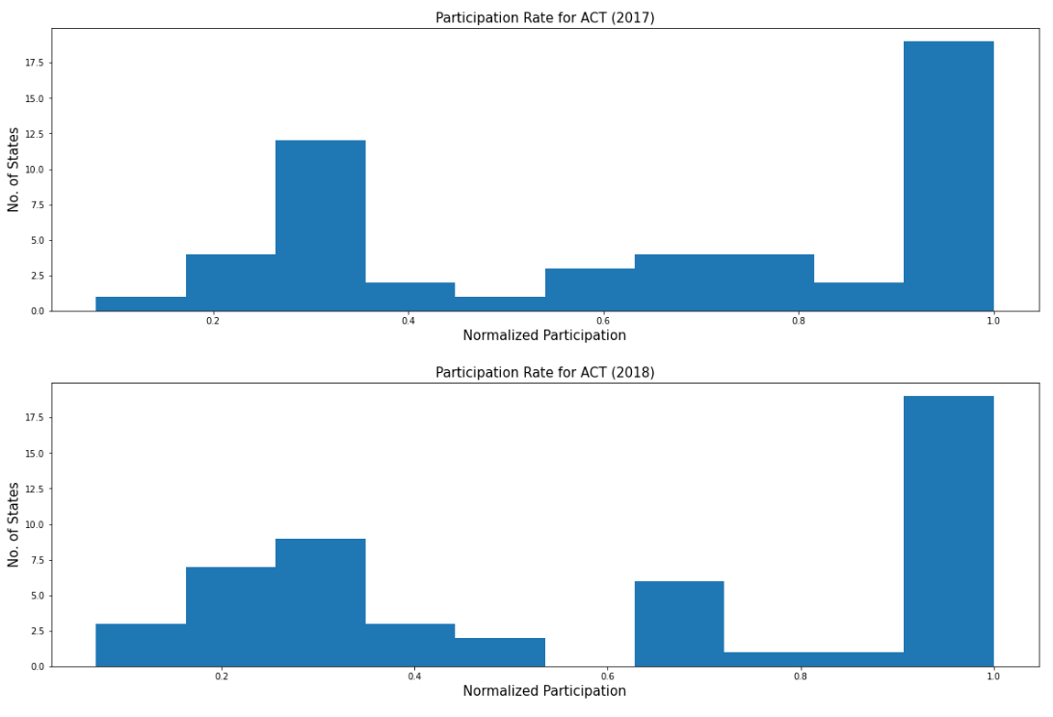
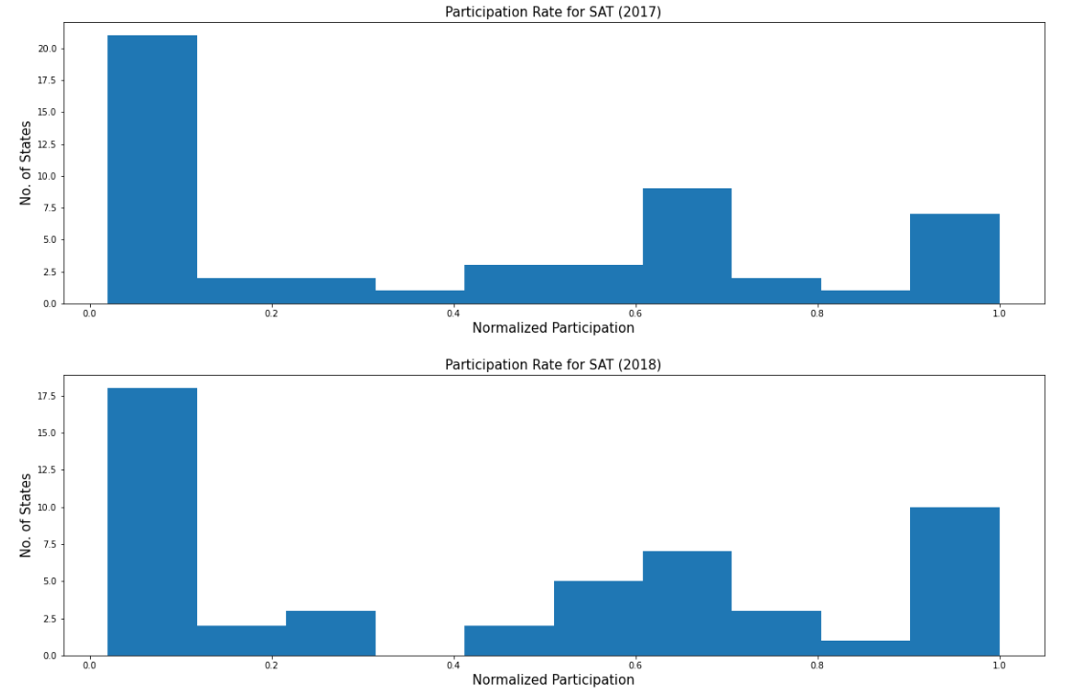
ACT tests have higher Participation Rate than SAT tests

Slide 6
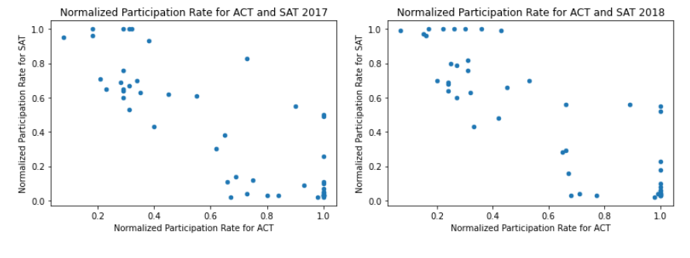
Participation Rates are negatively correlated between ACT and SAT

Slide 7
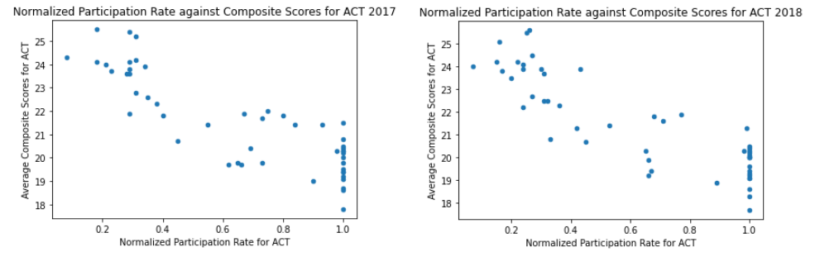
Scores are also negatively correlated against Participation Rates!

Slide 8
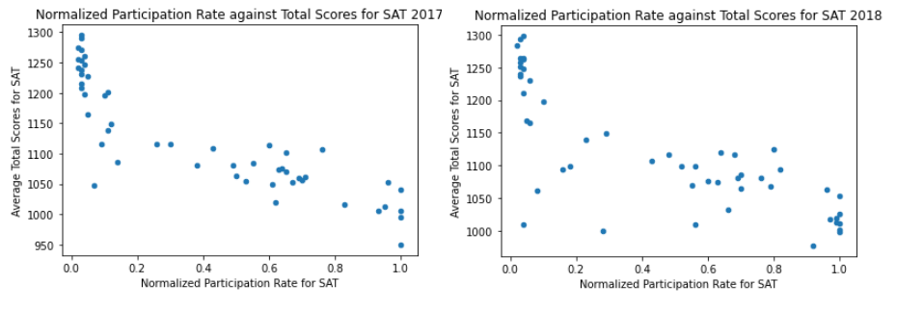
Scores are also negatively correlated against Participation Rates!

Slide 9
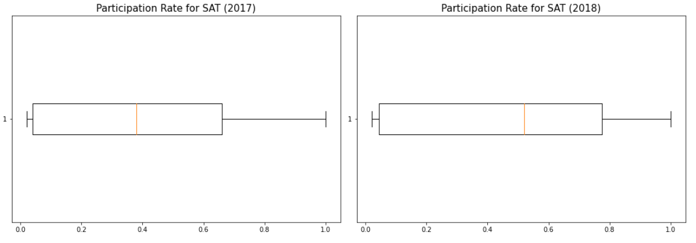
The larger portion of participate rate fall in the Q1 for SAT, indicating that the participation rate is low.

Slide 10
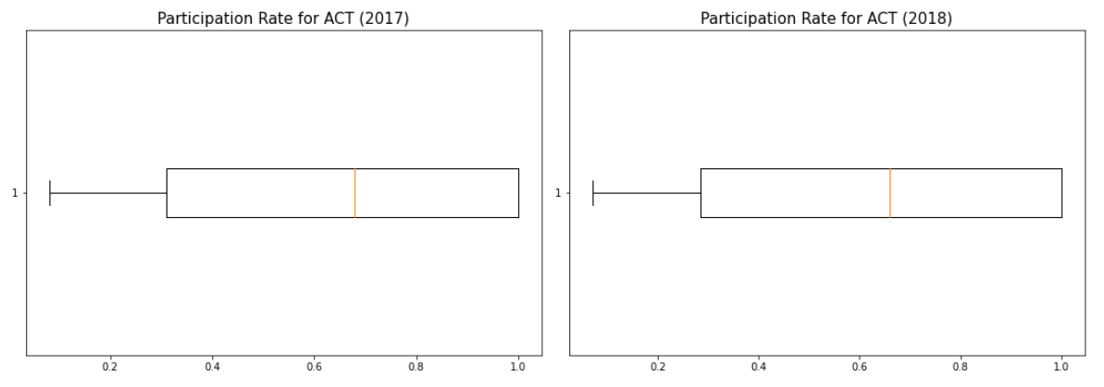
75th-100th percentile fall under 100% participation rate!!

Slide 11
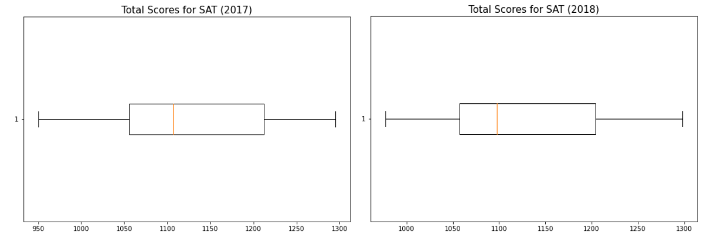
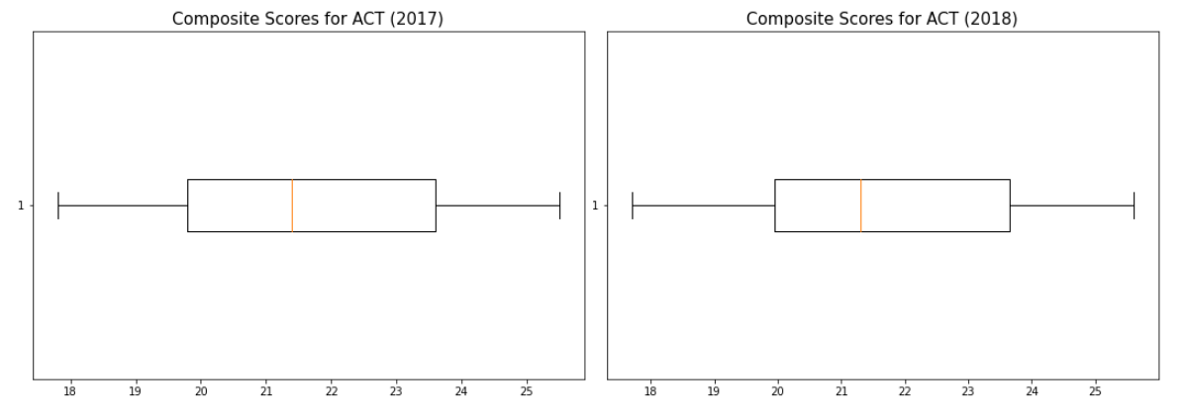
There is a larger range for SAT test score in the Q3 than ACT!

Slide 12

# And so? What are the findings?
The participation rate for ACT has been performing well, which may indicate that more states are leading towards taking ACT rather than SAT.

Slide 13

# And so? What are the findings?
The SAT test has a large range of average test scores, as such, it may show that students who do well in SAT will do very well and vice versa.

Slide 14

# And so? What are the findings?
Even with a higher number of participation rates, ACT results have been consistent with its disparity less than SAT which may indicate that ACT has more consistency in its difficulty and grading.

Slide 15

# And so? What are the findings?
Participation Rates are negative correlated and there are a number of states with mandatory ACT and SAT tests.

Slide 16
# Recommendations?
To remain as it is, as there are no benefits in mandating either ACT or SAT based on the data.
Collect more data!
Student data - include students who take neither or both
Income
City level participation rate and scores

