Slide 1
Methods Test
Yang Wei, Jianshu Zhang

Slide 2
Current Methods
Pyclone
ddClone
SCITE
MATCH
SCITE PLUS

Slide 3
Current Methods
Methods\Input | Single Cell Sequence | Bulk Sequence
PyClone | No | Yes
ddClone | Yes | Yes(Primary)
SCITE | Yes | No
MATCH | Yes(Primary) | Yes

Slide 4
Current Methods
PyClone & ddClone
Giving clusters as result
SCITE & MATCH
Giving Trees as result
SCITE PLUS – SCITE with Bulk sequence
Not included in this test

Slide 5
Test Data Set
Simulation Data using our 199 nodes tree Structure
Simulation Data from ddClone

Slide 6
Simulation From 199 node Tree
35 Single Cells
About 100 mutations

Slide 7
Simulation From ddClone
50 single cells
About 45 mutations

Slide 8
ddClone
Some Introduction About ddClone

Slide 9
PyClone & ddClone
Why I want to add PyClone to the comparison
To show how much has ddClone improved from PyClone
To give a general comparison about the number of Clusters ddClone gives us.

Slide 10
PyClone & ddClone
Method\Case | Case1 | Case2 | Case3 | Case4
PyClone
ddClone

Slide 11
SCITE
Some Introduction about SCITE

Slide 12
MATCH
Some Introduce about MATCH

Slide 13
SCITE & MATCH
Comparing the output trees with the original 199 nodes tree to give out the simulation
Transfer trees to ancestor matrix
Pick up the mutations appear in the simulation data
Calculate how many percent of cells in both matrices are same

Slide 14
SCITE & MATCH
Method\Case | Case1 | Case2 | Case3 | Case4
SCITE
MATCH | 100% | 100% | 100% | 100%

Slide 15
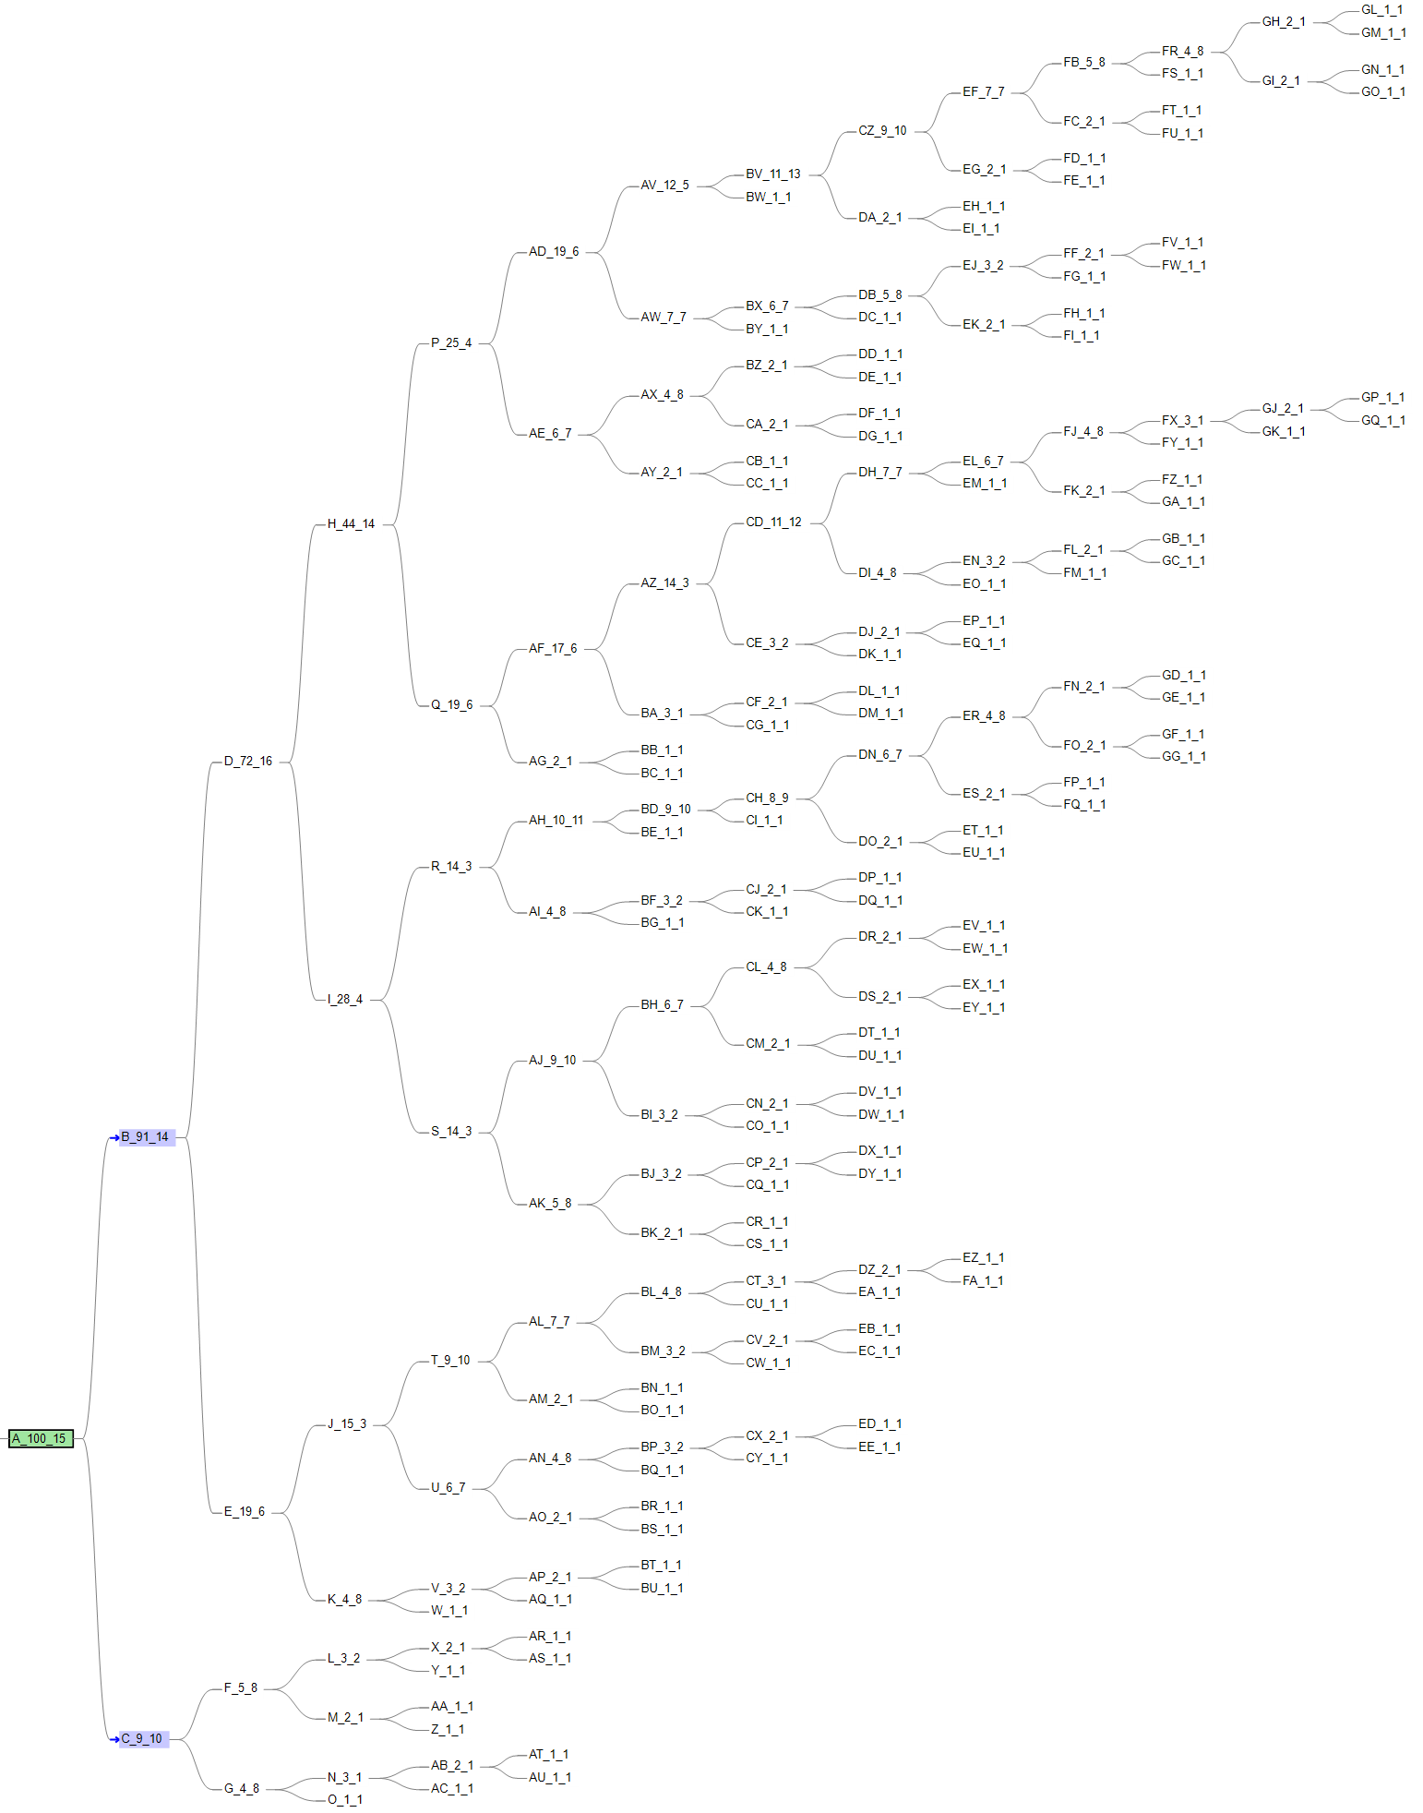
PyClone& ddClone & SCITE
Using our simulated tree data as benchmark
VAF-SIMU-NUM-0

Slide 16
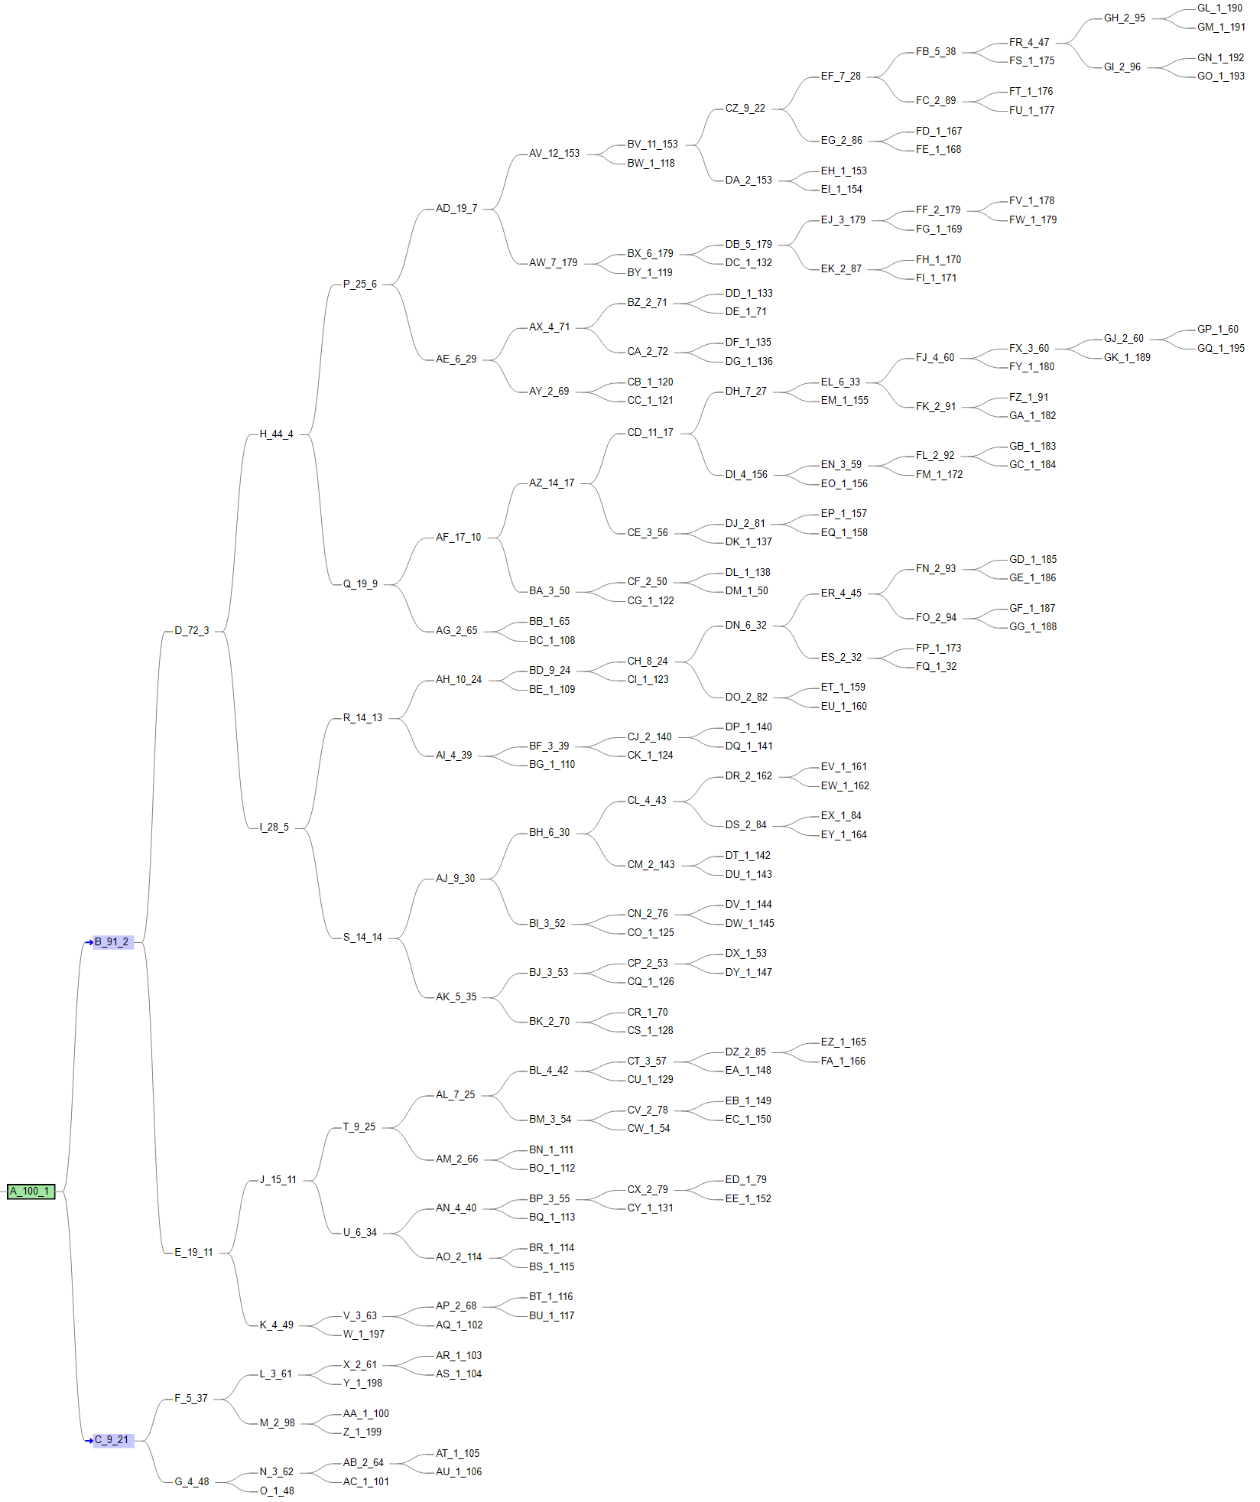
PyClone& ddClone & SCITE

Slide 17
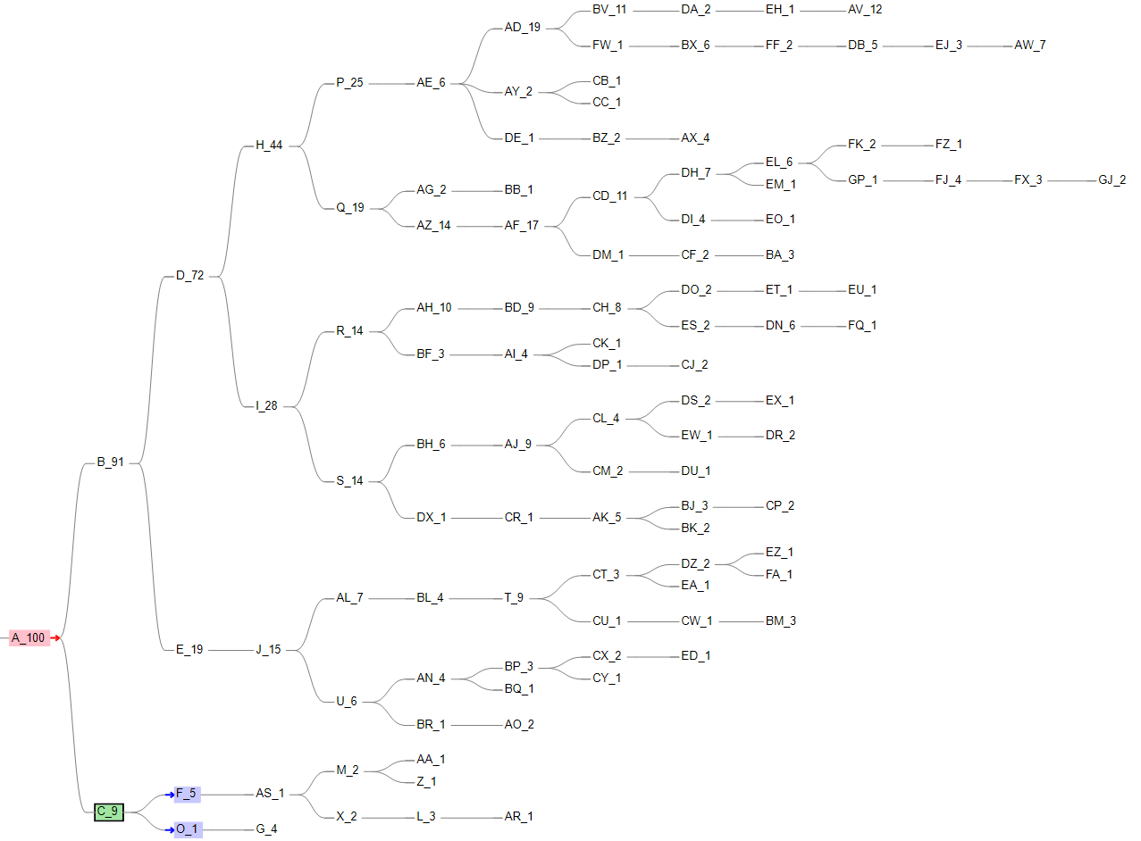
PyClone& ddClone & SCITE

Slide 18
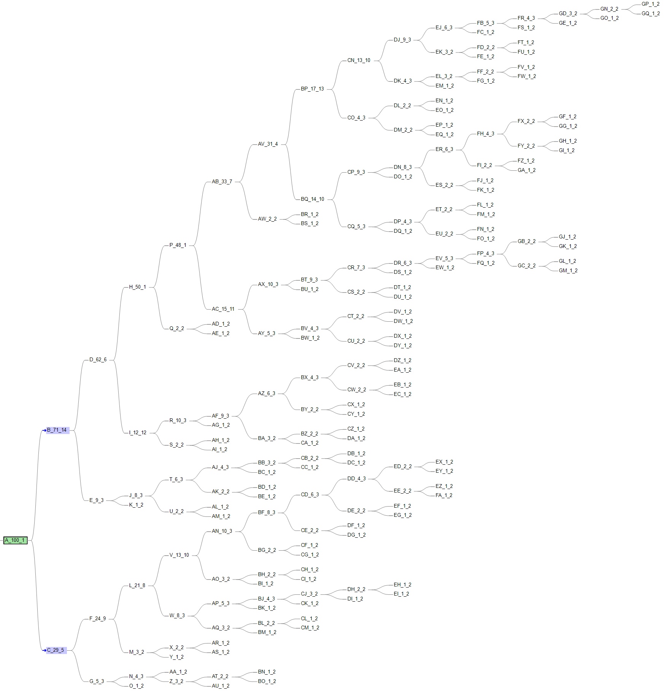
PyClone& ddClone & SCITE
Using our simulated tree data as benchmark
VAF-SIMU-NUM-30

Slide 19
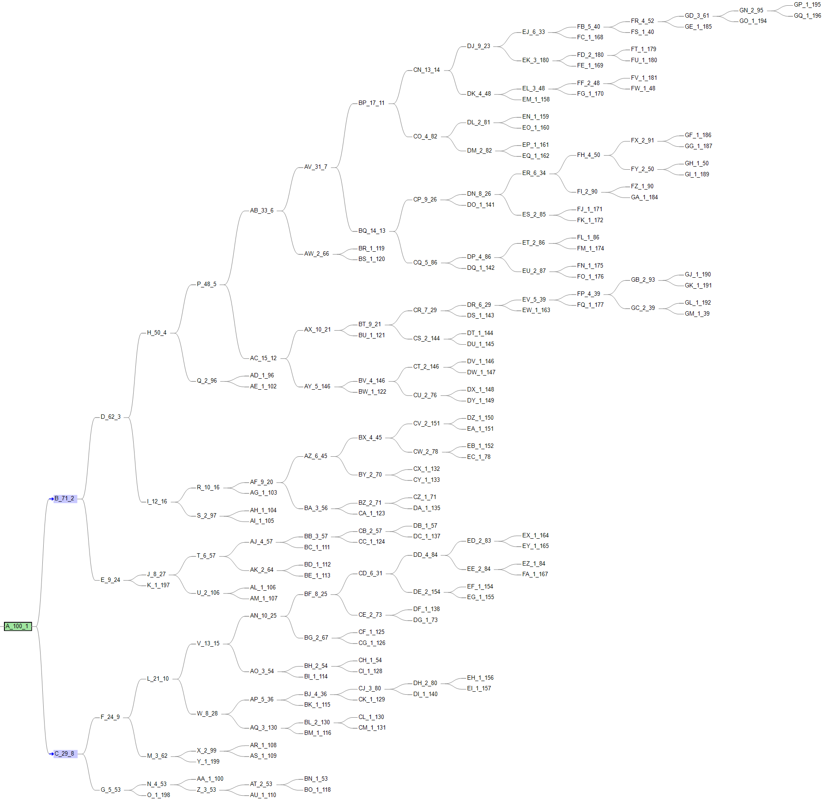
PyClone& ddClone & SCITE

Slide 20
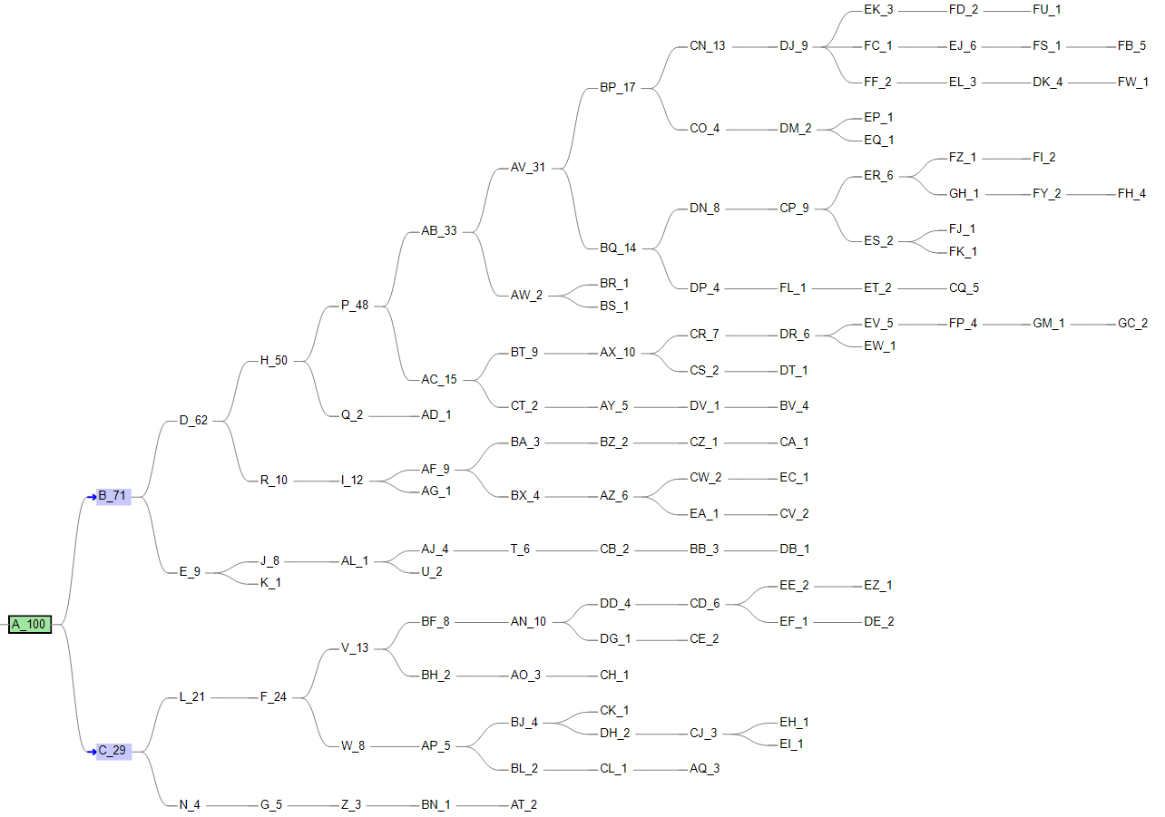
PyClone& ddClone & SCITE

Slide 21
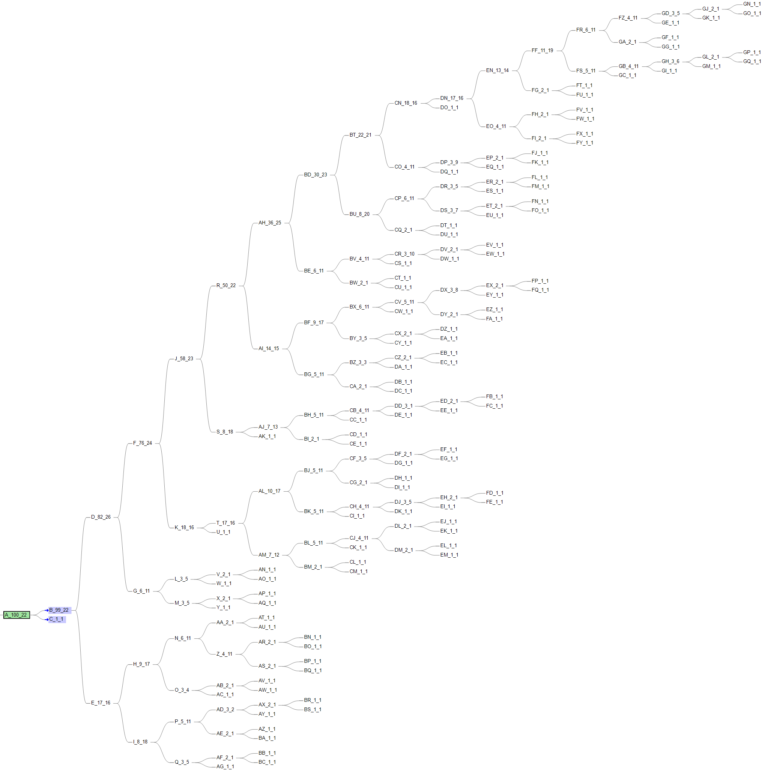
PyClone& ddClone & SCITE
Using our simulated tree data as benchmark
VAF-SIMU-NUM-50

Slide 22
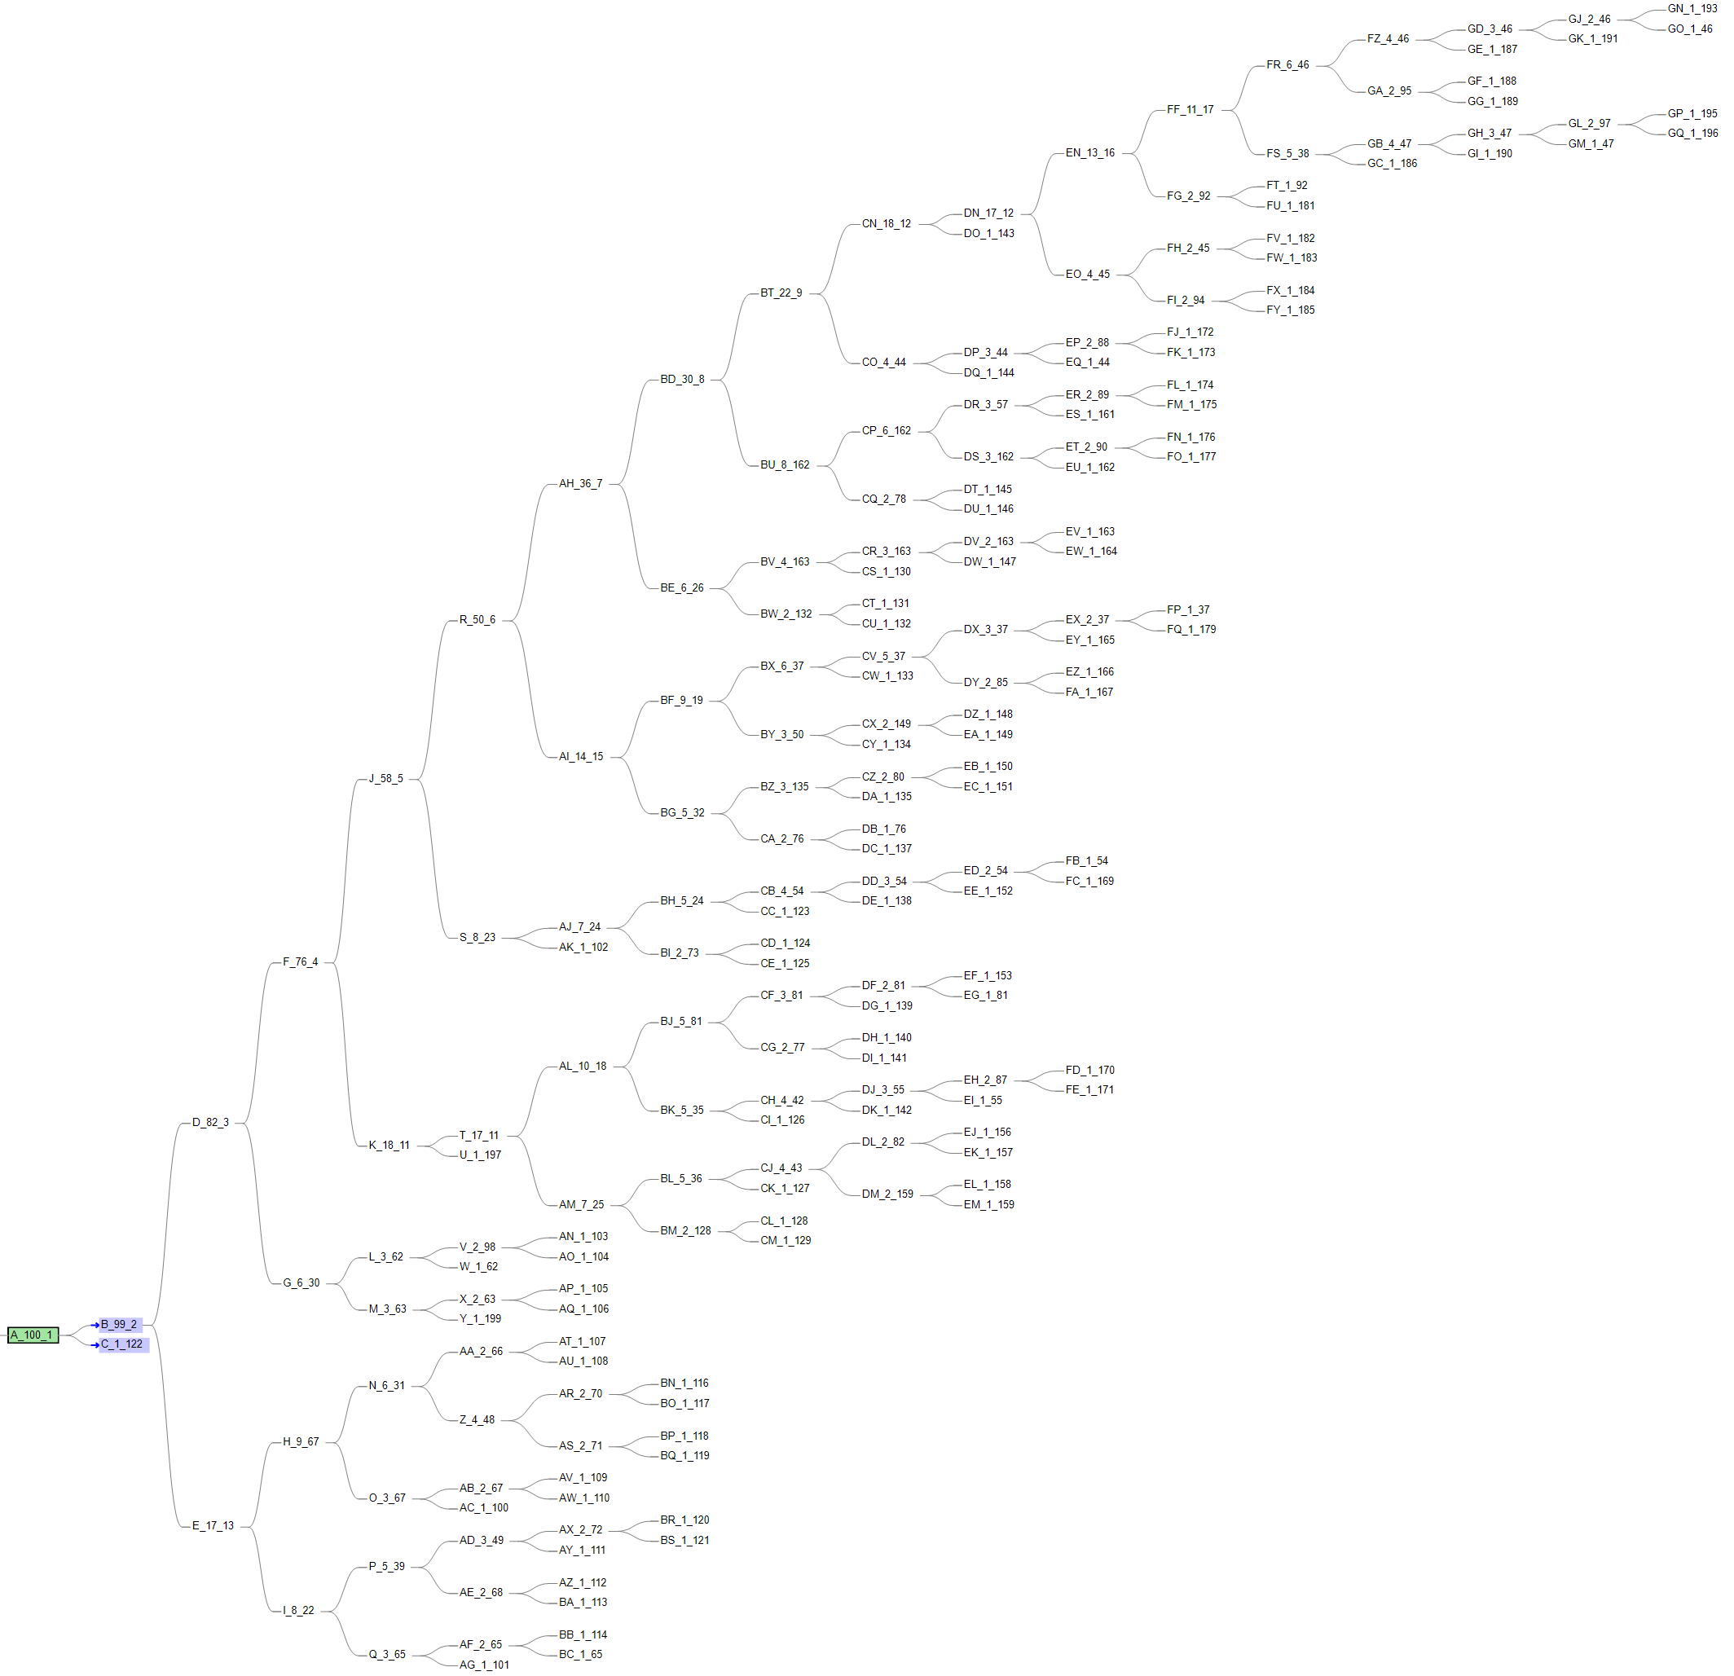
PyClone& ddClone & SCITE

Slide 23
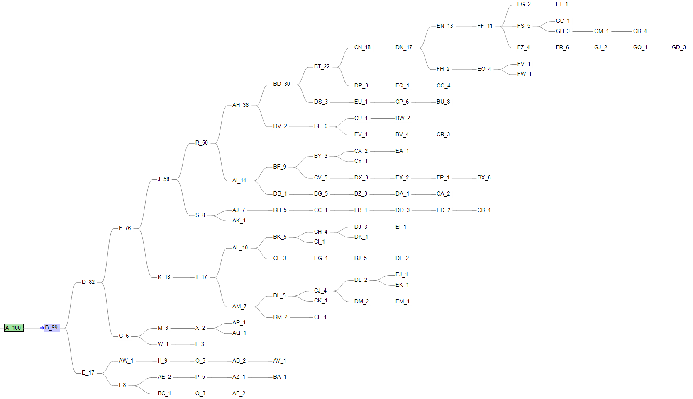
PyClone& ddClone & SCITE

Slide 24
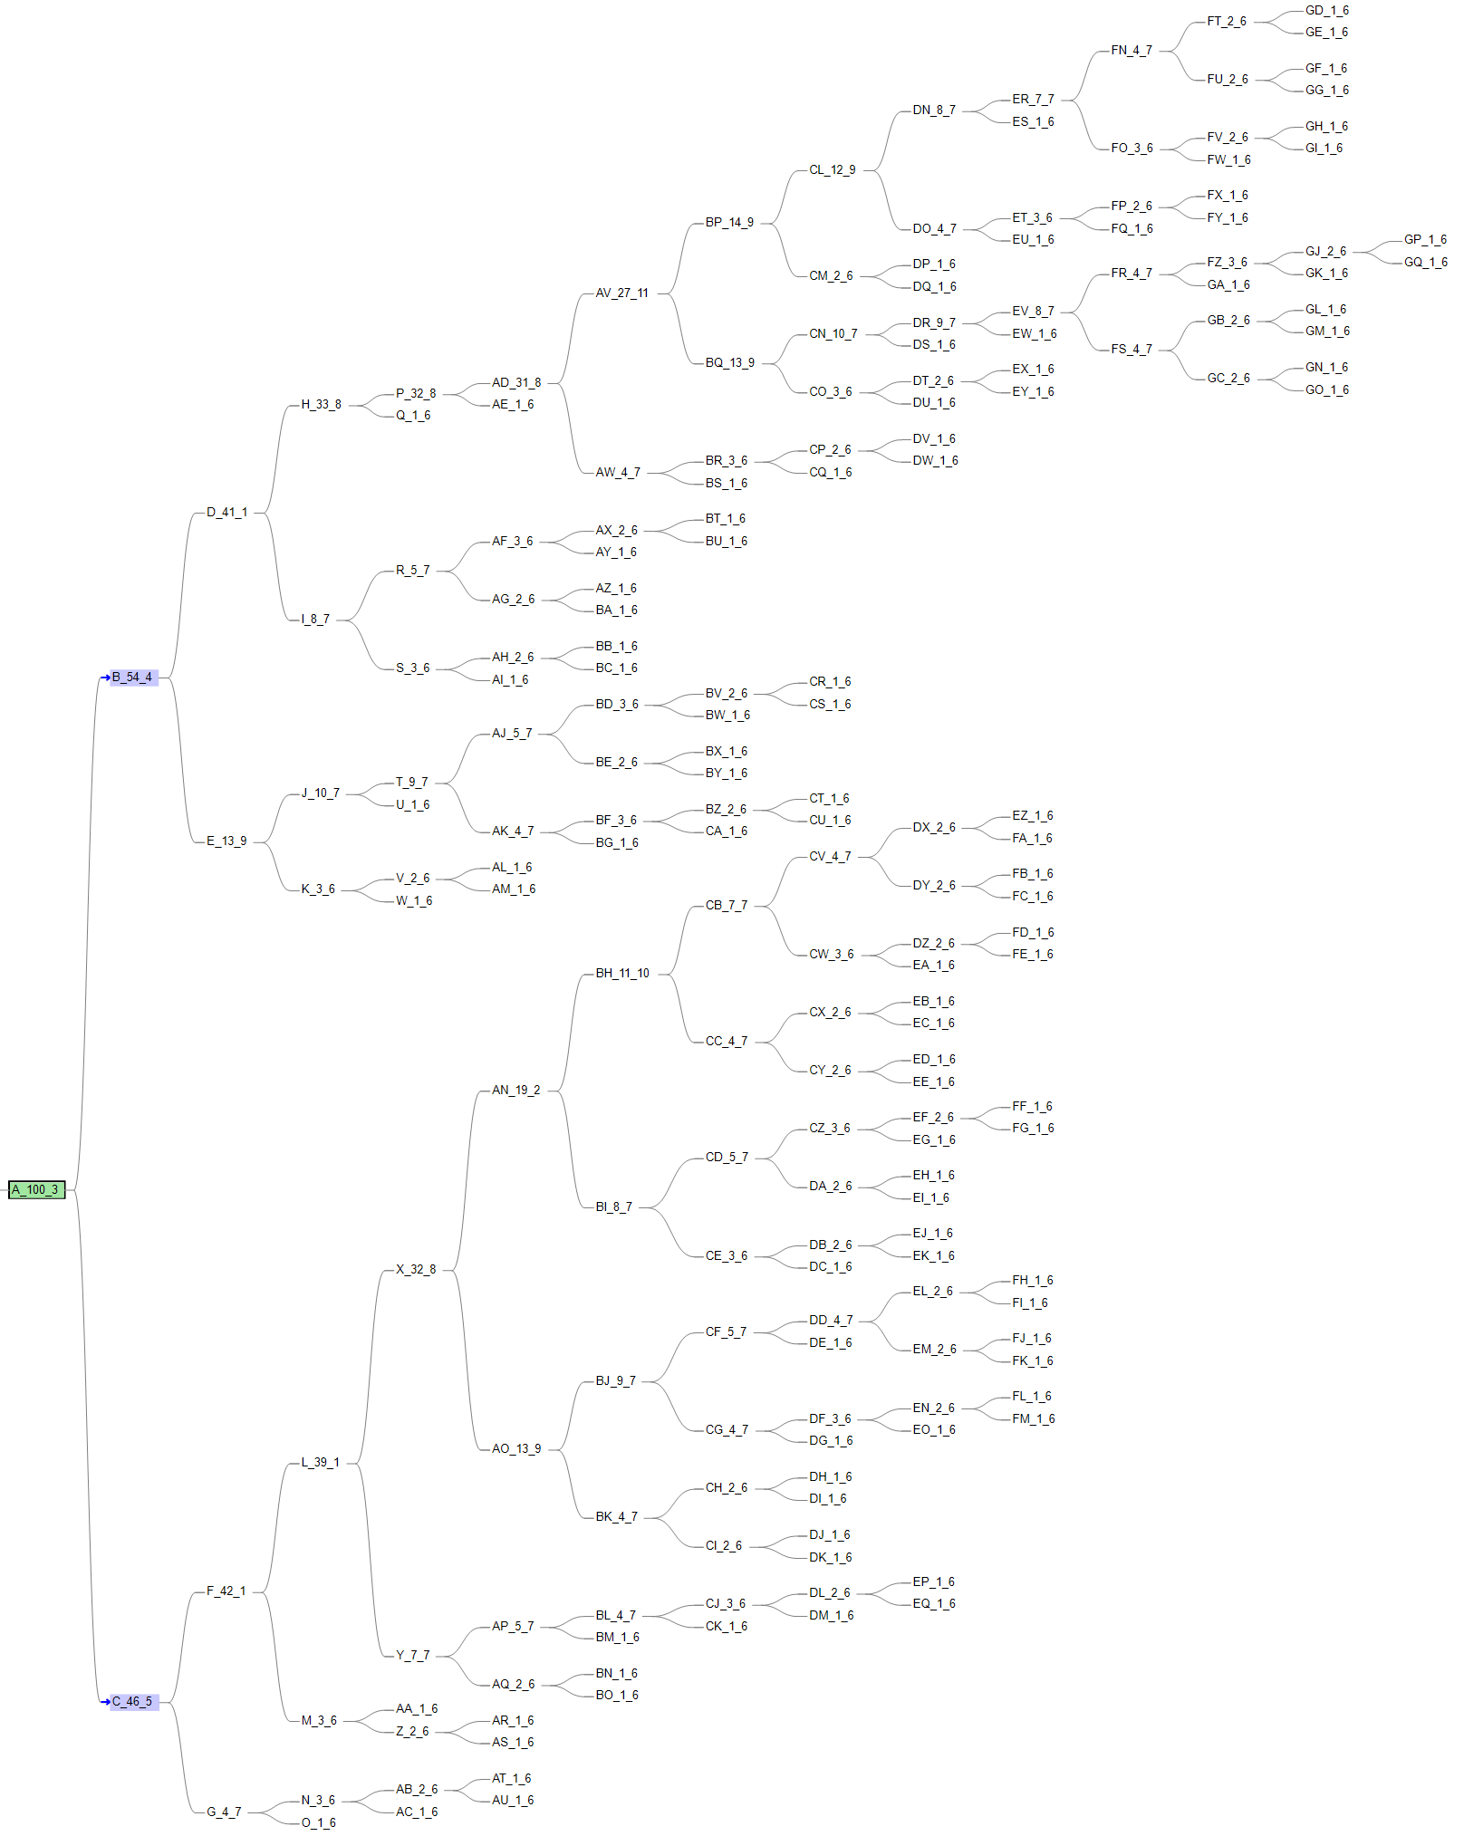
PyClone& ddClone & SCITE
Using our simulated tree data as benchmark
VAF-SIMU-NUM-96

Slide 25
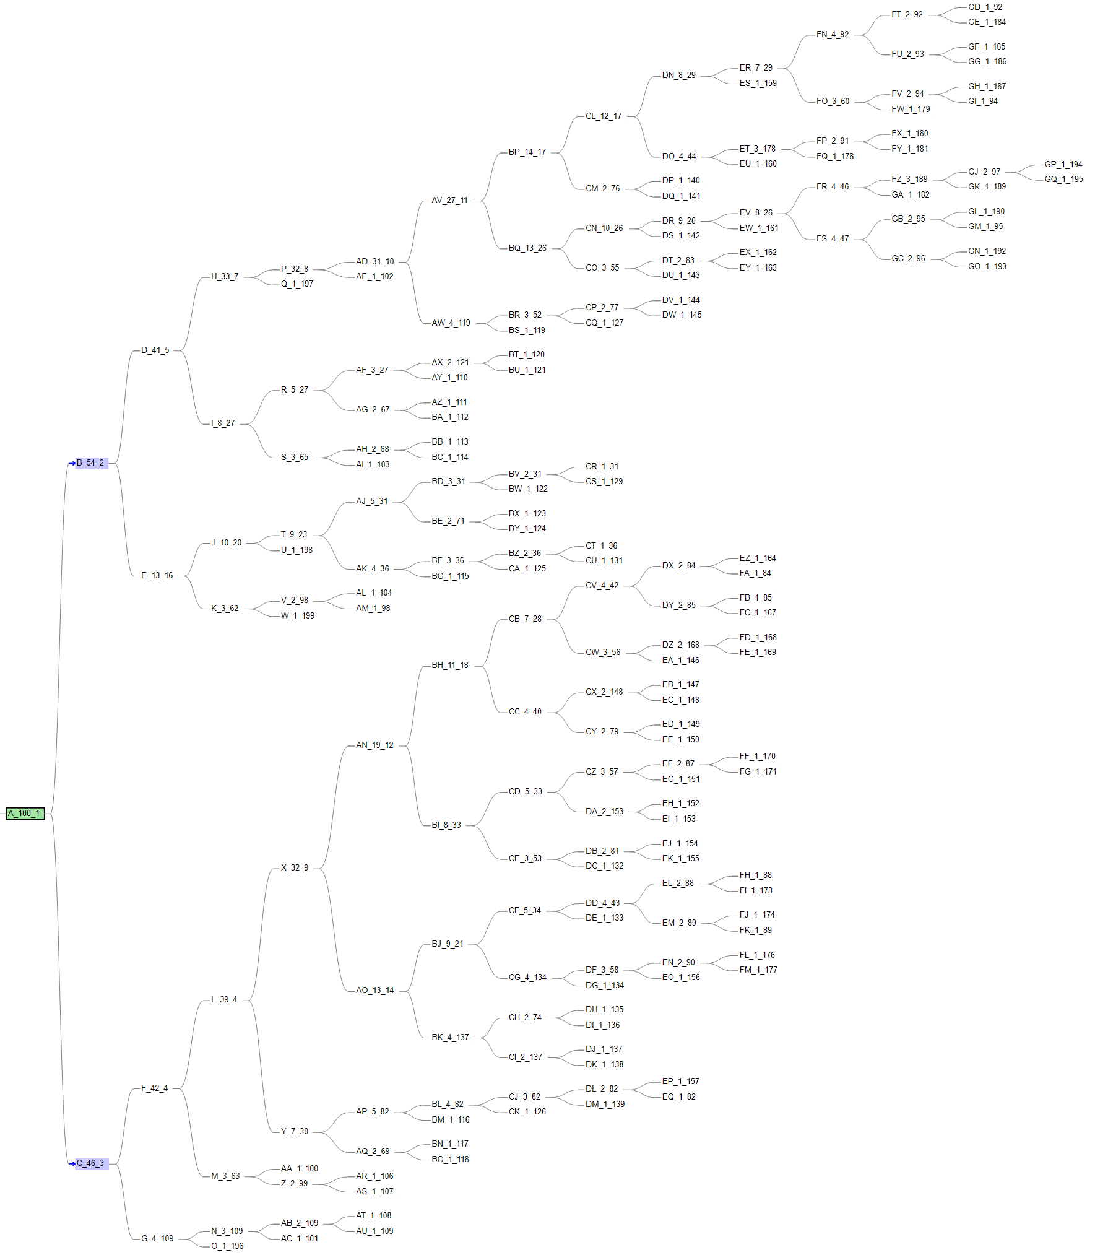
PyClone& ddClone & SCITE

Slide 26
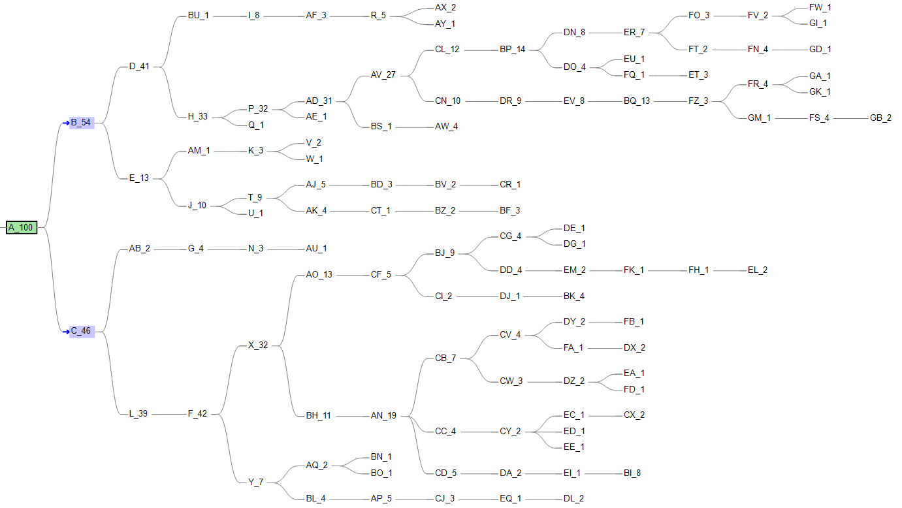
PyClone& ddClone & SCITE

Slide 27
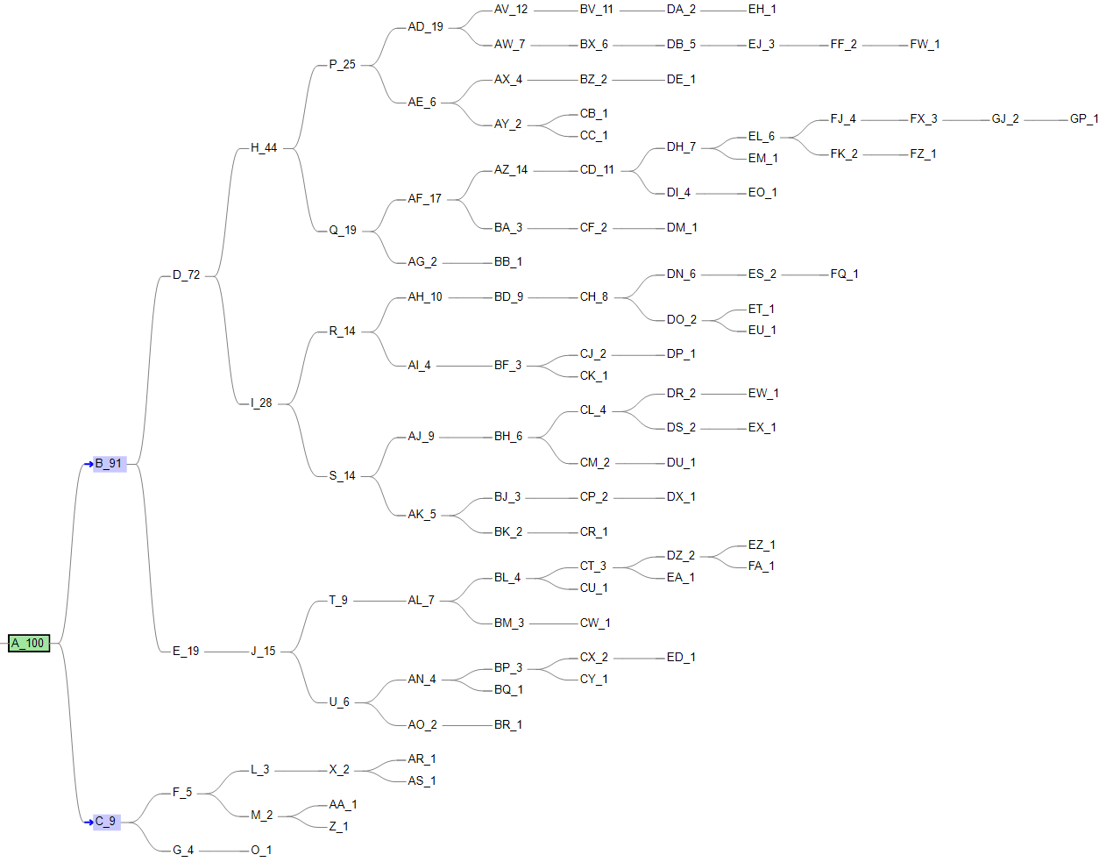

Slide 28
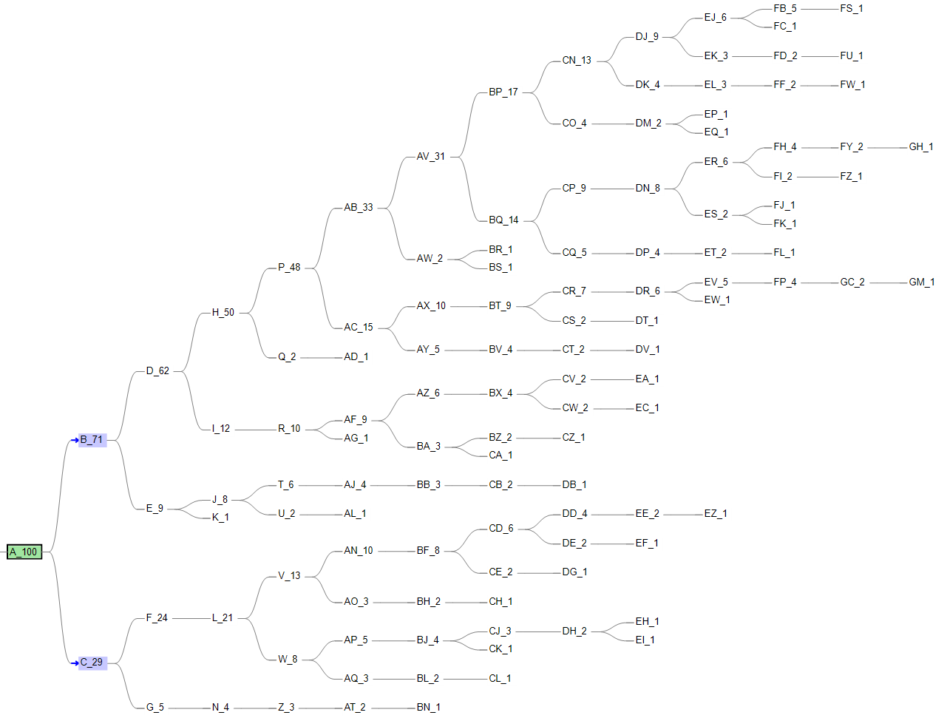

Slide 29
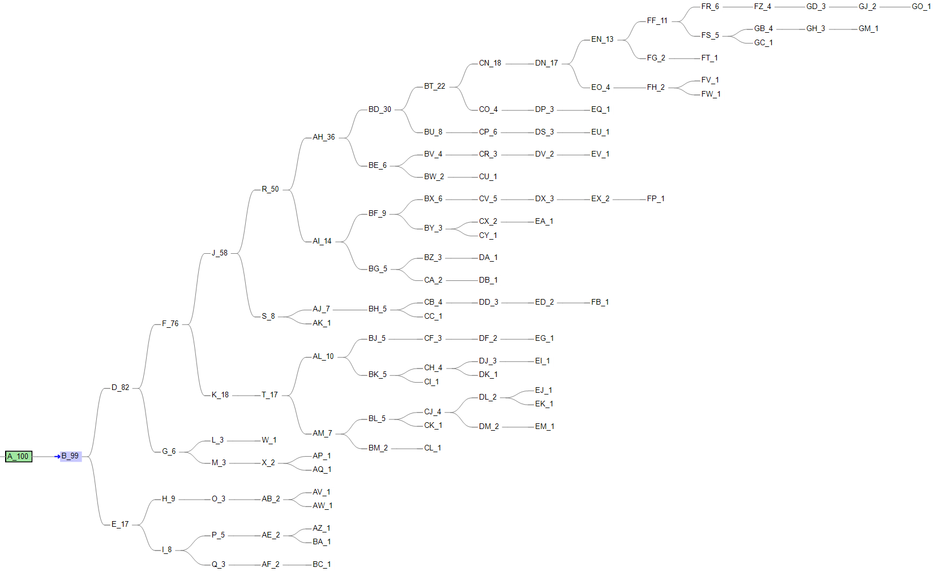

Slide 30
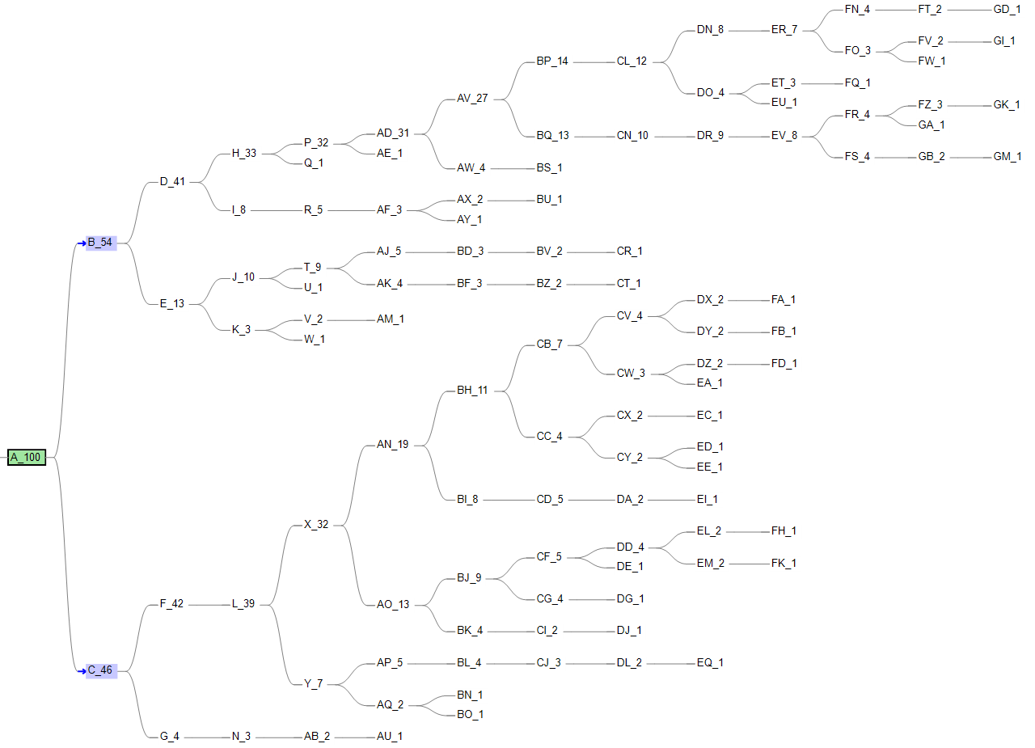

Slide 31
SCITE & ddClone
Using ddClone’s simulation data to run SCITE, we obtained the tree structure and label the mutation with cluster id provided by ddClone
Example 1:

Slide 32
SCITE & ddClone
Using ddClone’s simulation data to run SCITE, we obtained the tree structure and label the mutation with cluster id provided by ddClone
Example 2:

Slide 33
SCITE & ddClone
Using ddClone’s simulation data to run SCITE, we obtained the tree structure and label the mutation with cluster id provided by ddClone
Example 3:

Slide 34
